Slide 1

Software Engineering Session: Sprint 8 Session 3 Instructor: Eric Pogue
Agenda:
Roles, Schedule, and Backlog
Portfolio Standup Scrum of Scrums
Klump Speak Program: Scrum of Scrums Standup with limited Report-out (blocking items only)
Image Filter Program: Scrum of Scrums Standup with limited Report-out (blocking items only)
Final Project Presentation Schedule
Demos and/or Presentations
Demos, Presentations, and Roles Assignments Review
Review Assignment 8 and Discussion Board 8
Lab: Working on Final Project
Notes:
Demos & Presentations: UI Team, Quinn, Juan, Alex

Slide 2
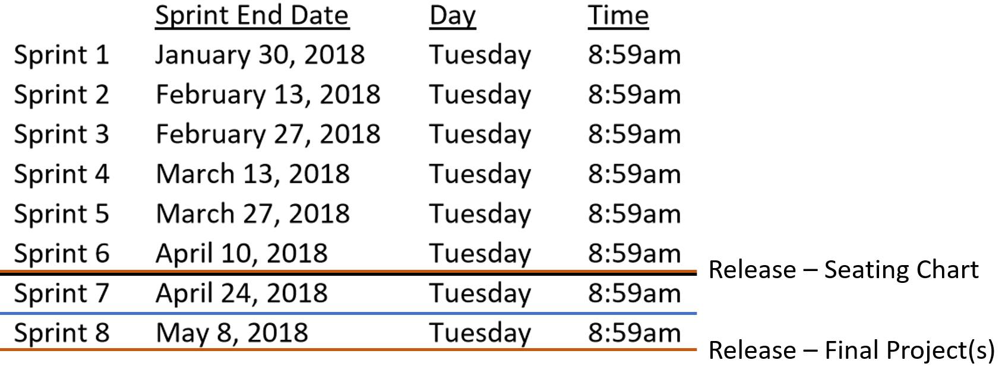
Sprint 8 Roles and Schedule
 | Team Klump Speak |  |  |  | Team Image Filter (IFP)
 | Product Manager | Project Manager | Product Architect | UI Designer | Product Manager | Project Manager | Product Architect | UI Designer
Sprint 8 | Marissa | Juan | Lenny | Brandon | Jake | John | Karol | Cris
May 3, 2018

Slide 3
Scrum-of-Scrums Report-out
The “daily” scrum meeting is not used as a problem-solving or issue resolution meeting. Issues that are raised are taken offline and usually dealt with by the relevant subgroup immediately after the meeting. During the daily scrum, each team member answers the following three questions:
What did you do since our last standup?
What will you do before our next standup?
Are there any impediments in your way that you need help from outside the team to resolve?

Slide 4
Final Project Presentations Schedule for Thursday, May 3
Klump Speak
Image Filter Program (IFP)

Slide 5
Demos and/or Presentations
Notes:
UI Team meet and prepare to Present or Demo UI Design for Klump

Slide 6
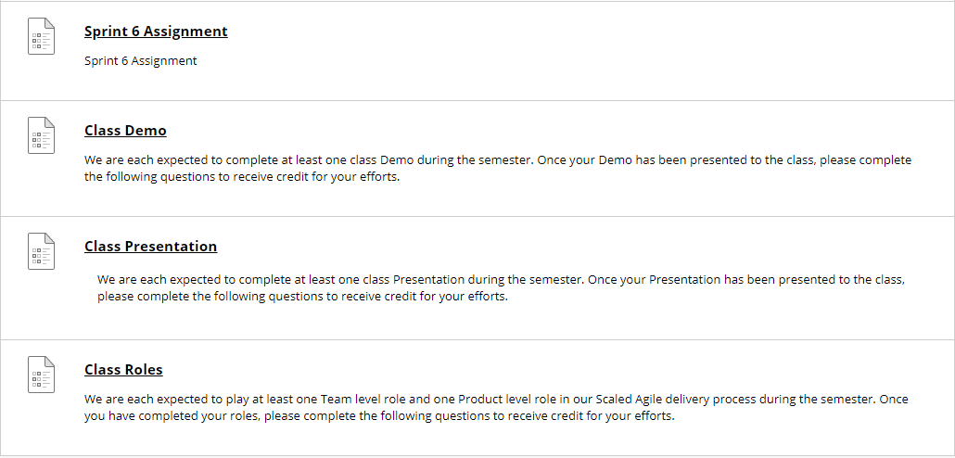
Demos, Presentations, and Roles Review
Going forward, complete your Demo or Presentation assignment before you deliver you Demo or Presentation… those demoing and presenting today have until tomorrow evening to complete
At the start of Sprint 8, I will be marking all incomplete Demo, Presentation, and Roles assignments zero (0) to help us make sure that we complete them all… I will grade them normally once the are submitted
Note that at the end of our last class session they will actually be zeros

Slide 7
Assignment 8 and DB 8 due Thursday at 9am
Notes:
UI Team meet and prepare to Present or Demo UI Design for Klump

Slide 8
Lab: Portfolio, Program, Scrum Teams … working on Final Projects
Notes:
UI Team meet and prepare to Present or Demo UI Design for Klump

Slide 9
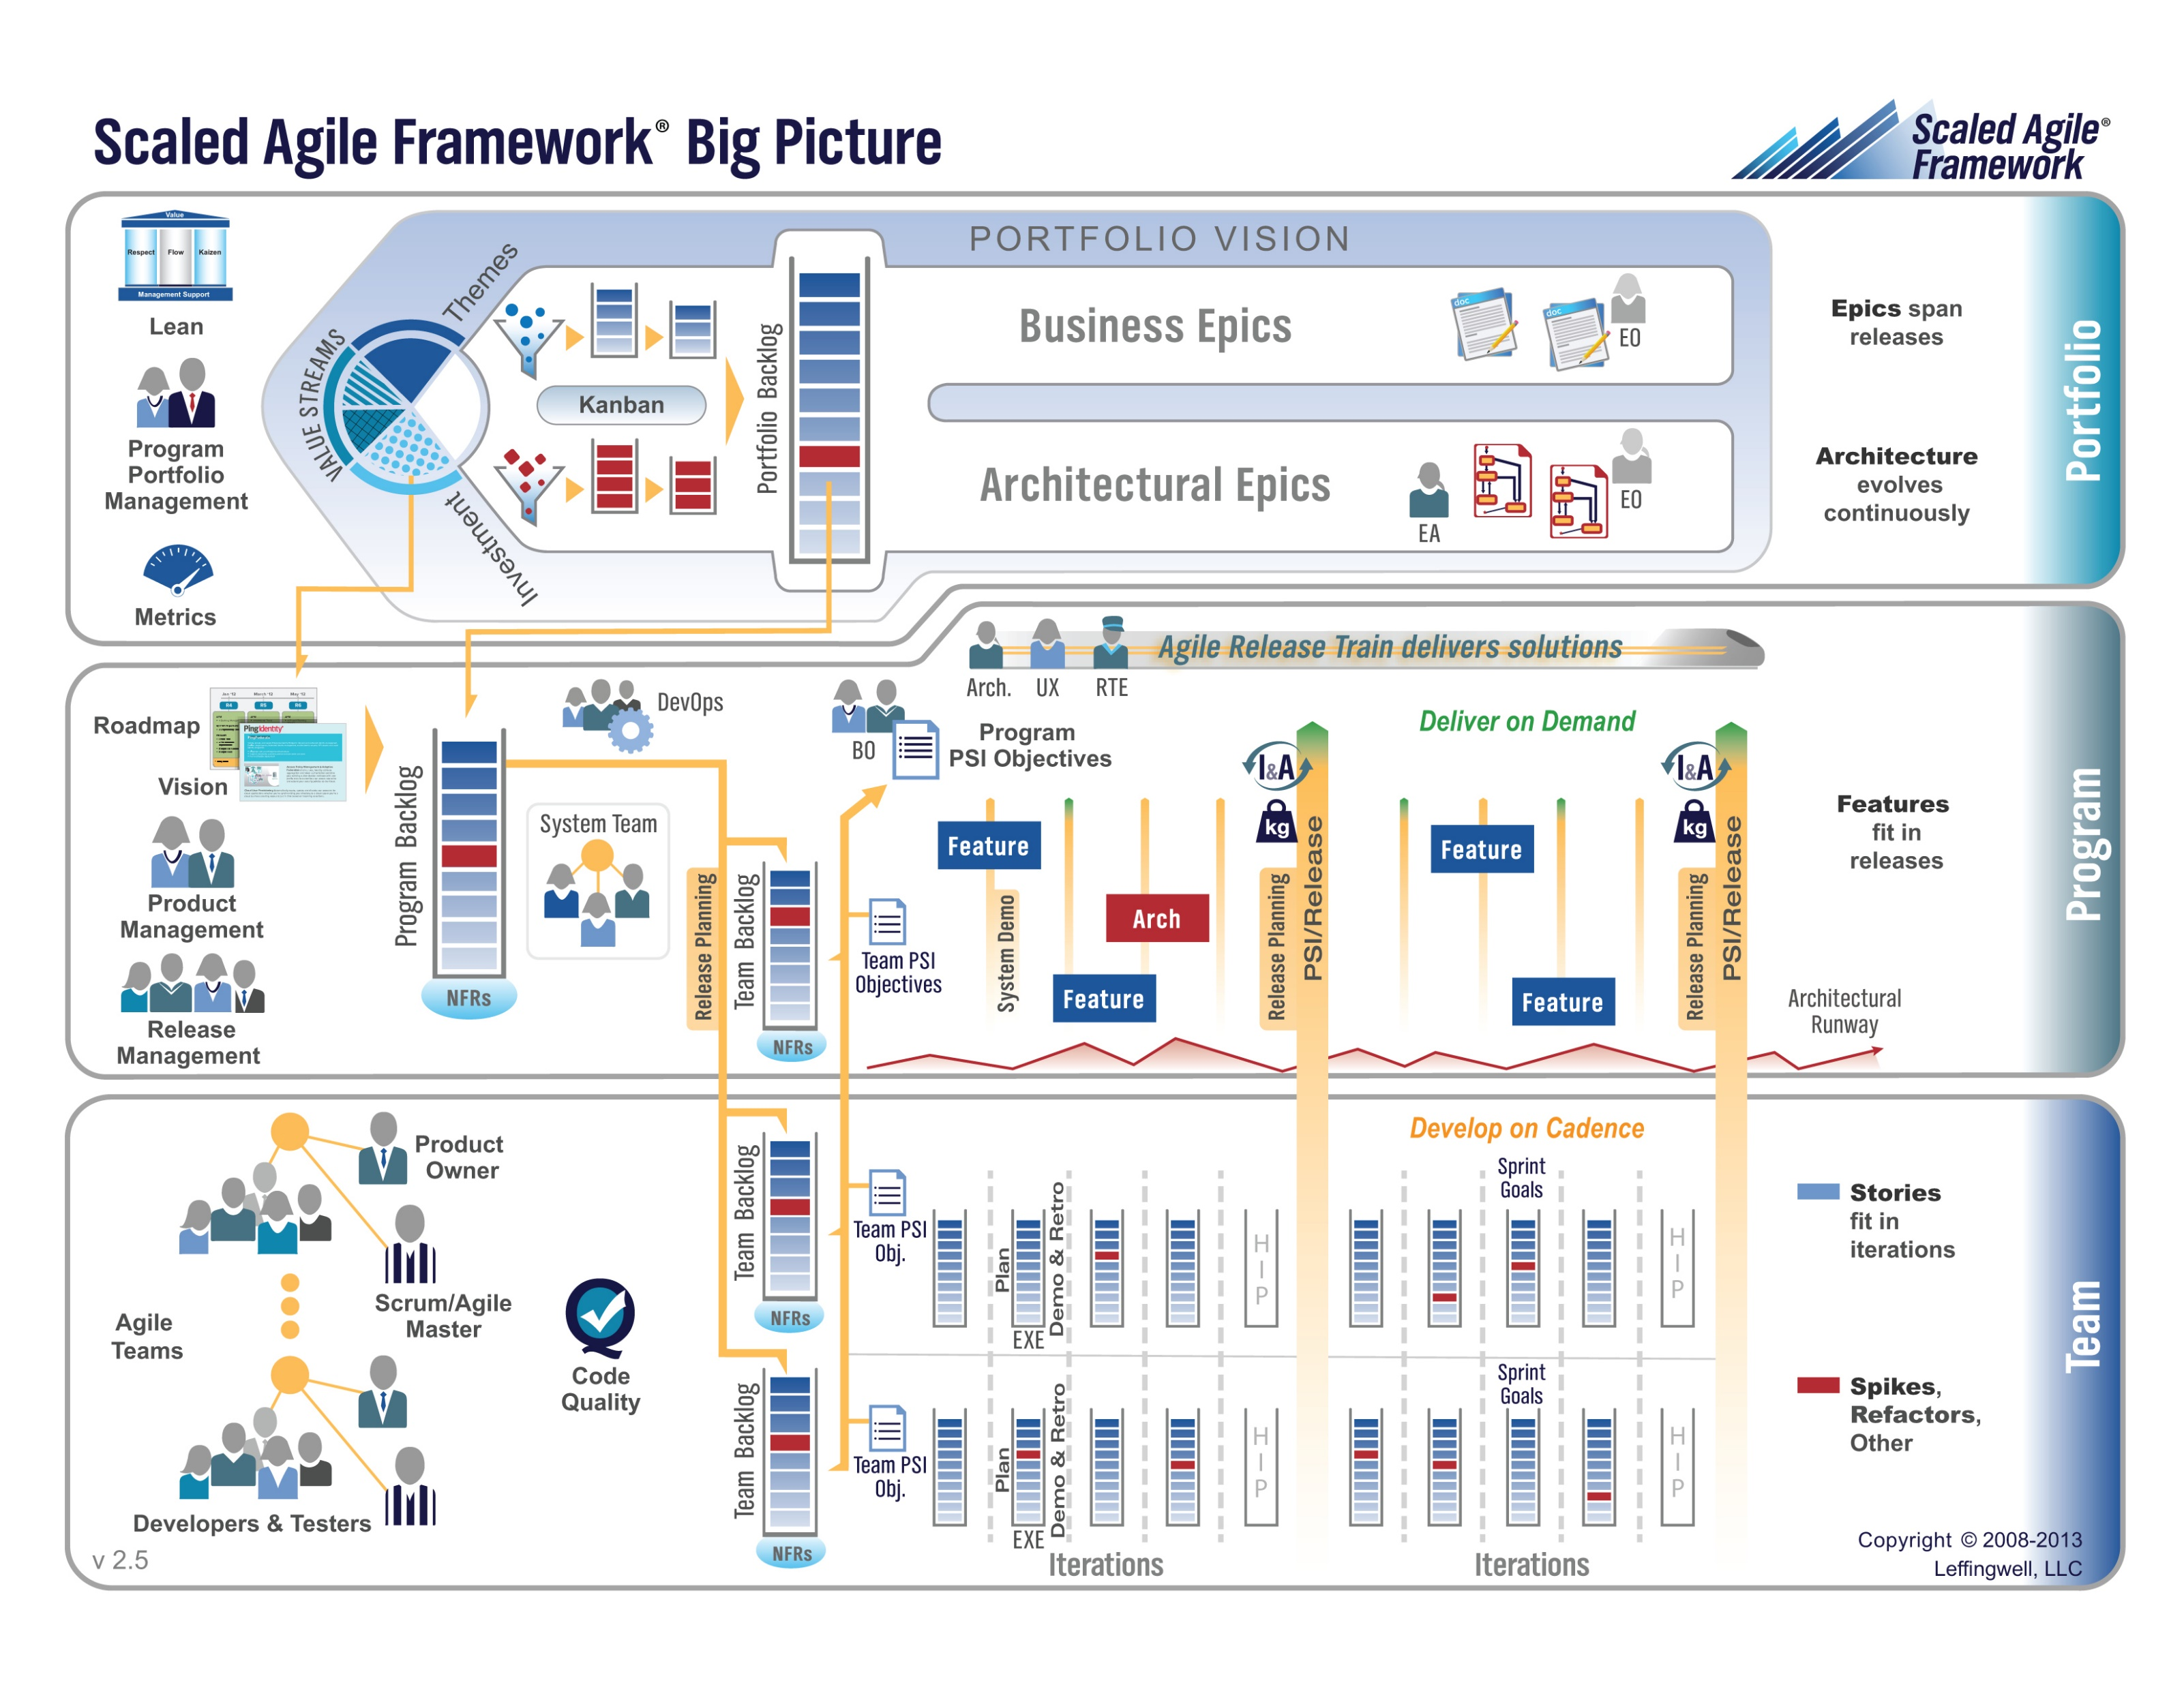
5%
10%
85%
Notes:
The physics of getting work done help the team(s) self organize/optimize

Slide 10
Portfolio Level Responsibilities
Portfolio Responsibilities:
Release Schedule
Investment & Staffing
Program Team Dependencies
Epic Backlog
Notes:
UI Team meet and prepare to Present or Demo UI Design for Klump

Slide 11
Portfolio Responsibilities
Investment & Staffing:
Klump Speak – Three Scrum Teams
Image Formatting Program (IFP) – Two Scrum Teams
Program Team Dependencies:
No cross-program dependencies required or allowed
Epic Backlog:
Deliver Klump Speak v1 & IFP v1 by May 3, 2018 at 9am
Prepare for final by May 8, 2018 at 10:30am
Notes:
UI Team meet and prepare to Present or Demo UI Design for Klump

Slide 12
Program Level Responsibilities
Program Responsibilities:
Investment & Staffing
Feature Backlog
Scrum Team Dependencies
Notes:
UI Team meet and prepare to Present or Demo UI Design for Klump

Slide 13
Program Backlog
Complete Sprint 8 Assignment
Deliver Final Project… “Klump Speak” or “IFP” that:
Include either two or three Scrum teams with each Product Team
Includes all Scaled Agile and Scrum roles
Verifiably completes all Team Level Agile Rituals and Metrics… Sprint planning, user stories, metrics, retrospectives, demos, etc.
Verifiably completes some Product Level Rituals including Product Team Stand-up, prioritized Feature Backlog and Say-Do ratio
Be deployed in a cloud environment in both test and production environments
Be deployed to each team members desktop
Include GitHub source code control that has each individual in each team contribute something to the product… you will need to give me access the repository as well
Implement branching to control test and production deployments
Read and be prepared to discuss selected sections of Chapter 11 plus two sections of Chapter 12 (12.3 and 12.9)… this can be done after May 3rd.
 | Team Klump Speak |  |  |  | Team IFP
 | Product Manager | Project Manager | Product Architect | UI Designer | Product Manager | Project Manager | Product Architect | UI Designer
Sprint 8 | Marissa | Juan | Lenny | Brandon | Jake | John | Karol | Cris

Slide 14
Backup Slides for Study Guide

Slide 15
Study Guide – Exam 2

Slide 16
Exam 2
Tuesday, May at 10:30am CST… don’t be late
No notes or external sources
Online format similar to Quizzes… be sure to get logged and make sure that you have access ahead of time
~30 questions worth 50 points
~6 short answer worth 3 to 6 points each
~24 multiple choice and multiple answer questions worth 1 point each
Anticipated 50 minutes or less
Test Auto-Submits after 60 minutes*
Pace yourself… 2 minutes per point? Maybe a little more for short-answer and a little less for multiple choice
Be prepared to show me that you have successfully submitted the test before leaving
There is no penalty for guessing

Slide 17
Study Guide and Course Review – Part 1
Assignment/Quiz 1 through 4
Chapters 1, 2, 6, 7, and 10
Scaled Agile Framework (SAFe)
Class Discussion Topics
HTML, JavaScript, Node.js
Class Presentations
Databases on Azure including “Azure tables vs Azure MongoDB vs Azure other DBs”
Cloud/Azure based Authentication/Authorization services and who they could be integrated into a NodeJS based application
JavaScript and NodeJS with a focus on Azure and including the best Internet based tutorials and/or books on the topic
Notes:
… the test questions will be similar to the questions from the Quizzes. The test will be limited to 50 minutes and you will not have access to notes or other resources.
As a Class commit each Team to research, discuss, and present at least one of the following topics:
Databases on Azure including “Azure tables vs Azure MongoDB vs Azure other DBs”**
Cloud/Azure based Authentication/Authorization services and who they could be integrated into a NodeJS based application*
JavaScript and NodeJS with a focus on Azure and including the best Internet based tutorials and/or books on the topic
SaaS Frameworks including “MEAN vs LAMP vs Ruby on Rails”
Service Oriented Architectures including “Web Services and SOAP/WSAD vs REST vs Sockets”
SaaS Client Frameworks including “HTML/JavaScript vs AngularJS vs Angular2 vs React vs others”
File Formats including “HTML vs XML vs JSON vs Key/Value Pair Text Files”

Slide 18
Week 1
Notes:
Who will volunteer to bring us a “Friendly Conversation” topic Thursday?

Slide 19
People, Process, and Technology
Software Engineering:
People: Teams, Optimism, Engagement, Ambition, Dedication, Leadership, Skills, Experience, Domain Knowledge…
Process: Waterfall/Iterative/Agile, Portfolio Management, Project Management, Funding, Prioritization, Metrics…
Technology: Configuration Management, Cloud Hosting, Scriptable Infrastructure, Source Code Management, Automated Testing…
Notes:
Eric’s View

Slide 20
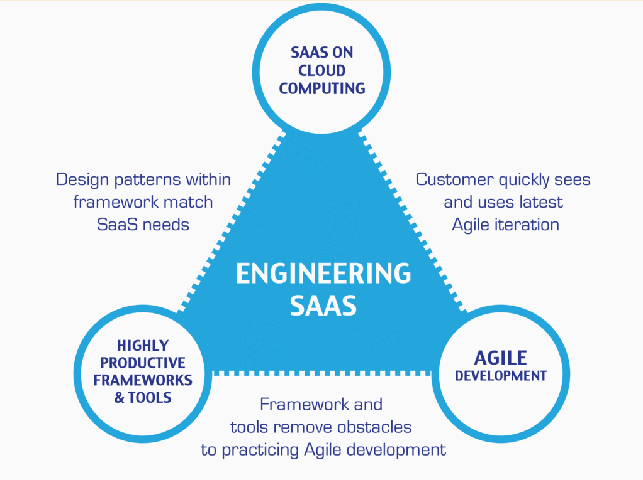
…And the Virtuous Triangle
Hosting Technology: Cloud, Scriptable Infrastructure, Software as a Service (SaaS)…
People: Teams, Optimism, Engagement, Ambition, Dedication, Leadership, Skills, Experience, Domain Knowledge…
Process: Agile, Portfolio Management, Project Management, Funding, Prioritization, Metrics…
Productivity Technology: Configuration Management, Source Code Management, Automated Testing…

Slide 21
Agile Manifesto (February 2001)
“We are uncovering better ways of developing software by doing it and helping others do it. Through this work we have come to value:
Individuals and interactions over processes and tools
Working software over comprehensive documentation
Customer collaboration over contract negotiation
Responding to change over following a plan
That is, while there is value in the items on the right, we value the items on the left more.”

Slide 22
Assignment
Prior to class on Thursday:
Be fully prepared “Scrum-ify” Ourselves… our first chance to demonstrate our capabilities as self-organizing Scrum team members
View and reflect on “Introduction to Scrum in 7 Minutes” video [link]
Be prepared to discuss Ch.1.1 to 1.3
Be prepared to discuss Ch.10.1 to 10.5… focusing on Scrum and Git
Install/implement MS PowerShell [link]
Install Git Client [link]… and test it on multiple shells
Be prepared to: Utilize (local) Git Client to create, update, branch, and merge a local project utilizing a beginners level tutorial… one option would be “An Intro to Git and GitHub for Beginners” [link]

Slide 23
Assignment
Prior to class on Tuesday:
“Scrum-ify” Ourselves… our second chance to demonstrate our capabilities as self-organizing Scrum team members
Complete Discussion Board “Introduction” before you leave class today
Read and be prepared to discuss Preface & Chapter 1
Install MS PowerPoint & MS Word Viewers (if you do not have access to the full products)
Setup a GitHub account with a Student Developer Pack/Plan [link]
Utilize Git & GitHub to create, update, branch, and merge local and remote projects utilizing several beginner level tutorials:
One option would be “An Intro to Git and GitHub for Beginners” tutorial [link]
Another option would be the GitHub “Hello World” tutorial [link]
Create a public GitHub repository and share it with another Team Member
Be the recipient of a shared public GitHub repository from a Team Member

Slide 24
Week 2
Notes:
Who will volunteer to bring us a “Friendly Conversation” topic Thursday?

Slide 25
Assignment (for a full week instead if one class period)
Sprint 1b Product Backlog… due Monday night (11:59pm):
Create a public GitHub repository and share it with another Team Member… carry over from last assignment
Be the recipient of a shared public GitHub repository from a Team Member… carry over from last assignment
Individually setup a Microsoft Imagine Azure account [link]
Individually complete the Azure static website tutorial... leave the site in place [link]
As a Team agree on a standard and extensible “My Information” JSON format and data requirements that include FirstName, LastName, PreferredName, TeamName, SeatLocation, and Roles* in a standard file name (e.g. “my-information.json”) at a minimum… Product Owners to discuss/lead and elect someone to play the Product Architect role
Individually complete a “permanent” personal static website where you will initially host your “My Information” JSON file for this class utilizing the previous tutorial to create the new website
Complete Sprint 2 Planning Session
Individually complete Quiz 1
Read Chapter 2
Notes:
A Backlog is a prioritized list of request deliverables. It exists at the Team and Product (and possibly Portfolio) levels… Stories, Features, Epics
Sprint 1b will end next Monday at 11:59pm… approximately 1 week
Notes:
All agile Backlogs must be a list of Features or Stores based prioritized on business value
Dependencies should be identified
The optimal order and method of completing them is up to the individual teams
Eventually we will need to provide a definition of “Done”

Slide 26
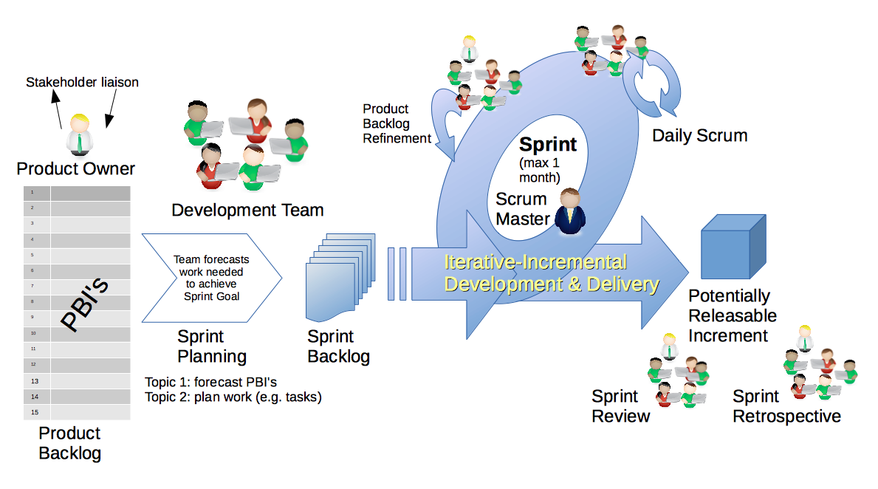
Scrum & Scrum Roles
By Dr ian mitchell - Own work, CC BY-SA 4.0, Link

Slide 27
Sprint 2
Notes:
Who will volunteer to bring us a “Friendly Conversation” topic Thursday?

Slide 28
Sprint 2 Product Backlog… page 1 of 2
As a Class document a standard “My Information” JSON format that at a minimum include one or more “records” that each include FirstName, LastName, PreferredName, TeamName, SeatLocation, and Roles in a standard file name (e.g. “my-information.json”)… Product Owners and the Product Architect will lead this effort
As a Class commit each Team to research, discuss, and present at least one of the following topics:
Databases on Azure including “Azure tables vs Azure MongoDB vs Azure other DBs”**
Cloud/Azure based Authentication/Authorization services and who they could be integrated into a NodeJS based application*
JavaScript and NodeJS with a focus on Azure and including the best Internet based tutorials and/or books on the topic
SaaS Frameworks including “MEAN vs LAMP vs Ruby on Rails”
Service Oriented Architectures including “Web Services and SOAP/WSAD vs REST vs Sockets”
As a Team select one or two team members who will lead the team’s effort to research and discuss the above topic and then delivery a (~10min) presentation on the topic to the class on Tuesday, February 13.
Read and be prepared to discuss Chapter 6
Complete the dynamic Azure NodeJS website tutorial… leave the site in place [link]
As a Team Test each other’s Personal Static Website, verify JSON formats, and report sites tested and defects found as a MS Word or JSON file to your Product Owner and to the owner of the site(s) where the defect was found
Find and complete an additional HTML/NodeJS tutorial on Azure… leave it in place
Complete Sprint 2 Quiz
Complete and document Sprint 2 Retrospective and summarization/prioritization of Team level Continuous Improvement (CI) items... be prepared to include one CI item on in your Sprint 3 backlog
Notes:
As a Class commit each Team to research, discuss, and present at least one of the following topics:
Databases on Azure including “Azure tables vs Azure MongoDB vs Azure other DBs”**
Cloud/Azure based Authentication/Authorization services and who they could be integrated into a NodeJS based application*
JavaScript and NodeJS with a focus on Azure and including the best Internet based tutorials and/or books on the topic
SaaS Frameworks including “MEAN vs LAMP vs Ruby on Rails”
Service Oriented Architectures including “Web Services and SOAP/WSAD vs REST vs Sockets”
SaaS Client Frameworks including “HTML/JavaScript vs AngularJS vs Angular2 vs React vs others”
File Formats including “HTML vs XML vs JSON vs Key/Value Pair Text Files”

Slide 29
Sprint 2 Product Backlog… page 2 of 2
Complete Sprint 3 Planning
Download class materials utilizing Git client and cloning “https://github.com/EricJPogue/sp18-cpsc-44000-001.git”
Notes:
As a Class commit each Team to research, discuss, and present at least one of the following topics:
Databases on Azure including “Azure tables vs Azure MongoDB vs Azure other DBs”**
Cloud/Azure based Authentication/Authorization services and who they could be integrated into a NodeJS based application*
JavaScript and NodeJS with a focus on Azure and including the best Internet based tutorials and/or books on the topic
SaaS Frameworks including “MEAN vs LAMP vs Ruby on Rails”
Service Oriented Architectures including “Web Services and SOAP/WSAD vs REST vs Sockets”
SaaS Client Frameworks including “HTML/JavaScript vs AngularJS vs Angular2 vs React vs others”
File Formats including “HTML vs XML vs JSON vs Key/Value Pair Text Files”

Slide 30
Sprint 3
Notes:
Who will volunteer to bring us a “Friendly Conversation” topic Thursday?

Slide 31
Presentation Schedule for Tuesday, February 13:
Databases on Azure including “Azure tables vs Azure MongoDB vs Azure other DBs”
– by the Ocelots presented by Jake & Thad
JavaScript and NodeJS with a focus on Azure and including the best Internet based tutorials and/or books
– by the Great White Buffalos presented by Cris & Nick
Cloud/Azure based Authentication/Authorization services and how they could be integrated into a NodeJS based application
– by the Lewis Honeybadgers presented by Kevin and Louie
Databases on Azure including “Azure tables vs Azure MongoDB vs Azure other DBs”
– by the Back Row Bandicoots presented by Tyler and Joe
JavaScript and NodeJS with a focus on Azure and including the best Internet based tutorials and/or books
– by the Flamingos presented by Lenny
Note that presentations may carry over to Thursday as needed.

Slide 32
Standup for Sprint 3 Product Backlog
Verify and Demo that all items from Sprint 2 are Done* or add them as Carryover items to Sprint 3
Complete Sprint 3 Assignment/Quiz
Complete and document Sprint 3 Retrospective and summarization/prioritization of Team level Continuous Improvement (CI) items... be prepared to include one CI item on in your Sprint 3 backlog
Complete Sprint 4 Planning
Read and be prepared to discuss Chapter 7
Complete and document Sprint 3 Metrics which will consist of a published Say-Do ratio
Download and/or update class materials utilizing Git client and cloning https://github.com/EricJPogue/sp18-cpsc-44000-001.git
Review, but do no complete, Eric’s Azure Static website tutorial video [link]
As a Team define the “Team Information Service” project by writing the necessary Team level User Stories for the project
As a Team create a shared private “Team Information Service” GitHub repository that is shared with everyone on the team and with the Instructor… name the repository “Team Information Service for [Team Name]”
As a Team create a “Team Information Service” Production site on Azure
As a Team develop, test, and deploy “Team Information Service” Release 1 to Test
Notes:
As a Class commit each Team to research, discuss, and present at least one of the following topics:
Databases on Azure including “Azure tables vs Azure MongoDB vs Azure other DBs”**
Cloud/Azure based Authentication/Authorization services and who they could be integrated into a NodeJS based application*
JavaScript and NodeJS with a focus on Azure and including the best Internet based tutorials and/or books on the topic
SaaS Frameworks including “MEAN vs LAMP vs Ruby on Rails”
Service Oriented Architectures including “Web Services and SOAP/WSAD vs REST vs Sockets”
SaaS Client Frameworks including “HTML/JavaScript vs AngularJS vs Angular2 vs React vs others”
File Formats including “HTML vs XML vs JSON vs Key/Value Pair Text Files”

Slide 33
JavaScript Basics (Chp. 6)

Slide 34
JavaScript Basics (Plus)
Let’s review some practical code:
Let’s start with our own sprint3.html file [link]
Now let’s look at Yahtzee Dice Roller
And finally Yahtzee Dice Roller with external JavaScript

Slide 36
Sprint 4
Notes:
Who will volunteer to bring us a “Friendly Conversation” topic Thursday?

Slide 37
Sprint 4 Product Backlog
Complete and document Sprint 4 Metrics, Retrospective, Review Sprint 5 Backlog, and be prepared for Sprint 5 Planning on Tuesday, March 13
Complete Sprint 4 Assignment/Quiz
Deliver Sprint 4 User Stories… it the “real” world, 80%+ of a teams capacity should be devote to this! In addition to Product functions, user Stories should include”
As a Team create a “Klump” Production site on Azure
As a Team create a “Klump” Test site on Azure
As a Team develop, test, and deploy “Klump” Release 1 to Test
As a Team test and deploy Klump Release 1 to Production
Individually deploy and test Klump to your local development environment
Read and be prepared to discuss Chapter 8
Notes:
As a Class commit each Team to research, discuss, and present at least one of the following topics:
Databases on Azure including “Azure tables vs Azure MongoDB vs Azure other DBs”**
Cloud/Azure based Authentication/Authorization services and who they could be integrated into a NodeJS based application*
JavaScript and NodeJS with a focus on Azure and including the best Internet based tutorials and/or books on the topic
SaaS Frameworks including “MEAN vs LAMP vs Ruby on Rails”
Service Oriented Architectures including “Web Services and SOAP/WSAD vs REST vs Sockets”
SaaS Client Frameworks including “HTML/JavaScript vs AngularJS vs Angular2 vs React vs others”
File Formats including “HTML vs XML vs JSON vs Key/Value Pair Text Files”

Slide 38
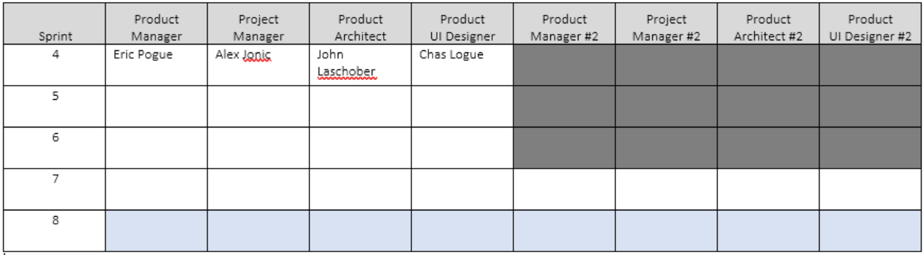
Scaled Agile Roles

Slide 39
Software Testing Overview
Software Testing [link] is important because, if done right, it can help us find and fix problems earlier and make our system delivery process less immobile, rigid, and fragile.
As future Software Engineers , we are going to:
Understand testing within the various Software Development Lifecycles
Understand testing terminology
Know how to develop applications that are easier to test
Understand Unit Testing and Automated Testing
Notes:
Never underestimate the value of good design and implementation (for testability, encapsulation, etc.) on the economics of testing. You can’t afford to test in quality!
Developers are responsible for product quality. Tester should be able to minimize that chance that a defect makes it to production.
We test to find defects and/or to validate that we have not introduced new defects.
Defects are exponentially more expensive to fix the longer the exist.
Performance issues are often the most difficult and expensive defects to fix. They are often not found until the application if running under production load… which is often only when it is in production.
Unit - $200
Integration - $600
User Acceptance - $6,000
Production - $100,000+
The permutations of modern software features, data, tools, environments, etc. quickly becomes unmanageable. Testability needs to be goal of nearly all non-trivial applications.
Dave Cutler of Windows NT fame had a quote. I wish I could remember the exact words, but it went something like, “I hate having testers because they give developers the false hope that someone else can save them from their sins.”

Slide 40
Software Testing “Truths”
Never underestimate the value of good design and implementation (for testability, encapsulation, etc.) on the economics of testing… You can’t afford to test in quality!
Defects are exponentially more expensive to fix the longer the exist.
Unit - $200
Integration - $600
User Acceptance - $6,000
Production - $100,000+
Performance issues are often the most difficult and expensive defects to fix. They are often not found until the application if running under production load… which is often only when it is in production.
The permutations of modern software features, data, tools, environments, etc. quickly becomes unmanageable. Testability needs to be goal of nearly all non-trivial applications.
Developers need to be responsible for product quality. Tester should be able to minimize that chance that a defect makes it to production.
Dave Cutler of Windows NT fame had a quote. I wish I could remember the exact words, but it went something like, “I hate having testers because they give developers the false hope that someone else can save them from their sins.”

Slide 41
Team the “Klump” Product
Our “Klump” product should include:
Reading each team member’s “My Information” JSON files from each of their Personal Static Websites
Validating of JSON formats
Publishing the consolidated data to a simple HTML/JavaScript web page
Consolidating the data into a multi-person Class standard JSON format… note that to make the format simpler, we can limit roles to 3 roles (role1, role2, and role3)… Product Architect to lead
Publishing the consolidated data to a Web Service that returns the standard multi-person JSON format
Include current time and last time each individuals information was last updated in the multi-person JSON response
Testing mode to validate and report JSON formatting errors
Implement 30 minute caching and forced refresh
Solid Development (each team member), Test (team), and Production sites (team)
Notes:
As a Class commit each Team to research, discuss, and present at least one of the following topics:
Databases on Azure including “Azure tables vs Azure MongoDB vs Azure other DBs”**
Cloud/Azure based Authentication/Authorization services and who they could be integrated into a NodeJS based application*
JavaScript and NodeJS with a focus on Azure and including the best Internet based tutorials and/or books on the topic
SaaS Frameworks including “MEAN vs LAMP vs Ruby on Rails”
Service Oriented Architectures including “Web Services and SOAP/WSAD vs REST vs Sockets”
SaaS Client Frameworks including “HTML/JavaScript vs AngularJS vs Angular2 vs React vs others”
File Formats including “HTML vs XML vs JSON vs Key/Value Pair Text Files”

Slide 42
Study Guide and Course Review – Part 2
Assignment/Quiz 5 through 8
Chapters 9, 10, 11, and parts of 12 (12.3 and 12.9)
More Scaled Agile Framework (SAFe) including Program and Portfolio level Rituals and Responsibilities
Class Discussion Topics
Databases, Licenses, JSON
Klump Project
Class Presentations
NodeJS
Web RTC
Software Licenses
Git Deployment using Branches
Screen Recording and Video Creation
Notes:
… the test questions will be similar to the questions from the Quizzes. The test will be limited to 50 minutes and you will not have access to notes or other resources.
As a Class commit each Team to research, discuss, and present at least one of the following topics:
Databases on Azure including “Azure tables vs Azure MongoDB vs Azure other DBs”**
Cloud/Azure based Authentication/Authorization services and who they could be integrated into a NodeJS based application*
JavaScript and NodeJS with a focus on Azure and including the best Internet based tutorials and/or books on the topic
SaaS Frameworks including “MEAN vs LAMP vs Ruby on Rails”
Service Oriented Architectures including “Web Services and SOAP/WSAD vs REST vs Sockets”
SaaS Client Frameworks including “HTML/JavaScript vs AngularJS vs Angular2 vs React vs others”
File Formats including “HTML vs XML vs JSON vs Key/Value Pair Text Files”

Slide 43
Sprint 5 Product Backlog
Complete midterm exam which is scheduled for Thursday, March 22 during the last 50 minutes of class
Complete and document Sprint 5 Metrics, Retrospective, Prepare and Review Sprint 6 Stories, and be prepared for Sprint 6 Planning on Tuesday, March 27
Complete Sprint 5 Assignment/Quiz
Deliver Sprint 5 User Stories that will allow your team to exceed “Klump” product specifications by the end of Sprint 6
Read and be prepared to discuss Chapter 9
Prepare and Groom Sprint 6 User Stories
Notes:
… the test questions will be similar to the questions from the Quizzes. The test will be limited to 50 minutes and you will not have access to notes or other resources.
As a Class commit each Team to research, discuss, and present at least one of the following topics:
Databases on Azure including “Azure tables vs Azure MongoDB vs Azure other DBs”**
Cloud/Azure based Authentication/Authorization services and who they could be integrated into a NodeJS based application*
JavaScript and NodeJS with a focus on Azure and including the best Internet based tutorials and/or books on the topic
SaaS Frameworks including “MEAN vs LAMP vs Ruby on Rails”
Service Oriented Architectures including “Web Services and SOAP/WSAD vs REST vs Sockets”
SaaS Client Frameworks including “HTML/JavaScript vs AngularJS vs Angular2 vs React vs others”
File Formats including “HTML vs XML vs JSON vs Key/Value Pair Text Files”

Slide 44
Observation
Notes:
Agile and Scaled Agile are very light, egalitarian, and bottom-up processes.

Slide 45
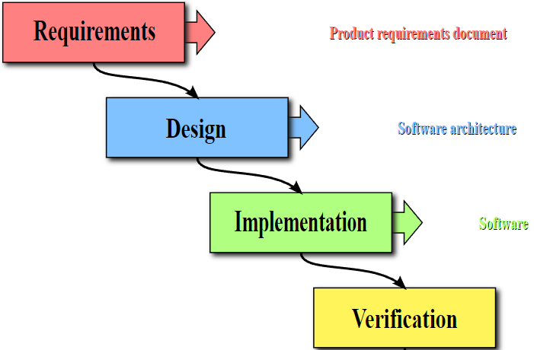
40%
50%
60%
50%
Notes:
The process encourages the promotion of whatever activities/skills a given group or individual possesses

Slide 46
15%
85%
Notes:
The physics of getting work done help the team(s) self organize/optimize

Slide 47
Sprint 6 Product Backlog
Verifiably complete all Agile Rituals (including Demos) and Metrics (including at least one team level metric)
Deliver User Stories that will complete the Klump product by exceeding specifications by the end of this Sprint… this will need to include testing and deployment to your test and production sites
Prepare a Presentation of your Klump product implementation to be delivered by 1 or 2 team members on 12 April
Complete Sprint 6 Assignment
Prepare a Demo of your team’s Stories and Story management method to be delivered by 1 or 2 team members on 10 April
Notes:
… the test questions will be similar to the questions from the Quizzes. The test will be limited to 50 minutes and you will not have access to notes or other resources.
As a Class commit each Team to research, discuss, and present at least one of the following topics:
Databases on Azure including “Azure tables vs Azure MongoDB vs Azure other DBs”**
Cloud/Azure based Authentication/Authorization services and who they could be integrated into a NodeJS based application*
JavaScript and NodeJS with a focus on Azure and including the best Internet based tutorials and/or books on the topic
SaaS Frameworks including “MEAN vs LAMP vs Ruby on Rails”
Service Oriented Architectures including “Web Services and SOAP/WSAD vs REST vs Sockets”
SaaS Client Frameworks including “HTML/JavaScript vs AngularJS vs Angular2 vs React vs others”
File Formats including “HTML vs XML vs JSON vs Key/Value Pair Text Files”

Slide 48
Sprint 7 Product Backlog
Verifiably complete all Agile Rituals (including Demos) and Metrics (including at least one team level metric)
Complete Sprint 7 Assignment
Read and be prepared to discuss Chapter 10
Create User Stories that will deliver a Klump tutorial based on your team’s Klump implementation. Requirements include:
Allow a future team should be able to effectively install the product on Azure and make a minor enhancement to your product in less than one hour by following the tutorial
Include a single zip file named klump-sp18-[your-team-name].zip with all product assets submitted on a USB drive that will be provided to your team
Include an appropriate license file
Include a Readme.txt or Readme.md file in the root folder of the zip file that represents the starting point for the tutorial
Assume or require only prerequisites that the tutorial participant should have an MS Azure account and knowledge equivalent to taking this software development class
Deliver the above tutorial by completing the user stories
Prepare a video recording that demonstrates completing your tutorial within 30 minutes… the video can substitute for a presentation for the individual(s) who record it
Prepare for Sprint 8 by creating a proposal for a final project… the final should include at least two teams working together
Notes:
… the test questions will be similar to the questions from the Quizzes. The test will be limited to 50 minutes and you will not have access to notes or other resources.
As a Class commit each Team to research, discuss, and present at least one of the following topics:
Databases on Azure including “Azure tables vs Azure MongoDB vs Azure other DBs”**
Cloud/Azure based Authentication/Authorization services and who they could be integrated into a NodeJS based application*
JavaScript and NodeJS with a focus on Azure and including the best Internet based tutorials and/or books on the topic
SaaS Frameworks including “MEAN vs LAMP vs Ruby on Rails”
Service Oriented Architectures including “Web Services and SOAP/WSAD vs REST vs Sockets”
SaaS Client Frameworks including “HTML/JavaScript vs AngularJS vs Angular2 vs React vs others”
File Formats including “HTML vs XML vs JSON vs Key/Value Pair Text Files”

Slide 49
Final Project Presentations Schedule for Thursday, May 3
Klump Speak
Image Filter Program (IFP)

Slide 50
Study Guide – Exam 2

Slide 51
End of Session

