Slide 1
Design
Introduction
Architectural Design

Slide 2
What is Design?
Design is a "wicked" problem
Design is sloppy
Design involves trade offs
Design involves restrictions
Design is nondeterministic
Design involves heuristics
Design is emergent

Slide 3
Design
Link between requirements and construction
Most creative part of the software development process
Creates a model of the software that provides details of the items that are necessary to implement the system

Slide 4
Good Design
Accurate
Clear
Complete

Slide 5
Quality Attributes
Functionality
Usability
Reliability
Performance
Supportability

Slide 6
Types of Design
Architectural design
Detailed design (component design)
User interface design

Slide 7
Architectural Design
Notes:
start here

Slide 8
Architecture
The manner in which various components are integrated to form a cohesive whole.
Overall structure of the software and the ways in which that structure provides conceptual integrity for a system

Slide 9
Architectural Design
The process for identifying the sub-systems making up a system and the framework for sub-system control and communication
An early stage of the system design process.
Represents the link between specification and design processes.

Slide 10
Architectural design
Architectural design should include
Structural properties
Non-functional properties
The output of this design process is a description of the software architecture.

Slide 11
Architectural Patterns

Slide 12
Pipe-Filter architecture style
The high level design solution is decomposed into two generic parts:
Filter is a service that transforms a stream of input data into a stream of output data
Pipe is a mechanism or conduit through which the data flows from one filter to another
Input
time cards
Prepare for
Check processing
Process Checks

Slide 13
Client-Server Style
Client may connect to more than one server
servers are usually independent

Slide 14
Model View Control (MVC) Style
Separates model (data) from view
Controller often integrated with view
View 1
Controller 1
Model
View 2
Controller 2

Slide 15
The organization of the Model-View-Controller
Model
Encapsulates application state
Notifies view of state changes
State
query
State
change
Change
Notification
View
Renders model
Request model updates
Sends user events to controller
Controller
Maps user actions to model updates
Selects view
User events
View selection

Slide 16
Layered Architecture
User Interface
User interface management Authentication and authorization
Core business logic/application functionality
System utilities
System support (OS, database, etc.)

Slide 17
Repository Architecture
Patient processing
Room Scheduling
Hospital
DB
Purchasing
.
.
Nurses Scheduling

Slide 18
Three tier style
Client 1a
Client 1b
Business
Tier
DB
Client 2

Slide 19
Process

Slide 20
Application Overview
Determine application type
Identify deployment constraints
Identify important architectural patterns
Determine relevant technologies

Slide 21
Application Types
Mobile applications
Rich client applications
Rich internet application
Service applications
Web applications

Slide 22
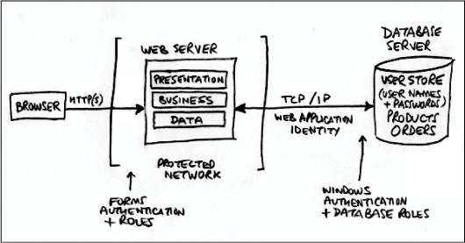
Create a model

Slide 23
Revise and Refine
Network diagrams
Component diagrams
Dataflow diagrams

Slide 24
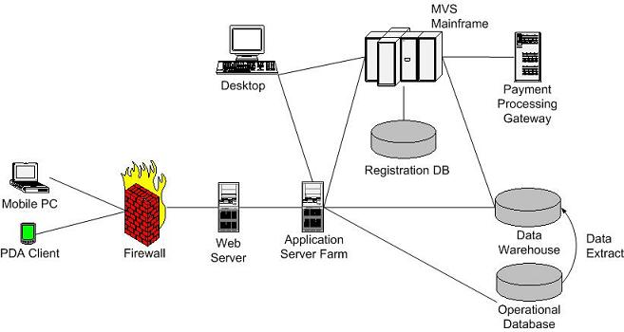
Network Diagram

Slide 25
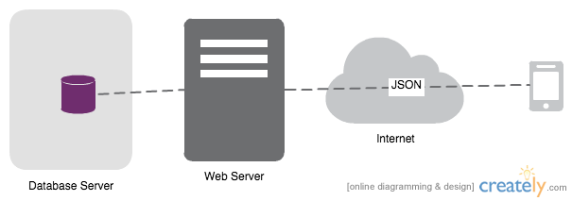
Network Diagram

Slide 26
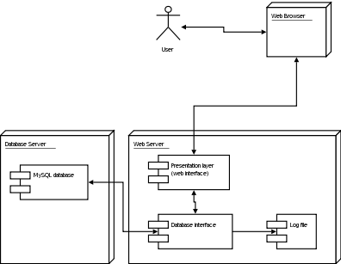
Component Diagram
"UML Diagramme Deploiement" by w:User:TexasDex - Wikipedia english. Licensed under CC BY-SA 3.0 via Wikimedia Commons - http://commons.wikimedia.org/wiki/File:UML_Diagramme_Deploiement.gif#mediaviewer/File:UML_Diagramme_Deploiement.gif

Slide 27
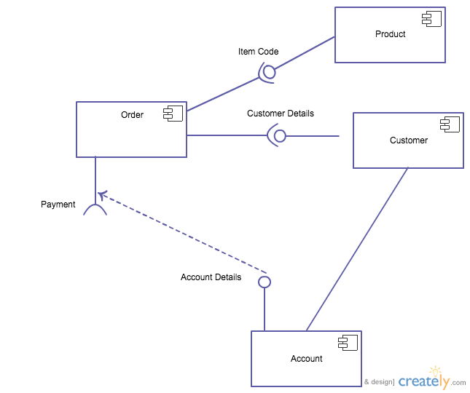
Component Diagram

Slide 28
Dataflow Diagrams
DFDs show
the flow of data from external entities into the system,
how the data is moved from one process to another
logical storage
There are only four symbols:
Squares representing external entities
Rounded rectangles representing processes
Arrows representing the data flows
Open-ended rectangles representing data stores

Slide 29
Dataflow Diagram

