Slide 1
Design Patterns

Slide 2
Object-oriented programming
Define problem in terms of objects
Identify pertinent objects
Create classes
Define interfaces
Define inheritance hierarchies
Emphasis on reusability
Even more difficult to design reusable objects

Slide 3
Design for change
Why might code in an application need to change?
Planning for change is the key to maximizing reuse
Anticipate new requirements and changes to existing requirements when designing your systems so that they can evolve
How to design for change
Identify the things that may vary
Program to the interface
Favor composition over inheritance

Slide 4
Application characteristics
Identify the aspects of your application that vary and separate them from what stays the same
Encapsulates what varies
If some aspect of your code changes with every new requirement remove it from the aspects that don’t change
Lets some part of a system vary independently from other parts

Slide 5
Favor composition over inheritance
Inheritance lets you define the implementation of one class in terms of another class
White-box reuse: Internals of the parent class are visible to subclasses
Composition lets you add new functionality by composing object to get more complex functionality
Black-box reuse: No internal details of objects are visible

Slide 6
Don’t reinvent the wheel
Reuse solutions that have worked in the past
Design patterns solve specific design problems
Can apply them without having to rediscover them

Slide 7
Design patterns
A design pattern is a way of reusing abstract knowledge about a problem and its solution
A pattern is a description of the problem and the essence of its solution
It should be sufficiently abstract to be reused in different settings
Pattern descriptions usually make use of object-oriented characteristics such as inheritance and polymorphism

Slide 8
Pattern elements
Name
Problem description
Solution description
Consequences

Slide 9
Design
To use patterns in your design, you need to recognize that any design problem you are facing may have an associated pattern that can be applied.

Slide 10
Common Design Patterns for PHP

Slide 11
Common Design Patterns for PHP
Observer Pattern
Strategy Pattern
Factory Pattern
Singleton Pattern
PHP Design Pattern Reference: http://www.fluffycat.com/PHP-Design-Patterns/

Slide 12
The Observer pattern
Description
Separates the display of object state from the object itself
Problem description
Used when multiple displays of state are needed
Solution description
One object makes itself observable by adding a method that allows another object to register itself
When the observable object changes, it sends a message to the registered observers
Consequences
Optimizations to enhance display performance are impractical.

Slide 13
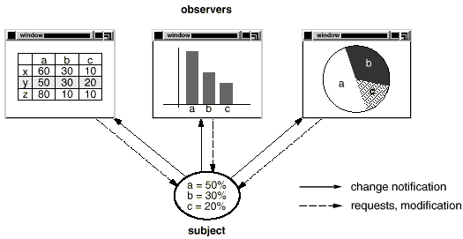
Multiple displays using the Observer pattern

Slide 14
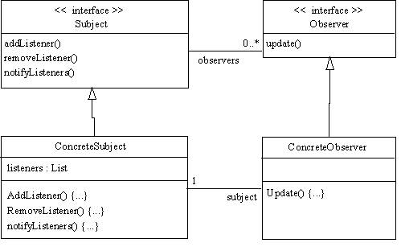
A UML model of the Observer pattern

Slide 15
PHP Implementation of Observer Pattern
PHP has library interfaces used to implement the observer pattern
SplSubject
SplObserver

Slide 16
The Strategy pattern
Problem Description
Algorithms are extracted from complex classes so they can be replaced easily
Lets the algorithms vary independently from clients that use them
Used when you need different variants of an algorithm

Slide 17
The Strategy Pattern (cont.)
Solution description
Participants:
Strategy: declares an interface common to all supported algorithms
Concrete strategy: implements the algorithm using the strategy interface
Context: configured with a concrete strategy objects and maintains a reference to a strategy object
Collaborations
Strategy and context interact to implement chosen algorithm
Context forwards requests from its clients to its strategy

Slide 18
The Strategy Pattern (cont.)
Consequences
Creates families of related algorithms
Increases the number of objects
Example: Find a list of users based on criteria

Slide 19
Factory Pattern
Problem Description
Define an interface for creating an object, but let subclasses decide which class to instantiate
The Factory Method pattern defines an interface for object creation but defers the actual instantiation to subclasses.

Slide 20
Factory Pattern (cont.)
Solution Description
The factory pattern is a class that has some methods that create objects for you.
Instead of using new directly, you use the factory class to create objects.
If you want to change the types of objects created, you can change just the factory. All the code that uses the factory changes automatically.
We code our application so it only expects a class that conforms to an interface

Slide 21
Factory Pattern (cont.)
Consequences
Refactoring an existing class to use factories breaks existing clients
Classes can't easily be extended
Examples
Different database implementations
Different types of users

Slide 22
Singleton Pattern
Problem Description
Situations in which there needs to be a single instance of a class
Some application resources are exclusive in that there is one and only one of this type of resource
Solution Description
Add a property to the class that stores the single instance of the object
This property should be static

Slide 23
Singleton Pattern
Consequences
Makes unit testing far more difficult, as it introduces global state into an application.
Reduces the potential for parallelism within a program, because access to the singleton in a multi-threaded context must be serialized
Example: Database connection

Slide 24
Other Design Patterns

Slide 25
Design Patterns
Abstract factory
Provide an interface for creating families of related or dependent objects without specifying their concrete classes
Command
Encapsulate a request as an object, thereby letting your parameterized clients with different requests, queue or log requests, and support undoable operations.

Slide 26
Other Design Patterns
Decorator
Attach additional responsibilities to an object dynamically. Decorators provide a flexible alternative to subclassing for extending functionality
Adapter
Convert the interface of a class into another interface clients expect. Adapter let classes work together that couldn’t otherwise because of incompatible interfaces.
Façade
Provide a unified interface to a set of interfaces in a subsystem. Façade defines a higher-level interface that makes the subsystem easier to use.

Slide 27
Other Design Patterns
Template method
Define the skeleton of an algorithm in an operation, deferring some steps to subclasses. Template Method lets subclasses redefine certain steps of an algorithm without changing the algorithm’s structure.
Iterator
Provides a way to access the elements of an aggregate object sequentially without exposing its underlying representation.
Composite
Composite objects into tree structures to represent part-whole hierarchies. Composite lets clients treat individual objects and composition of objects uniformly.

Slide 28
Other Design Patterns
State
Allows an object to alter its behavior when its internal state changes. The object will appear to change its class.
Proxy
Provide a surrogate or placeholder for another object to control access to it.
Compound
Combines two or more patterns into a solution that solves a recurring or general problem.
Model-view-controller

