Slide 1
User Interface Design

Slide 2
A user interface is like a joke. If you have to explain it, it’s not that good.

Slide 3
Cognitive Psychology
Three concepts to consider when reviewing UI design rules
Perception
Vision
Attention
Reference: Jeff Johnson. 2014 (2nd Edition). Designing with the Mind in Mind: Simple Guide to Understanding User Interface Design Guidelines. Morgan Kaufmann. ISBN: 978-0124079144.

Slide 4
Perception

Slide 5
Perception Biased by Experience
Priming
Familiarity
Habits
Attentional Blink

Slide 6
Other Perception Biases
Current context
Goals
Influencing where we look
Sensitizing to certain features

Slide 7
Impact of perception when designing
Avoid ambiguity
Be consistent
Understand goals

Slide 8
Vision

Slide 9
Gestalt Principles
Our vision is optimized to see structure
Most important Gestalt principles
Proximity
Similarity
Continuity
Closure
Symmetry
Figure/Ground
Common Fate
Impact of combined Gestalt principles on design

Slide 10
Visual Structure
Enhances ability to scan long numbers
Data-specific controls provide structure
Hierarchy aids focus

Slide 11
Color Vision
Optimized for contrast
Ability to discriminate colors dependent on presentation
Color-blindness
External factors
Notes:
Color vision is limited

Slide 12
Guidelines for using color
Distinguish colors by saturation, brightness and "blue"
Use distinctive colors
Avoid certain color pairs
Use other cues in addition to color
Separate strong opposing colors

Slide 13
Peripheral Vision
Detects Motion
Design Implications
Put messages where users are looking
Mark errors
Use symbols
Reserve red for errors
Impacts visual search

Slide 14
Attention

Slide 15
Short-term vs. Long-term Memory
Long-term memory
Semantic
Episodic
Procedural
Short-term memory

Slide 16
Attention and Working Memory
Attention = highly focused and selective
Working memory
7 plus or minus 2?

Slide 17
Design
Implications of working memory
Modes
Search results
Calls to action
Instructions
Navigation depth
Implications of long-term memory
Authentication

Slide 18
Attention Limits
Focus is on goals
Pay little attention to tools
Notice things related to goals
External aids
Paths
Those that lead toward goals
Familiar paths

Slide 19
Thought Cycle
Form a goal
Execute
Evaluate
Design implication - Provide support at each phase

Slide 20
UI Design Guidelines

Slide 21
Choosing Interface Elements
Be consist and predictable
Interface elements
input controls
navigational controls
informational components
When you have options, consider tradeoffs

Slide 22
10 User Interface Fundamentals
Know your user
Pay attention to patterns
Stay consistent
Use visual hierarchy
Provide feedback
BE FORGIVING
Empower your user
Speak their language
Keep it simple
Keep moving forward
http://blog.teamtreehouse.com/10-user-interface-design-fundamentals

Slide 23
Mandel's 3 Golden Rules of Interface Design
Place the user in control
Reduce the user's memory load
Design consistent user interfaces

Slide 24
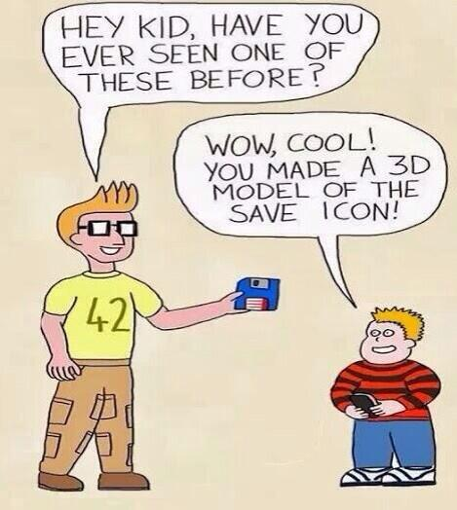
Other UI Issues
Kinds of users
Heuristics
UI Guidelines
Multicultural issues
Metaphors
Multiplatform software
Accessibility
Multimedia Interfaces

Slide 25
Design Tools

Slide 26
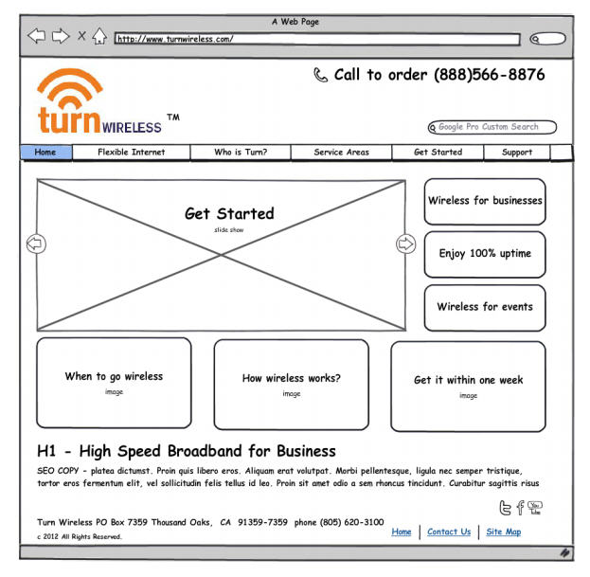
Design Tools
Low fidelity vs. high fidelity
Wire frames

Slide 27
Screen Flow

