Slide 1

Software Engineering Session: Sprint 6 Session 1 Instructor: Eric Pogue
Agenda:
Scaled Agile Product Roles
Scrum of Scrums Standup led by Jordon (Tyler) with product assistance from out new Product Manager Louie (Lorenzo)
Release Planning
Sprint 6 Backlog Grooming and Sprint Planning
Observations on Process and “Physics”
Recap - How did we get here?
Lab
 | Product Manager | Project Manager | Product Architect | UI Designer
Sprint 5 | Joe (Van Luyk) | Jordon (Elmer) | Quinn (Stratton) | Jace (Horner)
Sprint 6 | Louie (Lorenzo) | Tyler (Kummer) | Thad (Albert) | Michael (Pedzimaz)
Sprint 7 | Alex (Espinal) | Juan (Dasco) | Ryan (Clark) | Karol (Orszulak)

Slide 2
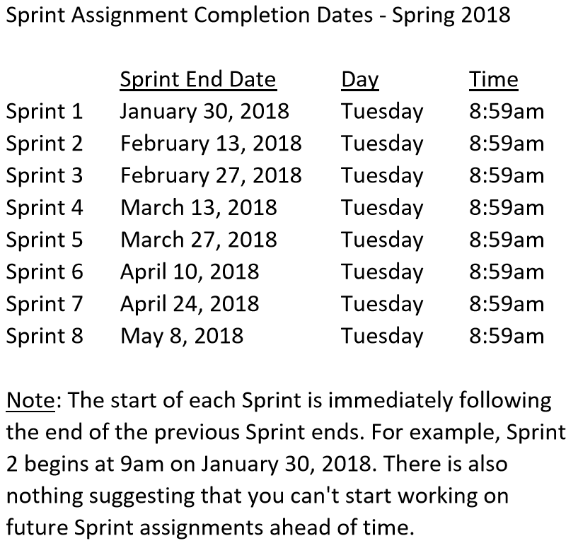

Slide 3
Sprint 5 Product Backlog
Complete midterm exam which is scheduled for Thursday, March 22 during the last 50 minutes of class
Complete and document Sprint 5 Metrics, Retrospective, Prepare and Review Sprint 6 Stories, and be prepared for Sprint 6 Planning on Tuesday, March 27
Complete Sprint 5 Assignment/Quiz
Deliver Sprint 5 User Stories that will allow your team to exceed “Klump” product specifications by the end of Sprint 6
Read and be prepared to discuss Chapter 9
Prepare and Groom Sprint 6 User Stories
Notes:
… the test questions will be similar to the questions from the Quizzes. The test will be limited to 50 minutes and you will not have access to notes or other resources.
As a Class commit each Team to research, discuss, and present at least one of the following topics:
Databases on Azure including “Azure tables vs Azure MongoDB vs Azure other DBs”**
Cloud/Azure based Authentication/Authorization services and who they could be integrated into a NodeJS based application*
JavaScript and NodeJS with a focus on Azure and including the best Internet based tutorials and/or books on the topic
SaaS Frameworks including “MEAN vs LAMP vs Ruby on Rails”
Service Oriented Architectures including “Web Services and SOAP/WSAD vs REST vs Sockets”
SaaS Client Frameworks including “HTML/JavaScript vs AngularJS vs Angular2 vs React vs others”
File Formats including “HTML vs XML vs JSON vs Key/Value Pair Text Files”

Slide 4
Team the “Klump” Product
Our “Klump” product should include:
Reading each team member’s “My Information” JSON files from each of their Personal Static Websites
Validating of JSON formats
Publishing the consolidated data to a simple HTML/JavaScript web page
Consolidating the data into a multi-person Class standard JSON format… note that to make the format simpler, we can limit roles to 3 roles (role1, role2, and role3)… Product Architect to lead
Publishing the consolidated data to a Web Service that returns the standard multi-person JSON format
Include current time and last time each individuals information was last updated in the multi-person JSON response
Testing mode to validate and report JSON formatting errors
Implement 30 minute caching and forced refresh
Solid Development (each team member), Test (team), and Production sites (team)
Notes:
As a Class commit each Team to research, discuss, and present at least one of the following topics:
Databases on Azure including “Azure tables vs Azure MongoDB vs Azure other DBs”**
Cloud/Azure based Authentication/Authorization services and who they could be integrated into a NodeJS based application*
JavaScript and NodeJS with a focus on Azure and including the best Internet based tutorials and/or books on the topic
SaaS Frameworks including “MEAN vs LAMP vs Ruby on Rails”
Service Oriented Architectures including “Web Services and SOAP/WSAD vs REST vs Sockets”
SaaS Client Frameworks including “HTML/JavaScript vs AngularJS vs Angular2 vs React vs others”
File Formats including “HTML vs XML vs JSON vs Key/Value Pair Text Files”

Slide 5
Scrum-of-Scrums Report-out
The “daily” scrum meeting is not used as a problem-solving or issue resolution meeting. Issues that are raised are taken offline and usually dealt with by the relevant subgroup immediately after the meeting. During the daily scrum, each team member answers the following three questions:
What did you do since our last standup?
What will you do before our next standup?
Are there any impediments in your way that you need help from outside the team to resolve?

Slide 6
Release/PSI Planning
Notes:
Who will volunteer to bring us a “Friendly Conversation” topic Thursday?

Slide 7
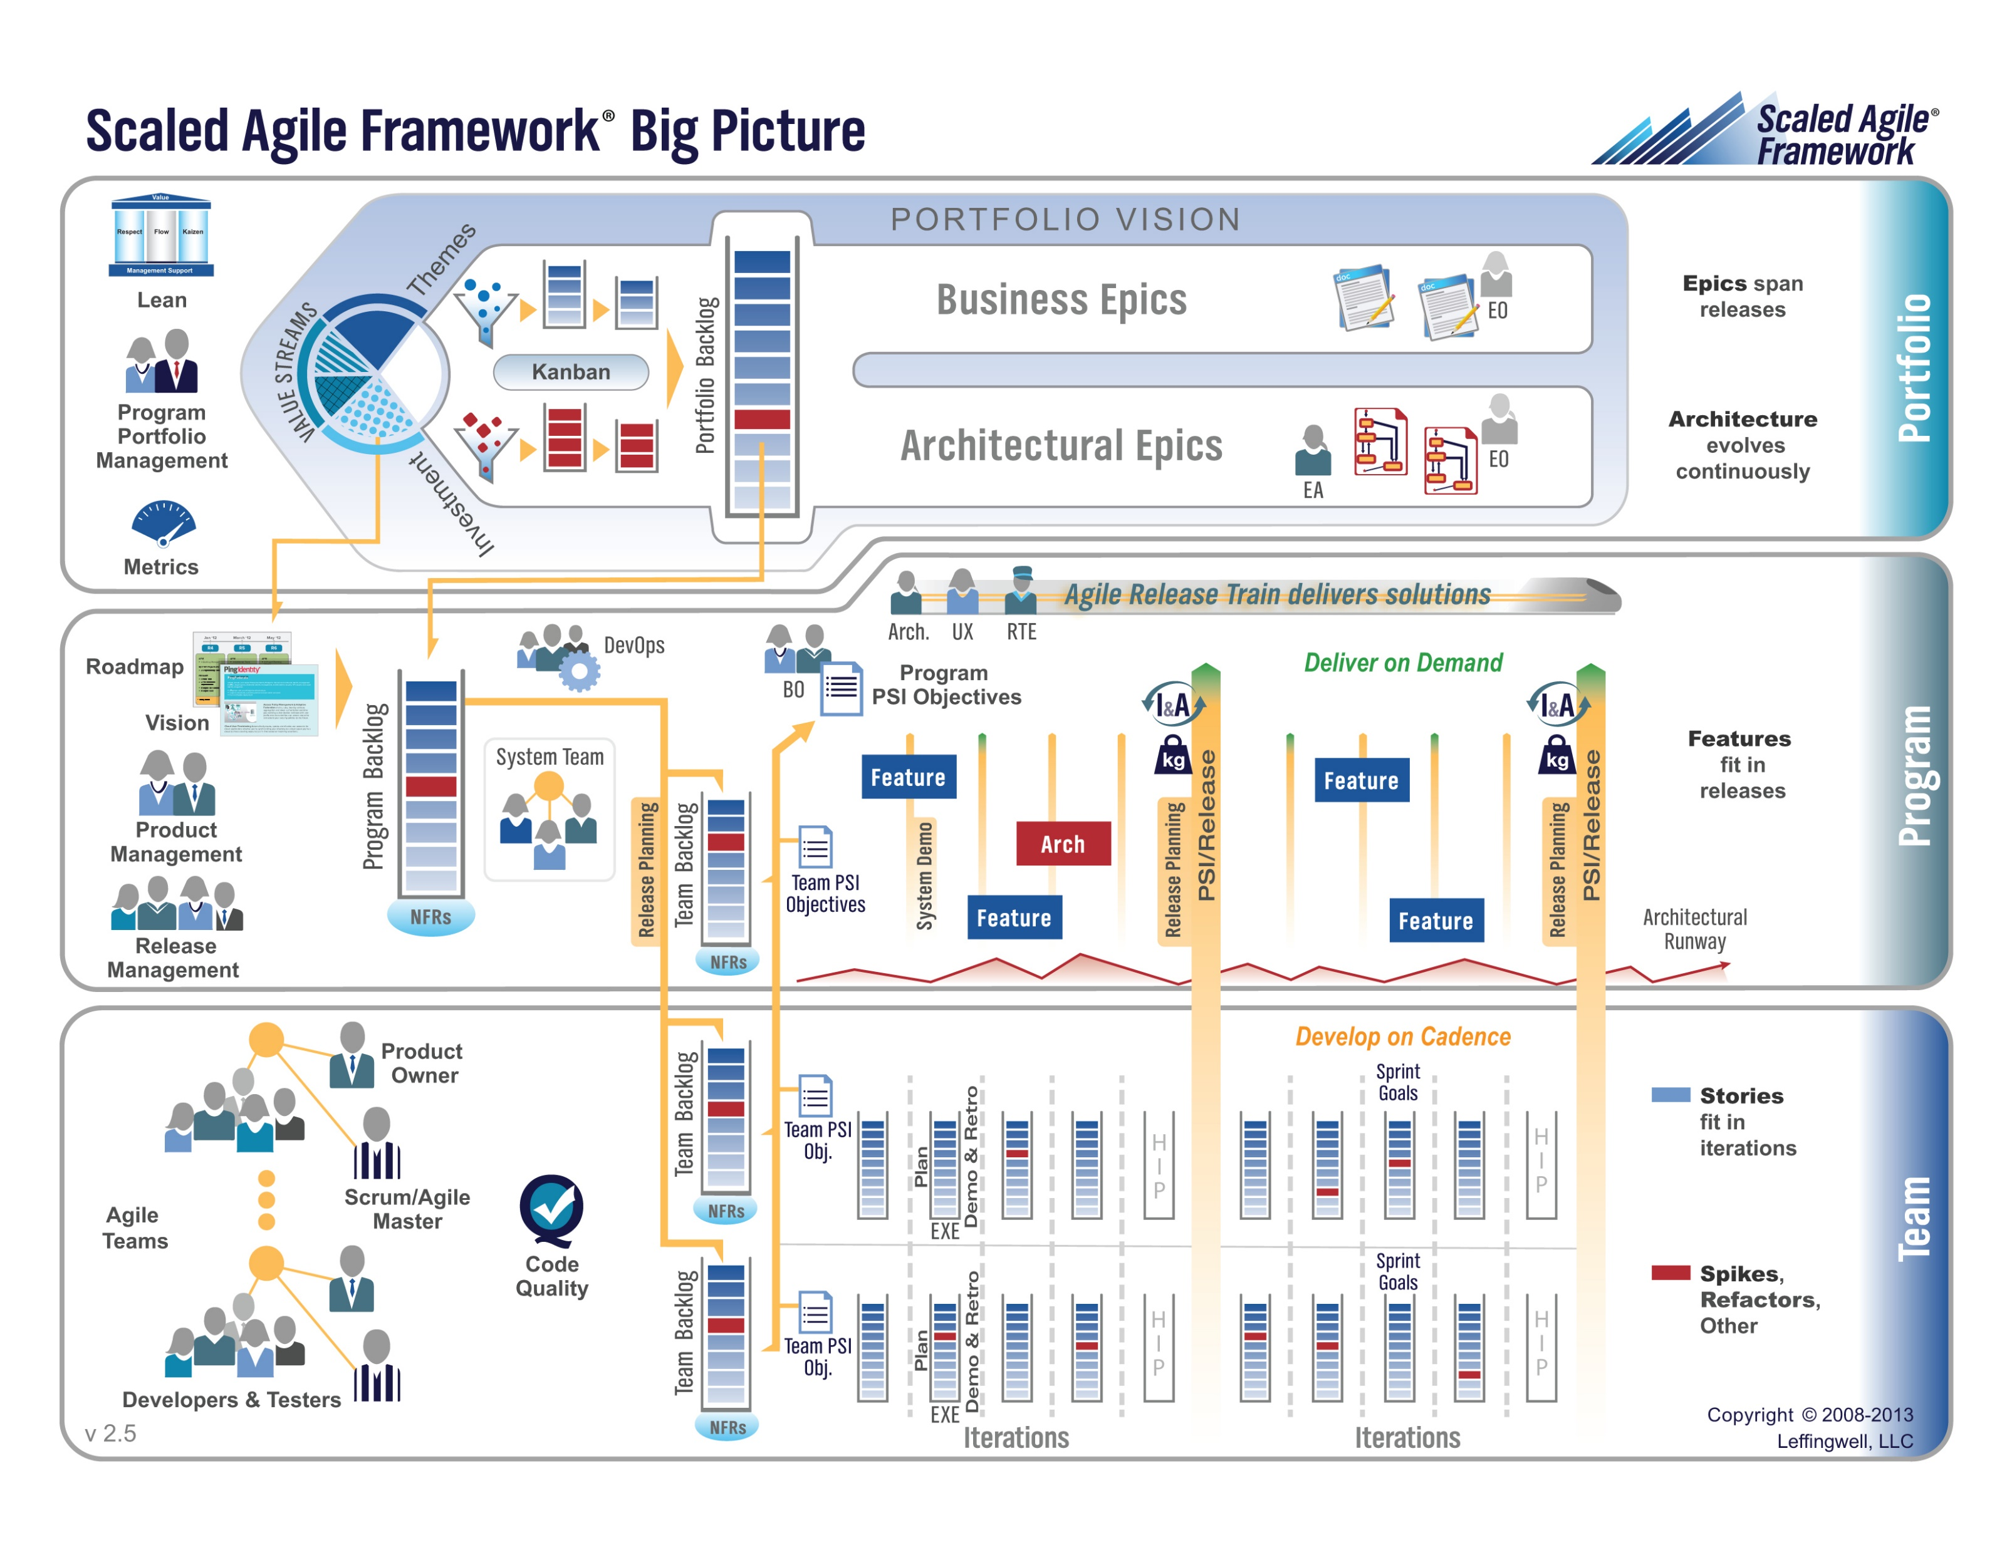

Slide 8
Release – Seating Chart
Release – Final Project(s)

Slide 9
Sprint 6 Backlog Grooming & Sprint 6 Planning
Notes:
Who will volunteer to bring us a “Friendly Conversation” topic Thursday?

Slide 10
Sprint 6 Product Backlog
Verifiably complete all Agile Rituals and Metrics including at least one team level metric
Deliver User Stories that will complete the Klump product by exceeding specifications by the end of this Sprint… this will need to include testing and deployment to your test and production sites
Prepare a Presentation of your Klump product implementation to be delivered by 1 or 2 team members on 12 April
Complete Sprint 6 Assignment
Prepare a Demo of your team’s Stories and Story management method to be delivered by 1 or 2 team members on 10 April
Prepare for Sprint 7 by preparing a proposal for a final project. The final project can be team level or up to three teams working together.
Read and be prepared to discuss Chapter 10
Important Note: You will need to scope that backlog items associated with #2 so that you will be able to complete at least through backlog item #5. I will be grading Klump based on (1) a functioning product, (2) feature complete, (3) quality of implementation.
Notes:
… the test questions will be similar to the questions from the Quizzes. The test will be limited to 50 minutes and you will not have access to notes or other resources.
As a Class commit each Team to research, discuss, and present at least one of the following topics:
Databases on Azure including “Azure tables vs Azure MongoDB vs Azure other DBs”**
Cloud/Azure based Authentication/Authorization services and who they could be integrated into a NodeJS based application*
JavaScript and NodeJS with a focus on Azure and including the best Internet based tutorials and/or books on the topic
SaaS Frameworks including “MEAN vs LAMP vs Ruby on Rails”
Service Oriented Architectures including “Web Services and SOAP/WSAD vs REST vs Sockets”
SaaS Client Frameworks including “HTML/JavaScript vs AngularJS vs Angular2 vs React vs others”
File Formats including “HTML vs XML vs JSON vs Key/Value Pair Text Files”

Slide 11
Team the “Klump” Product
Our “Klump” product should include:
Reading each team member’s “My Information” JSON files from each of their Personal Static Websites
Validating of JSON formats
Publishing the consolidated data to a simple HTML/JavaScript web page
Consolidating the data into a multi-person Class standard JSON format… note that to make the format simpler, we can limit roles to 3 roles (role1, role2, and role3)… Product Architect to lead
Publishing the consolidated data to a Web Service that returns the standard multi-person JSON format
Include current time and last time each individuals information was last updated in the multi-person JSON response
Testing mode to validate and report JSON formatting errors
Implement 30 minute caching and forced refresh
Solid Development (each team member), Test (team), and Production sites (team)
Notes:
As a Class commit each Team to research, discuss, and present at least one of the following topics:
Databases on Azure including “Azure tables vs Azure MongoDB vs Azure other DBs”**
Cloud/Azure based Authentication/Authorization services and who they could be integrated into a NodeJS based application*
JavaScript and NodeJS with a focus on Azure and including the best Internet based tutorials and/or books on the topic
SaaS Frameworks including “MEAN vs LAMP vs Ruby on Rails”
Service Oriented Architectures including “Web Services and SOAP/WSAD vs REST vs Sockets”
SaaS Client Frameworks including “HTML/JavaScript vs AngularJS vs Angular2 vs React vs others”
File Formats including “HTML vs XML vs JSON vs Key/Value Pair Text Files”

Slide 12
Observation
Notes:
Who will volunteer to bring us a “Friendly Conversation” topic Thursday?

Slide 13
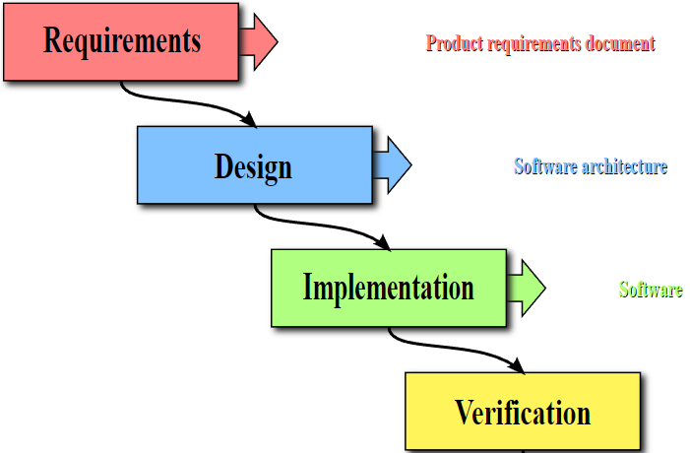
40%
50%
60%
50%
Notes:
The process encourages the promotion of whatever activities/skills a given group or individual possesses

Slide 14
15%
85%
Notes:
The physics of getting work done help the team(s) self organize/optimize

Slide 15
Recap – How did we get here?
Notes:
Who will volunteer to bring us a “Friendly Conversation” topic Thursday?

Slide 16
Today’s “Friendly Conversation” topic… ~3-5min
Agile Manifesto
“We are uncovering better ways of developing software by doing it and helping others do it. Through this work we have come to value:
Individuals and interactions over processes and tools
Working software over comprehensive documentation
Customer collaboration over contract negotiation
Responding to change over following a plan
That is, while there is value in the items on the right, we value the items on the left more.”
Notes:
This was kind of “hippy-ish” and egalitarian in its day… quite controversial in its day (2001)
“Everyone is a team member and is responsible for the work getting done”… we don’t need no titles or positions… self-organizing… we will make our own commitments… transparency (let’s share the information)… flexible/organic teams, organic architecture (minimal documentation/standards)… no contracts (let’s talk it over)
The flip side:
We will actively and voluntarily play important roles on our team
The rules (rituals) that we do have… we WILL follow
We will create, demo, and release working software/products
We will utilize practical processes, tools, documentation, and planning
When we make commitments, we will live up to those commitments… as a team (“No winners on a losing team, and no losers on a winning team”)
We will be responsive and continuously improve (Retrospectives)
We will be transparent with how WE work and share our information

Slide 17
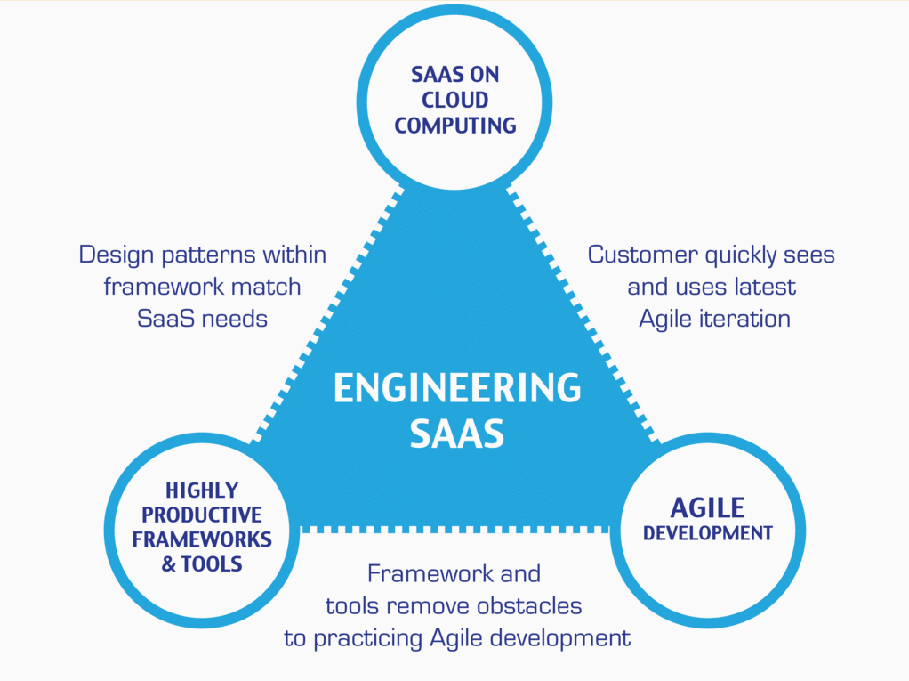
…And the Virtuous Triangle
Hosting Technology: Cloud, Scriptable Infrastructure, Software as a Service (SaaS)…
People: Teams, Optimism, Engagement, Ambition, Dedication, Leadership, Skills, Experience, Domain Knowledge…
Process: Agile, Portfolio Management, Project Management, Funding, Prioritization, Metrics…
Productivity Technology: Configuration Management, Source Code Management, Automated Testing…

Slide 18
Lab
Notes:
Who will volunteer to bring us a “Friendly Conversation” topic Thursday?

Slide 19
End of Session

