Slide 1
Summary
Track & Report production defects for 30 days after production release by criticality
Normalize by project size (100 hours suggested)… future function points, use case points, or story points
Note that Criticality is different from Severity
John Deere

Slide 2
Topics
Data:
Release Date (global project data)
Project Size in hours worked (global project data)
Defects by Criticality
Metrics Reported:
Weighted defect score per 100 hours worked (first 30 days)
Critical defects per 100 hours worked (first 30 days)
John Deere

Slide 3
Definitions
Defect:
“An instance of failure to conform to specifications.”
Severity:
“The classification of defect based on its degree of impact on the development or operation of a system.”
Priority:
“A subjective evaluation of how fast a defect needs to be corrected, based on other tasks in the queue and the current schedule.”
It is usually a business partner decision.
Undocumented or changed specifications are not considered as defects. It is important that all specifications are documented and approved by the project sponsor
John Deere

Slide 4
Options That were Considered
1
2
3
Levels | Severity | Linear Weights
1 | TRIVIAL | 1
2 | LOW | 2
3 | MEDIUM | 3
4 | HIGH | 4
5 | CRITICAL | 5
Levels | Severity | Linear Weights
1 | TRIVIAL/LOW | 1
2 | MEDIUM | 2
3 | HIGH | 3
4 | CRITICAL | 4
Levels | Severity | Linear Weights
1 | LOW | 1
2 | MEDIUM | 2
3 | CRITICAL | 3
4
5
6
Levels | Severity | Fibonacci Weights
1 | TRIVIAL | 1
2 | LOW | 2
3 | MEDIUM | 3
4 | HIGH | 5
5 | CRITICAL | 8
Levels | Severity | Fibonacci Weights
1 | TRIVIAL/LOW | 1
2 | MEDIUM | 2
3 | HIGH | 3
4 | CRITICAL | 5
Levels | Severity | Weights
1 | LOW | 1
2 | MEDIUM | 3
3 | CRITICAL | 6
John Deere

Slide 5
Defect Severity Weights
Fibonacci weights are used to normalize the severity of defects
Levels | Severity | Fibonacci Weights
1 | TRIVIAL | 1
2 | LOW | 2
3 | MEDIUM | 3
4 | HIGH | 5
5 | CRITICAL | 8
In other words, one critical defect equals to eight trivial defects and so on.
John Deere

Slide 6
Severity Levels of a Defect
1 | TRIVIAL | The defect is the result of non-conformance to a style standard or related to the aesthetics of the system
2 | LOW | The defect does not cause a failure, nor does impair usability
3 | MEDIUM | The defect does not result in a failure, but causes the system to produce incorrect, incomplete, or inconsistent results impairing the system’s usability.
4 | HIGH | The defect causes severely impaired functionality of the system.
5 | CRITICAL | The defect causes the failure of the complete software system, or of a subsystem, or of a software unit within the system.
John Deere

Slide 7
Severity Levels of a Defect – Real Examples
1 | TRIVIAL | Label on equipment record needs to be changed from "War Exp" to "Warr Exp“.
2 | LOW | The text from the message body of a message should wrap so that the user doesn't need to scroll all the way across the screen to read the whole section of text.
3 | MEDIUM | The user successfully added customer, but then when doing a search on the customer's last name, the customer was not found
4 | HIGH | User searches on a customer, customer was returned, but when the user tried to view customer details, a null exception error was displayed.
5 | CRITICAL | No Customers could log into the system - Page cannot be found. Database might have crashed.
John Deere

Slide 8

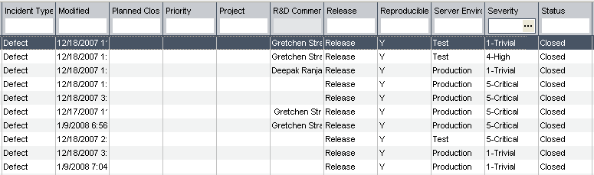
Where?
In Quality Center!
The Quality Center field “Severity” should be used to classify defects
John Deere

Slide 9
Criticality vs. Priority
John Deere

Slide 10
Priority Levels of a Defect
1 | LOW
2 | MEDIUM
3 | HIGH
4 | VERY HIGH
5 | URGENT
‘Priority’ determines the order in which defects are evaluated, resolved, and closed
Defect priority levels are used with severity categories to determine the immediacy of repair.
John Deere

Slide 11
Who Assigns Severity?
The project manager, with the input from team and business partners, will have the authority to assign severity levels to defects
The project manager should consider both system impact and business impact factors before severity has been assigned
If the project manager and the business partner do not agree on severity of a particular defect, the project manager should use his/her negotiation skills to reach consensus
John Deere

Slide 12
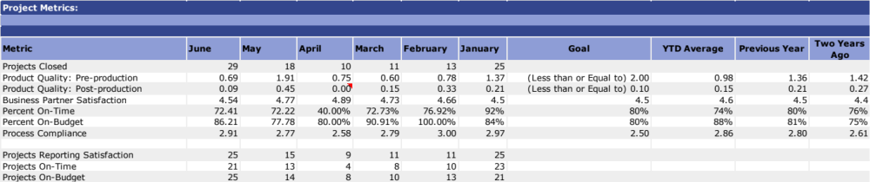
Example Metric
John Deere

Slide 13
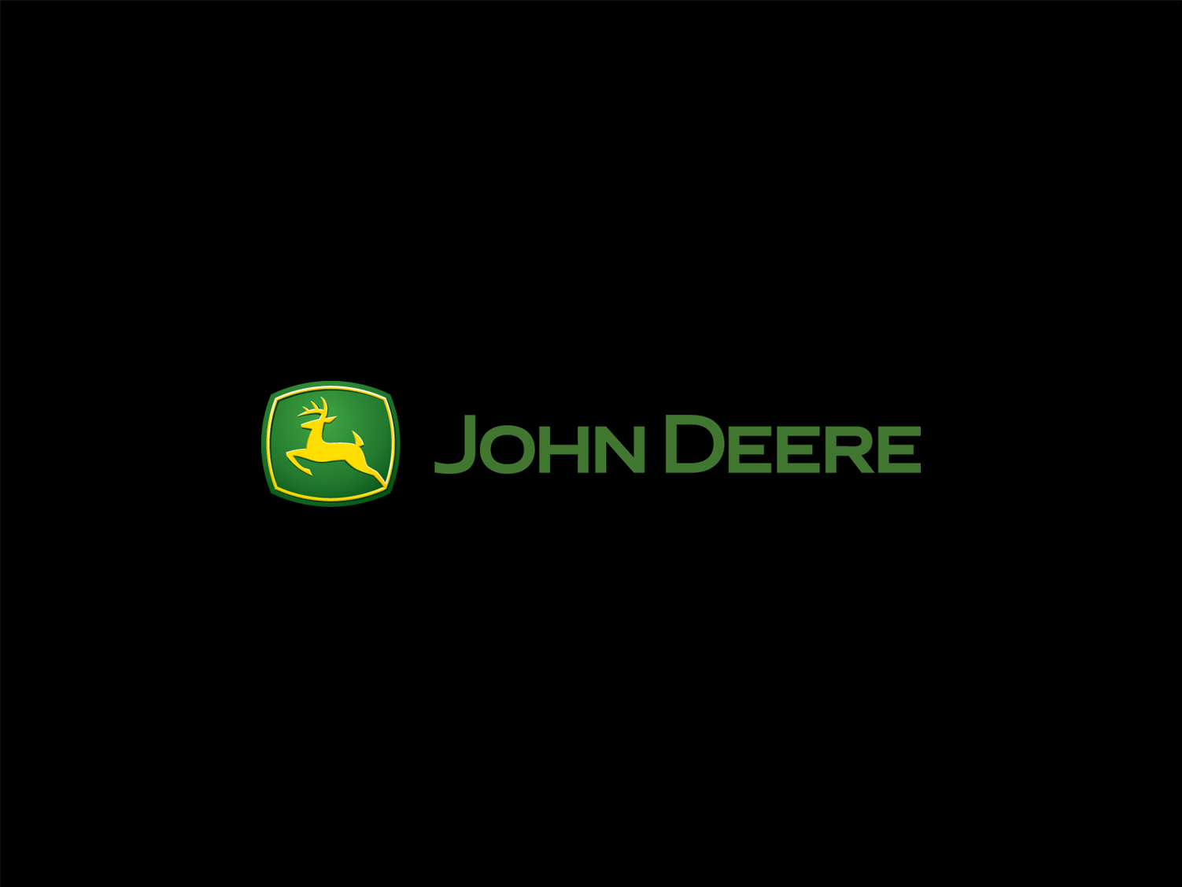

Slide 14
System Impact Vs. Customer Impact
System Impact:
It is the impact of the defect from development team’s perspective
Business Impact:
It is the impact of the defect from business partner’s perspective
SYSTEM IMPACT
Business IMPACT
SEVERITY
John Deere

