Slide 1

Class Session Check List
Everyone:
Sign into our Zoom meeting through our integrated Blackboard/Zoom link
Make sure that you can hear the conversation, see shared desktops, and view group chat topics
You will need a headset with a microphone to be able to effectively listen and speak
You will need to be able to share your computer screen
Thank you if you choose to leave your camera on to help make our class more interactive
In person participants also:
Make sure that your microphone and speakers are muted/off so that we don’t get an echo
Sit in a good spot near the classroom ceiling microphones if possible

Slide 2
Class Session Check List
Review that recordings are:
Opportunistic
Automatically available within Blackboard/Zoom
… Now make sure that the classroom microphone, speakers, and camera are being used in Zoom, move to the next slide, AND verify that recording is started.
… Also make sure that slides are visible to attendees

Slide 3
Agenda:
Friendly Conversation Topic – The Agile Manifesto Flip Side
Prework and Announcements
Foreshadowing Sprint Demos
Sprint Retrospectives
Prework for Next Class
Sprint 1 Assignments
Discussion & Questions welcome at any time but please be present with no phones or email during our time together

Slide 4
Recall The Agile Manifesto
“We are uncovering better ways of developing software by doing it and helping others do it. Through this work we have come to value:
Individuals and interactions over processes and tools
Working software over comprehensive documentation
Customer collaboration over contract negotiation
Responding to change over following a plan
That is, while there is value in the items on the right, we value the items on the left more.”
Notes:
This was kind of “hippy-ish” and egalitarian in its day… quite controversial in its day
“Everyone is a team member and is responsible for the work getting done”… we don’t need no titles or positions… self-organizing… we will make our own commitments… transparency (let’s share the information)… flexible/organic teams, organic architecture (minimal documentation/standards)… no contracts (let’s talk it over)
The flip side:
We will actively and voluntarily play important roles on our team
The rules (rituals) that we do have… we WILL follow
We will create, demo, and release working software/products
We will utilize practical processes, tools, documentation, and planning
When we make commitments, we will live up to those commitments… as a team (“No winners on a losing team, and no losers on a winning team”)
We will be responsive and continuously improve (Retrospectives)
We will be transparent with how WE work and share our information

Slide 5
The Agile Manifesto – The Flip Side
At fist glance The Agile Manifesto is very development team centric. However, successful agile are expected to make important commitments as well:
The rules (rituals) that we do have… we WILL follow
When we make commitments, we will live up to those commitments as a team (“No winners on a losing team, and no losers on a winning team”)
We will create, demo, and release working software/products
We will actively and voluntarily play important roles on our team
We will utilize practical processes, tools, documentation, and planning
We will be responsive and continuously improve (Retrospectives)
We will be transparent with how WE work and share our information

Slide 6
Prework & Announcements
Before class today we were anticipating that we would be able to:
Everything is due Sunday!
Prior to our next class please:
Be prepared to continue work on sprint 1 assignments focusing on Lab 1

Slide 7
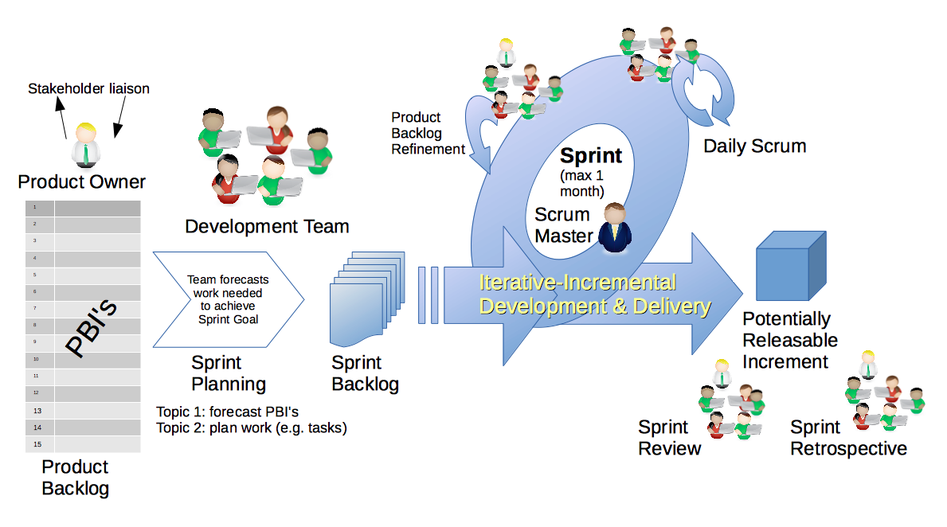
Scrum Process – Sprint Review & Demo
By Dr ian mitchell - Own work, CC BY-SA 4.0, Link

Slide 8

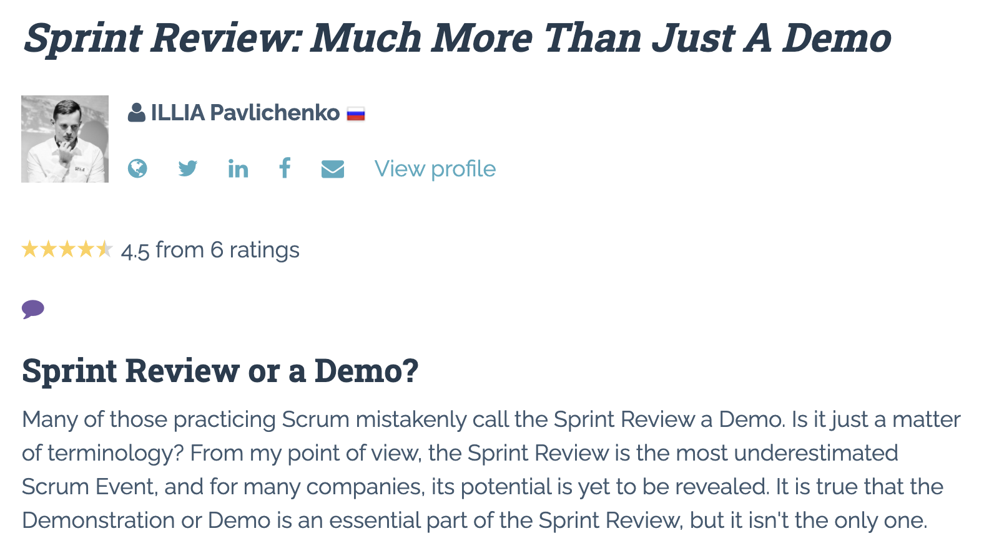

Slide 9
Demo Guidelines – Presenter
Everyone will give at least one demo of their work during the semester.
Your demo should be 2 to 5 minutes and can include any or all of the following:
Show your application running
Comment on your implementation
Show the source code
Explain how you organized the code
Talk about any challenges
You should not prepare slides or a presentation
**You will also need to complete the Demo assignment in Blackboard.

Slide 10
Demo Guidelines – Listener
Everyone will be listening to many demos during the semester.
Your listener responsibilities include:
Actively listening and watching what is being demoed
Come up with a meaningful yet easy to answer question
Ask your question if the presenter does not get sufficient questions from other listeners
Do not ask hard question or attempt to review the presenters code
Clap for the presenter at the end of the demo and thank them for presenting
Optionally follow up with the presenter later if you have what could be more difficult questions or if you have suggestions

Slide 11
Review Demo Schedule

Slide 12
Scrum Process – Sprint Retrospective
By Dr ian mitchell - Own work, CC BY-SA 4.0, Link

Slide 13
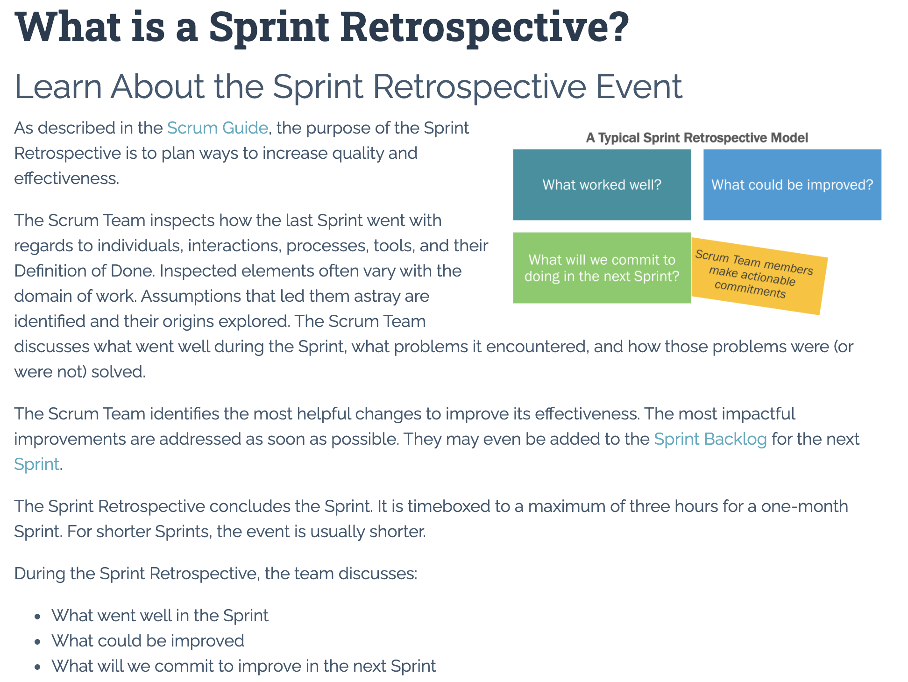

Slide 14
Scrum Team Chapter Review
Scrum Master accepts volunteers for (or assigns) Presenter
Team discusses and presenter summarizes the following topics:
On a scale of 1 to 10 how effective were chapters 1-6 of “Introducing Go”
Did you have a change to look at the tutorials on at golang.org? Thoughts?
Team sits back, relaxes, and acknowledges the bravery and dedication of the presenter
Team returns to class Zoom session where presenter presents summary

Slide 15
Prework For Next Class
Everything is due Sunday!
Be prepared for Sprint 1 Demos, Sprint 1 Retrospective, and Sprint 2 Planning next class.

Slide 16
Lab
How can we utilize our remaining time today to effectively complete our sprint 1 assignments?
Topics:
Blackboard Ultra quiz fields and copy/paste issues
Current sprint 1 assignment submissions
Discussion Board 1
Notes:
Quiz topics?

Slide 17
End of Session

