Slide 1

Class Session Check List
Everyone:
Sign into our Zoom meeting through our integrated Blackboard/Zoom link
Make sure that you can hear the conversation, see shared desktops, and view group chat topics
You will need a headset with a microphone to be able to effectively listen and speak
You will need to be able to share your computer screen
Thank you if you choose to leave your camera on to help make our class more interactive
In person participants also:
Make sure that your microphone and speakers are muted/off so that we don’t get an echo
Sit in a good spot near the classroom ceiling microphones if possible

Slide 2
Class Session Check List
Review that recordings are:
Opportunistic
Automatically available within Blackboard/Zoom
… Now make sure that the classroom microphone, speakers, and camera are being used in Zoom, move to the next slide, AND verify that recording is started.
… Also make sure that slides are visible to attendees

Slide 3
Agenda:
Prework and Announcements
Foreshadowing Sprint Demos
Sprint Retrospective
Scrum Team Discussion of Fox Chapter 2 and Fox Preface (continued)
Graduation Application Reminder
Prework for Next Class
Lab
Discussion & Questions welcome at any time but please be present with no phones or email during our time together

Slide 4
Prework & Announcements
Before class today we were anticipating that we would be able to:
Everything is due Sunday!
Prior to our next class please:
Be prepared to continue work on Lab 1

Slide 5
Foreshadowing Sprint Demos

Slide 6
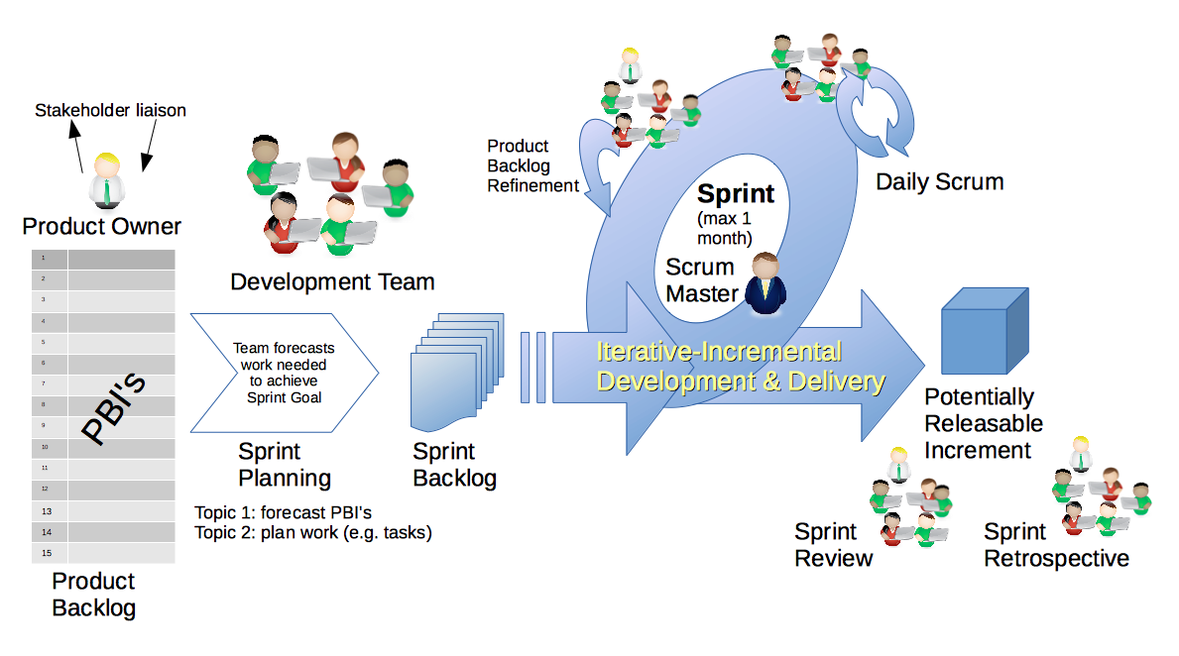
Scrum Process – Sprint Review & Demo
By Dr ian mitchell - Own work, CC BY-SA 4.0, Link

Slide 7

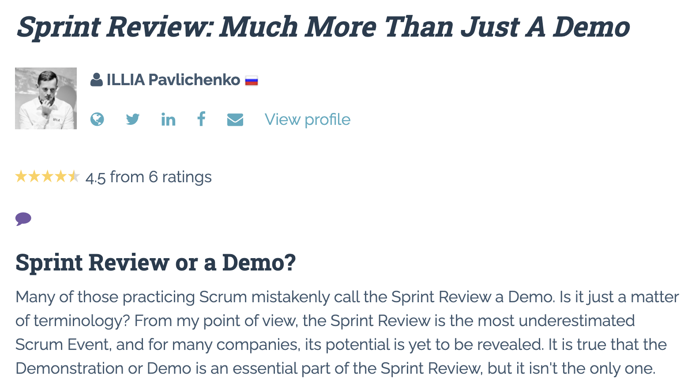

Slide 8
Demo Guidelines – Presenter
Everyone will give at least one demo of their work during the semester.
Your demo should be 2 to 5 minutes and can include any or all of the following:
Show your application running
Comment on your implementation
Show the source code
Explain how you organized the code
Talk about any challenges
You should not prepare slides or a presentation
**You will also need to complete the Demo assignment in Blackboard.

Slide 9
Demo Guidelines – Listener
Everyone will be listening to many demos during the semester.
Your listener responsibilities include:
Actively listening and watching what is being demoed
Come up with a meaningful yet easy to answer question
Ask your question if the presenter does not get sufficient questions from other listeners
Do not ask hard question or attempt to review the presenters code
Clap for the presenter at the end of the demo and thank them for presenting
Optionally follow up with the presenter later if you have what could be more difficult questions or if you have suggestions

Slide 10
Review Demo Schedule

Slide 11
Scrum Process – Sprint Retrospective
By Dr ian mitchell - Own work, CC BY-SA 4.0, Link

Slide 12
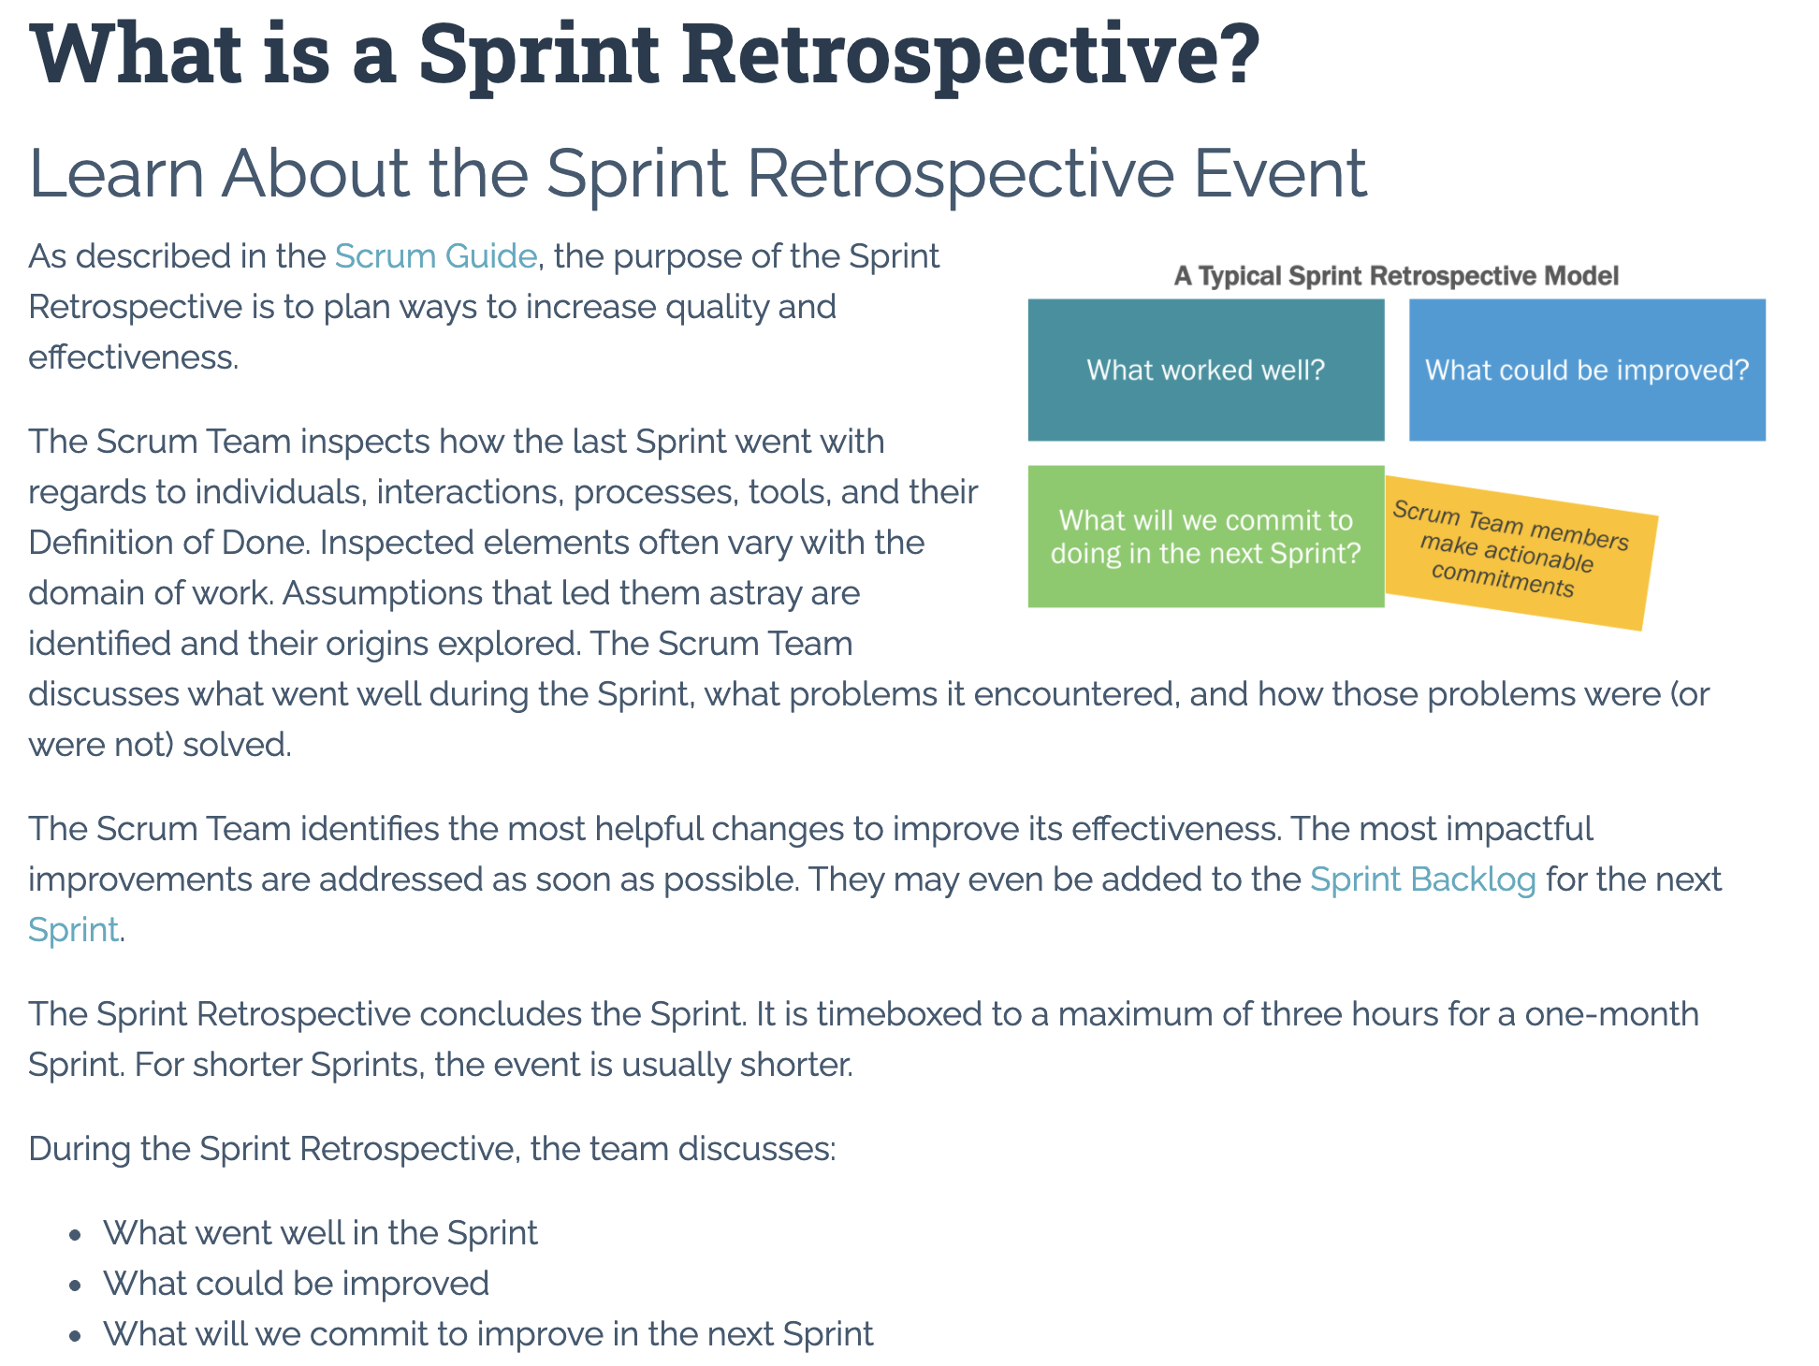

Slide 13
Scrum Team Fox Chapter 2 plus Preface Discussion
Scrum Master accepts volunteers for (or assigns) Presenter
Team discusses and presenter summarizes the topics from Chapter 2 including:
SaaS Architecture
The Authors’ SaaS Architecture
Our SaaS Architecture
Model-View-Controller
REST
Team sits back, relaxes, and acknowledges the bravery and dedication of the presenter
Team returns to class Zoom session where presenter presents summary

Slide 14
Architecture and Tool Choices
There are many very good Language / Framework / Hosting options available including:
Ruby / Rails / Rack
JavaScript / Express / Node.js
Java / Spring / Tomcat
.NET / ASP.NET / IIS (Internet Information Services)
We will be focusing on the JavaScript / Express / Node.js combination with the possible addition of Bootstrap and TypeScript.

Slide 15
Cloud Hosting Choices
There are also many very good cloud hosting services available including:
Amazon AWS
Microsoft Azure
Google App Engine
cloud9
GoDaddy
We will be focusing on the Microsoft Azure.

Slide 16
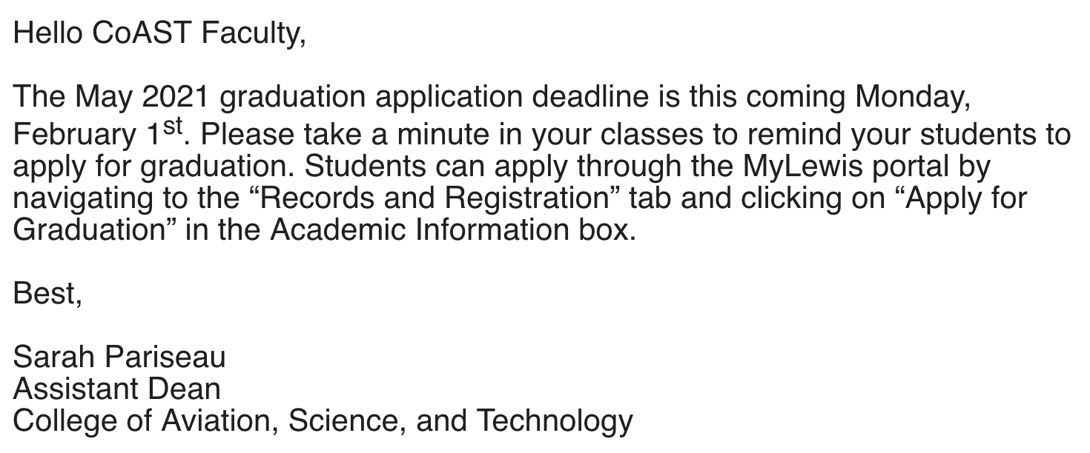

Slide 17
Prework For Next Class
Everything is due Sunday!
Be prepared for Sprint 1 Demos, Sprint 1 Retrospective, and Sprint 2 Planning next class.

Slide 18
Lab
How can we utilize our remaining time today to effectively complete our sprint 1 assignments?
Topics:
Blackboard Ultra quiz fields and copy/paste issues
Current sprint 1 assignment submissions
Discussion Board 1

Slide 19
End of Session

