Slide 1

Class Session Check List
Everyone:
Sign into our Zoom meeting through our integrated Blackboard/Zoom link
Make sure that you can hear the conversation, see shared desktops, and view group chat topics
You will need a headset with a microphone to be able to effectively listen and speak
You will need to be able to share your computer screen
Thank you if you choose to leave your camera on to help make our class more interactive
In person participants also:
Make sure that your microphone and speakers are muted/off so that we don’t get an echo
Sit in a good spot near the classroom ceiling microphones if possible

Slide 2
Attendance
Document in-person attendance for contact tracing.

Slide 3
Class Session Check List
Review that recordings are:
Opportunistic
Automatically available within Blackboard/Zoom
… Now make sure that the classroom microphone, speakers, and camera are being used in Zoom, move to the next slide, AND verify that recording is started.
… Also make sure that slides are visible to attendees

Slide 4
Agenda:
Prework and Announcements
Sprint 2 Planning
Prework for Next Class
Lab: Scrum Team Sprint 2 Planning Review
Discussion & Questions welcome at any time but please be present with no phones or email during our time together

Slide 5
Prework & Announcements
Everything is due Sunday!
Be prepared for Sprint 2 Planning Monday
Be prepared for Sprint 1 Demos, Sprint 1 Retrospective on Wednesday

Slide 6
Sprint Planning

Slide 7
Sprint Planning
Sprint 2 Changes:
Very similar to sprint 1 with sprint 2 including Discussion 2, Quiz 2, Lab 2, and Reflection 2
We will attempt our first Scrum Team Discussion on Friday
Should be a little easier since we are not missing the first Monday of the sprint

Slide 8
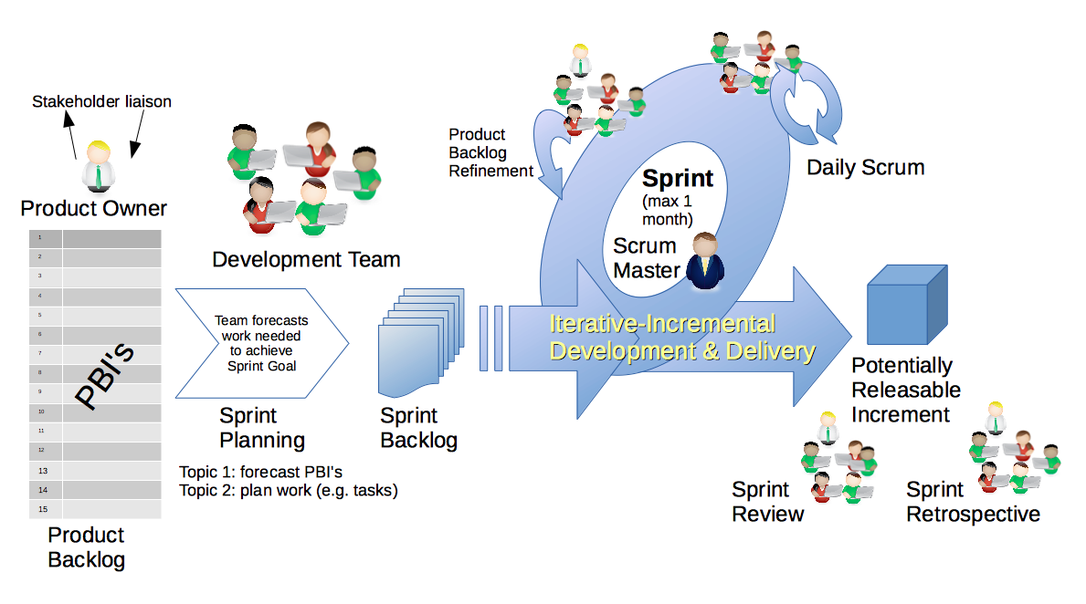
Scrum Process – Sprint Planning
By Dr ian mitchell - Own work, CC BY-SA 4.0, Link

Slide 9
Review Activities List and Assignments

Slide 10
Prework For Next Class
Complete through activity 5 prior to next class
Those scheduled to demo on Wednesday please be a couple of minutes early to class

Slide 11
Lab
As a scrum team:
Review sprint 2 activities & assignments in detail
Discuss and document questions/concerns
Scrum master share your team’s top 2 questions/concerns during report out

Slide 12
End of Session

