Slide 1

Class Session Check List
Everyone:
Sign into our Zoom meeting through our integrated Blackboard/Zoom link
Make sure that you can hear the conversation, see shared desktops, and view group chat topics
You will need a headset with a microphone to be able to effectively listen and speak
You will need to be able to share your computer screen
Thank you if you choose to leave your camera on to help make our class more interactive
In person participants also:
Make sure that your microphone and speakers are muted/off so that we don’t get an echo
Sit in a good spot near the classroom ceiling microphones if possible

Slide 2
Class Session Check List
Review that recordings are:
Opportunistic
Automatically available within Blackboard/Zoom
… Now make sure that the classroom microphone, speakers, and camera are being used in Zoom, move to the next slide, AND verify that recording is started.
… Also make sure that slides are visible to attendees

Slide 3
Agenda:
Prework and Announcements
Sprint 1 Demos
Sprint 1 Retrospective
Sprint 2 Planning
Prework for Next Class
Lab: Scrum Team Sprint 2 Planning Review
Discussion & Questions welcome at any time but please be present with no phones or email during our time together

Slide 4
Prework & Announcements
Everything is due Sunday!
Be prepared for Sprint 1 Demos, Sprint 1 Retrospective, and Sprint 2 Planning next class.

Slide 5
Sprint Demos

Slide 6
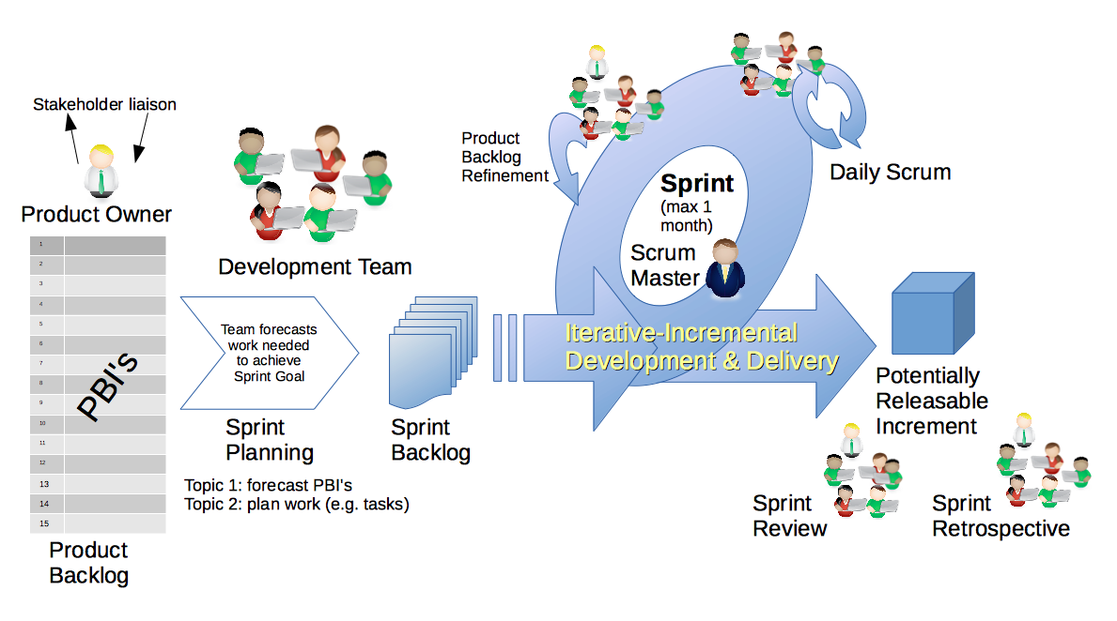
Scrum Process – Sprint Review & Demo
By Dr ian mitchell - Own work, CC BY-SA 4.0, Link

Slide 7
Demo Guidelines – Presenter
Everyone will give at least one demo of their work during the semester.
Your demo should be 2 to 5 minutes and can include any or all of the following:
Show your application running
Comment on your implementation
Show the source code
Explain how you organized the code
Talk about any challenges
You should not prepare slides or a presentation
**You will also need to complete the Demo assignment in Blackboard.

Slide 8
Demo Guidelines – Listener
Everyone will be listening to many demos during the semester.
Your listener responsibilities include:
Actively listening and watching what is being demoed
Come up with a meaningful yet easy to answer question
Ask your question if the presenter does not get sufficient questions from other listeners
Do not ask hard question or attempt to review the presenters code
Clap for the presenter at the end of the demo and thank them for presenting
Optionally follow up with the presenter later if you have what could be more difficult questions or if you have suggestions

Slide 9
Sprint Demos

Slide 10
Complete Sprint Demo Assignment

Slide 11
Scrum Process – Sprint Retrospective
By Dr ian mitchell - Own work, CC BY-SA 4.0, Link

Slide 12

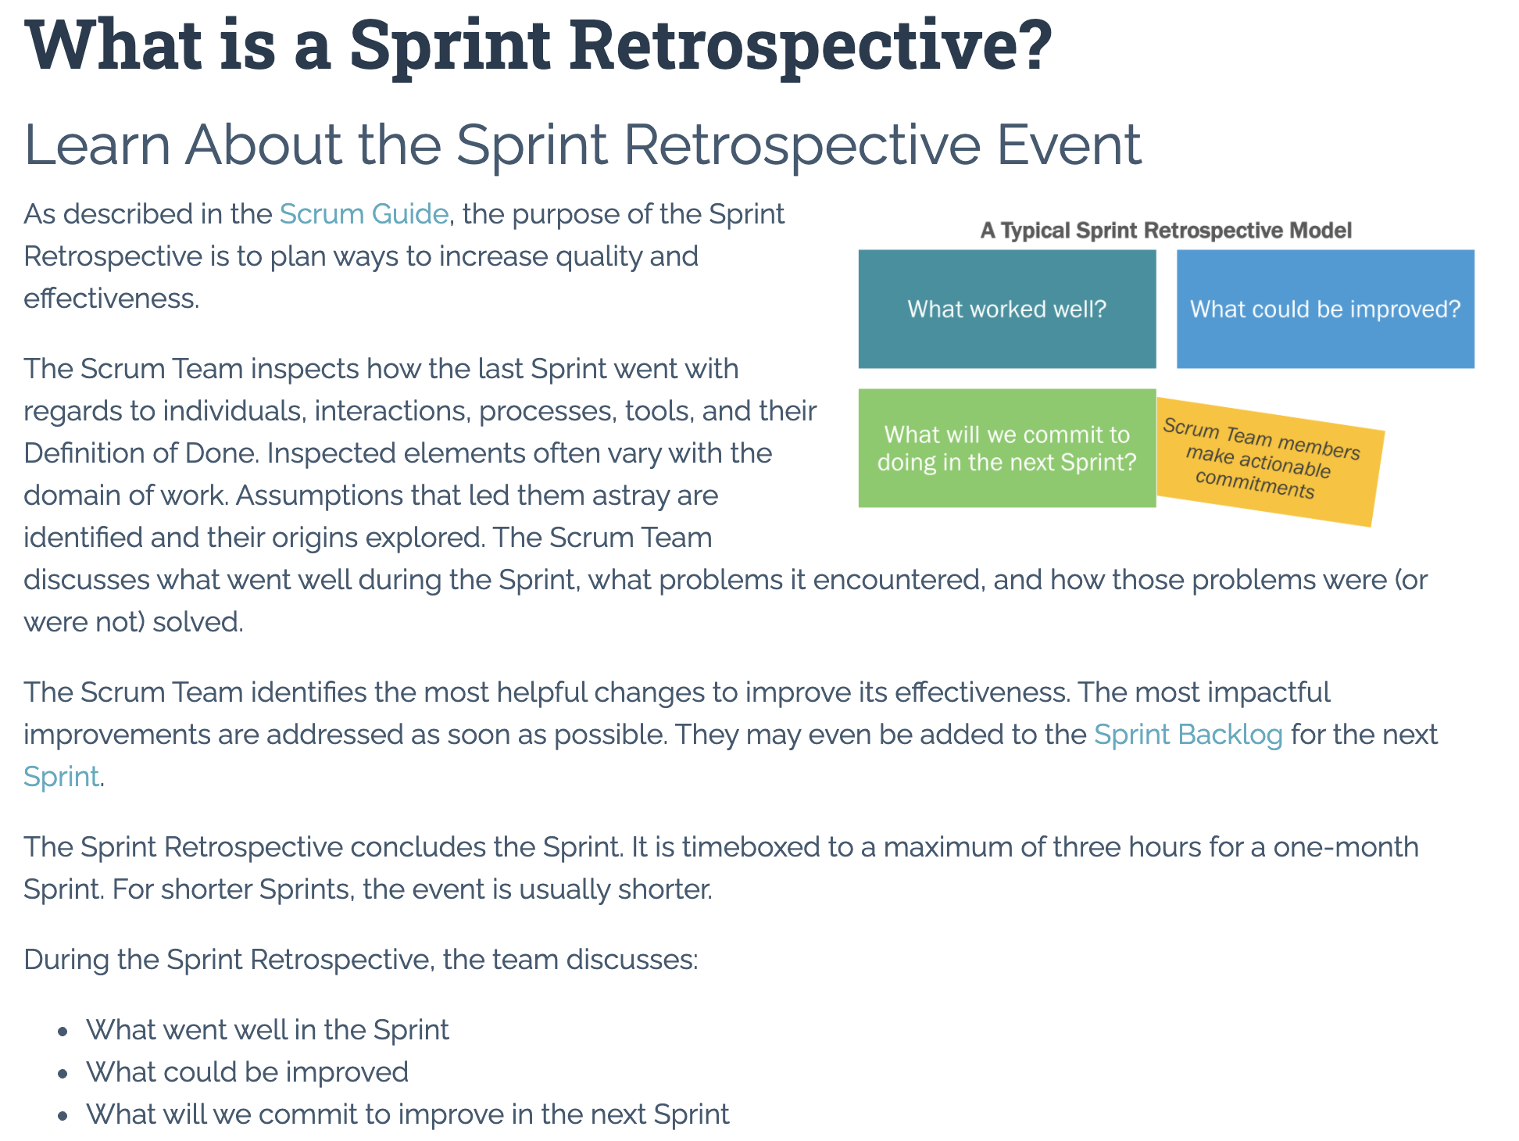

Slide 13
Submission Percentage

Slide 14
Class Retrospective
Feedback from Assignments & Reflections:
Solid job assignments turned in and turned in on time
Doesn’t feel very good that two of our missing assignments were labs
Discussion 1: Products have likely evolved their development processes over time
Discussion 1: Fixed bid contracted development seems to be the biggest challenge for Agile
Office 365 plus Azure are a nice but not required combination
What can I/we do to improve in sprint 2?
Scrum team discussions starting Thursday

Slide 15
Sprint Planning

Slide 16
Sprint Planning
Sprint 2 Changes:
Very similar to sprint 1 with sprint 2 including Discussion 2, Quiz 2, Lab 2, and Reflection 2
We will attempt our first scrum team discussion on Thursday

Slide 17
Scrum Process – Sprint Planning
By Dr ian mitchell - Own work, CC BY-SA 4.0, Link

Slide 18
Product Backlog vs Sprint Backlog

Slide 19
Scrum Process – Product Backlog to Sprint Backlog
By Dr ian mitchell - Own work, CC BY-SA 4.0, Link

Slide 20
Scrum Process – Sprint Planning
By Dr ian mitchell - Own work, CC BY-SA 4.0, Link

Slide 21
Review Activities List and Assignments

Slide 22
Prework For Next Class
Complete through activity 5 prior to next class
Be prepared for a scrum team discussion of chapter 6**
Be prepared for some programming together time focused on “Website Creation with GitHub and Microsoft Azure - 2020 Supplemental Edition”

Slide 23
Lab
As a scrum team:
Review sprint 2 activities & assignments in detail
Discuss questions/concerns and topics that need more clarification
Scrum master share your team’s top 2 questions/concerns during report out

Slide 24
End of Session

Slide 25
Backup & Future Slides

Slide 26
Binary & Text Files Review

Slide 27
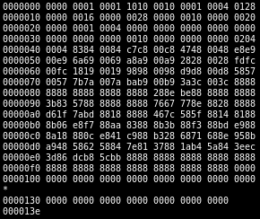
Files
All computer files are binary and can be represented in Hex notation
The term “binary file” is often used to imply that a file is a “non-text” file.

Slide 28
ASCII Text Files

Slide 29
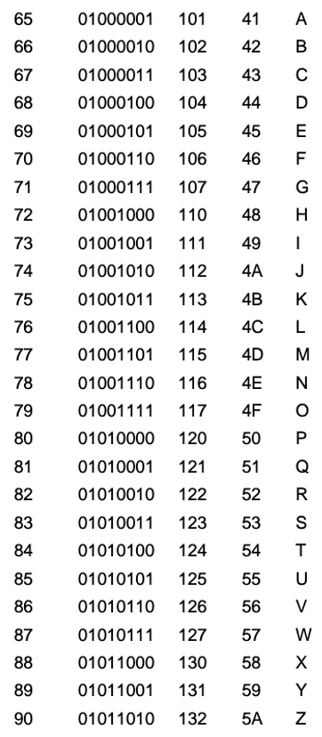
ASCII Files
Bytes are frequently used to hold individual characters in a text document. In the ASCII character set, each binary value between 0 and 127 is given a specific character. Most computers extend the ASCII character set to use the full range of 256 characters available in a byte. The upper 128 characters handle special things like accented characters from common foreign languages.

Slide 30
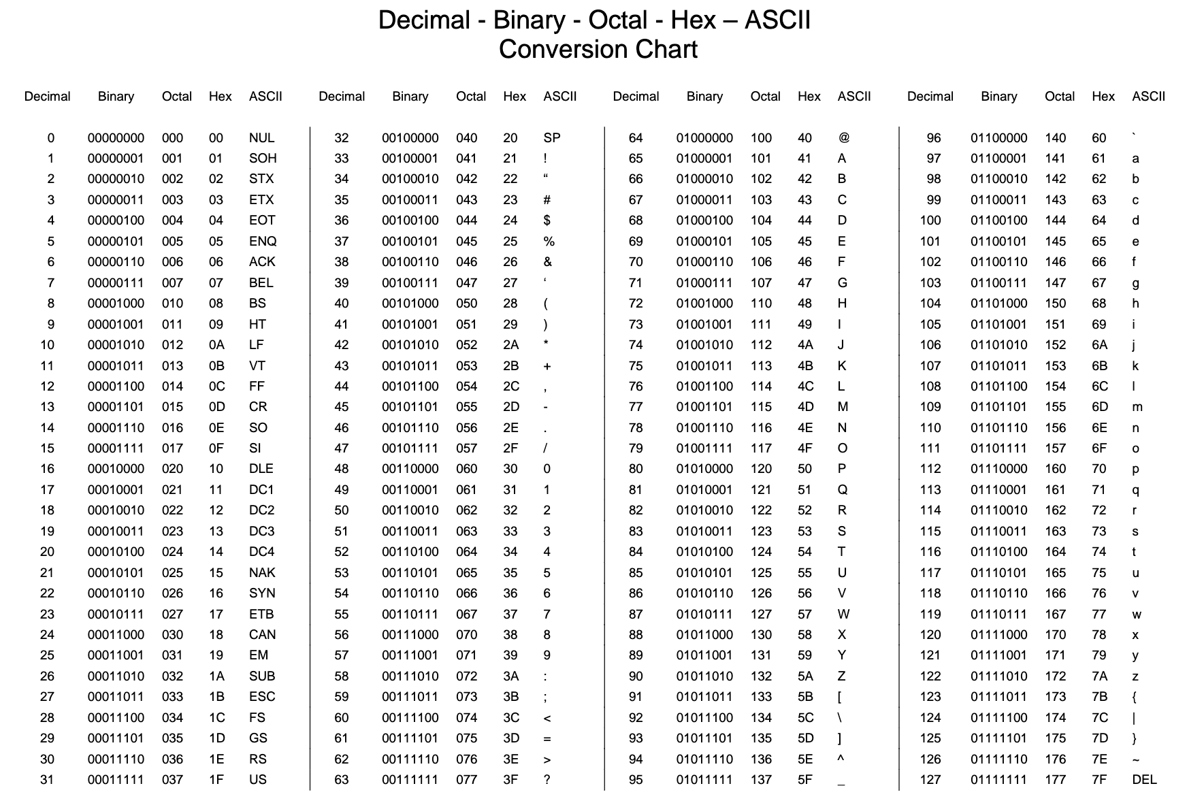

Slide 31
Unicode & UTF-16

Slide 32
Unicode & UTF-16
Unicode includes 65,536 possible combinations covering 154 modern and historical scripts, as well as multiple symbol sets [link]

Slide 33
UTF-8

Slide 34
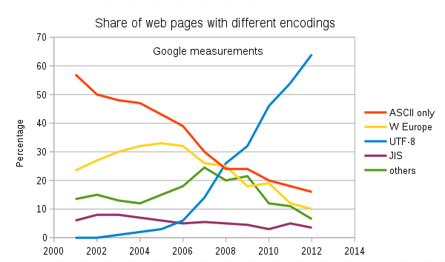
Text File Standards (Encoding)
ASCII
Unicode
UTF-8
Others

Slide 35
Text File End-Of-Line (EOL) and Encoding
Industry adoption of end-of-line encoding includes:
Windows: Both Carriage Return (CR, \r, 0x0d) and Line Feed (LF, \n, 0x0a) together.
Unix/Linux/OSX: Just Line Feed (LF, \n, 0x0a)
Mac (pre-OSX): Just Carriage Return (CR, \r, 0x0d)
Article on Windows Notepad supporting non-Windows EOF conventions [link]

Slide 36
HTML Character Entities

Slide 37

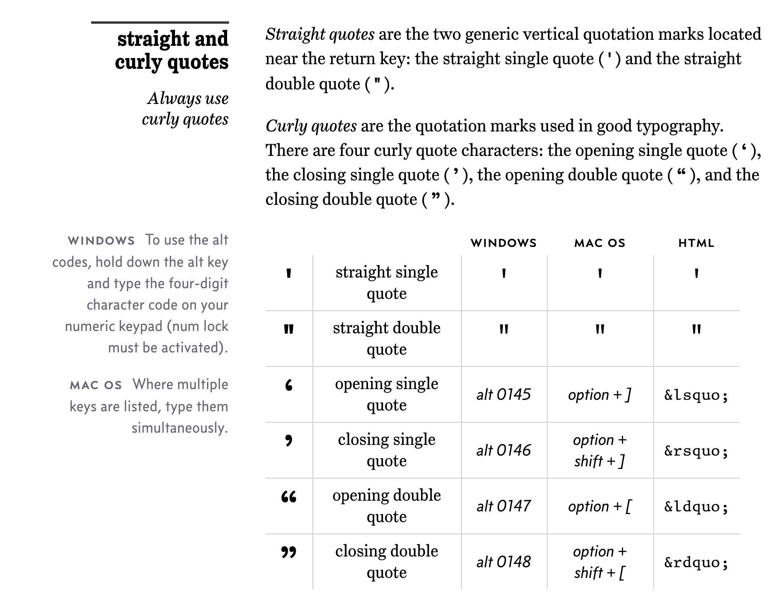
Straight vs Curly Quotes

Slide 38
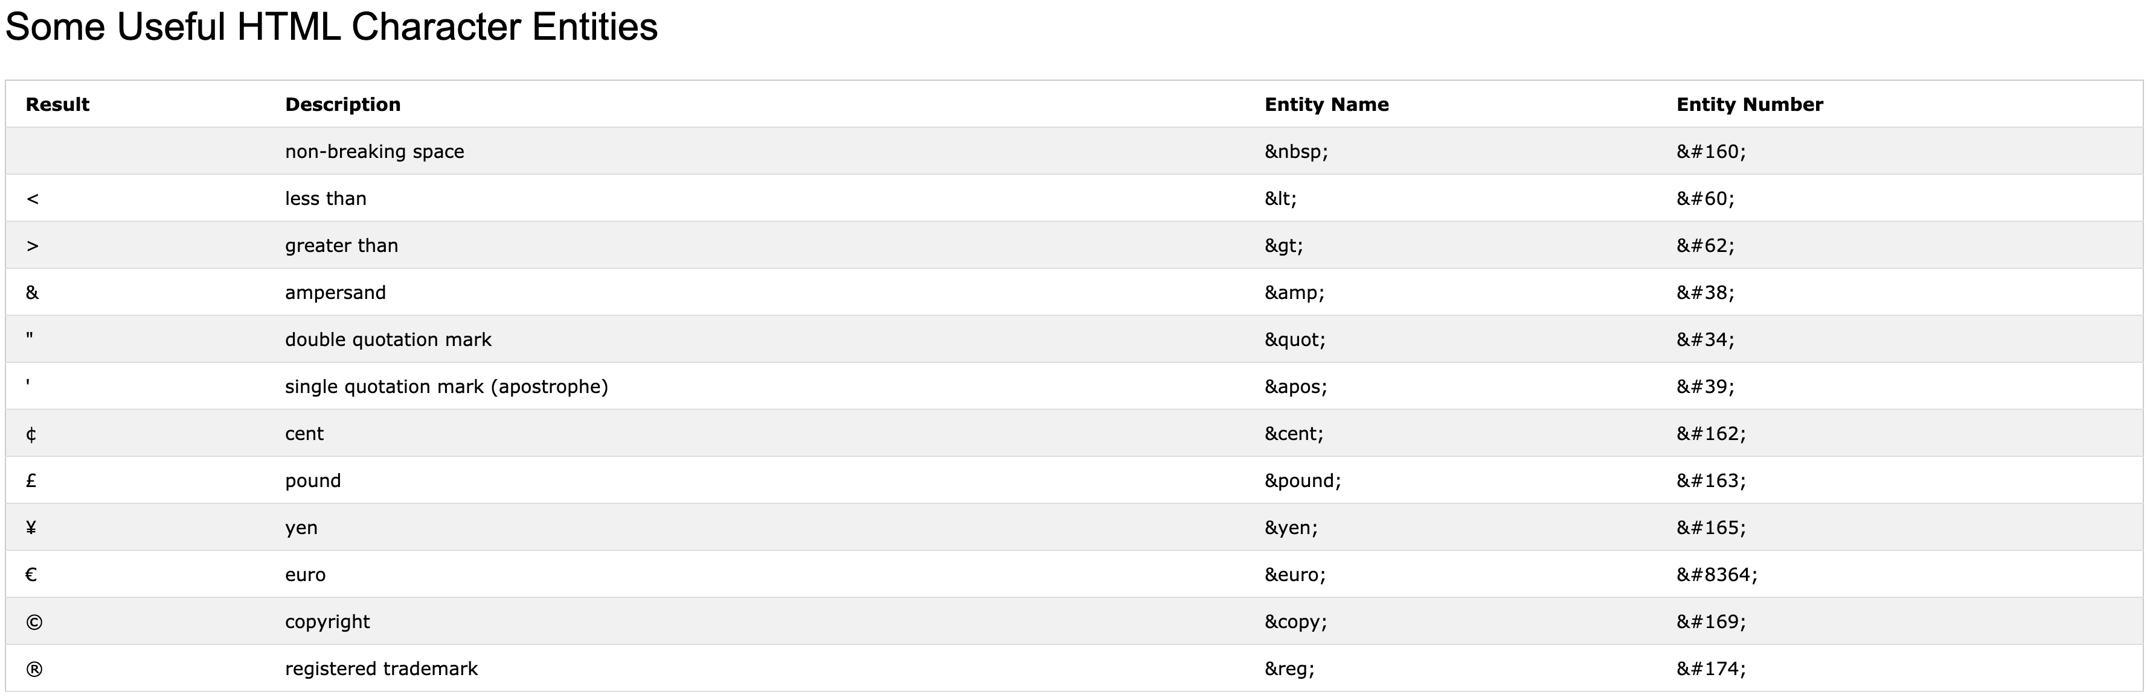
HTML Character Entities

Slide 39

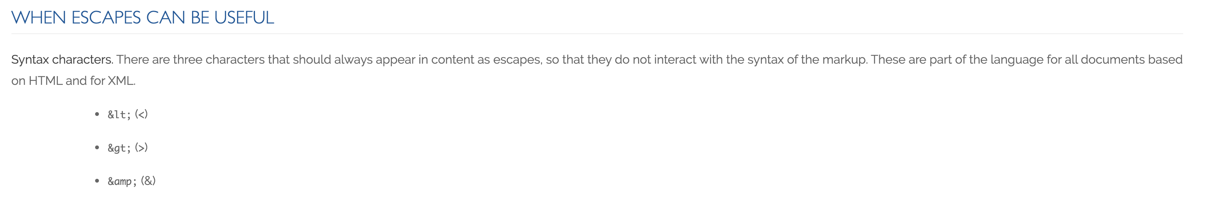
Always Escape

Slide 40
Scrum Team Discussion Boards in 14 Minutes
Scrum teams should complete discussion board (DB) in 14 minutes by:
Scrum master accepting volunteers (or assigning) note taker and presenter responsibilities in 1 minute
Team discussing Discussion Board topic for 10 minutes while the note taker documents:
Discussion board number & title
Team name
Fully participating team members
At least 5 bulleted discussion topics from discussion
Note taker shares notes with participating team members in 1 minute
Team member who actively participated paste an exact copy of the notes into their individual DB post and submit the post taking at most 1 minute
Presenter is preparing to give a very brief report out from the team during above discussion
Team sits back, relaxes, and acknowledges the fine work of the note taker and presenter for 1 minute
Note: Team members who actively participated and submit DB notes in their individual DB do not need to make additional DB posts responding to other classmates’ posts

Slide 41
Friendly Conversation Topic JAMStack

Slide 42
JAMstack
The ‘JAM,’ part stands for JavaScript, APIs, and Markup.
These are the essential building blocks to any JAMstack site. This term was invented by Netlify co-founder Mathias Biilmann.
Single-page application [link]
Serverless computing [link]

Slide 43
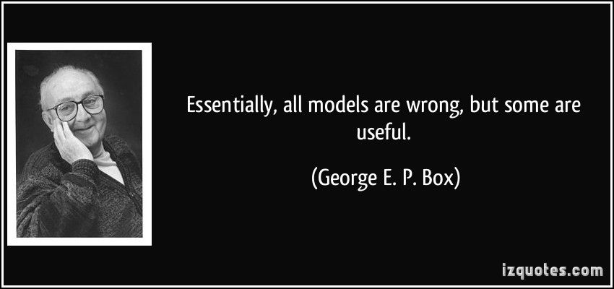
Models

