Slide 1

Class Session Check List
Everyone:
Sign into our Zoom meeting through our integrated Blackboard/Zoom link
Make sure that you can hear the conversation, see shared desktops, and view group chat topics
You will need a headset with a microphone to be able to effectively listen and speak
You will need to be able to share your computer screen
Thank you if you choose to leave your camera on to help make our class more interactive
In person participants also:
Make sure that your microphone and speakers are muted/off so that we don’t get an echo
Sit in a good spot near the classroom ceiling microphones if possible

Slide 2
Class Session Check List
Review that recordings are:
Opportunistic
Automatically available within Blackboard/Zoom
… Now make sure that the classroom microphone, speakers, and camera are being used in Zoom, move to the next slide, AND verify that recording is started.
… Also make sure that slides are visible to attendees

Slide 3
Agenda:
Prework and Announcements
Scrum Team Discussion Board
Binary & Text Files
Scrum Team Chapter Review: Patterns
Sprint 2 Planning Q&A
Lab (as time allows)
Discussion & Questions welcome at any time but please be present with no phones or email during our time together

Slide 4
Prework & Announcements
Complete through activity 5 prior to next class
Be prepared for a scrum team discussion of Object-Oriented Programming Patterns
Be prepared for scrum team discussion board

Slide 5
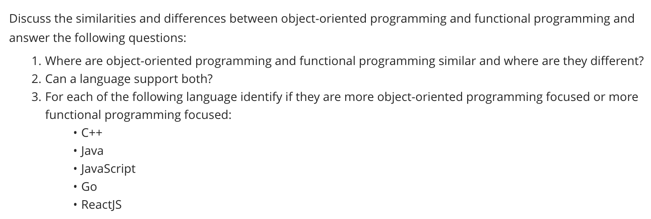
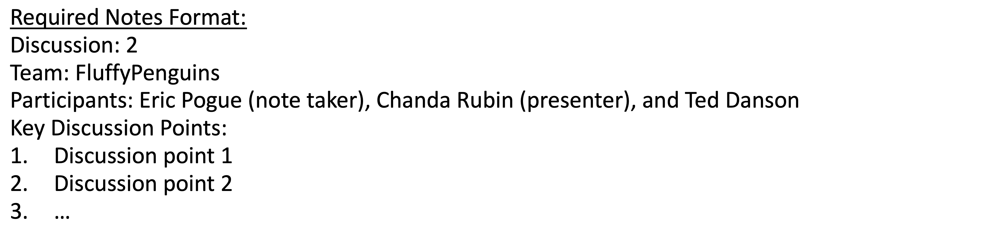
Scrum Team Discussion
Assign note taker and presenter roles to team members
Review and discuss the discussion topic for this sprint for approximately 10 minutes
Note taker takes notes and presenter prepares a report out summary
Note taker share notes with all participating team members
Each team member pastes and submits exact copy of the notes into their discussion board
Sit back, relax, and tell the note taker and presenter what I wonderful job the did

Slide 6
Binary & Text Files Review (and coding standards 5 & 6)

Slide 7
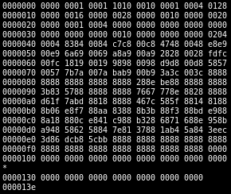
Files
All computer files are binary and can be represented in Hex notation
The term “binary file” is often used to imply that a file is a “non-text” file.

Slide 8
ASCII Text Files

Slide 9
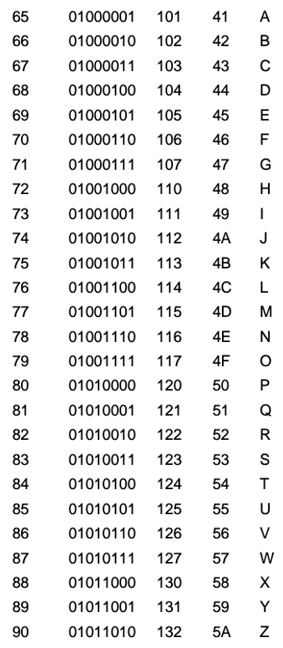
ASCII Files
Bytes are frequently used to hold individual characters in a text document. In the ASCII character set, each binary value between 0 and 127 is given a specific character. Most computers extend the ASCII character set to use the full range of 256 characters available in a byte. The upper 128 characters handle special things like accented characters from common foreign languages.

Slide 10
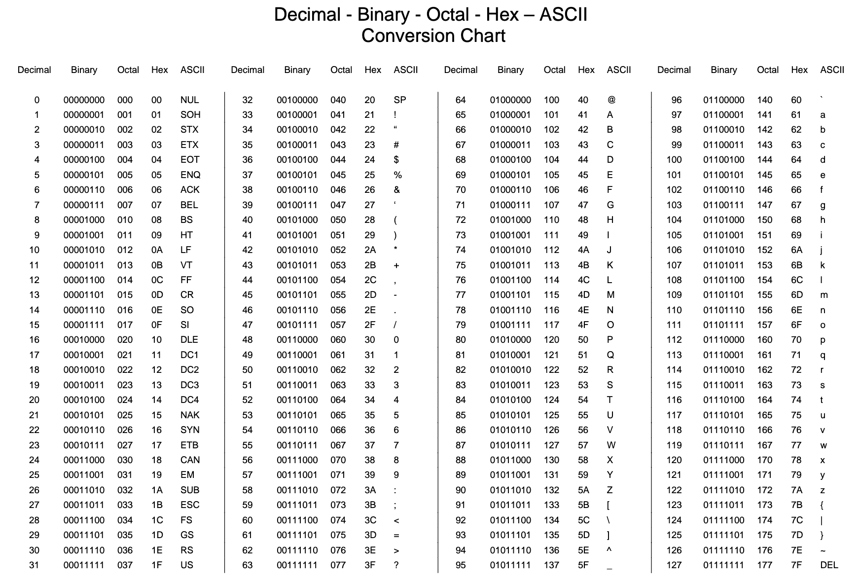

Slide 11
Unicode & UTF-16

Slide 12
Unicode & UTF-16
Unicode includes 65,536 possible combinations covering 154 modern and historical scripts, as well as multiple symbol sets [link]

Slide 13
UTF-8

Slide 14
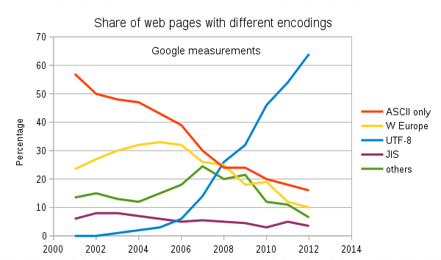
Text File Standards (Encoding)
ASCII
Unicode
UTF-8
Others

Slide 15
Text File End-Of-Line (EOL) and Encoding
Industry adoption of end-of-line encoding includes:
Windows: Both Carriage Return (CR, \r, 0x0d) and Line Feed (LF, \n, 0x0a) together.
Unix/Linux/OSX: Just Line Feed (LF, \n, 0x0a)
Mac (pre-OSX): Just Carriage Return (CR, \r, 0x0d)
Article on Windows Notepad supporting non-Windows EOF conventions [link]

Slide 16
HTML Character Entities

Slide 17

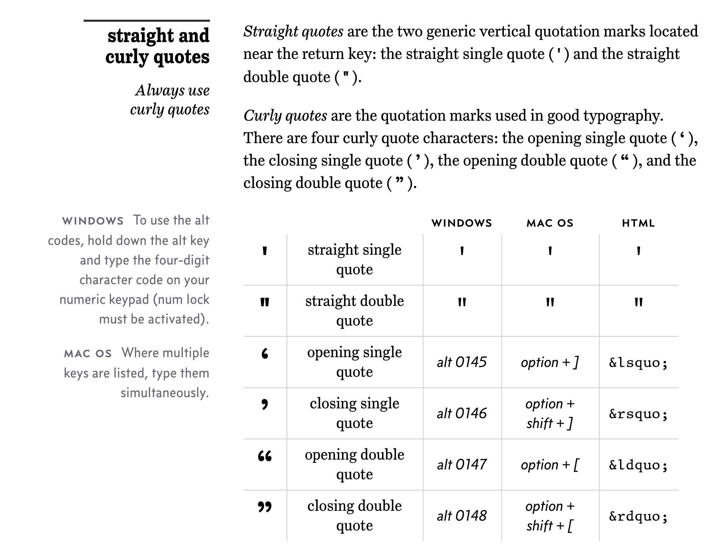
Straight vs Curly Quotes

Slide 18
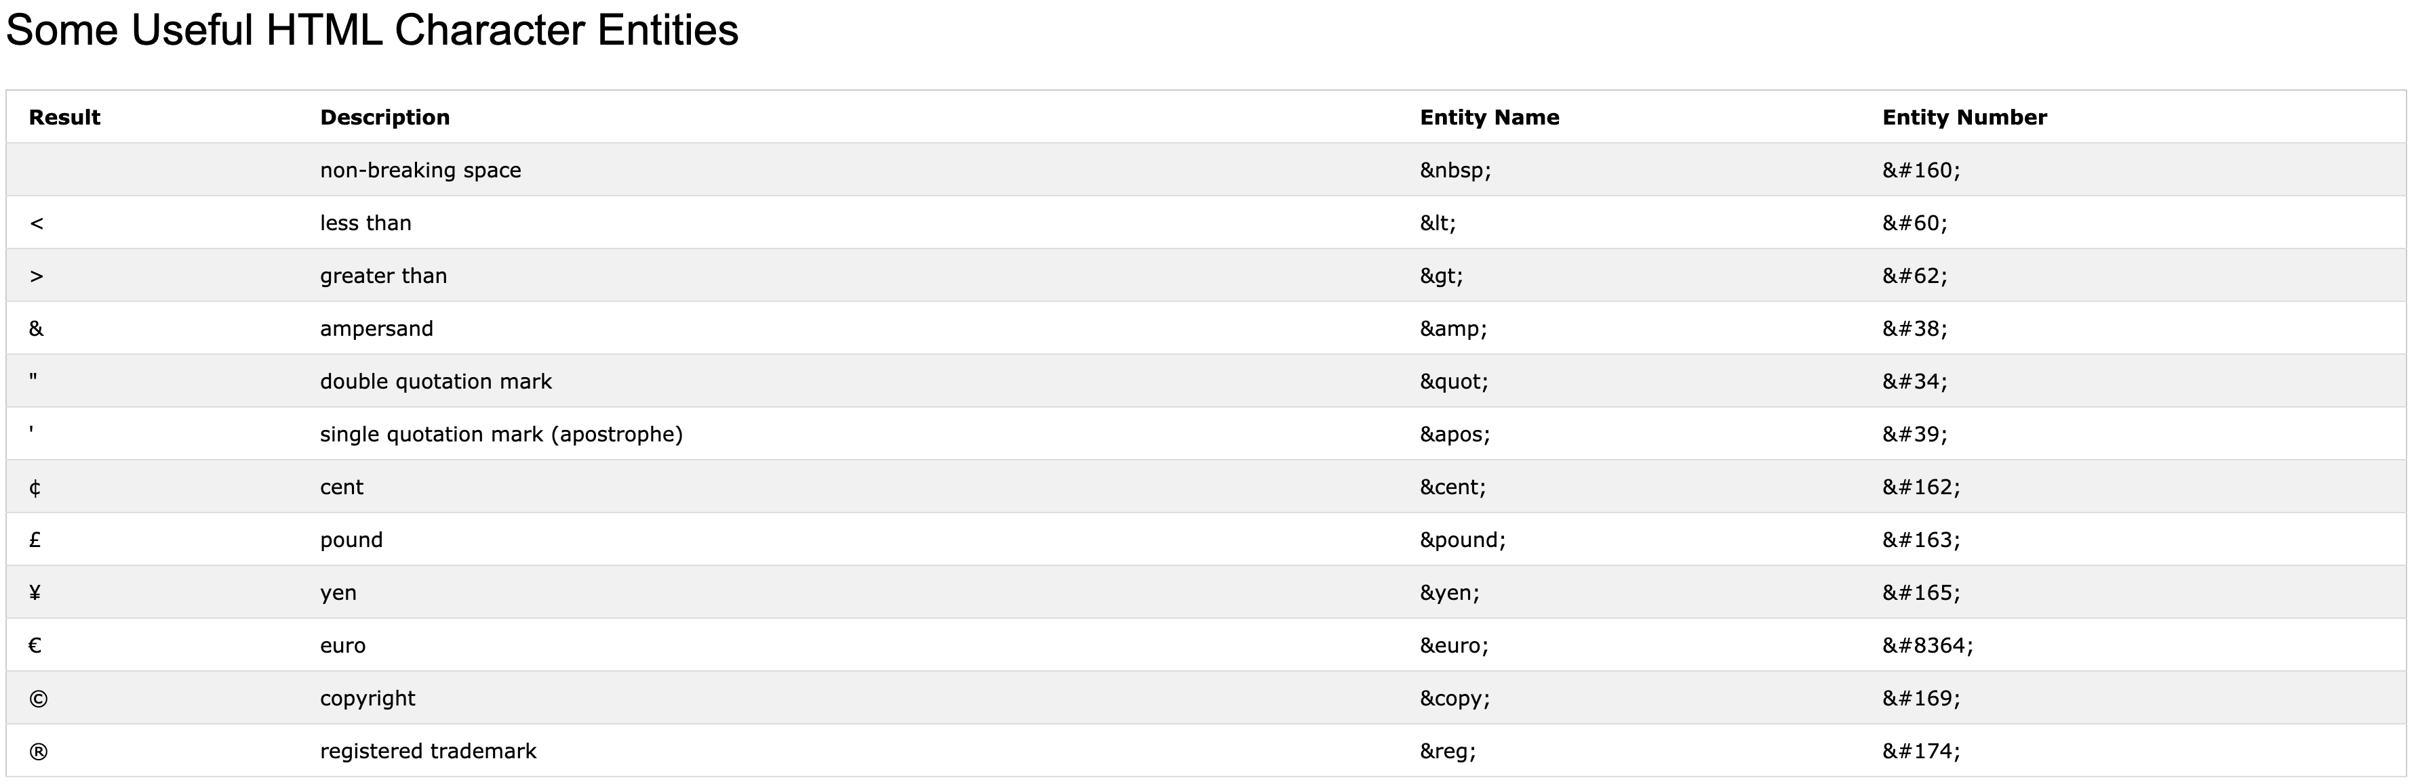
HTML Character Entities

Slide 19

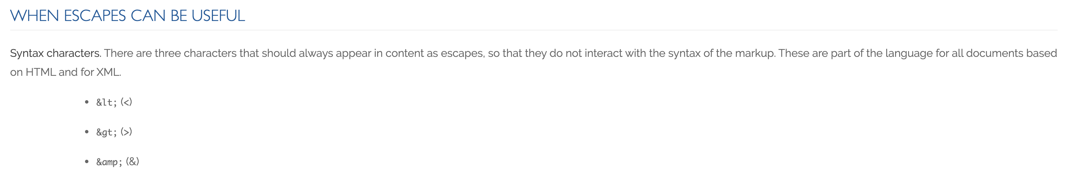
Always Escape

Slide 20
Scrum Team Chapter Review
Assign presenter
Team discusses topics while the presenter summarizes the 5 topics below:
What is the “bible” of Patterns?
What pattern or patterns do you feel would be the most valuable for you to know? Why?
What pattern or patterns do you feel would be the least valuable? Why?
What pattern or patterns do you feel are the mostly likely be be asked about in an interview? Why?
Team sits back, relaxes, and acknowledges the bravery and dedication of the presenter
Object-Oriented Programming Patterns

Slide 21
Sprint Planning Q&A

Slide 22
Prework For Next Class
Prior to our next class please:
Complete through activity 11 prior to next class
Be prepared for scrum team chapter review of OOP Principles
Be prepared for Quiz 2

Slide 23
Lab
As a class:
Review how to access our class sample code
Complete “Website Creation with GitHub and Microsoft Azure - 2020 Supplemental Edition”

Slide 24
End of Session

