Slide 1

Class Session Check List
Everyone:
Sign into our Zoom meeting through our integrated Blackboard/Zoom link
Make sure that you can hear the conversation, see shared desktops, and view group chat topics
You will need a headset with a microphone to be able to effectively listen and speak
You will need to be able to share your computer screen
Thank you if you choose to leave your camera on to help make our class more interactive
In person participants also:
Make sure that your microphone and speakers are muted/off so that we don’t get an echo
Sit in a good spot near the classroom ceiling microphones if possible

Slide 2
Class Session Check List
Review that recordings are:
Opportunistic
Automatically available within Blackboard/Zoom
… Now make sure that the classroom microphone, speakers, and camera are being used in Zoom, move to the next slide, AND verify that recording is started.
… Also make sure that slides are visible to attendees

Slide 3
Agenda:
Prework and Announcements
Scrum Team Discussion Board
Jamstack
Scrum Team Chapter Review: Chapter 6
Sprint 2 Planning Q&A
Lab (as time allows)
Discussion & Questions welcome at any time but please be present with no phones or email during our time together

Slide 4
Prework & Announcements
Before class today we aspired to:
Complete through activity 5
Prepare for a scrum team discussion of chapter 6**
Prepare for some programming together time focused on “Website Creation with GitHub and Microsoft Azure - 2020 Supplemental Edition”

Slide 5
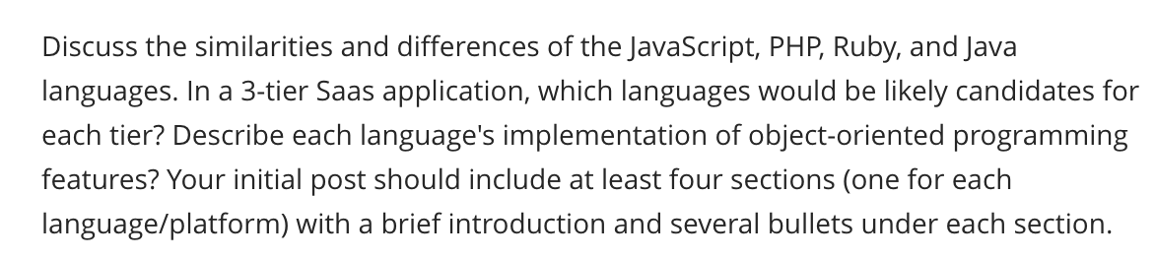
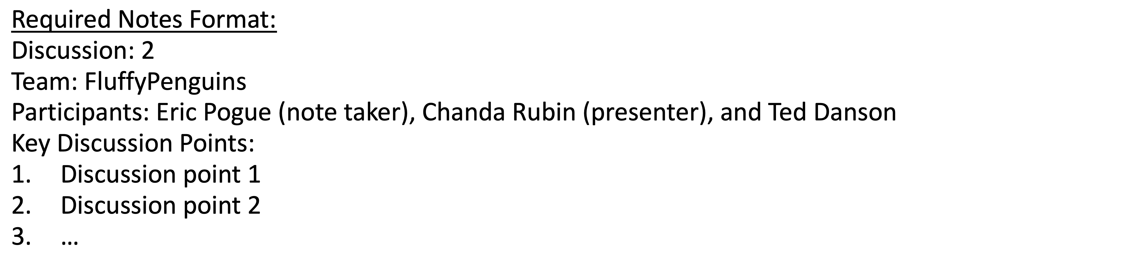
Scrum Team Discussion
Assign note taker and presenter roles to team members
Review and discuss the discussion topic for this sprint for approximately 10 minutes
Note taker takes notes and presenter prepares a report out summary
Note taker share notes with all participating team members
Each team member pastes and submits exact copy of the notes into their discussion board
Sit back, relax, and tell the note taker and presenter what I wonderful job the did
Notes:
Seating chart and attendance tracker (virtual and in person)

Slide 6
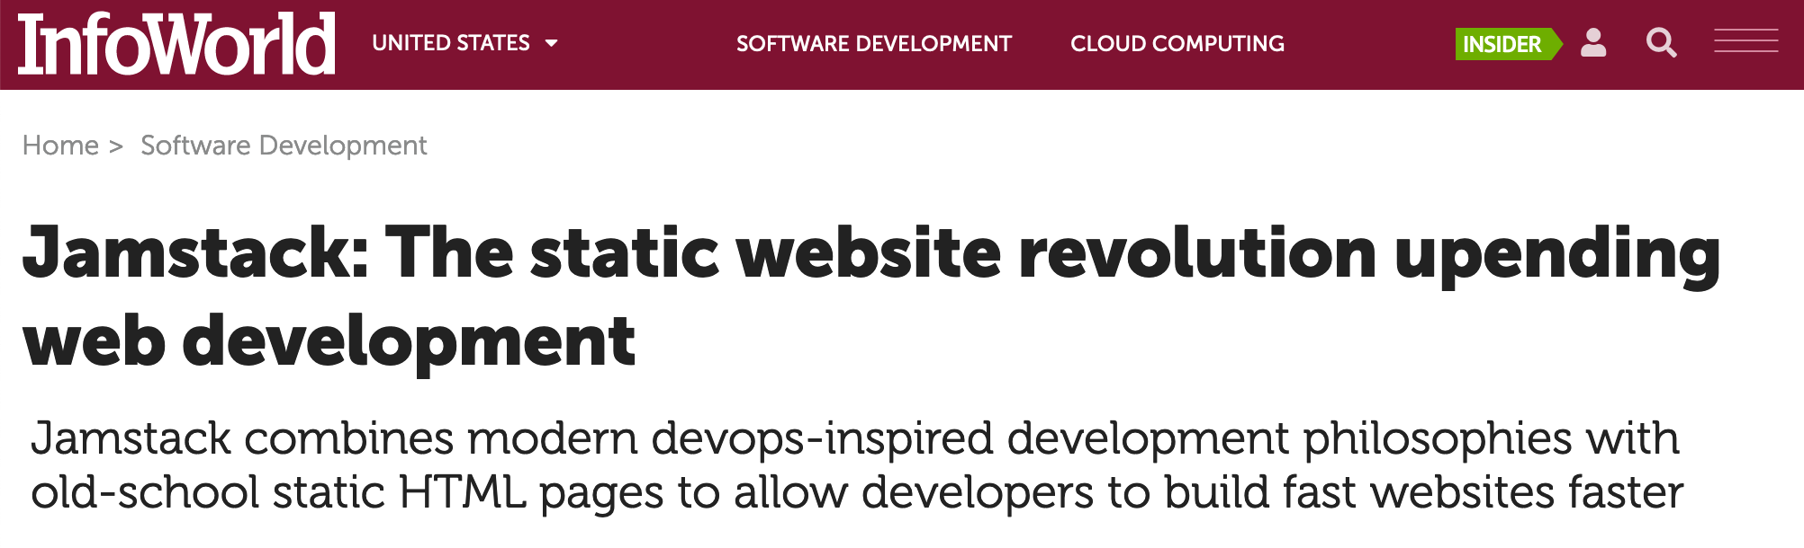
Jamstack
What is Jamstack? And why do we care?

Slide 7
Scrum Team Chapter Review
Assign presenter
Team discusses topics while the presenter summarizes the 5 topics below:
JavaScript
AJAX
XML/JSON
Single-Page Web Applications
Angular, React, other single-page web application environments
Where does Jamstack fit?
Team sits back, relaxes, and acknowledges the bravery and dedication of the presenter
Fox Chapter 6 Saas Client Framework

Slide 8
Sprint Planning Q&A

Slide 9
Prework For Next Class
Prior to our next class please:
Complete through activity 14 prior to next class
Be prepared for scrum team chapter review of chapters 3 through 5 and plus A.6 and A.7
Be prepared for Quiz 2

Slide 10
Lab
As a class:
Review how to access our class sample code
Complete “Website Creation with GitHub and Microsoft Azure - 2020 Supplemental Edition”

Slide 11
End of Session

Slide 12
Backup & Future Slides

Slide 13
Binary & Text Files Review

Slide 14
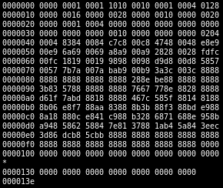
Files
All computer files are binary and can be represented in Hex notation
The term “binary file” is often used to imply that a file is a “non-text” file.

Slide 15
ASCII Text Files

Slide 16
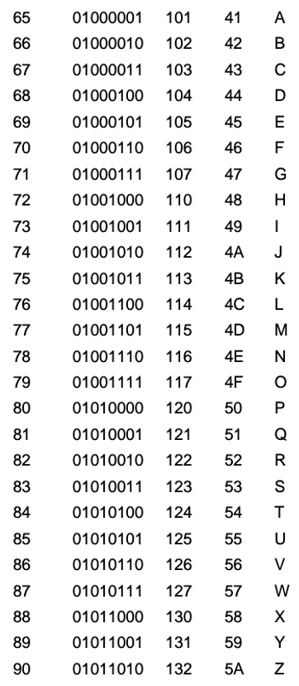
ASCII Files
Bytes are frequently used to hold individual characters in a text document. In the ASCII character set, each binary value between 0 and 127 is given a specific character. Most computers extend the ASCII character set to use the full range of 256 characters available in a byte. The upper 128 characters handle special things like accented characters from common foreign languages.

Slide 17
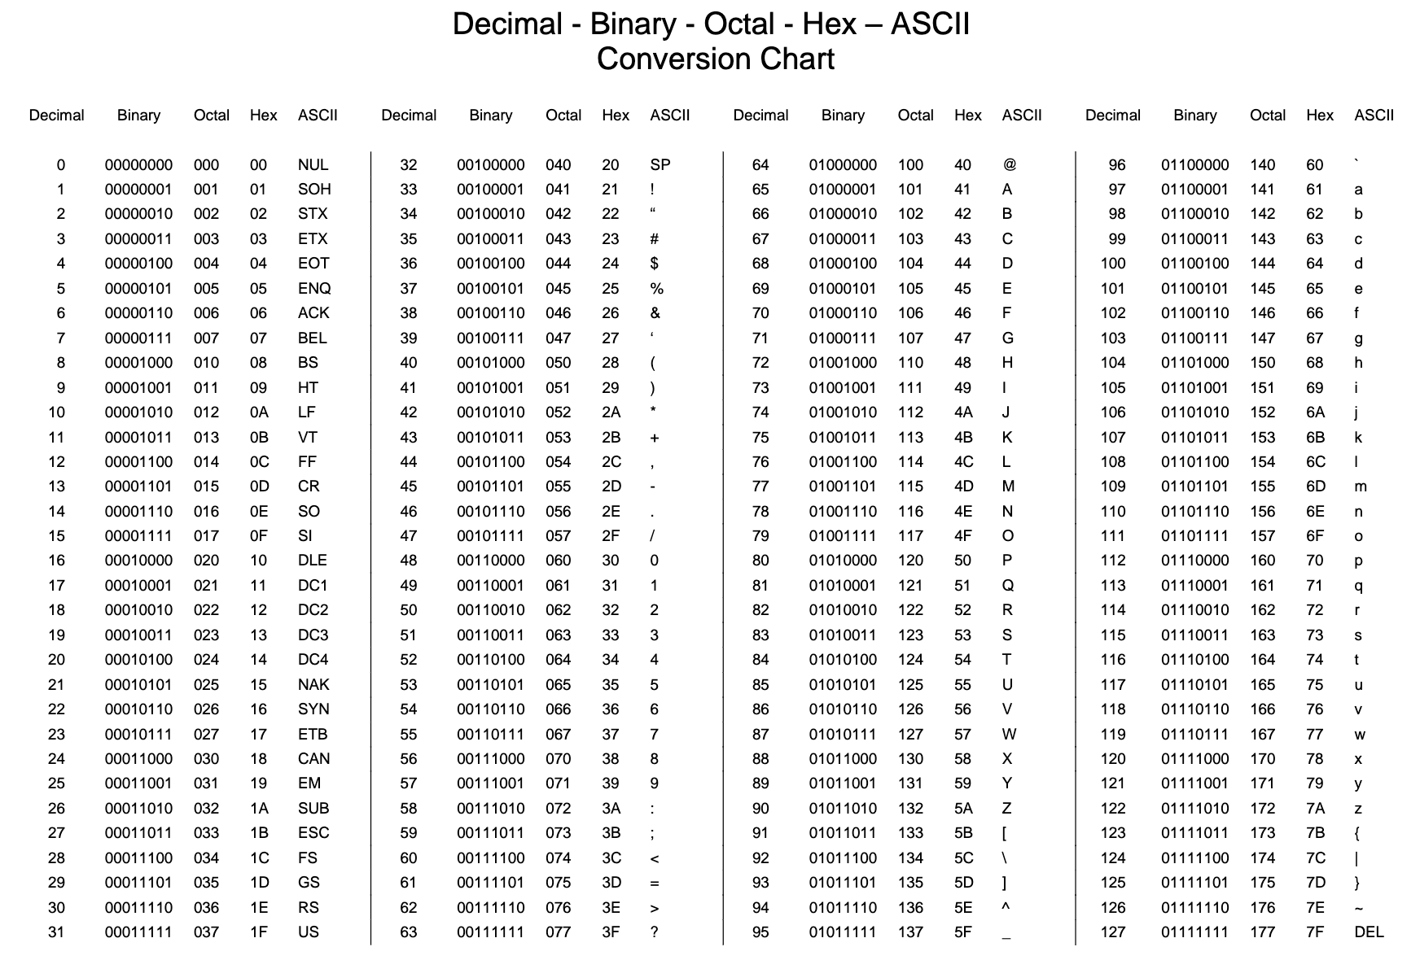

Slide 18
Unicode & UTF-16

Slide 19
Unicode & UTF-16
Unicode includes 65,536 possible combinations covering 154 modern and historical scripts, as well as multiple symbol sets [link]

Slide 20
UTF-8

Slide 21
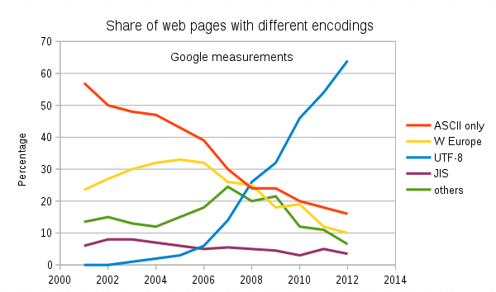
Text File Standards (Encoding)
ASCII
Unicode
UTF-8
Others

Slide 22
Text File End-Of-Line (EOL) and Encoding
Industry adoption of end-of-line encoding includes:
Windows: Both Carriage Return (CR, \r, 0x0d) and Line Feed (LF, \n, 0x0a) together.
Unix/Linux/OSX: Just Line Feed (LF, \n, 0x0a)
Mac (pre-OSX): Just Carriage Return (CR, \r, 0x0d)
Article on Windows Notepad supporting non-Windows EOF conventions [link]

Slide 23
HTML Character Entities

Slide 24

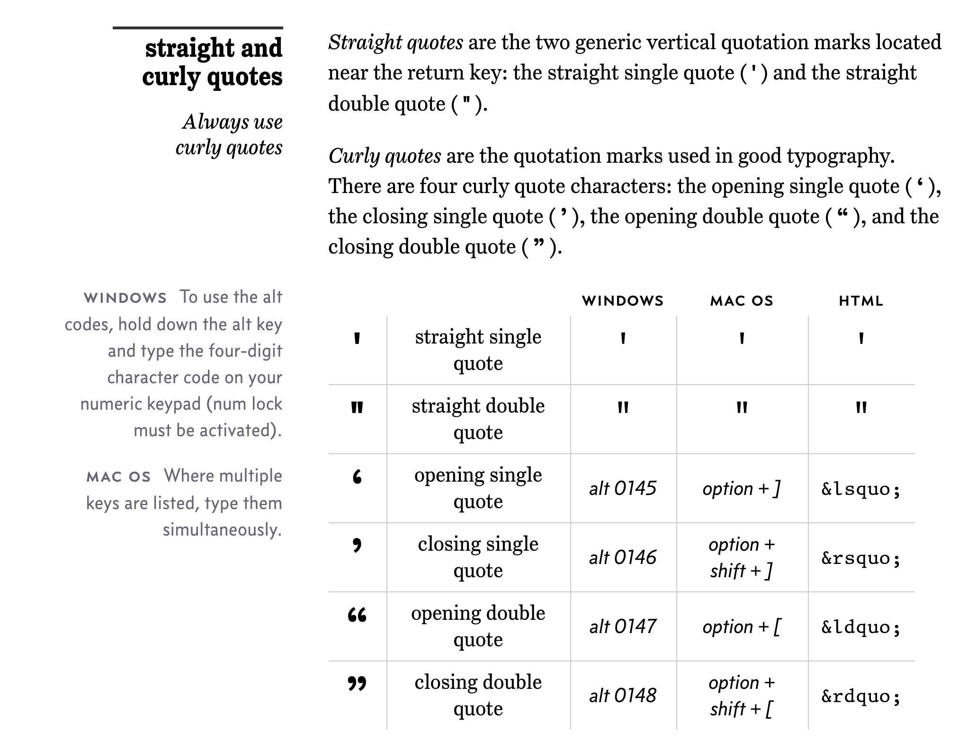
Straight vs Curly Quotes

Slide 25
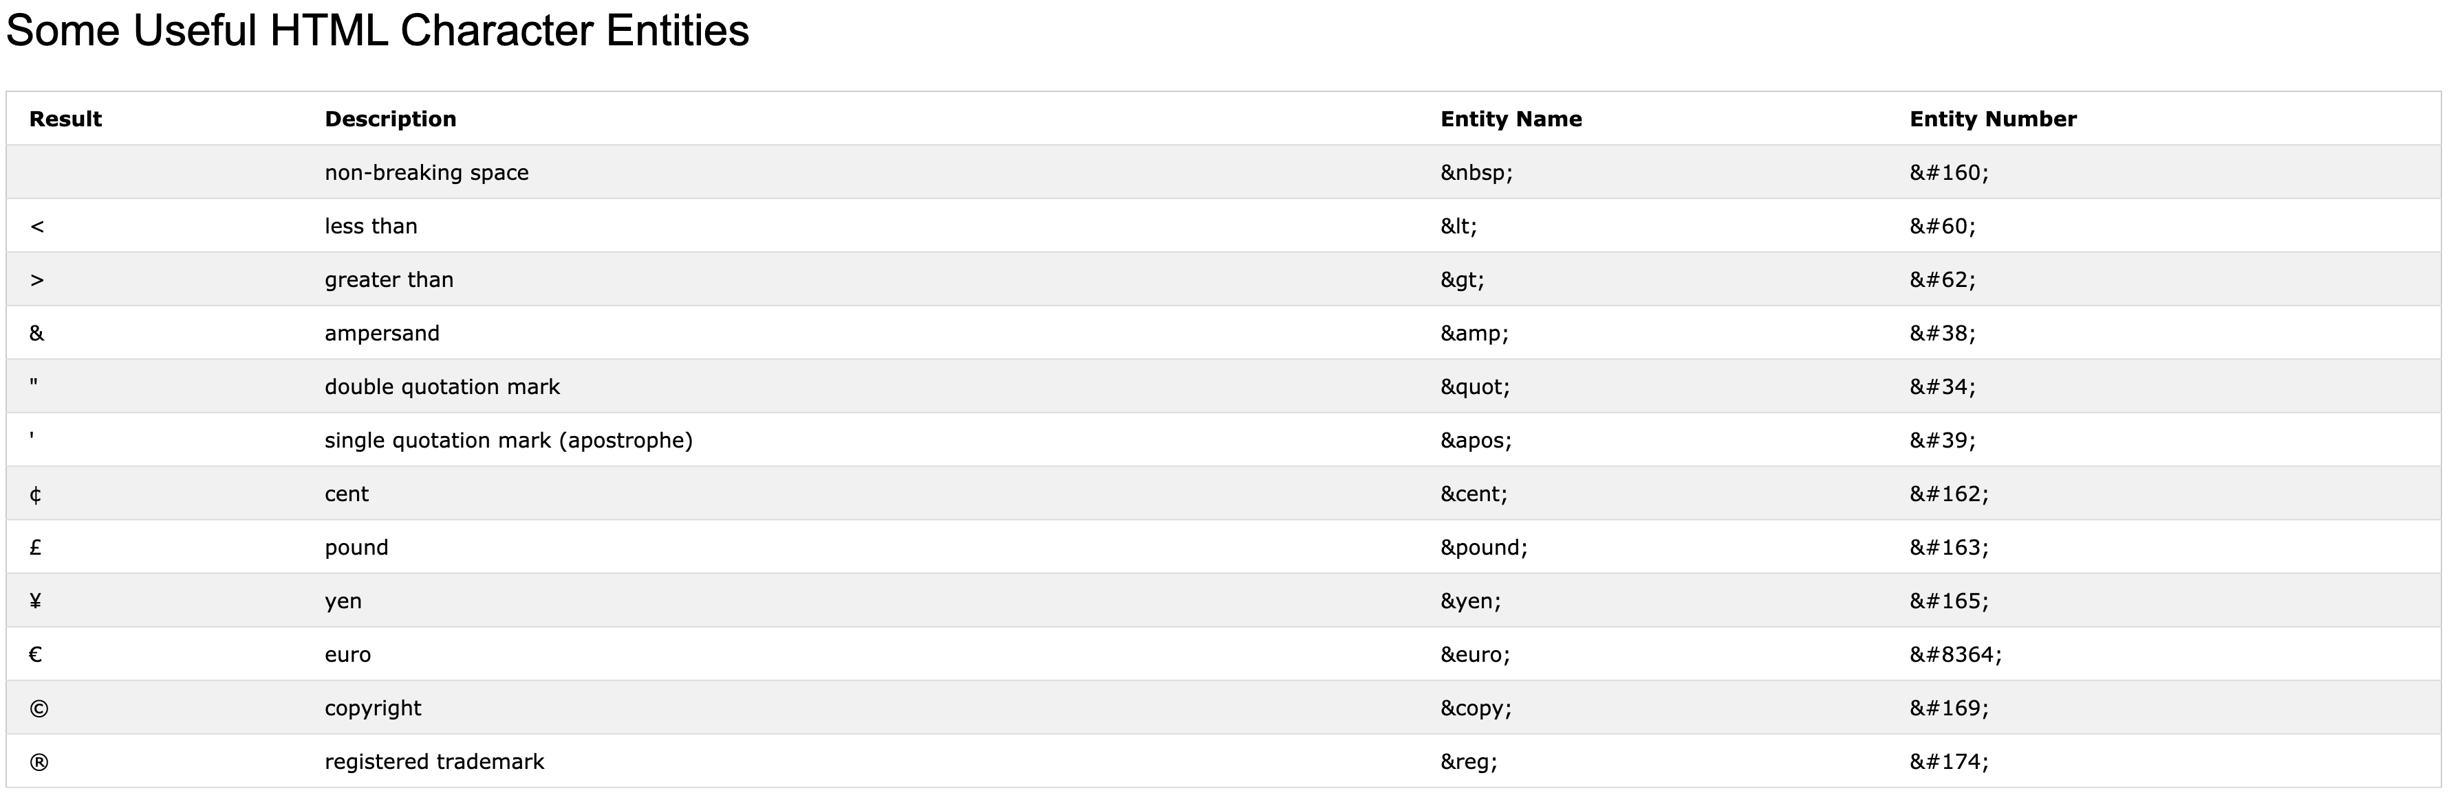
HTML Character Entities

Slide 26

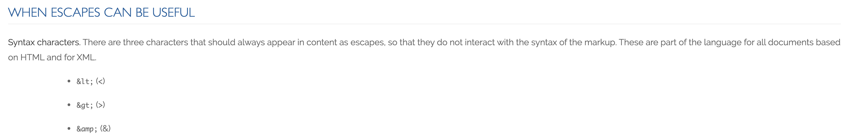
Always Escape

Slide 27
Scrum Team Chapter Discussion
Assign presenter
Team discussing chapter topics while the presenter summarizes the 5 topics below:
The importance of Branching is VCS systems (which VCS focused on branching)
Where should pared programming fit into the development process
The priority of specialization vs generalization in Agile vs Waterfall/Iterative
The relative importance of PMs in Agile vs Waterfall/Iterative
The two most important book on managing people and conflict (according to the author)
Team sits back, relaxes, and acknowledges the bravery and dedication of the presenter
Fox Chapter 10 on Project Management, Scrum, Pairs, and Version Control Systems

Slide 28
Scrum Team Discussion Boards in 14 Minutes
Scrum teams should complete discussion board (DB) in 14 minutes by:
Scrum master accepting volunteers (or assigning) note taker and presenter responsibilities in 1 minute
Team discussing Discussion Board topic for 10 minutes while the note taker documents:
Discussion board number & title
Team name
Fully participating team members
At least 5 bulleted discussion topics from discussion
Note taker shares notes with participating team members in 1 minute
Team member who actively participated paste an exact copy of the notes into their individual DB post and submit the post taking at most 1 minute
Presenter is preparing to give a very brief report out from the team during above discussion
Team sits back, relaxes, and acknowledges the fine work of the note taker and presenter for 1 minute
Note: Team members who actively participated and submit DB notes in their individual DB do not need to make additional DB posts responding to other classmates’ posts

Slide 29
Friendly Conversation Topic JAMStack

Slide 30
JAMstack
The ‘JAM,’ part stands for JavaScript, APIs, and Markup.
These are the essential building blocks to any JAMstack site. This term was invented by Netlify co-founder Mathias Biilmann.
Single-page application [link]
Serverless computing [link]

Slide 31
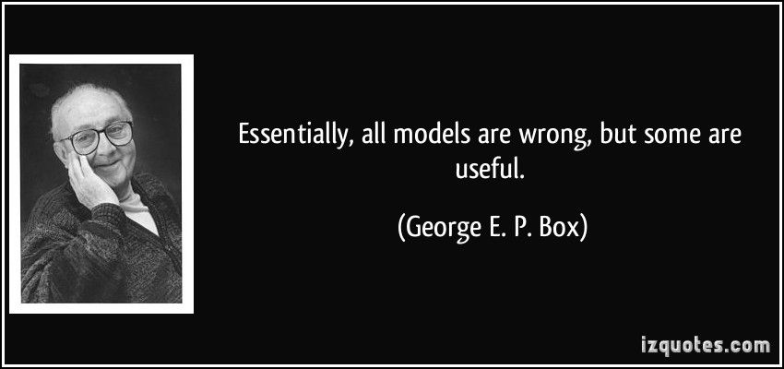
Models

