Slide 1

Class Session Check List
Everyone:
Sign into our Zoom meeting through our integrated Blackboard/Zoom link
Make sure that you can hear the conversation, see shared desktops, and view group chat topics
You will need a headset with a microphone to be able to effectively listen and speak
You will need to be able to share your computer screen
Thank you if you choose to leave your camera on to help make our class more interactive
In person participants also:
Make sure that your microphone and speakers are muted/off so that we don’t get an echo
Sit in a good spot near the classroom ceiling microphones if possible

Slide 2
Class Session Check List
Review that recordings are:
Opportunistic
Automatically available within Blackboard/Zoom
… Now make sure that the classroom microphone, speakers, and camera are being used in Zoom, move to the next slide, AND verify that recording is started.
… Also make sure that slides are visible to attendees

Slide 3
Applied Programming Languages
Eric Pogue

Slide 4
Agenda:
Prework and Announcements
Sprint Progress Polling
Scrum Teams and Discord
Introductions Assignment
Sprint Planning Q&A
Scrum Team Discussion on OOP Concepts
Prework for Next Class
Discussion & Questions welcome at any time but please be present with no phones or email during our time together

Slide 5
Prework & Announcements
Before class today we were anticipating that we would be able to:
Complete through activity 9 prior to next class
Get your headset with microphone for teaming and programming together activities
Be ready to test your scrum team discussion capabilities with your team Discord server*
Be prepared for your first Scrum Team chapter review which will be on Object-Oriented Concepts which will require you to use you Discord server to communicate

Slide 6
Sprint Progress Polling

Slide 7
Scrum Teams and Discord
Set up your scrum team Discord server by:
Reviewing your scrum team members
Make sure everyone has a Discord account
Set up a Discord server (with your team name if possible) and grant access to the team
Test audio, video, and desktop sharing
Sign up for Eric’s Lewis Discord sever

Slide 8
Introductions Assignment
Complete your Introductions assignment by:
Making your initial Introduction post
Responding to at least two of our classmates
As time allows set up O’Reilly Books if you have not already

Slide 9
Sprint Planning Q&A
Notes:
Review programming assignment.

Slide 10
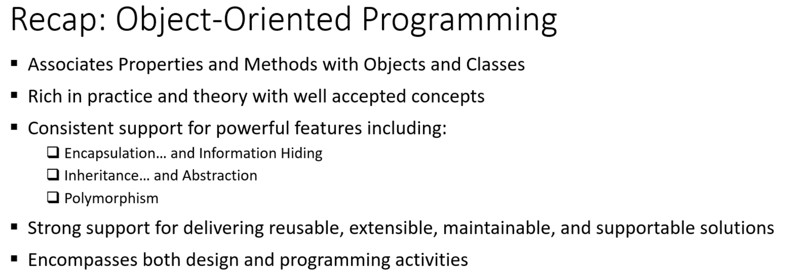
Scrum Team Object-Oriented Programming Concepts
Scrum Master accepts volunteers for (or assigns) Presenter
Team discusses and presenter summarizes topics considering:
Team sits back, relaxes, and acknowledges the bravery and dedication of the presenter
Team returns to class Zoom session where presenter presents summary

Slide 11
How would the designers of Go prioritize OOP Concepts?
Review “Go at Google: Language Design in the Service of Software Engineering” which is available at https://talks.golang.org/2012/splash.article
Team discusses and presenter summarizes topics considering above article and:
Team sits back, relaxes, and acknowledges the bravery and dedication of the presenter
Team returns to class Zoom session where presenter presents summary

Slide 12
Prework For Next Class
Prior to our next class please:
Complete through activity 13 prior to next class
Be prepared for your Scrum Team chapter review on Fox Chapter 2 and Fox Preface
Be prepared to complete Quiz 1

Slide 13
End of Session

