Slide 1

Class Session Check List
Everyone:
Sign into our Zoom meeting through our integrated Blackboard/Zoom link
Make sure that you can hear the conversation, see shared desktops, and view group chat topics
You will need a headset with a microphone to be able to effectively listen and speak
You will need to be able to share your computer screen
Thank you if you choose to leave your camera on to help make our class more interactive
In person participants also:
Make sure that your microphone and speakers are muted/off so that we don’t get an echo
Sit in a good spot near the classroom ceiling microphones if possible

Slide 2
Attendance
Document in-person attendance for contact tracing.

Slide 3
Class Session Check List
Review that recordings are:
Opportunistic
Automatically available within Blackboard/Zoom
… Now make sure that the classroom microphone, speakers, and camera are being used in Zoom, move to the next slide, AND verify that recording is started.
… Also make sure that slides are visible to attendees

Slide 4
Agenda:
Friendly Conversation Topic – Software Development Job Openings
Prework and Announcements
Foreshadowing Sprint Demos
Foreshadowing Sprint Retrospective
Graduation Application Reminder
Prework for Next Class
Lab and Programming Together
Discussion & Questions welcome at any time but please be present with no phones or email during our time together

Slide 5
Friendly Conversation Topic
Current Software Development Job Openings [link]

Slide 6
Foreshadowing Sprint Demos

Slide 7
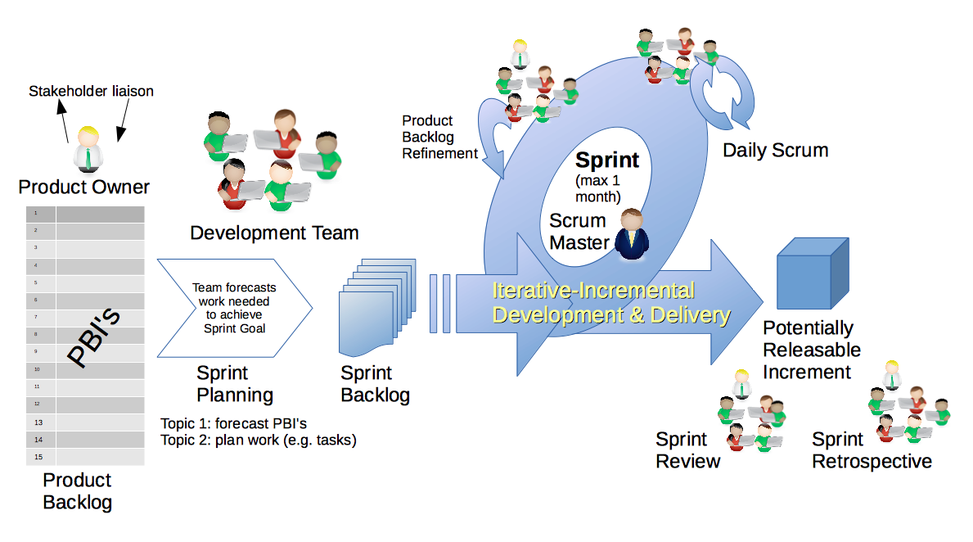
Scrum Process – Sprint Review & Demo
By Dr ian mitchell - Own work, CC BY-SA 4.0, Link

Slide 8

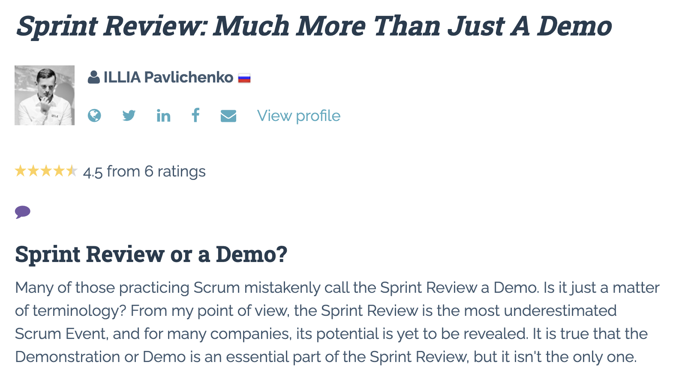

Slide 9
Demo Guidelines – Presenter
Everyone will give at least one demo of their work during the semester.
Your demo should be 2 to 5 minutes and can include any or all of the following:
Show your application running
Comment on your implementation
Show the source code
Explain how you organized the code
Talk about any challenges
You should not prepare slides or a presentation
**You will also need to complete the Demo assignment in Blackboard.

Slide 10
Demo Guidelines – Listener
Everyone will be listening to many demos during the semester.
Your listener responsibilities include:
Actively listening and watching what is being demoed
Come up with a meaningful yet easy to answer question
Ask your question if the presenter does not get sufficient questions from other listeners
Do not ask hard question or attempt to review the presenters code
Clap for the presenter at the end of the demo and thank them for presenting
Optionally follow up with the presenter later if you have what could be more difficult questions or if you have suggestions

Slide 11
Review Demo Schedule

Slide 12
Scrum Process – Sprint Retrospective
By Dr ian mitchell - Own work, CC BY-SA 4.0, Link

Slide 13
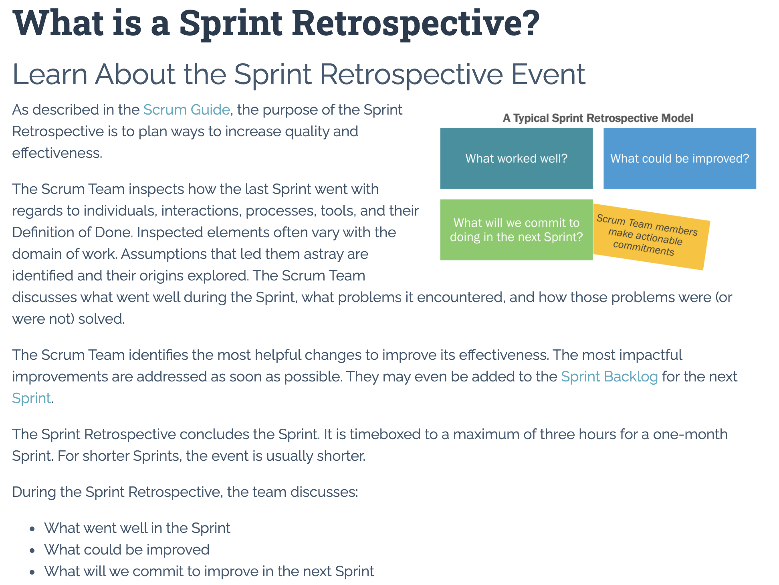

Slide 14
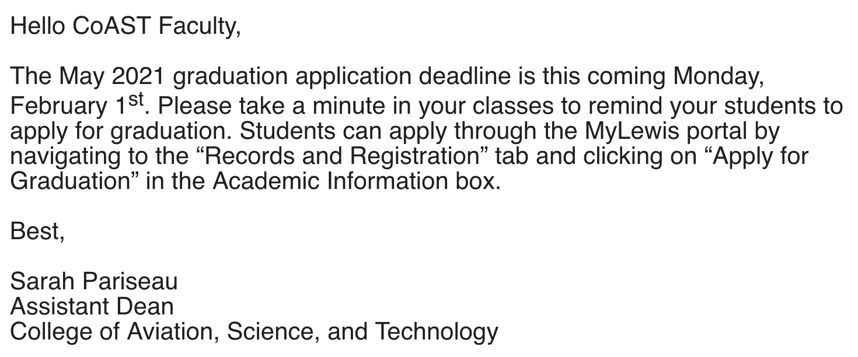

Slide 15
Prework For Next Class
Everything is due Sunday!
Be prepared for Sprint 2 Planning Monday
Be prepared for Sprint 1 Demos, Sprint 1 Retrospective on Wednesday

Slide 16
Lab and Programming Together
Review Lab 1 one more time.
Programming Together with:
Terminal (MacOS) or PowerShell (Windows),
File Systems (pwd, cd, and ls)
File Systems (Finder or File Manager)
VS Code
Python
Something else?
How can I help you with getting sprint 1 assignments complete?

Slide 17
End of Session

Slide 18
Backup Slides

Slide 19
Scrum Team Chapter Discussion
Assign presenter
Team discussing chapter topics while the presenter summarizes the 5 topics below:
The importance of Branching is VCS systems (which VCS focused on branching)
Where should pared programming fit into the development process
The priority of specialization vs generalization in Agile vs Waterfall/Iterative
The relative importance of PMs in Agile vs Waterfall/Iterative
The two most important book on managing people and conflict (according to the author)
Team sits back, relaxes, and acknowledges the bravery and dedication of the presenter
Fox Chapter 10 on Project Management, Scrum, Pairs, and Version Control Systems

Slide 20
Scrum Team Discussion
Assign presenter
Discuss topic(s) while the presenter summarizes the 3 to 5 most import items discussed
Team sits back, relaxes, and acknowledges the bravery and dedication of the presenter
“Application Architectures and Databases – Part 1”

Slide 21
Monday, November 30th
Demo Schedule
(Please try to keep demos to 2-3 minutes each)

Slide 22
Sprint Demos

Slide 23
Complete Sprint Demo Assignment
I will be grading all demos from sprints 1 through 5.

Slide 24
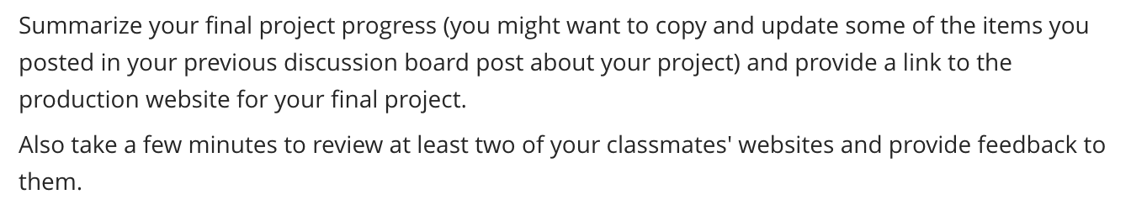
Scrum Team Discussion Board in 12 (to 28) minutes
Assign note taker and presenter roles to team members (1 minute)
** As necessary update your final project progress (16 minutes) **
Note taker capture notes URLs to JSON files (8 minutes)
Note taker share notes with all participating team members (1 minute)
Each team member submits exact copy of the notes into their individual discussion board (1 minute)
Sit back, relax, and tell the note taker and presenter what I wonderful job the did (1 minute)
Required Format:
Discussion 6
Final Project Product: Andrew
Final Project Team Participants: Eric Pogue (note taker), Chanda Rubin (presenter), and Ted Danson
Final Project Stories & Progress:
Story 1.1 (Epic 1/Story1): As a college instructor, I would like to see a page that represents a multiple choice question, so that start working on my questions. (3sp)... complete
Story 1.2: As a student, I would like how I answer a multiple choice question, so that I can provide feedback on improvements. (3sp)... committed in sprint 2 but only complete one-third of the story
…

Slide 25
Scrum Team Sprint Review
Scrum Master accepts volunteers for (or assigns) Presenter
Team discusses sprint 1 and identifies questions or concerns
Team sits back, relaxes, and acknowledges the bravery and dedication of the presenter
Team returns to class Zoom session where presenter presents summary

Slide 26
Programming Together with
“Azure Functions with VS Code and JavaScript”
Or Programming Together with
“React On Azure”
Or Sprint 3 Planning
Or QuizMaster Data

