Slide 1

Class Session Check List
Everyone:
Sign into our Zoom meeting through our integrated Blackboard/Zoom link
Make sure that you can hear the conversation, see shared desktops, and view group chat topics
You will need a headset with a microphone to be able to effectively listen and speak
You will need to be able to share your computer screen
Thank you if you choose to leave your camera on to help make our class more interactive
In person participants also:
Make sure that your microphone and speakers are muted/off so that we don’t get an echo
Sit in a good spot near the classroom ceiling microphones if possible

Slide 2
Attendance
Document in-person attendance in anticipation of future need for contact tracing.

Slide 3
Class Session Check List
Review that recordings are:
Opportunistic
Automatically available within Blackboard/Zoom
… Now make sure that the classroom microphone, speakers, and camera are being used in Zoom, move to the next slide, AND verify that recording is started.
… Also make sure that slides are visible to attendees

Slide 4
Agenda:
Friendly Conversation Topic – Software Development Job Openings
Prework and Announcements
Foreshadowing Sprint Demos
Foreshadowing Sprint Retrospective
Graduation Application Reminder
Prework for Next Class
Lab and Programming Together
Discussion & Questions welcome at any time but please be present with no phones or email during our time together

Slide 5
Friendly Conversation Topic
Current Software Development Job Openings [link]

Slide 6
Foreshadowing Sprint Demos

Slide 7
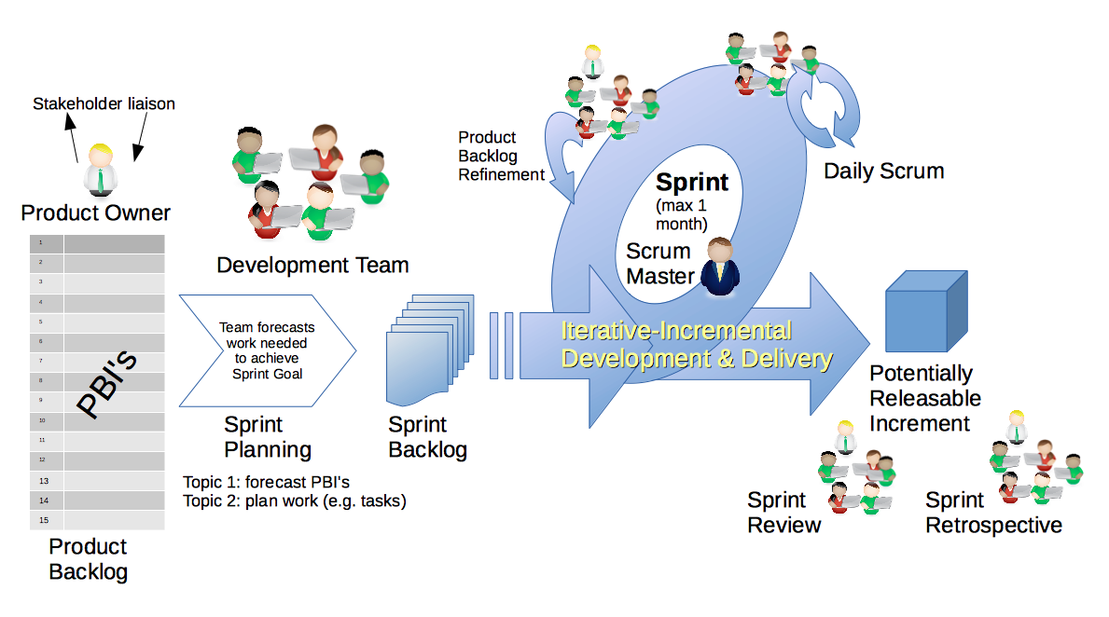
Scrum Process – Sprint Review & Demo
By Dr ian mitchell - Own work, CC BY-SA 4.0, Link

Slide 8

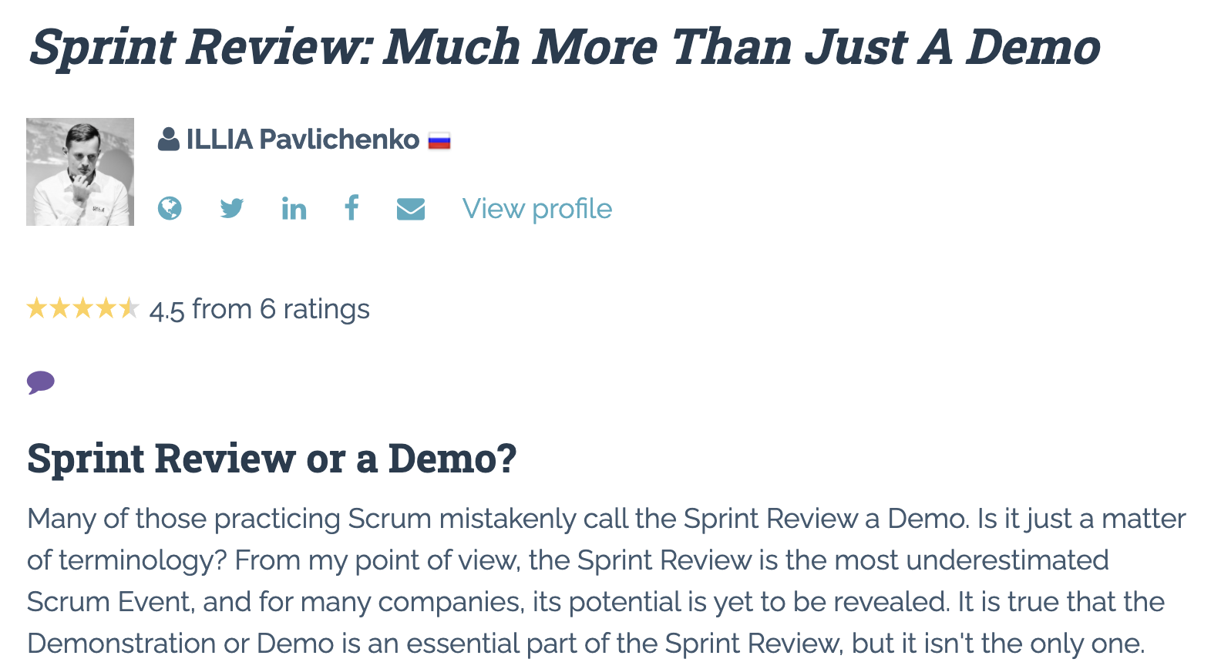

Slide 9
Demo Guidelines – Presenter
Everyone will give at least one demo of their work during the semester.
Your demo should be 2 to 5 minutes and can include any or all of the following:
Show your application running
Comment on your implementation
Show the source code
Explain how you organized the code
Talk about any challenges
You should not prepare slides or a presentation
**You will also need to complete the Demo assignment in Blackboard.

Slide 10
Demo Guidelines – Listener
Everyone will be listening to many demos during the semester.
Your listener responsibilities include:
Actively listening and watching what is being demoed
Come up with a meaningful yet easy to answer question
Ask your question if the presenter does not get sufficient questions from other listeners
Do not ask hard question or attempt to review the presenters code
Clap for the presenter at the end of the demo and thank them for presenting
Optionally follow up with the presenter later if you have what could be more difficult questions or if you have suggestions

Slide 11
Review Demo Schedule

Slide 12
Scrum Process – Sprint Retrospective
By Dr ian mitchell - Own work, CC BY-SA 4.0, Link

Slide 13
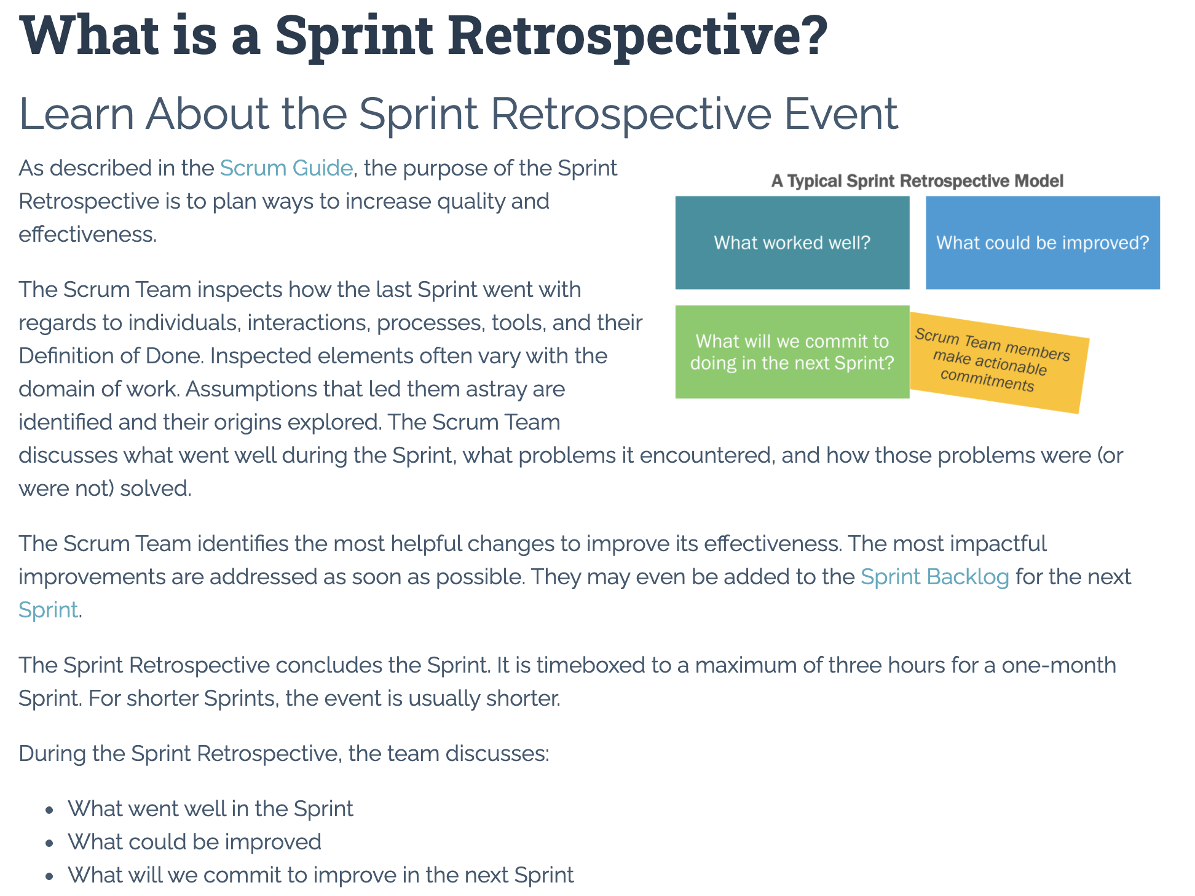

Slide 14
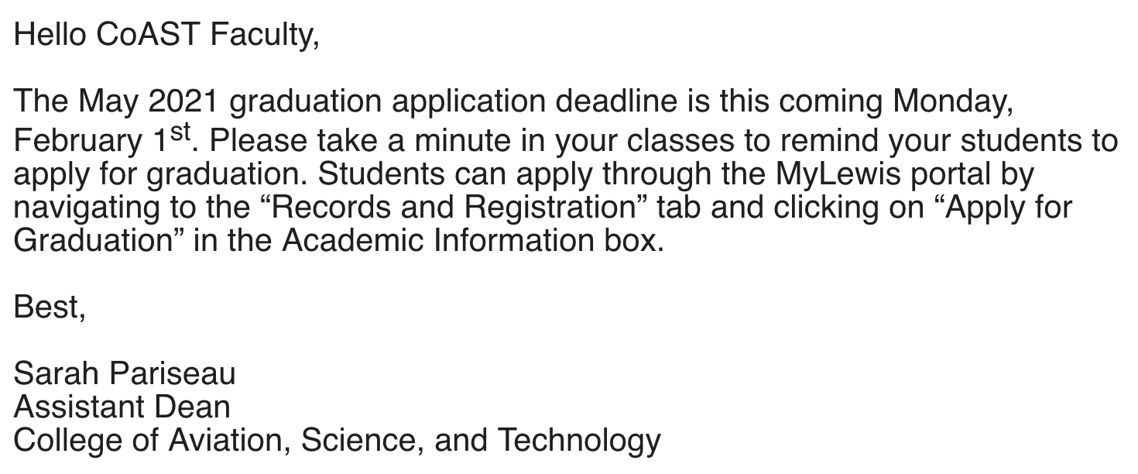

Slide 15
Prework For Next Class
Everything is due Sunday!
Monday: Be prepared for Sprint 2 Planning Monday
Wednesday: Be prepared for Sprint 1 Demos, Sprint 1 Retrospective

Slide 16
Lab and Programming Together
Review Lab 1 one more time.
Programming Together with:
Terminal (MacOS) or PowerShell (Windows),
File Systems (pwd, cd, and ls)
File Systems (Finder or File Manager)
VS Code
Java
Something else?
How can I best help you complete your assignments?

Slide 17
End of Session

Slide 18
Discuss Learning Java, 5th Edition

