Slide 1

Class Session Check List
Everyone:
Sign into our Zoom meeting through our integrated Blackboard/Zoom link
Make sure that you can hear the conversation, see shared desktops, and view group chat topics
You will need a headset with a microphone to be able to effectively listen and speak
You will need to be able to share your computer screen
Thank you if you choose to leave your camera on to help make our class more interactive
In person participants also:
Make sure that your microphone and speakers are muted/off so that we don’t get an echo
Sit in a good spot near the classroom ceiling microphones if possible

Slide 2
Class Session Check List
Review that recordings are:
Opportunistic
Automatically available within Blackboard/Zoom
… Now make sure that the classroom microphone, speakers, and camera are being used in Zoom, move to the next slide, AND verify that recording is started.
… Also make sure that slides are visible to attendees

Slide 3
Agenda:
Prework and Announcements
Sprint 1 Demos
Sprint 1 Retrospective
Sprint 2 Planning
Prework for Next Class
Lab: Scrum Team Sprint 2 Planning Review
Discussion & Questions welcome at any time but please be present with no phones or email during our time together

Slide 4
Prework & Announcements
Everything is due Sunday!
Be prepared for Sprint 1 Demos, Sprint 1 Retrospective, and Sprint 2 Planning next class.

Slide 5
Sprint Demos

Slide 6
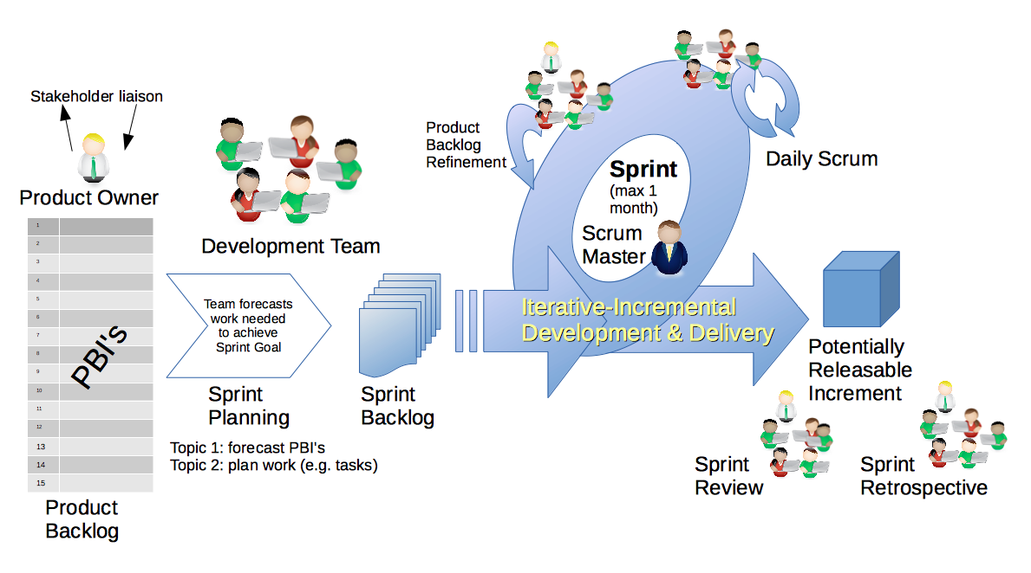
Scrum Process – Sprint Review & Demo
By Dr ian mitchell - Own work, CC BY-SA 4.0, Link

Slide 7
Demo Guidelines – Presenter
Everyone will give at least one demo of their work during the semester.
Your demo should be 2 to 5 minutes and can include any or all of the following:
Show your application running
Comment on your implementation
Show the source code
Explain how you organized the code
Talk about any challenges
You should not prepare slides or a presentation
**You will also need to complete the Demo assignment in Blackboard.

Slide 8
Demo Guidelines – Listener
Everyone will be listening to many demos during the semester.
Your listener responsibilities include:
Actively listening and watching what is being demoed
Come up with a meaningful yet easy to answer question
Ask your question if the presenter does not get sufficient questions from other listeners
Do not ask hard question or attempt to review the presenters code
Clap for the presenter at the end of the demo and thank them for presenting
Optionally follow up with the presenter later if you have what could be more difficult questions or if you have suggestions

Slide 9
Sprint Demos

Slide 10
Complete Sprint Demo Assignment

Slide 11
Scrum Process – Sprint Retrospective
By Dr ian mitchell - Own work, CC BY-SA 4.0, Link

Slide 12

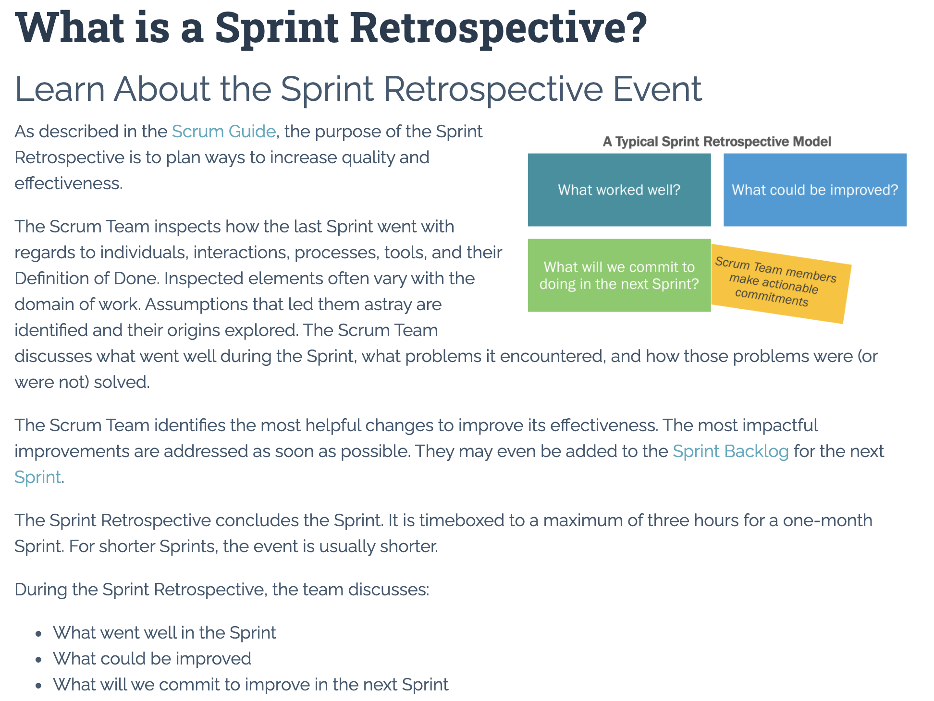

Slide 13
Submission Percentage

Slide 14
Class Retrospective
Feedback from Assignments & Reflections:
Wow! I’ve never seen a sprint 1 with these kinds of submission numbers
…
What can I/we do to improve in sprint 2?
What can we do to keep up the energy
How do you feel about scrum team submissions which are scheduled for Thursday

Slide 15
Sprint Planning

Slide 16
Sprint Planning
Sprint 2 Changes:
Very similar to sprint 1 with sprint 2 including Discussion 2, Quiz 2, Lab 2, and Reflection 2
Completely new programming assignment for sprint 2 which will likely need your feedback
This is also the first time I am utilizing private GitHub repositories for submitting assignments
We will attempt our first scrum team discussion on Thursday

Slide 17
Scrum Process – Sprint Planning
By Dr ian mitchell - Own work, CC BY-SA 4.0, Link

Slide 18
Product Backlog vs Sprint Backlog

Slide 19
Scrum Process – Product Backlog to Sprint Backlog
By Dr ian mitchell - Own work, CC BY-SA 4.0, Link

Slide 20
Scrum Process – Sprint Planning
By Dr ian mitchell - Own work, CC BY-SA 4.0, Link

Slide 21
Review Activities List and Assignments

Slide 22
Prework For Next Class
Complete through activity 5 prior to next class
Be prepared for a scrum team discussion of Object-Oriented Programming Patterns
Be prepared for some programming together time focused on “Website Creation with GitHub and Microsoft Azure - 2020 Supplemental Edition”

Slide 23
Lab
As a scrum team:
Review sprint 2 activities & assignments in detail focusing on “Coding Standards Validator”
Discuss questions/concerns and topics that need more clarification
Scrum master share your team’s top 2 questions/concerns during report out

Slide 24
End of Session

