Slide 1

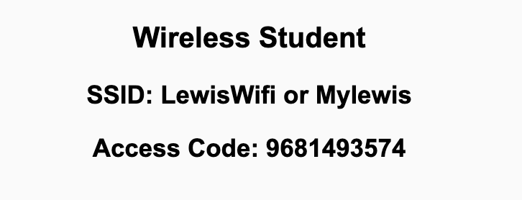
Preflight Check List
Sign into our Zoom meeting through our integrated Blackboard/Zoom link
Make sure that you can hear the conversation, see shared desktops, and view chat topics
Thank you if you choose to leave your camera on to help make our class more interactive
Be prepared to share your computer screen
Be prepared to utilize a headset with a microphone
In person participants also:
Make sure that your microphone and speakers are muted/off so that we don’t get an echo
Sit in a good spot near the classroom ceiling microphones if possible

Slide 2

Preflight Check List
Food!

Slide 3
Recordings
Discuss that recording are:
Opportunistic
Automatically available in Blackboard/Zoom
Sound Check… plus Video, and Desktop Sharing check
Start Recording

Slide 4
Agenda:
Thank you!
Final Project Presentations
Discussion & Questions welcome at any time but please be present with no phones or email during our time together

Slide 5
Thank You!

Slide 6
Presentation Guidelines
Your demo should be 3 to 5 per team member minutes and should include an overview and a presentation from each team member:
Introduce your team, yourself, and your product
Each person should present application features that they developed
Show your feature running and comment on your implementation
Show the source code and explain how it is organized
Talk about the research and implementation of the most challenging features
Discuss what else do you intend to implement by the end of the day Thursday
**You should have already submitted your Presentation Assignment in Blackboard.

Slide 7
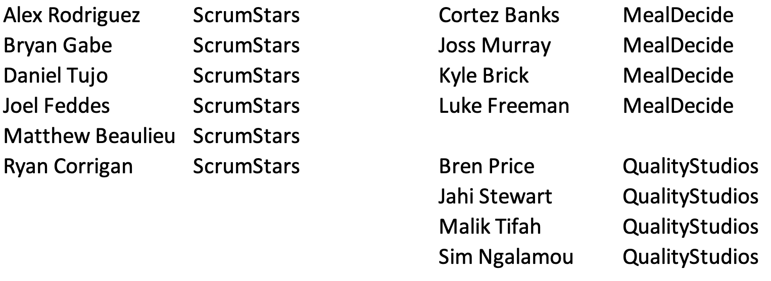
Final Project Presentations

Slide 8
Everything is due Thursday

Slide 9
Have A Wonderful Holiday!

Slide 10
End of Session

