Slide 1

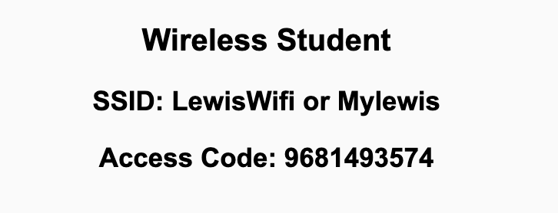
Preflight Check List
Sign into our Zoom meeting through our integrated Blackboard/Zoom link
Make sure that you can hear the conversation, see shared desktops, and view chat topics
Thank you if you choose to leave your camera on to help make our class more interactive
Be prepared to share your computer screen
Be prepared to utilize a headset with a microphone
In person participants also:
Make sure that your microphone and speakers are muted/off so that we don’t get an echo
Sit in a good spot near the classroom ceiling microphones if possible

Slide 2
Recordings
Discuss that recording are:
Opportunistic
Automatically available in Blackboard/Zoom
Start Recording

Slide 3
Agenda:
Prework
Witron Feedback
Remaining Demos?
Review Saas Client Frameworks and FOX chapter 6
Discussion 2
Prework for Next Class
Lab (as time allows)
Discussion & Questions welcome at any time but please be present with no phones or email during our time together

Slide 4
Prework
Complete through activity 9 and actively working on activity 10 prior to next class
Be prepared for Scrum Team Review of FOX chapter 6 Saas Client Framework
Be prepared for Scrum Team Discussion 2

Slide 5
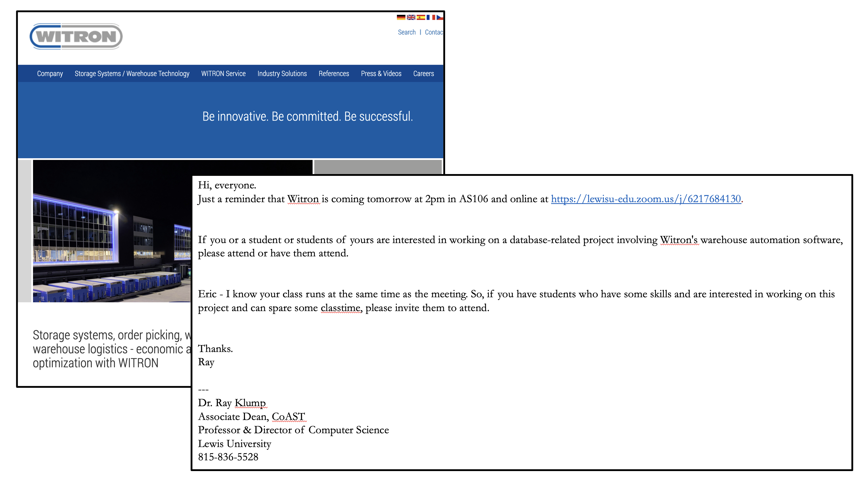
Witron Feedback

Slide 6
Remaining Sprint 1 Demos?

Slide 7
Complete Sprint Demo Assignment

Slide 8
Review Sass Client Framework (FOX chapter 6)
Assign presenter
Team discusses topics while the presenter summarizes the topics below:
JavaScript
AJAX
XML/JSON
Single-Page Web Applications
Angular, React, other single-page web application environments
Where does Jamstack fit?
Team sits back, relaxes, and acknowledges the bravery and dedication of the presenter

Slide 9
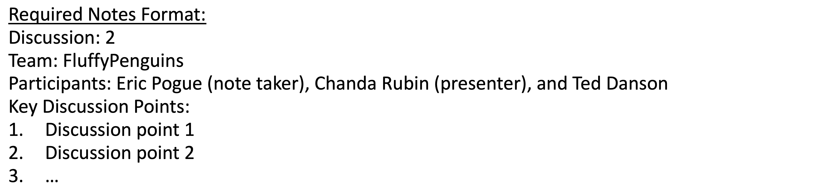
Discussion
Assign note taker and presenter roles
Review and discuss the discussion topic for this sprint for approximately 10 minutes
Note taker takes notes and presenter prepares a summary report out
Note taker share notes with all participating team members and each team member pastes and submits exact copy of the notes into their individual discussion board
Presenter Report Out

Slide 10
Prework For Next Class
Complete through activity 11
Be prepared for Review of FOX Chapters 3 through 5 and plus A.6 and A.7

Slide 11
Lab: Azure Web Applications with CI/CD
What is CI/CD?
How would we create and Azure based web application while focusing on CI/CD?
Prerequisites include Git, GitHub, Azure, Web Browser, Finder, Terminal, and VS Code
Review our example code to find a suitable basic web application
Create a GitHub repository
Add basic web application to the GitHub repository
Create an Azure website and link it to the GitHub repository
Update local Git repository with “git pull --no-edit” to update GitHub action
Update website, push changes, and review site
Regularly update and test Azure website during development
Notes:
git config –global pull.rebase false

Slide 12
End of Session

