Slide 1

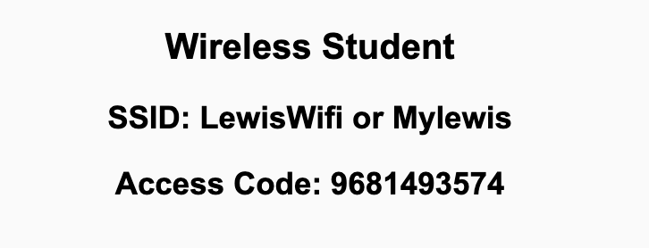
Preflight Check List
Sign into our Zoom meeting through our integrated Blackboard/Zoom link
Make sure that you can hear the conversation, see shared desktops, and view chat topics
Thank you if you choose to leave your camera on to help make our class more interactive
Be prepared to share your computer screen
Be prepared to utilize a headset with a microphone
In person participants also:
Make sure that your microphone and speakers are muted/off so that we don’t get an echo
Sit in a good spot near the classroom ceiling microphones if possible

Slide 2
Recordings
Discuss that recording are:
Opportunistic
Automatically available in Blackboard/Zoom
Start Recording

Slide 3
Agenda:
Prework
Review FOX Chapters 3 through 5 and plus A.6 and A.7
Prework for Next Class
Lab
Discussion & Questions welcome at any time but please be present with no phones or email during our time together

Slide 4
Prework For Next Class
Complete through activity 11
Be prepared for Review of FOX Chapters 3 through 5 and plus A.6 and A.7

Slide 5
Review FOX Chapters 3 through 5 and plus A.6 and A.7
Assign presenter
Team discusses topics while the presenter summarizes the topics below:
Chapter 3 Introduction to Ruby
Chapter 4 Introduction to Rails
Chapter 5 Advanced Rails
A.6 Git and Version Control
A.7 GitHub
ORM (Object-Relational-Mapper)
Team sits back, relaxes, and acknowledges the bravery and dedication of the presenter

Slide 6
Prework For Next Class
Complete through activity 14
Be prepared for Quiz 2

Slide 7
Lab
Web Resume
Notes:
git config –global pull.rebase false

Slide 8
Lab: Azure Web Applications with CI/CD
What is CI/CD?
How would we create and Azure based web application while focusing on CI/CD?
Prerequisites include Git, GitHub, Azure, Web Browser, Finder, Terminal, and VS Code
Review our example code to find a suitable basic web application
Create a GitHub repository
Add basic web application to the GitHub repository
Create an Azure website and link it to the GitHub repository
Update local Git repository with “git pull --no-edit” to update GitHub action
Update website, push changes, and review site
Regularly update and test Azure website during development
Notes:
git config –global pull.rebase false

Slide 9
End of Session

