Slide 1

Preflight Check List
Food!

Slide 2

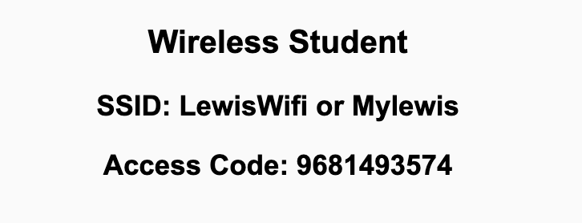
Preflight Check List
Sign into our Zoom meeting through our integrated Blackboard/Zoom link
Make sure that you can hear the conversation, see shared desktops, and view chat topics
Thank you if you choose to leave your camera on to help make our class more interactive
Be prepared to share your computer screen
Be prepared to utilize a headset with a microphone
In person participants also:
Make sure that your microphone and speakers are muted/off so that we don’t get an echo
Sit in a good spot near the classroom ceiling microphones if possible

Slide 3
Recordings
Discuss that recording are:
Opportunistic
Automatically available in Blackboard/Zoom
Sound Check… plus Video, and Desktop Sharing check
Start Recording

Slide 4
Agenda:
Prework & Announcements
Sprint 3 Review & Demos
Sprint 3 Retrospective
Scrum Team Sprint 3 Retrospective
Software Licensing
Prework for Next Class
Discussion & Questions welcome at any time but please be present with no phones or email during our time together

Slide 5
Prework & Announcements
Complete through activity 5 part 1 and working part 2 on activity 5
Those scheduled to demo on Wednesday please be a couple of minutes early to class

Slide 6
Sprint Review & Demos

Slide 7
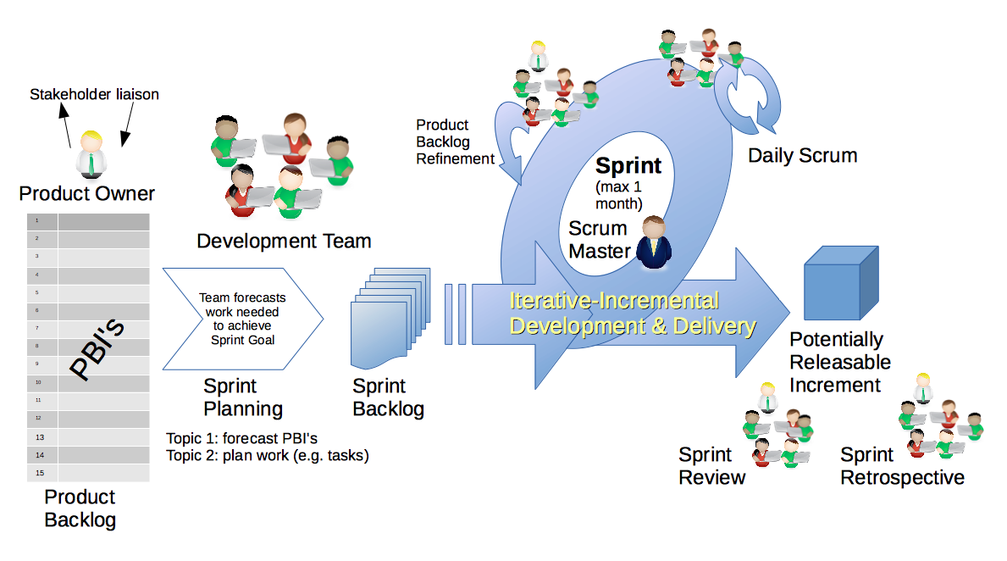
Scrum Process – Sprint Review & Demo
By Dr ian mitchell - Own work, CC BY-SA 4.0, Link

Slide 8
Demos

Slide 9
Demo Guidelines – Presenter
Everyone will give at least one demo of their work during the semester.
Your demo should be 2 to 5 minutes and can include any or all of the following:
Show your application running
Comment on your implementation
Show the source code
Explain how you organized the code
Talk about any challenges
You should not prepare slides or a presentation
**You will also need to complete the Demo assignment in Blackboard.

Slide 10
Demo Guidelines – Listener
Everyone will be listening to many demos during the semester.
Your listener responsibilities include:
Actively listening and watching what is being demoed
Come up with a meaningful yet easy to answer question
Ask your question if the presenter does not get sufficient questions from other listeners
Do not ask hard question or attempt to review the presenters code
Clap for the presenter at the end of the demo and thank them for presenting
Optionally follow up with the presenter later if you have what could be more difficult questions or if you have suggestions

Slide 11
Sprint Demos

Slide 12
Complete Sprint Demo Assignment

Slide 13
Scrum Process – Sprint Retrospective
By Dr ian mitchell - Own work, CC BY-SA 4.0, Link

Slide 14
Submission Percentage – Sprint 3

Slide 15
Class Retrospective
Feedback from Assignments & Reflections:
I’m speechless! 100% two sprints in a row. Unbelievable job turning in assignments on time!
All assignments are graded and posted
Remember to copy/paste the requirement into the lab response
README.md files and LICENSE files remain common questions
HTML and CSS went well
Azure hosting was challenging in some cases
We will be taking a break from HTML, CSS, and Azure but will be coming back to them

Slide 16
Scrum Team Retrospective
What’s working and what’s not working (team/class)?
What is one continuous improvement activity (team/class)?
Who will be the new Scrum Master for sprint 4?
Team Report-out

Slide 17
Software Licensing
Primary software license types include:
Public Domain
Permissive including MIT and BSD
Copy Left including GPL and LGPL
Proprietary including all rights reserved
5 types of software licenses you need to understand [link]
What are you afraid of [link]

Slide 18
Prework For Next Class
Complete through activity 7
Be prepared for Scrum Team Discussion 4
Be prepared for programming together with “MatchmakerLite - Part 1”

Slide 19
End of Session

