Slide 1

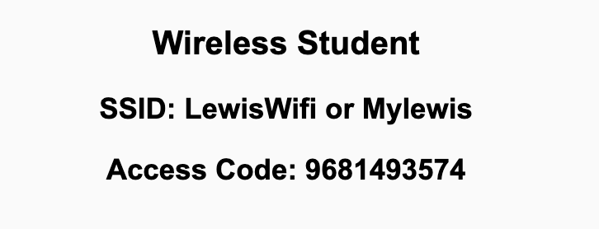
Preflight Check List
Sign into our Zoom meeting through our integrated Blackboard/Zoom link
Make sure that you can hear the conversation, see shared desktops, and view chat topics
Thank you if you choose to leave your camera on to help make our class more interactive
Be prepared to share your computer screen
Be prepared to utilize a headset with a microphone
In person participants also:
Make sure that your microphone and speakers are muted/off so that we don’t get an echo
Sit in a good spot near the classroom ceiling microphones if possible

Slide 2
Recordings
Discuss that recording are:
Opportunistic
Automatically available in Blackboard/Zoom
Sound Check… plus Video, and Desktop Sharing check
Start Recording

Slide 3
Agenda:
Prework & Announcements
YouTube, Eric’s Trip to Google, The Social Dilemma, and Technology Business Models
Review “Computer Science Illuminated” Artificial Intelligence
Lab
Discussion & Questions welcome at any time but please be present with no phones or email during our time together

Slide 4
Prework & Announcements
Complete through activity 9
Be prepared to review “Computer Science Illuminated” Artificial Intelligence

Slide 5
YouTube, Eric’s Trip to Google, The Social Dilemma, and Technology Business Models

Slide 6
The Question
“Professor Pogue, Why don’t you put your videos on YouTube? It works great.”
- students from Lewis University
The Response:
It makes me uncomfortable that Google and YouTube (and Facebook and Amazon) are all focused on getting more of your attention and I am enabling that by putting my content on YouTube.

Slide 7
Story Time with
Eric’s Trip to Google

Slide 8
Quotes from “The Social Dilemma”
“We’re the product. Our attention is the product being sold to advertisers.” - Justin Rosenstein, former engineer Facebook and Google, co-founder of Asana
“It’s the gradual, slight, imperceptible change in your own behavior and perception that is the product.” - Jaron Lainer, founding father of Virtual Reality Computer Scientist

Slide 9
Quotes from “The Social Dilemma”
“We’ve created a world in which online connection has become primary. Especially for younger generations. And yet, in that world, anytime two people connect, the only way it’s financed is through a sneaky third person whose paying to manipulate those two people. So we’ve created an entire global generation of people who were raised within a context with the very meaning of communication, the very meaning of culture, is manipulation.” - Jaron Lainer, founding father of Virtual Reality Computer Scientist

Slide 10
Quotes from “The Social Dilemma”
“If something is a tool, it genuinely is just sitting there, waiting patiently. If something is not a tool it's demanding things from you. It's seducing you, it’s manipulating you, it wants things from you. We've moved away from a tools based technology environment, to an addiction and manipulation used technology environment. Social media isn't a tool waiting to be used. It has its own goals, and it has its own means of pursuing them by using your psychology against you.” - Tristan Harris, former design ethicist at Google and co-founder of Centre for Humane Technologies‍

Slide 11
Quotes from “The Social Dilemma”
“We’re training and conditioning a whole new generation of people that when we are uncomfortable or lonely or uncertain or afraid, we have a digital pacifier for ourselves. That is kind of atrophying our own ability to deal with that.” - Tristan Harris, former design ethicist at Google and co-founder of Centre for Humane Technologies

Slide 12
Eric’s Opinion and Editorial Comments
We are polarizing viewpoints by providing individualized feeds that reinforce already held views and opinions. This reinforcement and polarization is a byproduct of the desire to gain a few more seconds of attention (or another click).

Slide 13
The Original Question
“Professor Pogue, Why don’t you put your videos on YouTube? It works great.”
-- students from Lewis University
The Response:
It makes me uncomfortable that Google and YouTube (and Facebook and Amazon) are all focused on getting more of your attention and I am enabling that by putting my content on YouTube.

Slide 14
Update - October, 2021
"The result has been more division, more harm, more lies, more threats and more combat. In some cases, this dangerous online talk has led to actual violence that harms and even kills people,"
-- Former Facebook data scientist Frances Haugen
Also considerable conversation around the “addictive” nature of social media and impact to children and young adults.

Slide 15
Recommendation
Take a few minutes to to contemplate the Google, YouTube, Facebook, WhatsApp, and TicTok style business model. Also consider the Apple and Microsoft business model.
Be aware. Decide what’s right for you.

Slide 16
Artificial Intelligence
Assign presenter
Team discusses topics while the presenter summarizes the most important topics including the representation of:
Thinking Machines and The Turing Test
Knowledge Representation, Semantic Networks, and Search Trees
Expert Systems and Neural Networks
Natural Language Processing, Voice Synthesis, and Voice Recognition
Robotics, Subsumption Architecture, and Physical Components
Team sits back, relaxes, and acknowledges the bravery and dedication of the presenter

Slide 17
Prework For Next Class
Complete through activity 9 and be working on activity 10
Be prepared for Quiz 4

Slide 18
End of Session

