Slide 1

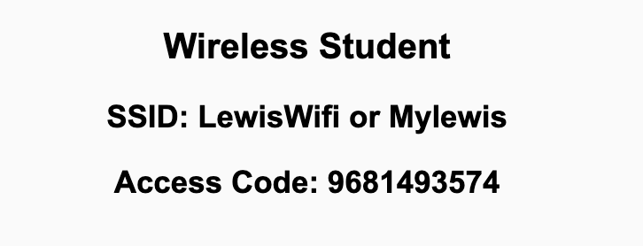
Preflight Check List
Sign into our Zoom meeting through our integrated Blackboard/Zoom link
Make sure that you can hear the conversation, see shared desktops, and view chat topics
Thank you if you choose to leave your camera on to help make our class more interactive
Be prepared to share your computer screen
Be prepared to utilize a headset with a microphone
In person participants also:
Make sure that your microphone and speakers are muted/off so that we don’t get an echo
Sit in a good spot near the classroom ceiling microphones if possible

Slide 2
Recordings
Discuss that recording are:
Opportunistic
Automatically available in Blackboard/Zoom
Sound Check… plus Video, and Desktop Sharing check
Start Recording

Slide 3
Agenda:
Prework & Announcements
TIOBE Index and Python’s Popularity
Lab
Discussion & Questions welcome at any time but please be present with no phones or email during our time together

Slide 4
Prework & Announcements
Complete through activity 10
Be prepared for Lab

Slide 5
TIOBE Index

Slide 6
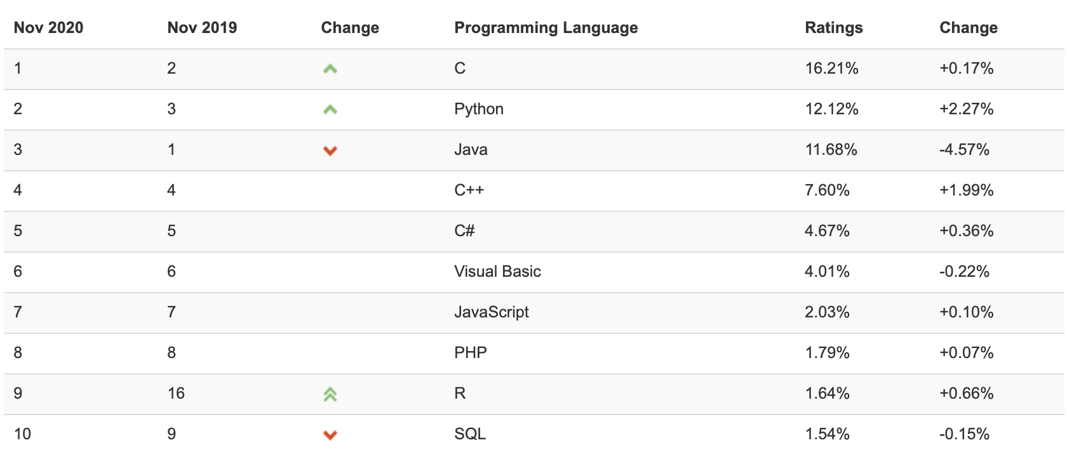
TIOBE Index for November 2020 November Headline: Python is unstoppable and surpasses Java

Slide 7
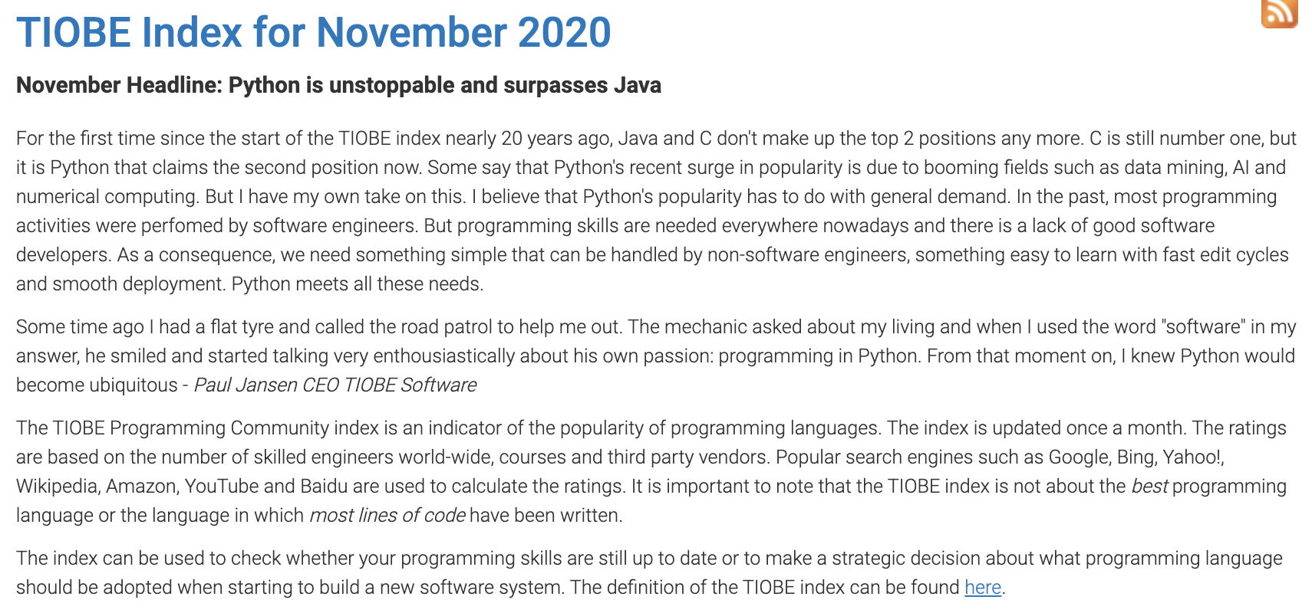
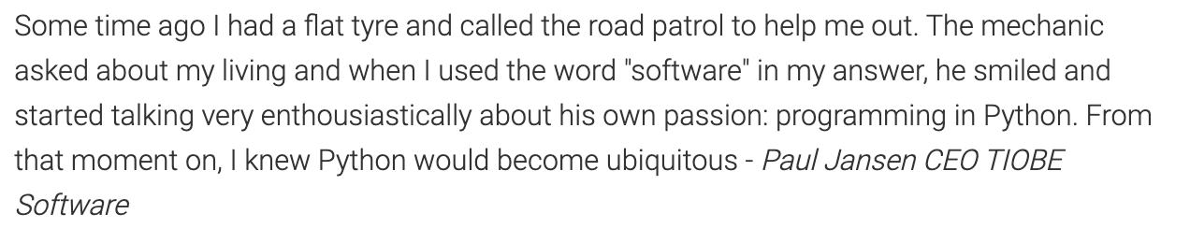

Slide 8
TIOBE Index

Slide 9
Prework For Next Class
Everything is due Sunday!

Slide 10
Lab

Slide 11
End of Session

