Slide 1

Class Session Check List
Everyone:
Sign into our Zoom meeting through our integrated Blackboard/Zoom link
Make sure that you can hear the conversation, see shared desktops, and view group chat topics
You will need a headset with a microphone to be able to effectively listen and speak
You will need to be able to share your computer screen
Thank you if you choose to leave your camera on to help make our class more interactive
In person participants also:
Make sure that your microphone and speakers are muted/off so that we don’t get an echo
Sit in a good spot near the classroom ceiling microphones if possible

Slide 2
Class Session Check List
Review that recordings are:
Opportunistic
Automatically available within Blackboard/Zoom
… Now make sure that the classroom microphone, speakers, and camera are being used in Zoom, move to the next slide, AND verify that recording is started.
… Also make sure that slides are visible to attendees

Slide 3
Agenda:
Prework and Announcements
Assignment Q&A
Programming Together
Prework for Next Class
Discussion & Questions welcome at any time but please be present with no phones or email during our time together

Slide 4
Prework & Announcements
Complete through activity 16 and be actively working on activity 17
Be prepared for programming together with Azure… if you have not been actively working with Microsoft Azure yet this, you are behind
Be prepared for Nick and Eric programming Azure together
Everything is due Sunday!

Slide 5
Assignment Q&A

Slide 6
Programming Together
Review activities and assignments
Azure deployment strategies
Review Azure Website… plus FAQ section
Nick and Eric programming Azure together

Slide 7
Programming Together

Slide 8
Prework For Next Class
Everything is due Sunday!

Slide 9
End of Session

Slide 10
Backup & Future Slides

Slide 11
Scrum Team Chapter Discussion
Assign presenter
Team discussing chapter topics while the presenter summarizes the 5 topics below:
The importance of Branching is VCS systems (which VCS focused on branching)
Where should pared programming fit into the development process
The priority of specialization vs generalization in Agile vs Waterfall/Iterative
The relative importance of PMs in Agile vs Waterfall/Iterative
The two most important book on managing people and conflict (according to the author)
Team sits back, relaxes, and acknowledges the bravery and dedication of the presenter
Fox Chapter 10 on Project Management, Scrum, Pairs, and Version Control Systems

Slide 12
Scrum Team Discussion Boards in 14 Minutes
Scrum teams should complete discussion board (DB) in 14 minutes by:
Scrum master accepting volunteers (or assigning) note taker and presenter responsibilities in 1 minute
Team discussing Discussion Board topic for 10 minutes while the note taker documents:
Discussion board number & title
Team name
Fully participating team members
At least 5 bulleted discussion topics from discussion
Note taker shares notes with participating team members in 1 minute
Team member who actively participated paste an exact copy of the notes into their individual DB post and submit the post taking at most 1 minute
Presenter is preparing to give a very brief report out from the team during above discussion
Team sits back, relaxes, and acknowledges the fine work of the note taker and presenter for 1 minute
Note: Team members who actively participated and submit DB notes in their individual DB do not need to make additional DB posts responding to other classmates’ posts

Slide 13
JAMStack
The ‘JAM,’ part stands for JavaScript, APIs, and Markup.
These are the essential building blocks to any JAMstack site. This term was invented by Netlify co-founder Mathias Biilmann.
Single-page application [link]
Serverless computing [link]

Slide 14
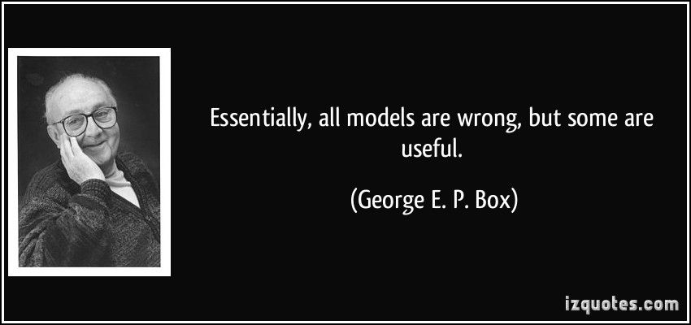
Models

