Slide 1

Class Session Check List
Everyone:
Sign into our Zoom meeting through our integrated Blackboard/Zoom link
Make sure that you can hear the conversation, see shared desktops, and view group chat topics
You will need a headset with a microphone to be able to effectively listen and speak
You will need to be able to share your computer screen
Thank you if you choose to leave your camera on to help make our class more interactive
In person participants also:
Make sure that your microphone and speakers are muted/off so that we don’t get an echo
Sit in a good spot near the classroom ceiling microphones if possible

Slide 2
Attendance
Document in-person attendance for contact tracing.

Slide 3
Class Session Check List
Review that recordings are:
Opportunistic
Automatically available within Blackboard/Zoom
… Now make sure that the classroom microphone, speakers, and camera are being used in Zoom, move to the next slide, AND verify that recording is started.
… Also make sure that slides are visible to attendees

Slide 4
Agenda:
Prework and Announcements
Friendly Conversation Topic
The Humble Text File
Sprint 3 Planning
Prework for Next Class
Discussion & Questions welcome at any time but please be present with no phones or email during our time together

Slide 5
Prework & Announcements
Everything is due Sunday!
Be prepared for sprint 3 planning on Monday

Slide 6
Friendly Conversation Topic Should there be one or two spaces after a period?

Slide 7
Representation: Text Files

Slide 8
The Humble Text File
Notes:
Anybody else wonder how the simple text file remains the standard for building some of the most complex creations in the world?

Slide 9
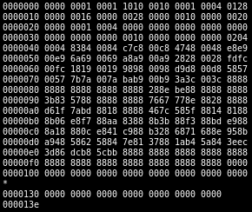
Files
All computer files are binary and can be represented in Hex
Some binary files can also be represented as text files
The term “binary file” is often incorrectly used to imply that a file is a “non-text” file.

Slide 10
In The Beginning There Were ASCII Text Files

Slide 11
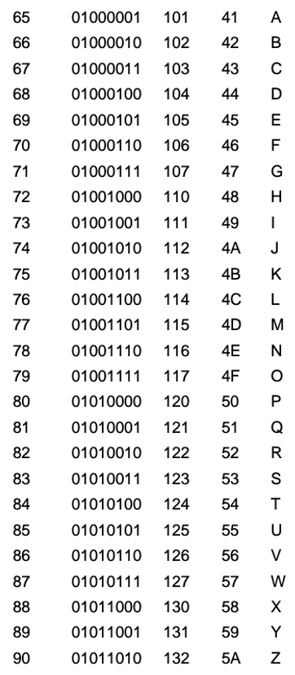
ASCII Files
Bytes are frequently used to hold individual characters in a text document. In the ASCII character set, each binary value between 0 and 127 is given a specific character. Most computers extend the ASCII character set to use the full range of 256 characters available in a byte. The upper 128 characters handle special things like accented characters from common foreign languages.

Slide 12
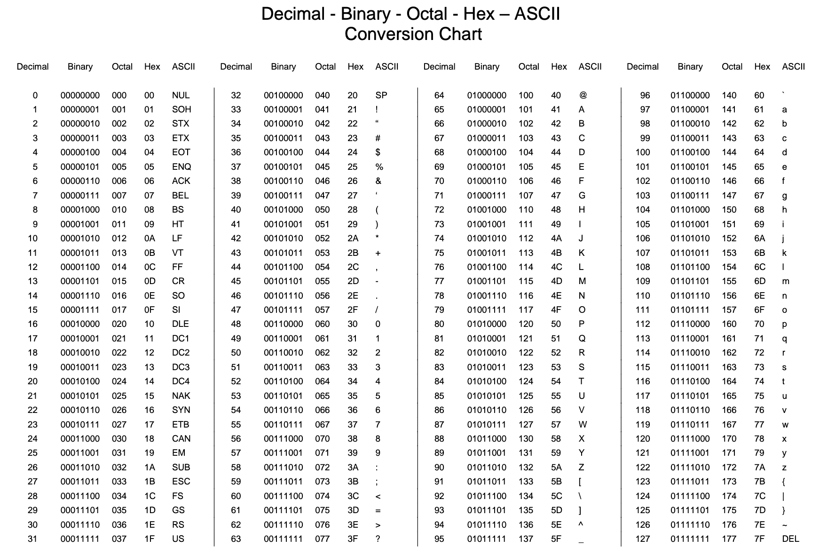

Slide 13
Unicode & UTF-16

Slide 14
Unicode, UTF-16, and UTF-8
Unlike ASCII, UTF-16 (Unicode) includes 65,536 possible combinations covering 154 modern and historical scripts, as well as multiple symbol sets [link]

Slide 15

Unicode, UTF-16, and UTF-8
Unicode
Unicode was a brave effort to create a single character set that included every reasonable writing system on the planet and some make-believe ones like Klingon, too. Some people are under the misconception that Unicode is simply a 16-bit code where each character takes 16 bits and therefore there are 65,536 possible characters. This is not, actually, correct. It is the single most common myth about Unicode, so if you thought that, don’t feel bad. [link]
“Oops!” -- Eric

Slide 16
Unicode, UTF-16, and UTF-8
Unicode: Code Points
UTF-16 Encoding: 2 bytes per character… plus some craziness

Slide 17
UTF-8

Slide 18
Unicode, UTF-16, and UTF-8
Unicode
For a while it seemed like that (UTF-16) might be good enough, but programmers were complaining. “Look at all those zeros!” they said, since they were Americans and they were looking at English text … Also they were liberal hippies in California who wanted to conserve (sneer). If they were Texans they wouldn’t have minded guzzling twice the number of bytes. But those Californian wimps couldn’t bear the idea of doubling the amount of storage it took for strings, and anyway, there were already all these doggone documents out there using various ANSI and DBCS character sets and who’s going to convert them all? Moi? For this reason alone most people decided to ignore Unicode for several years and in the meantime things got worse.
Thus was invented the brilliant concept of UTF-8. UTF-8 was another system for storing your string of Unicode code points, those magic U+ numbers, in memory using 8 bit bytes. In UTF-8, every code point from 0-127 is stored in a single byte. Only code points 128 and above are stored using 2, 3, in fact, up to 6 bytes.

Slide 19
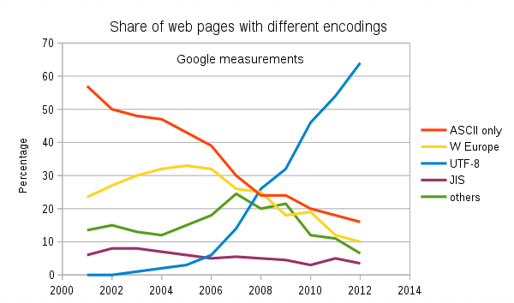
Text File Standards (Encoding)
ASCII
Unicode
UTF-8
Others

Slide 20
Text File End-Of-Line (EOL) and Encoding
Industry adoption of end-of-line encoding includes:
Windows: Both Carriage Return (CR, \r, 0x0d) and Line Feed (LF, \n, 0x0a) together.
Unix/Linux/OSX: Just Line Feed (LF, \n, 0x0a)
Mac (pre-OSX): Just Carriage Return (CR, \r, 0x0d)
Article on Windows Notepad supporting non-Windows EOF conventions [link]

Slide 21
HTML Character Entities

Slide 22

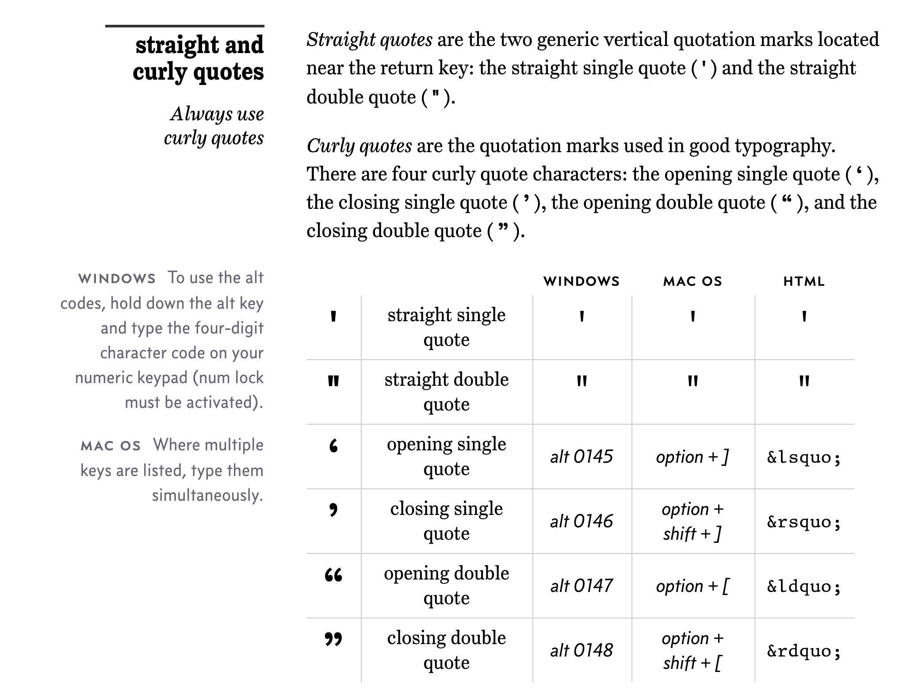
Straight vs Curly Quotes

Slide 23
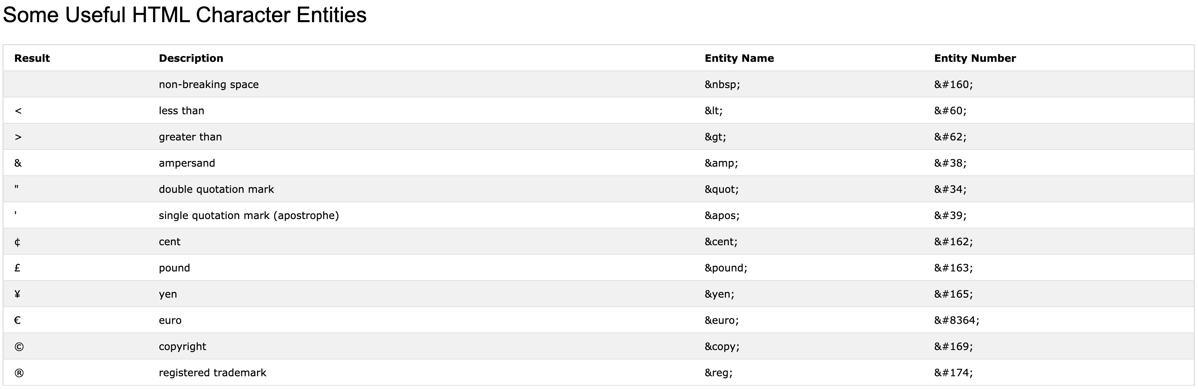
HTML Character Entities

Slide 24

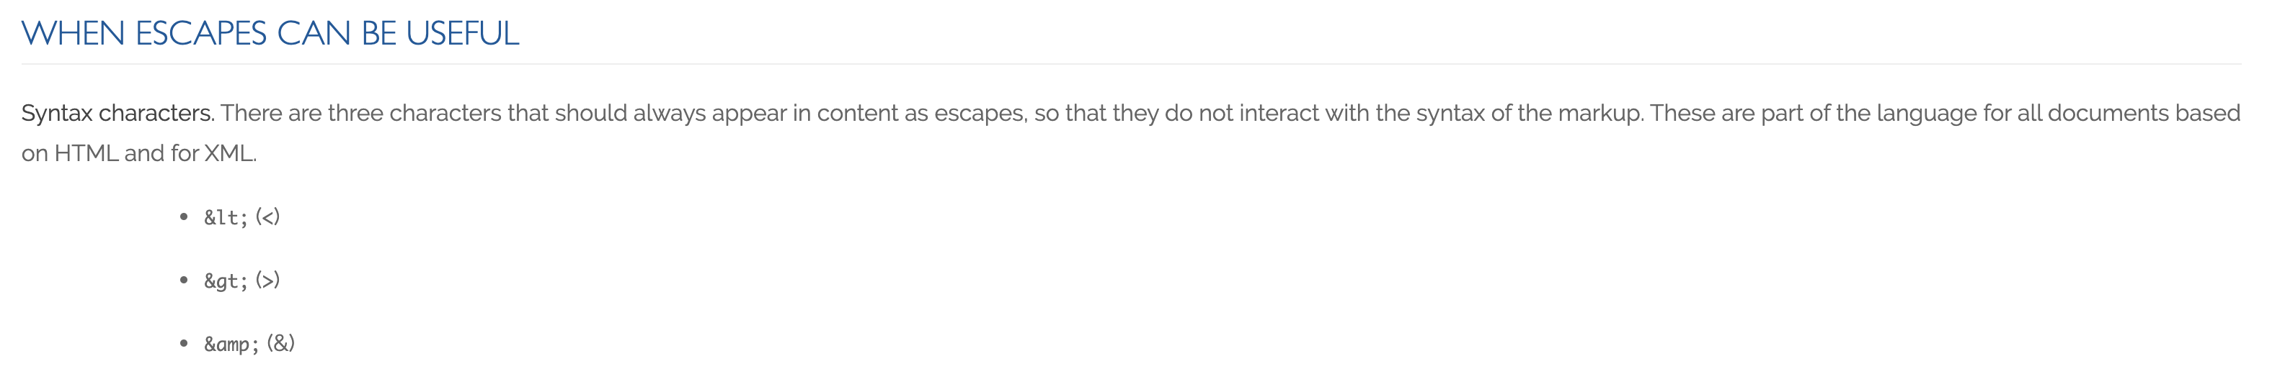
Always Escape

Slide 25
And Only One Space After a Period
Rule: Utilize one space after a period or similar punctuation [link]
Proportional based fonts like Helvetica and Times were designed to have the most visually appealing amount of space after the period.
Notes:
A possible exception would be non-proportional based fonts

Slide 26
Sprint Planning

Slide 27
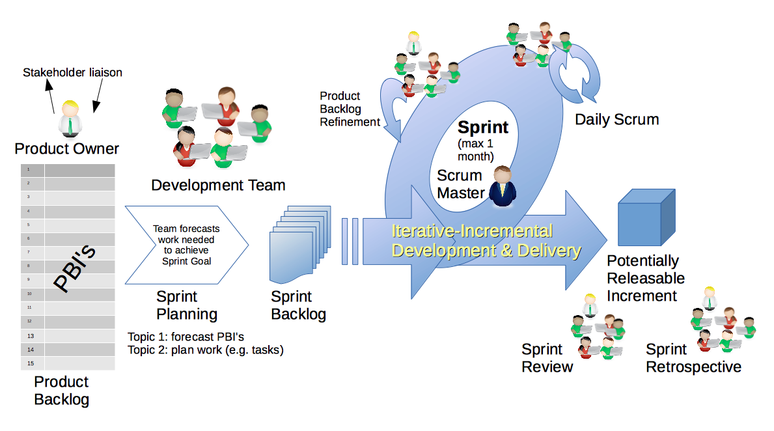
Scrum Process – Sprint Planning
By Dr ian mitchell - Own work, CC BY-SA 4.0, Link

Slide 28
Review Activities List and Assignments

Slide 29
Prework For Next Class
Complete through activity 7 prior to next class
Be prepared for scrum team review of Gates & Circuits
Those scheduled to demo on Wednesday please be a couple of minutes early to class

Slide 30
Review Demo Schedule

Slide 31
End of Session

