Slide 1

Class Session Check List
Everyone:
Sign into our Zoom meeting through our integrated Blackboard/Zoom link
Make sure that you can hear the conversation, see shared desktops, and view group chat topics
You will need a headset with a microphone to be able to effectively listen and speak
You will need to be able to share your computer screen
Thank you if you choose to leave your camera on to help make our class more interactive
In person participants also:
Make sure that your microphone and speakers are muted/off so that we don’t get an echo
Sit in a good spot near the classroom ceiling microphones if possible

Slide 2
Attendance
Document in-person attendance for contact tracing.

Slide 3
Class Session Check List
Review that recordings are:
Opportunistic
Automatically available within Blackboard/Zoom
… Now make sure that the classroom microphone, speakers, and camera are being used in Zoom, move to the next slide, AND verify that recording is started.
… Also make sure that slides are visible to attendees

Slide 4
Agenda:
Prework and Announcements
Sprint 2 Demos
Sprint 2 Retrospective
Prework for Next Class
Lab (as time allows)
Discussion & Questions welcome at any time but please be present with no phones or email during our time together

Slide 5
Prework
Complete through activity 7 prior to next class
Be prepared for scrum team review of Graphical User Interfaces (GUI) in Java
Those scheduled to demo on Wednesday please be a couple of minutes early to class

Slide 6
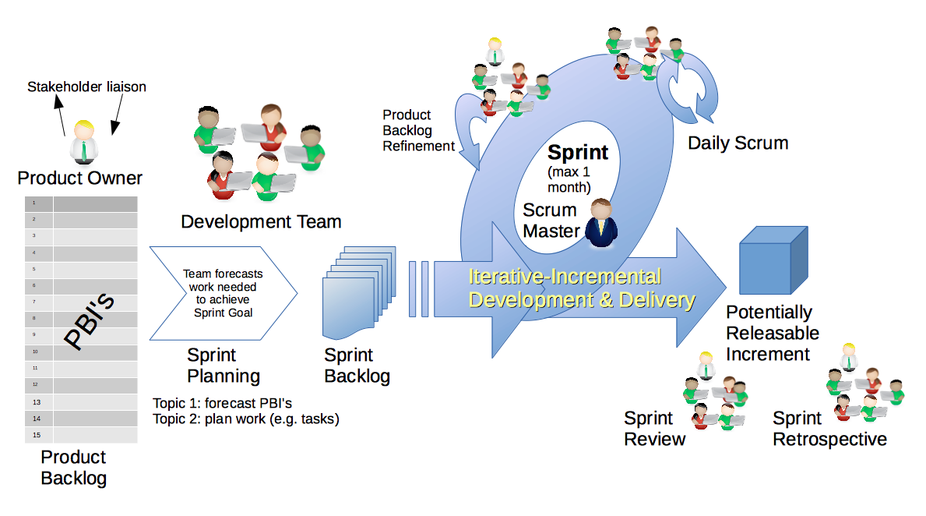
Scrum Process – Sprint Review & Demo
By Dr ian mitchell - Own work, CC BY-SA 4.0, Link

Slide 7
Demo Guidelines – Presenter
Everyone will give at least one demo of their work during the semester.
Your demo should be 2 to 5 minutes and can include any or all of the following:
Show your application running
Comment on your implementation
Show the source code
Explain how you organized the code
Talk about any challenges
You should not prepare slides or a presentation
**You will also need to complete the Demo assignment in Blackboard.

Slide 8
Demo Guidelines – Listener
Everyone will be listening to many demos during the semester.
Your listener responsibilities include:
Actively listening and watching what is being demoed
Come up with a meaningful yet easy to answer question
Ask your question if the presenter does not get sufficient questions from other listeners
Do not ask hard question or attempt to review the presenters code
Clap for the presenter at the end of the demo and thank them for presenting
Optionally follow up with the presenter later if you have what could be more difficult questions or if you have suggestions

Slide 9
Sprint Demos

Slide 10
Complete Sprint Demo Assignment

Slide 11
Scrum Process – Sprint Retrospective
By Dr ian mitchell - Own work, CC BY-SA 4.0, Link

Slide 12
Submission Percentage from Sprint 1

Slide 13
Submission Percentage for Sprint 2

Slide 14
Class Retrospective
Feedback from Assignments & Reflections:
Very good submission numbers
The numbers don’t even tell the whole story as doesn’t feel great to have two missing lab
Grades should be posted for assignments
Stephanie and I continue to be challenged to effectively get through the grading before our Wednesday class
Suggestion 1: Become comfortable with submitting 90% of what’s requested
Suggestion 2: Take a hard look at where you are in the class because it is very hard to turn things around after sprint 3

Slide 15
Scrum Team Retrospective
Provide your feedback on:
What is one thing your team can commit to improving on in sprint 3
Should we continue scrum team discussion boards?
Class Forum options?
Who will be the new scrum master for sprints 3 and 4

Slide 16
Prework
Complete through activity 8 prior to next class
Be prepared for scrum team Discussion 3
Be prepared for scrum team review of Gates & Circuits

Slide 17
Lab (as time allows)
Deploying web applications to Azure:
Class sample code from GitHub
Deploy application to Azure

Slide 18
End of Session

Slide 19
Software Licensing
Primary software license types include:
Public Domain
Permissive including MIT and BSD
Copy Left including GPL and LGPL
Proprietary including all rights reserved
5 types of software licenses you need to understand [link]
What are you afraid of [link]

