Slide 1

Class Session Check List
Everyone:
Sign into our Zoom meeting through our integrated Blackboard/Zoom link
Make sure that you can hear the conversation, see shared desktops, and view group chat topics
You will need a headset with a microphone to be able to effectively listen and speak
You will need to be able to share your computer screen
Thank you if you choose to leave your camera on to help make our class more interactive
In person participants also:
Make sure that your microphone and speakers are muted/off so that we don’t get an echo
Sit in a good spot near the classroom ceiling microphones if possible

Slide 2
Class Session Check List
Review that recordings are:
Opportunistic
Automatically available within Blackboard/Zoom
… Now make sure that the classroom microphone, speakers, and camera are being used in Zoom, move to the next slide, AND verify that recording is started.
… Also make sure that slides are visible to attendees

Slide 3
Agenda:
Prework and Announcements
Testing Q&A
YouTube, Eric’s Trip to Google, and The Social Dilemma of Technology Business Models
Programming Together
Prework for Next Class
Quiz 3
Discussion & Questions welcome at any time but please be present with no phones or email during our time together

Slide 4
Prework & Announcements
Complete through activity 10
Be prepared for Quiz 3

Slide 5
Testing Q&A
Notes:
Critical Path… Light Weight long-term planning

Slide 6
Software Testing “Truths”
Never underestimate the value of good design and implementation (for testability, encapsulation, etc.) on the economics of testing… You can’t afford to test in quality!
Defects are exponentially more expensive to fix the longer the exist.
Unit - $200
Integration - $600
User Acceptance - $6,000
Production - $100,000+
Performance issues are often the most difficult and expensive defects to fix. They are often not found until the application if running under production load… which is often only when it is in production.
The permutations of modern software features, data, tools, environments, etc. quickly becomes unmanageable. Testability needs to be goal of nearly all non-trivial applications.

Slide 7
Testing Terms
Important testing terms include:
Unit Testing: developer testing their own code
Integration Testing: development team testing their full code
System Testing: multiple development teams testing a full system or systems
Performance Testing: testing performance at the Unit, Integration, and/or System level
Manual Testing: a person using the application often running test scenarios
Automated Testing: a group of automated tests that run on the application in the Unit, Integration, System, or Performance testing areas
UI Automated Testing attempts to exercise the application be reproducing user events (key & mouse events)
API Automated Testing occurs at the function/method API level (JUnit for example)

Slide 8
Automated Testing
Unit testing can be done in two ways − manual testing and automated testing.
Automated testing has become a more important part of effective software testing. The pros of Automated Testing include:
Repeatable tests that are quick to run and can support Iterative and Agile development
Very effective in validating environments and doing “smoke tests” to make sure a new build meets a minimal set of requirements
Supports Performance Testing very effectively
Very inexpensive and quick to repeat testing and validate fixes
Various implications include UI, API, and Unit automation tests… each has a very different set of pros and cons
Notes:
False positives versus valid defects found.
Manual Testing and Automated Testing can be supportive of each other.

Slide 9
Automated Testing
Unit testing can be done in two ways − manual testing and automated testing.
Some of the benefits of Automated Testing have been oversold. Some of the challenges include:
Developers rarely can come up with scenarios in scripts that they would not already have tested in their normal unit testing… they often don’t know what they don’t know
UI focused Automated Testing (key & mouse events) are often challenging and create/maintain a great number of false-positives
API Level Automated Testing (i.e. REST) scripts are often more useful and easier to maintain
Environmental verification, API, and finally UI Automated testing is generally the best order to show value quickly with Automated Testing
Automated Testing investment is often not prioritized or tracked so it is difficult to know its effectiveness
Scripts can be expensive to develop and maintain
Notes:
False positives versus valid defects found.
Manual Testing and Automated Testing can be supportive of each other.

Slide 10
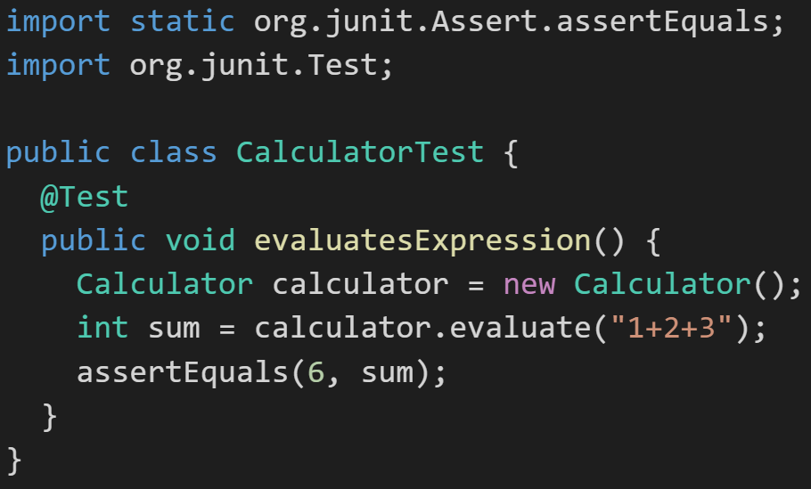
Automated Unit Testing Example: JUnit
Unit testing can be done in two ways − manual testing and automated testing.
JUnit [link] is a Automated Testing framework focused on developing and running Unit test for Java applications. JUnit:
Is a Java opensource extension
Provides annotations to identify test methods.
Provides assertions for testing expected results.
Provides test runners for running tests.
JUnit tests allow you to write codes faster, which increases quality.
JUnit is elegantly simple. It is less complex and takes less time.
JUnit tests can be run automatically and they check their own results and provide immediate feedback. There's no need to manually comb through a report of test results
Notes:
@Test
identifies the method as a test method (remember, method and function are synonyms)
@Test(expected = Exception.class)
fails if the method does not throw the named exception
@Test(timeout=100)
fails if the method takes longer than 100 milliseconds
@Before
public void method()
This method is executed before each test. It is used to prepare the test environment.
@After
public void method()
This method is executed after each test. It is used to clean up the test environment, including cleaning up expensive memory structures.
@BeforeClass
public static void method()
This method is executed once, before any test is done. It is used to do time-intensive tasks before any test is done.

Slide 11
The Question
“Professor Pogue, Why don’t you put your videos on YouTube? It works great.” - students from Lewis University
The Response:
It makes me uncomfortable that Google and YouTube (and Facebook and Amazon) are all focused on getting more of your attention and I am enabling that by putting my content on YouTube.

Slide 12
Story Time with
Eric’s Trip to Google

Slide 13
Quotes from “The Social Dilemma”
“We’re the product. Our attention is the product being sold to advertisers.” - Justin Rosenstein, former engineer Facebook and Google, co-founder of Asana
“It’s the gradual, slight, imperceptible change in your own behavior and perception that is the product.” - Jaron Lainer, founding father of Virtual Reality Computer Scientist

Slide 14
Quotes from “The Social Dilemma”
“We’ve created a world in which online connection has become primary. Especially for younger generations. And yet, in that world, anytime two people connect, the only way it’s financed is through a sneaky third person whose paying to manipulate those two people. So we’ve created an entire global generation of people who were raised within a context with the very meaning of communication, the very meaning of culture, is manipulation.” - Jaron Lainer, founding father of Virtual Reality Computer Scientist

Slide 15
Quotes from “The Social Dilemma”
“If something is a tool, it genuinely is just sitting there, waiting patiently. If something is not a tool it's demanding things from you. It's seducing you, it’s manipulating you, it wants things from you. We've moved away from a tools based technology environment, to an addiction and manipulation used technology environment. Social media isn't a tool waiting to be used. It has its own goals, and it has its own means of pursuing them by using your psychology against you.” - Tristan Harris, former design ethicist at Google and co-founder of Centre for Humane Technologies‍

Slide 16
Quotes from “The Social Dilemma”
“We’re training and conditioning a whole new generation of people that when we are uncomfortable or lonely or uncertain or afraid, we have a digital pacifier for ourselves. That is kind of atrophying our own ability to deal with that.” - Tristan Harris, former design ethicist at Google and co-founder of Centre for Humane Technologies

Slide 17
Eric’s Editorial Comment
We are polarizing viewpoints by providing individualized feeds that reinforce already held views and opinions. This reinforcement and polarization is a byproduct of the desire to gain a few more seconds of attention or another click.

Slide 18
The Original Question
“Professor Pogue, Why don’t you put your videos on YouTube? It works great.” - students from Lewis University
The Response:
It makes me uncomfortable that Google and YouTube (and Facebook and Amazon) are all focused on getting more of your attention and I am enabling that by putting my content on YouTube.
Recommendation:
Take a minute to to contemplate the Google, YouTube, Facebook, WhatsApp, and TicTok style business model. Also consider the Apple and Microsoft business model.
Be aware. Decide what’s right for you.

Slide 19
Programming Together
Team Time plus Repository Sharing

Slide 20
Prework
Complete through activity 12 and be working on 13
Be prepared for Programming Together

Slide 21
Prework
Complete through activity 12 and be working on 13
Be prepared for Programming Together… how much time do you need with your team?

Slide 22
Quiz

Slide 23
End of Session

