Slide 1

Class Session Check List
Everyone:
Sign into our Zoom meeting through our integrated Blackboard/Zoom link
Make sure that you can hear the conversation, see shared desktops, and view group chat topics
You will need a headset with a microphone to be able to effectively listen and speak
You will need to be able to share your computer screen
Thank you if you choose to leave your camera on to help make our class more interactive
In person participants also:
Make sure that your microphone and speakers are muted/off so that we don’t get an echo
Sit in a good spot near the classroom ceiling microphones if possible

Slide 2
Class Session Check List
Review that recordings are:
Opportunistic
Automatically available within Blackboard/Zoom
… Now make sure that the classroom microphone, speakers, and camera are being used in Zoom, move to the next slide, AND verify that recording is started.
… Also make sure that slides are visible to attendees

Slide 3
Agenda:
Prework and Announcements
Sprint 3 Demos
Sprint 3 Retrospective
Sprint 4 Planning
Prework for Next Class
Scrum Team Sprint 4 Planning
Discussion & Questions welcome at any time but please be present with no phones or email during our time together

Slide 4
Prework & Announcements
Everything is due Sunday!
Be prepared for Sprint 3 Demos, Sprint 3 Retrospective, and Sprint 4 Planning next class.

Slide 5
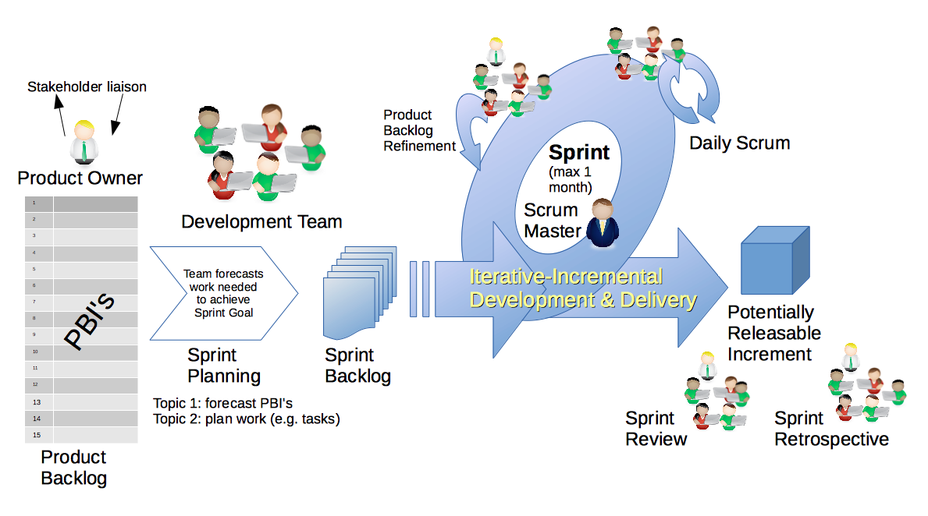
Scrum Process – Sprint Review & Demo
By Dr ian mitchell - Own work, CC BY-SA 4.0, Link

Slide 6
Demo Guidelines – Presenter
Everyone will give at least one demo of their work during the semester.
Your demo should be 2 to 5 minutes and can include any or all of the following:
Show your application running
Comment on your implementation
Show the source code
Explain how you organized the code
Talk about any challenges
You should not prepare slides or a presentation
**You will also need to complete the Demo assignment in Blackboard.

Slide 7
Demo Guidelines – Listener
Everyone will be listening to many demos during the semester.
Your listener responsibilities include:
Actively listening and watching what is being demoed
Come up with a meaningful yet easy to answer question
Ask your question if the presenter does not get sufficient questions from other listeners
Do not ask hard question or attempt to review the presenters code
Clap for the presenter at the end of the demo and thank them for presenting
Optionally follow up with the presenter later if you have what could be more difficult questions or if you have suggestions

Slide 8
Sprint Demos

Slide 9
Complete Sprint Demo Assignment

Slide 10
Scrum Process – Sprint Retrospective
By Dr ian mitchell - Own work, CC BY-SA 4.0, Link

Slide 11
Submission Percentage from Sprint 1

Slide 12
Submission Percentage from Sprint 2

Slide 13
Submission Percentage for Sprint 3

Slide 14
Class Retrospective
Feedback from Assignments & Reflections:
Solid assignment submission numbers
Grades are posted for assignments that were submitted on time
Quiz answer should be available now… email me with questions or comments about the quiz
Stephanie and I are getting better at getting through the grading before our Tuesday class
Check your current grade… and be aware of drop date deadlines
Email me if you want to change scrum teams or if you would be okay with changing scrum teams

Slide 15
Scrum Team Retrospective
Provide your feedback on:
What is one thing your team can commit to improving on in sprint 4
Do we need to make any scrum team changes?

Slide 16
Sprint Planning

Slide 17
Sprint Planning
Sprint 4 Changes:
Similar to last sprint including Discussion, Quiz, Lab, and Reflection
Missing class next Thursday will be a challenge

Slide 18
Scrum Process – Sprint Planning
By Dr ian mitchell - Own work, CC BY-SA 4.0, Link

Slide 19
Product Backlog vs Sprint Backlog

Slide 20
Scrum Process – Product Backlog to Sprint Backlog
By Dr ian mitchell - Own work, CC BY-SA 4.0, Link

Slide 21
Scrum Process – Sprint Planning
By Dr ian mitchell - Own work, CC BY-SA 4.0, Link

Slide 22
Review Activities List and Assignments

Slide 23
Prework For Next Class
Complete through activity 5 prior to next class
Focus on 5 as the highest priority
Be prepared for a scrum team decision on server platforms and JSON formats

Slide 24
Scrum Team Sprint 4 Planning
As a scrum team:
Review sprint 4 activities & assignments in detail
Discuss questions/concerns and topics that need more clarification
Scrum master share your team’s top 2 questions/concerns during report out

Slide 25
Job Opportunities

Slide 26
End of Session

Slide 27
Global Software Development & Working With India
Developing software with distributed teams for global customers:
Economics
Culture
Process
Teams
Technology

Slide 28

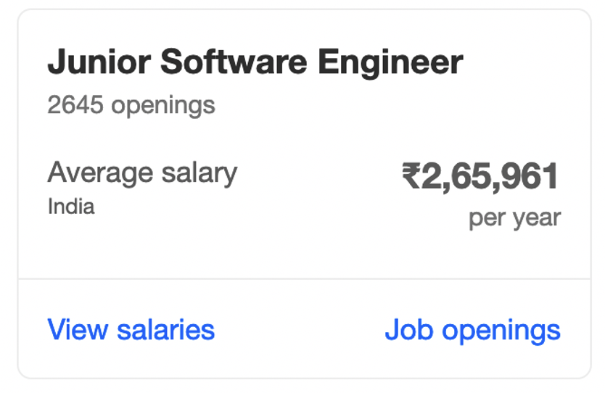
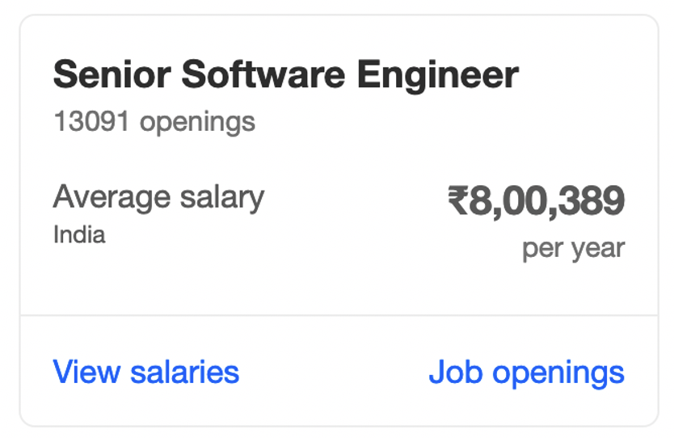
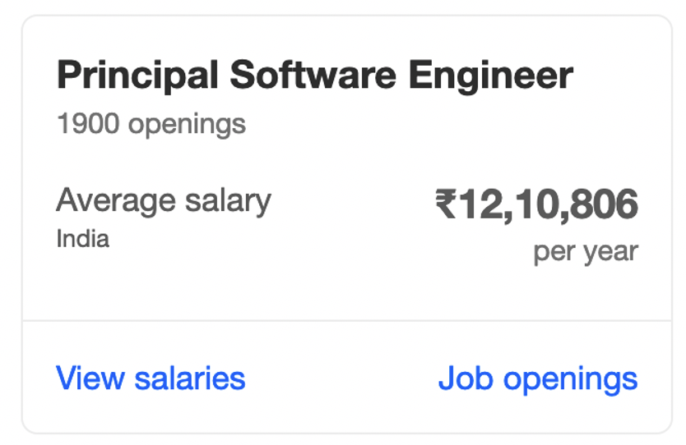
Economics

Slide 29

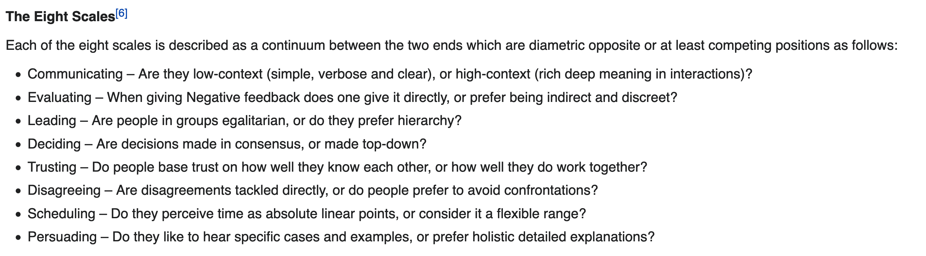
Cultural

Slide 30

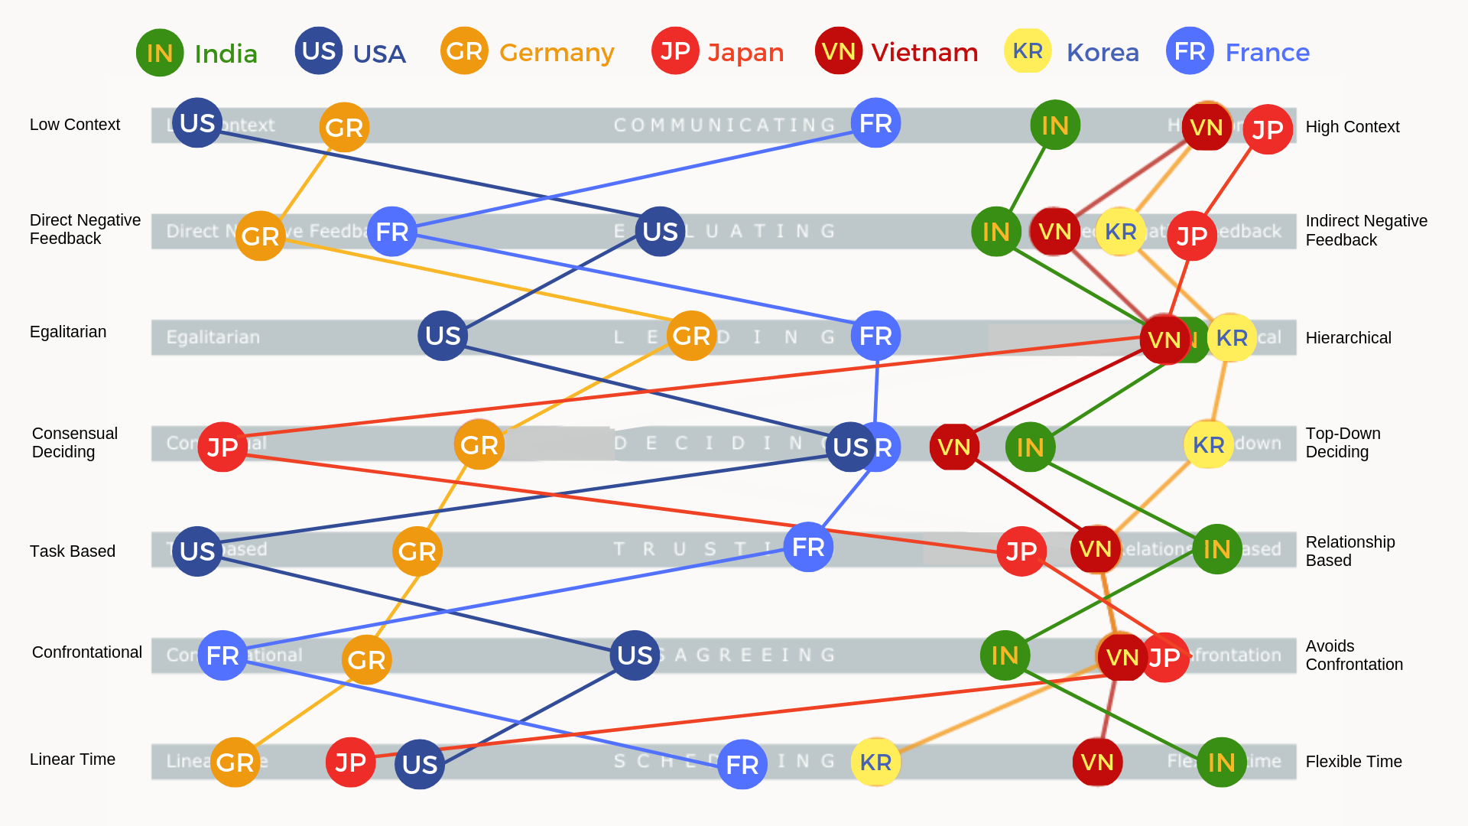
Cultural Map: Context & Feedback

Slide 31
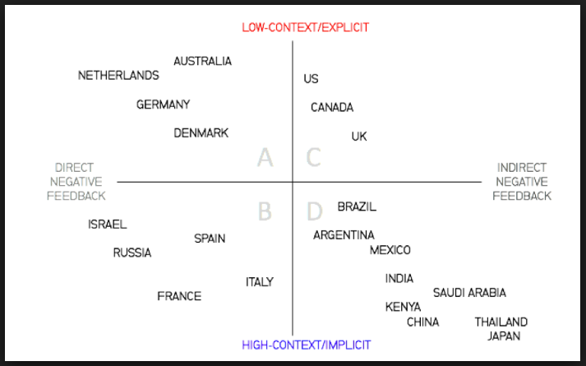
Distributed Software Development & Working With India
Notes:
Norway vs US
Germany and India

Slide 32
Cultural Map: Egalitarianism

Slide 33

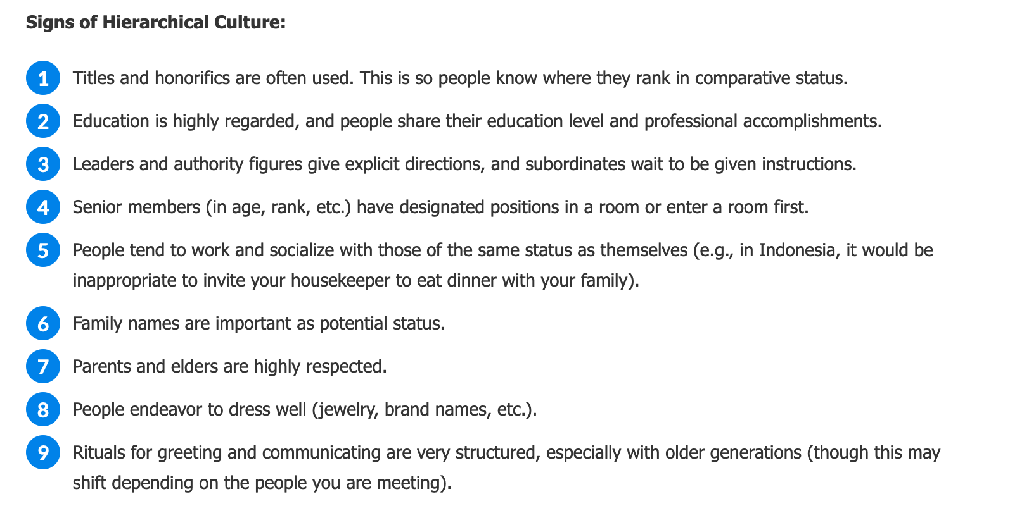
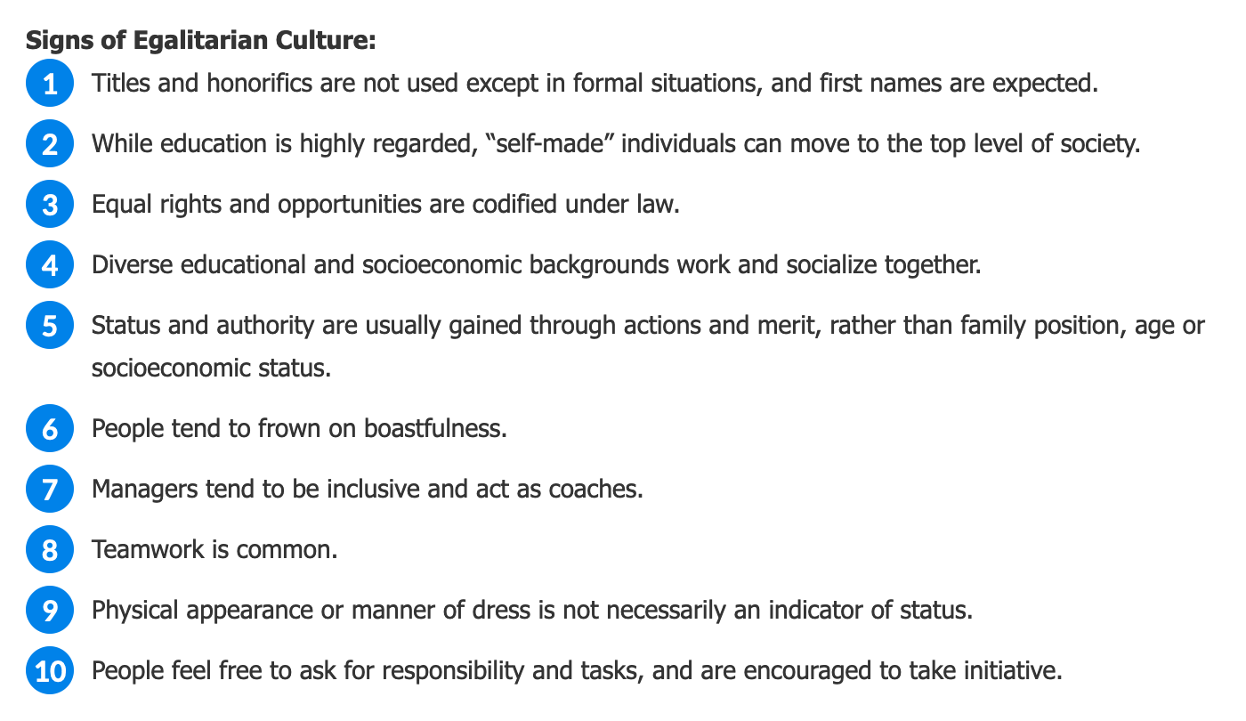
Cultural Understanding: Egalitarian vs Hierarchical
Notes:
Hierarchical

Slide 34
Cultural Map: Task Based

Slide 35
Process
Process Discussion Topics:
Project Outsourcing Model
CMMI Certifications
Default to Plan & Document
Technology

Slide 36
Teams
Teams Discussion Topics:
Economics push us to hire junior level India developers
Agile processes move us to full team by location model with mix of skill levels

Slide 37
Technology
Technology Discussion Topics:
Specialist focus in India development teams
Global Customers… a topic for another day.

Slide 38
Summary: Software Development & Working With India
Economics
Culture
Process
Teams
Technology
Embrace the adventure!

