Slide 1

Class Session Check List
Everyone:
Sign into our Zoom meeting through our integrated Blackboard/Zoom link
Make sure that you can hear the conversation, see shared desktops, and view group chat topics
You will need a headset with a microphone to be able to effectively listen and speak
You will need to be able to share your computer screen
Thank you if you choose to leave your camera on to help make our class more interactive
In person participants also:
Make sure that your microphone and speakers are muted/off so that we don’t get an echo
Sit in a good spot near the classroom ceiling microphones if possible

Slide 2
Class Session Check List
Review that recordings are:
Opportunistic
Automatically available within Blackboard/Zoom
… Now make sure that the classroom microphone, speakers, and camera are being used in Zoom, move to the next slide, AND verify that recording is started.
… Also make sure that slides are visible to attendees

Slide 3
Agenda:
Prework
Sprint 3 Demos
Sprint 3 Retrospective
Prework for Next Class
Lab (as time allows)
Discussion & Questions welcome at any time but please be present with no phones or email during our time together

Slide 4
Prework
Complete through activity 6 prior to next class
Be prepared for demos & retrospective
Be prepared for scrum team discussion of Action Listeners and Graphical User Interfaces

Slide 5
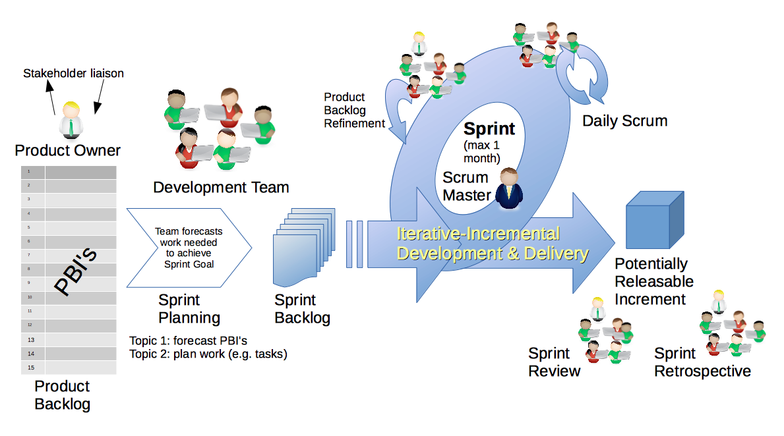
Scrum Process – Sprint Review & Demo
By Dr ian mitchell - Own work, CC BY-SA 4.0, Link

Slide 6
Demo Guidelines – Presenter
Everyone will give at least one demo of their work during the semester.
Your demo should be 2 to 5 minutes and can include any or all of the following:
Show your application running
Comment on your implementation
Show the source code
Explain how you organized the code
Talk about any challenges
You should not prepare slides or a presentation
**You will also need to complete the Demo assignment in Blackboard.

Slide 7
Demo Guidelines – Listener
Everyone will be listening to many demos during the semester.
Your listener responsibilities include:
Actively listening and watching what is being demoed
Come up with a meaningful yet easy to answer question
Ask your question if the presenter does not get sufficient questions from other listeners
Do not ask hard question or attempt to review the presenters code
Clap for the presenter at the end of the demo and thank them for presenting
Optionally follow up with the presenter later if you have what could be more difficult questions or if you have suggestions

Slide 8
Sprint Demos
Notes:
//filing in my own rectangle
g.setColor(new Color(0, 0, 139));
g.fillRect(0, 0, panelWidth, panelHeight);

Slide 9
Complete Sprint Demo Assignment

Slide 10
Scrum Process – Sprint Retrospective
By Dr ian mitchell - Own work, CC BY-SA 4.0, Link

Slide 11
Class Retrospective
Feedback from Assignments & Reflections:
Solid assignment submission numbers
Very nice FaceDraw projects!
Grades are posted
Quiz answer are available now and you may email me with questions
Check your current grade and be aware of drop date deadlines
Email me if you want to change scrum teams
We need to work on data consistency and application redraws

Slide 12
Scrum Team Retrospective
Provide your feedback on:
What can we change in the class to make your life better and/or easier?
What is one thing your team can commit to improving on in sprint 4?
What are you going to due to manage the fact that we are off two days next week?

Slide 13
Prework
Complete through activity 7
Be prepared for scrum team discussion of Artificial Intelligence
Be prepared for scrum team Discussion 3

Slide 14
Prework For Next Class
Complete through activity 6 prior to next class
Be prepared for scrum team discussion of Action Listeners and Graphical User Interfaces
Be prepared for scrum team Discussion 4

Slide 15
Lab (as time allows)
Programming together preview

Slide 16
End of Session

