Slide 1

Class Session Check List
Everyone:
Sign into our Zoom meeting through our integrated Blackboard/Zoom link
Make sure that you can hear the conversation, see shared desktops, and view group chat topics
You will need a headset with a microphone to be able to effectively listen and speak
You will need to be able to share your computer screen
Thank you if you choose to leave your camera on to help make our class more interactive
In person participants also:
Make sure that your microphone and speakers are muted/off so that we don’t get an echo
Sit in a good spot near the classroom ceiling microphones if possible

Slide 2
Class Session Check List
Review that recordings are:
Opportunistic
Automatically available within Blackboard/Zoom
… Now make sure that the classroom microphone, speakers, and camera are being used in Zoom, move to the next slide, AND verify that recording is started.
… Also make sure that slides are visible to attendees

Slide 3
Agenda:
Prework and Announcements
Scrum Team Review of Testing and Testing-Driven Development
Software Development Models and Testing
Discussion Board 4
Prework for Next Class
Discussion & Questions welcome at any time but please be present with no phones or email during our time together

Slide 4
Prework For Next Class
Complete through activity 5 prior to next class
Be prepared for a scrum team chapter 8 on Test-Driven Development

Slide 5
Testing, Testing, Testing, and More Testing!!!
Notes:
Critical Path… Light Weight long-term planning

Slide 6
Scrum Team Review – Chapter 8 Test-Driven Development
Assign presenter
Team reviews key topics including percent of chapter and percent of lecture
Team sits back, relaxes, and acknowledges the bravery and dedication of the presenter
Oh yes, and finalize your sprint 4 research paper topic

Slide 7
Testing, Testing, Testing and More Testing!!!
Notes:
Critical Path… Light Weight long-term planning

Slide 8
Prework
Complete through activity 7 prior to next class
Plus do an Internet search on Software Testing and review the results
Be prepared for a scrum team discussion of Testing

Slide 9
Scrum Team Review – Test-Driven Development
Assign presenter
Team reviews key topics using “team number percent of chapter” focus
Team sits back, relaxes, and acknowledges the bravery and dedication of the presenter

Slide 10
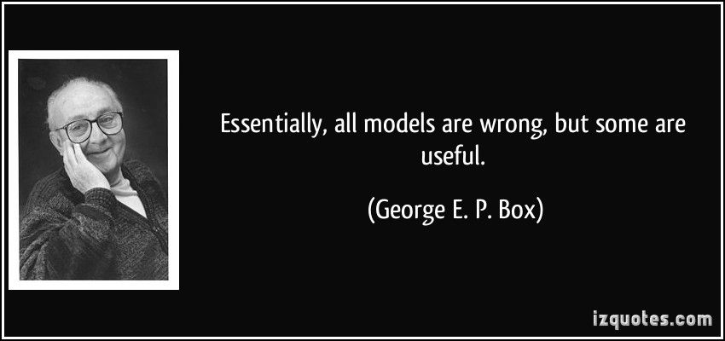
Models

Slide 11
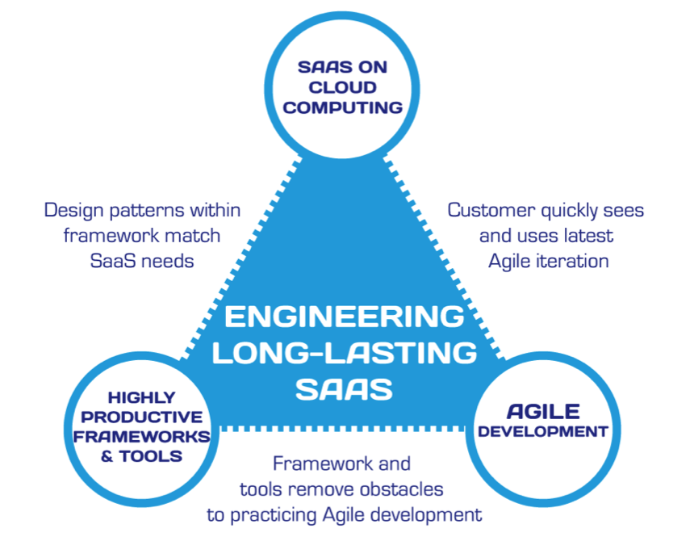
Hosting Technology: Cloud & Software as a Service (SaaS)…
People: Organizations, Domain Knowledge, Customers, Business Process…
The
Virtuous Triangle
Process: Agile, Requirements, Project Management, Prioritization, Portfolio Management, Metrics…
Productivity Technology: Configuration Management, Source Code Management, Automated Testing…

Slide 12
The Righteous Triangle of Software Development
People & Organizations
Technology & Tools
Process & Roles

Slide 13
Waterfall vs Iterative vs Agile Requirements
 | Waterfall | Iterative | Agile
References | United States Department of Defense: DOD-STD-2167A (1985) | Rational Unified Process (RUP) Open Unified Process | Scrum Kanban Scaled Agile Framework (SAFe)
Priorities | Planning and predictability | Architecture, modeling, and efficiency through early detection & fixing of issues (verification) | Responsiveness to feedback, efficiency through engineering practices, early detection & fixing of issues, and validation
Principles | Execute phases sequentially: Requirements Analysis Design Coding Testing / Validation and Operations Define and commit to Scope, Cost, and Timeline “early” Implement strict Change Control | Manage requirements Develop and test iteratively Validate quality iteratively Use components Model visually Control changes | Capture lightweight near term requirements Allow requirements to evolve but maintain fixed timelines Develop, test, deploy, and release iteratively Validate and Verify quality iteratively Empower teams Apply engineering practices and systems thinking Integrate early user feedback into remaining plan Maintain a collaborative approach between all stakeholders
Notes:
The views on testing and change management have changed dramatically as organizations have moved from Waterfall to Iterative to Agile development lifecycles.
Successful Agile (and Iterative) Development REQUIRES better application design, development techniques, and testing practices.
Testing and lack of defects are not the end goal. A higher quality more usable more cost-effective product is the goal.
Requirements:
Waterfall:
Full project requirements upfront
Inconsistent industry capture techniques
Tend to be verbose requirements with formal signoff
Change requests needed
Estimation bottom up detailed estimates sometimes function points
Iterative:
Mostly upfront

Slide 14
Recall Requirements – Waterfall
When working in a Waterfall SDLC Requirements are generally:
Captured up front (before any design or development)
Documented in a variety of formats
Verbose
Estimated in detail using bottom-up estimating techniques (sometime Function Points)
Risk Analysis & Mitigation
Signed off on
Managed with change requests
Notes:
Grace period until Monday morning a 6am CT

Slide 15
Recall Requirements – Iterative (RUP)
When working in an Iterative (RUP) SDLC Requirements are generally:
Captured primarily up front but updated during design
Documented in Use Cases
Moderately verbose
Estimated using Use Case points
Signed off on with an understanding that minor changes are likely
Managed with change requests
Notes:
Grace period until Monday morning a 6am CT

Slide 16
Recall Scaled Agile Framework is an Agile Model
Notes:
Critical Path… Light Weight long-term planning

Slide 17
Recall Requirements – Agile (Scrum)
When working in an Agile (Scrum) SDLC Requirements are generally:
Captured before each sprint
Documented using Stories (light weight)
In Scaled Agile Epics & Features are also used
Only detailed as needed
Estimated using Story Points (very light weight)
Immutable for current sprint
Change is encouraged for future sprints
Notes:
Final Topics:
SMART: Specific, Measurable, Achievable, Relevant, and Time-boxed
Be very careful attempting to measure productivity across teams
Story Points vs Use Case Points vs Function Points

Slide 18
Testing, Testing, Testing and More Testing!!!
Notes:
Critical Path… Light Weight long-term planning

Slide 19
Software Testing “Truths”
Never underestimate the value of good design and implementation (for testability, encapsulation, etc.) on the economics of testing… You can’t afford to test in quality!
Defects are exponentially more expensive to fix the longer the exist.
Unit - $200
Integration - $600
User Acceptance - $6,000
Production - $100,000+
Performance issues are often the most difficult and expensive defects to fix. They are often not found until the application if running under production load… which is often only when it is in production.
The permutations of modern software features, data, tools, environments, etc. quickly becomes unmanageable. Testability needs to be goal of nearly all non-trivial applications.

Slide 20
Software Testing “Truths” (continued)
Developers need to be responsible for product quality. Tester should be able to minimize that chance that a defect makes it to production.
Dave Cutler of Windows NT fame had a quote. I wish I could remember the exact words, but it went something like:
“I hate having testers because they give developers the false
hope that someone else can save them from their sins.”

Slide 21
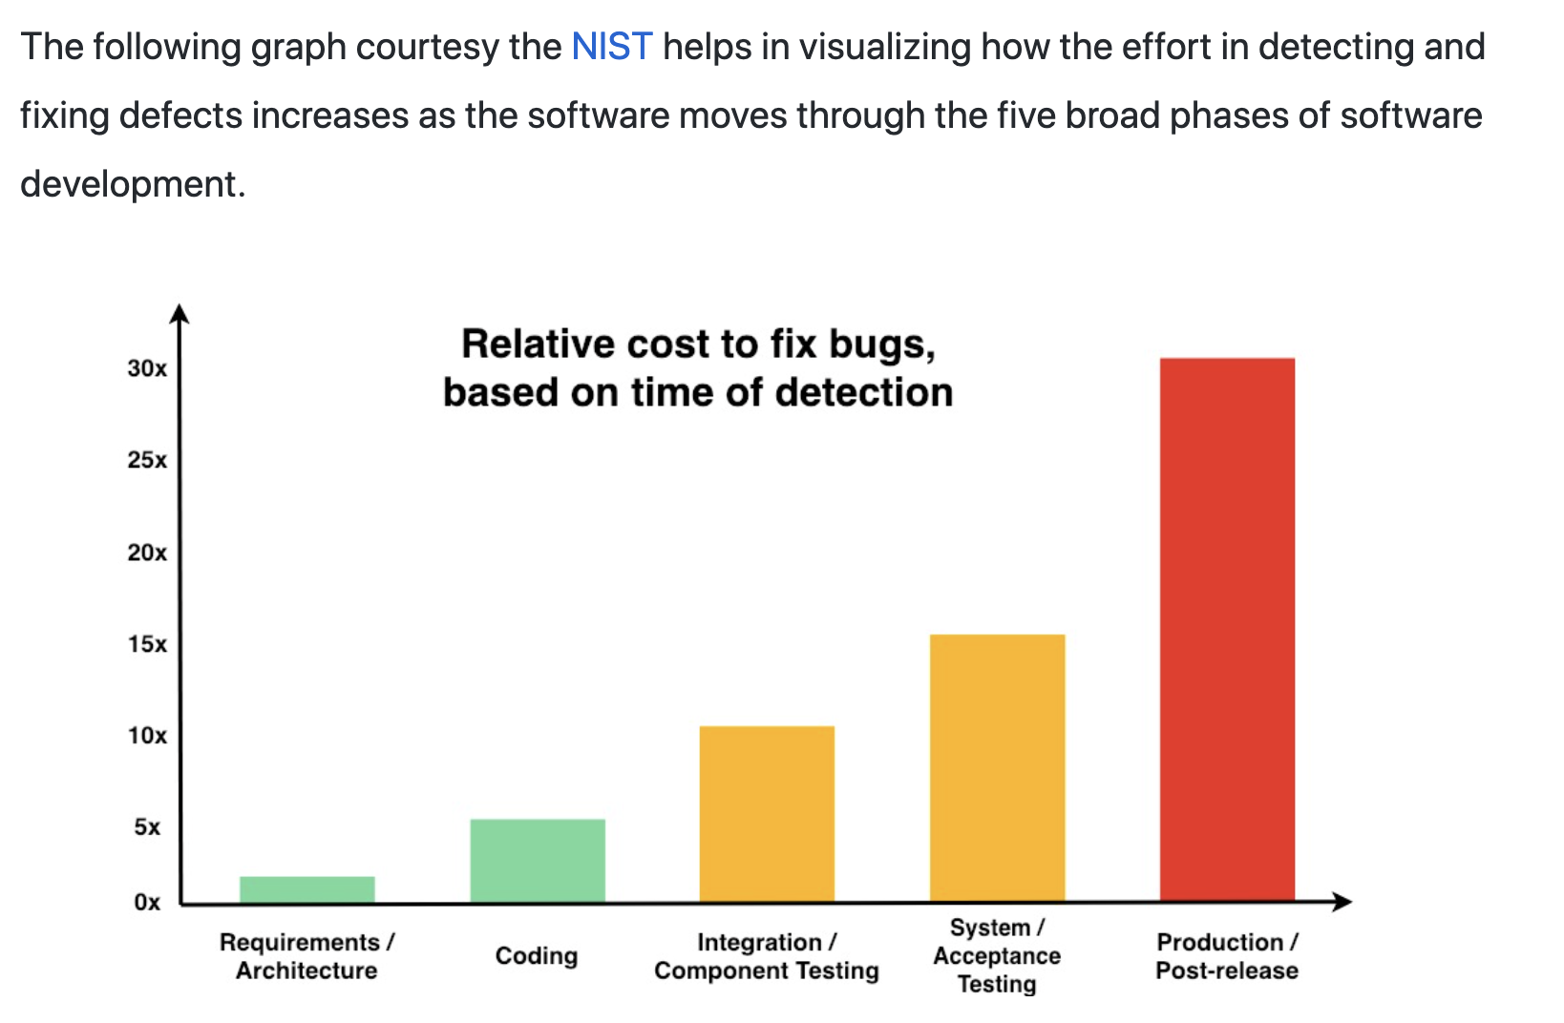
The Cost of Fixing a Defect Increases Exponentially

Slide 22
Testing Terms
Important testing terms include:
Unit Testing: developer testing their own code
Integration Testing: development team testing their full code
System Testing: multiple development teams testing a full system or systems
Performance Testing: testing performance at the Unit, Integration, and/or System level
Manual Testing: a person using the application often running test scenarios
Automated Testing: a group of automated tests that run on the application in the Unit, Integration, System, or Performance testing areas
UI Automated Testing attempts to exercise the application be reproducing user events (key & mouse events)
API Automated Testing occurs at the function/method API level (JUnit for example)

Slide 23
Testing Terms
Important testing terms (continued):
Verification: does the application perform as expected
Validation: does the application provide the business benefit that was expected
Behavioral Testing: verifying that the correct functions were called with the correct parameters
State Testing: focuses on the results of those calls

Slide 24
Automated Testing
Unit testing can be done in two ways − manual testing and automated testing.
Automated testing has become a more important part of effective software testing. The pros of Automated Testing include:
Repeatable tests that are quick to run and can support Iterative and Agile development
Very effective in validating environments and doing “smoke tests” to make sure a new build meets a minimal set of requirements
Supports Performance Testing very effectively
Very inexpensive and quick to repeat testing and validate fixes
Various implications include UI, API, and Unit automation tests… each has a very different set of pros and cons
Notes:
False positives versus valid defects found.
Manual Testing and Automated Testing can be supportive of each other.

Slide 25
Automated Testing
Unit testing can be done in two ways − manual testing and automated testing.
Some of the benefits of Automated Testing have been oversold. Some of the challenges include:
Developers rarely can come up with scenarios in scripts that they would not already have tested in their normal unit testing… they often don’t know what they don’t know
UI focused Automated Testing (key & mouse events) are often challenging and create/maintain a great number of false-positives
API Level Automated Testing (i.e. REST) scripts are often more useful and easier to maintain
Environmental verification, API, and finally UI Automated testing is generally the best order to show value quickly with Automated Testing
Automated Testing investment is often not prioritized or tracked so it is difficult to know its effectiveness
Scripts can be expensive to develop and maintain
Notes:
False positives versus valid defects found.
Manual Testing and Automated Testing can be supportive of each other.

Slide 26
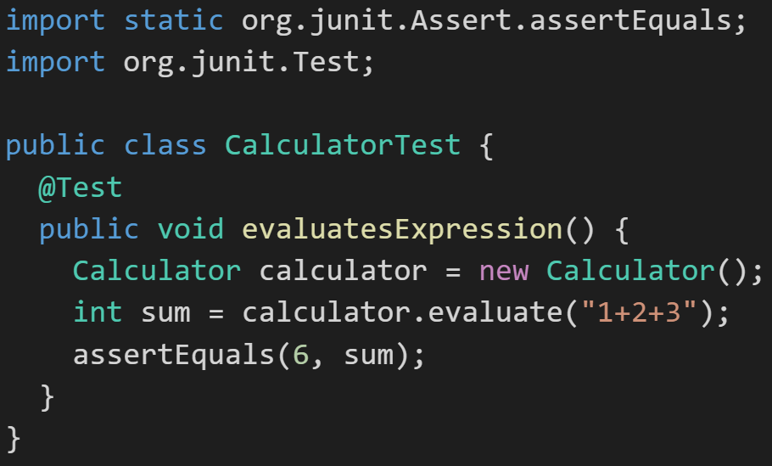
Automated Unit Testing Example: JUnit
Unit testing can be done in two ways − manual testing and automated testing.
JUnit [link] is a Automated Testing framework focused on developing and running Unit test for Java applications. JUnit:
Is a Java opensource extension
Provides annotations to identify test methods.
Provides assertions for testing expected results.
Provides test runners for running tests.
JUnit tests allow you to write codes faster, which increases quality.
JUnit is elegantly simple. It is less complex and takes less time.
JUnit tests can be run automatically and they check their own results and provide immediate feedback. There's no need to manually comb through a report of test results
Notes:
@Test
identifies the method as a test method (remember, method and function are synonyms)
@Test(expected = Exception.class)
fails if the method does not throw the named exception
@Test(timeout=100)
fails if the method takes longer than 100 milliseconds
@Before
public void method()
This method is executed before each test. It is used to prepare the test environment.
@After
public void method()
This method is executed after each test. It is used to clean up the test environment, including cleaning up expensive memory structures.
@BeforeClass
public static void method()
This method is executed once, before any test is done. It is used to do time-intensive tasks before any test is done.

Slide 27
Software Testing
Final Thoughts:
Web Services and APIs
Test Data
Automated Testing & False Positives
Logging
Internal Testing and Test Cases as Product Documentation
Maybe Test-Driven Development is more of a spectrum and evolution
Notes:
Final Topics:

Slide 28
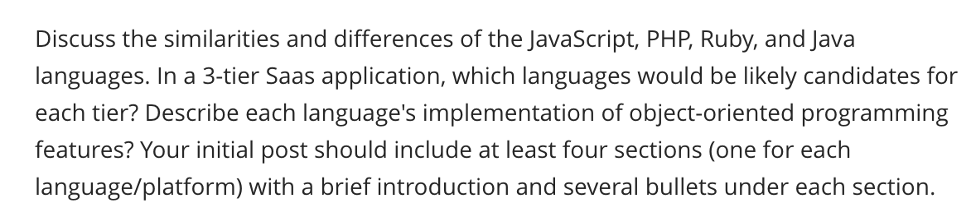
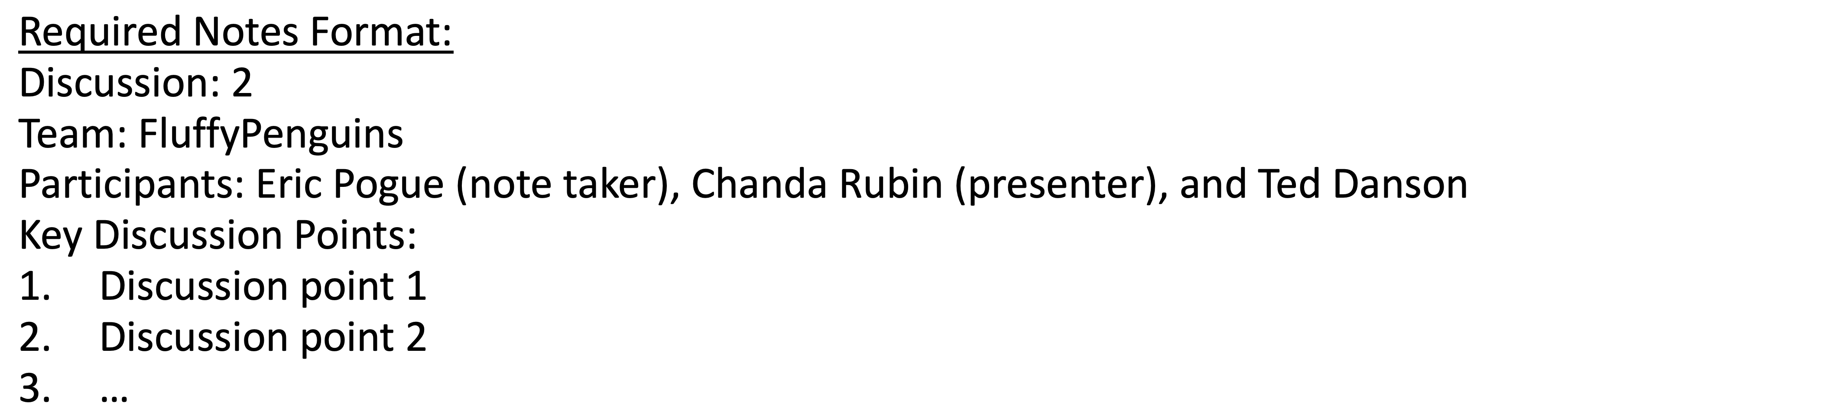
Scrum Team Discussion Board 4
Assign note taker and presenter roles to team members
Review and discuss the discussion topic for this sprint for approximately 10 minutes
Note taker takes notes and presenter prepares a report out summary
Note taker share notes with all participating team members
Each team member pastes and submits exact copy of the notes into their discussion board
Sit back, relax, and tell the note taker and presenter what I wonderful job the did
Notes:
Seating chart and attendance tracker (virtual and in person)

Slide 29
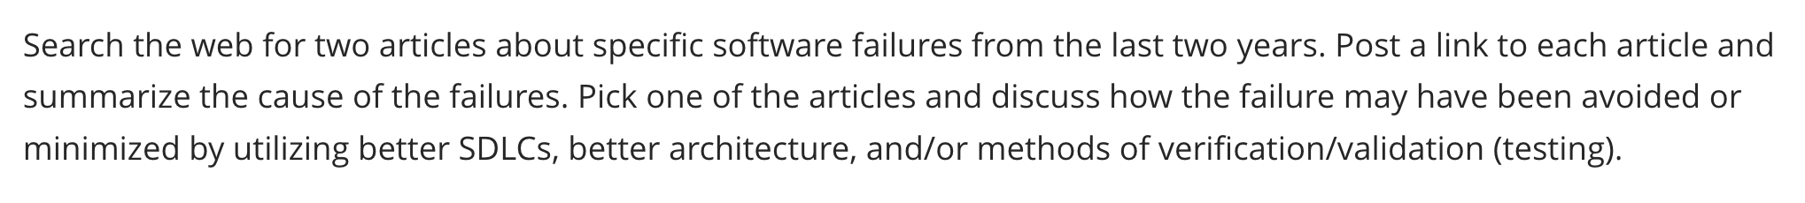
Scrum Team Discussion Board 4
Assign note taker and presenter roles to team members
Review and discuss the discussion topic for this sprint for approximately 10 minutes
Note taker takes notes and presenter prepares a report out summary
Note taker share notes with all participating team members
Each team member pastes and submits exact copy of the notes into their discussion board
Sit back, relax, and tell the note taker and presenter what I wonderful job the did
Notes:
Seating chart and attendance tracker (virtual and in person)

Slide 30
End of Session

