Slide 1

Preflight Check List
Everyone:
Sign into our Zoom meeting through our integrated Blackboard/Zoom link
Make sure that you can hear the conversation, see shared desktops, and view group chat topics
You will need a headset with a microphone to be able to effectively listen and speak
You will need to be able to share your computer screen
Thank you if you choose to leave your camera on to help make our class more interactive
In person participants also:
Make sure that your microphone and speakers are muted/off so that we don’t get an echo
Sit in a good spot near the classroom ceiling microphones if possible

Slide 2
Agenda:
Prework and Announcements
Programming Together
Discussion Board
Prework for Next Class
Discussion & Questions welcome at any time but please be present with no phones or email during our time together

Slide 3
Prework
Next Class:
Complete through activity 7
Be prepared for scrum team Discussion on Brainstorming Final Project ideas
Be prepared for Programming Together with TurtleDraw Lite – Part 1/2
Upcoming:
Monday: Scrum team discussion on Networks
Wednesday: Quiz

Slide 4
Programming Together with
Together with TurtleDraw Lite – Part 1/2

Slide 5
Final Project Discussions
Application Name (2 minutes)
Application Purpose and Key Features (10 minutes)
Notes:
Seating chart and attendance tracker (virtual and in person)

Slide 6
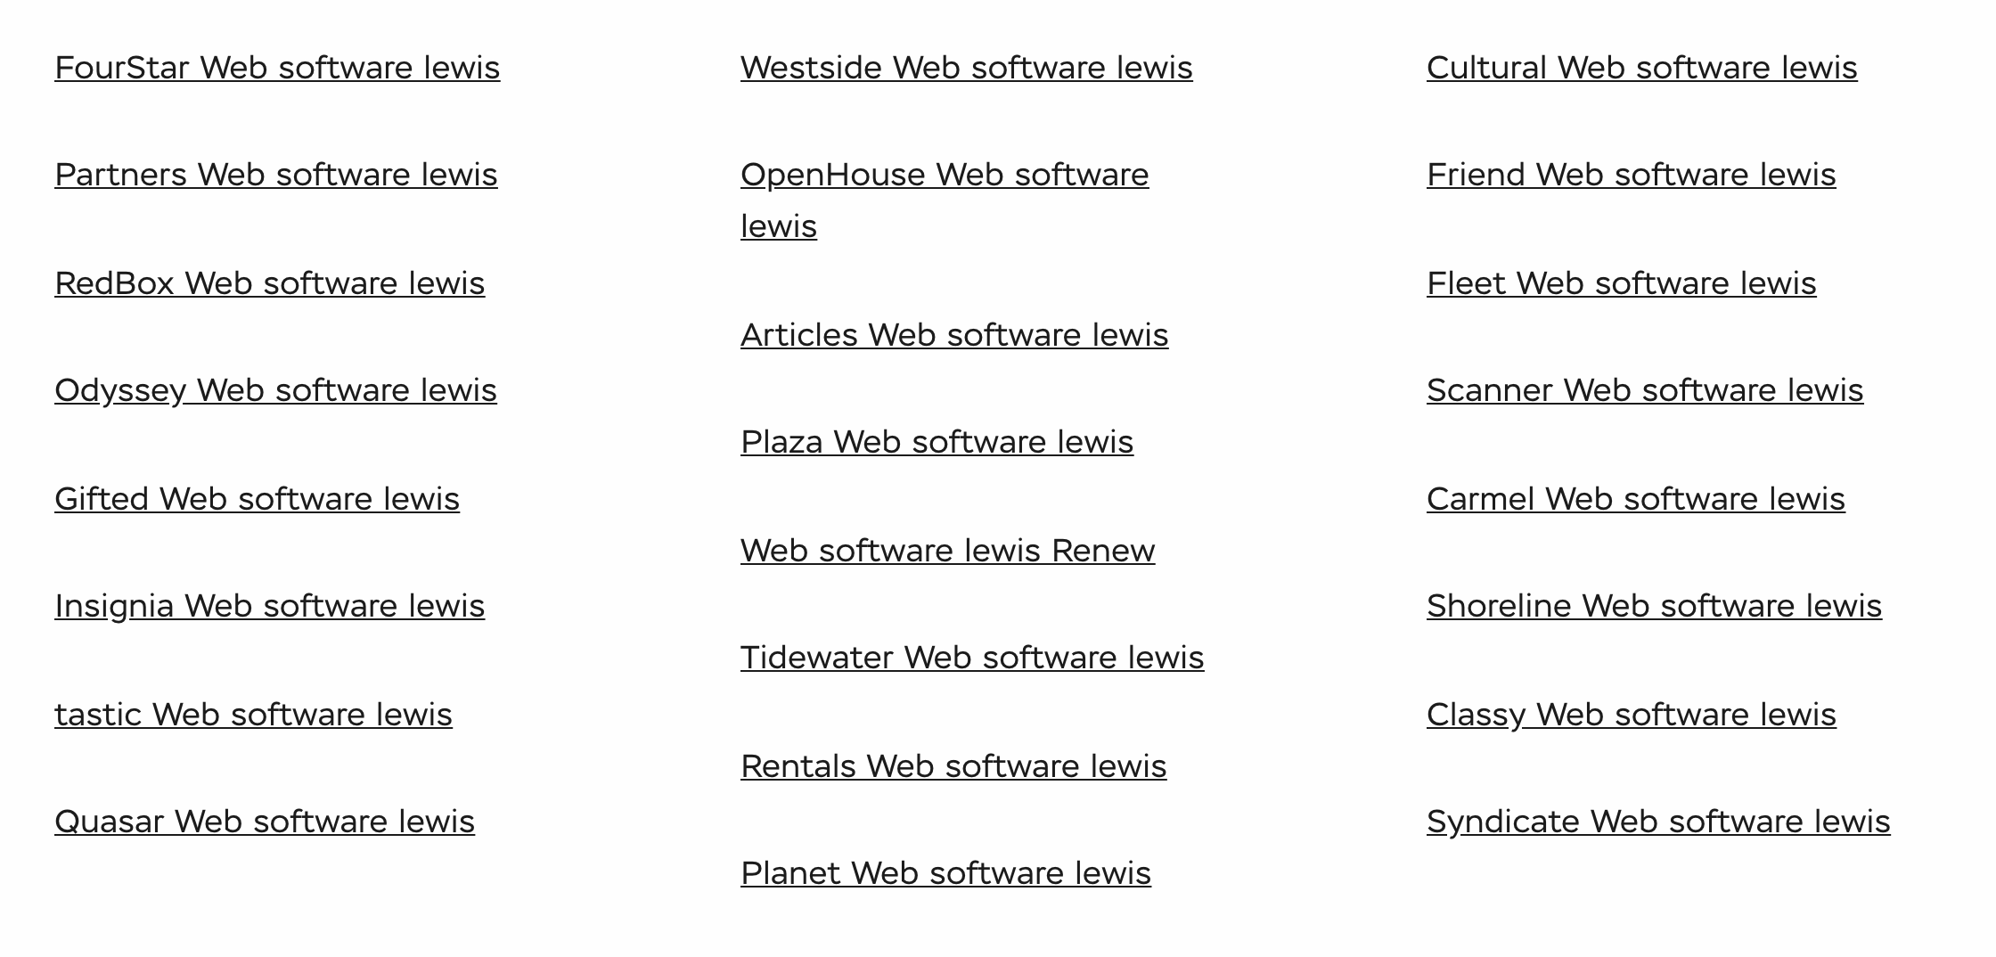
Lab
Final Project Teams and Application Names

Slide 7
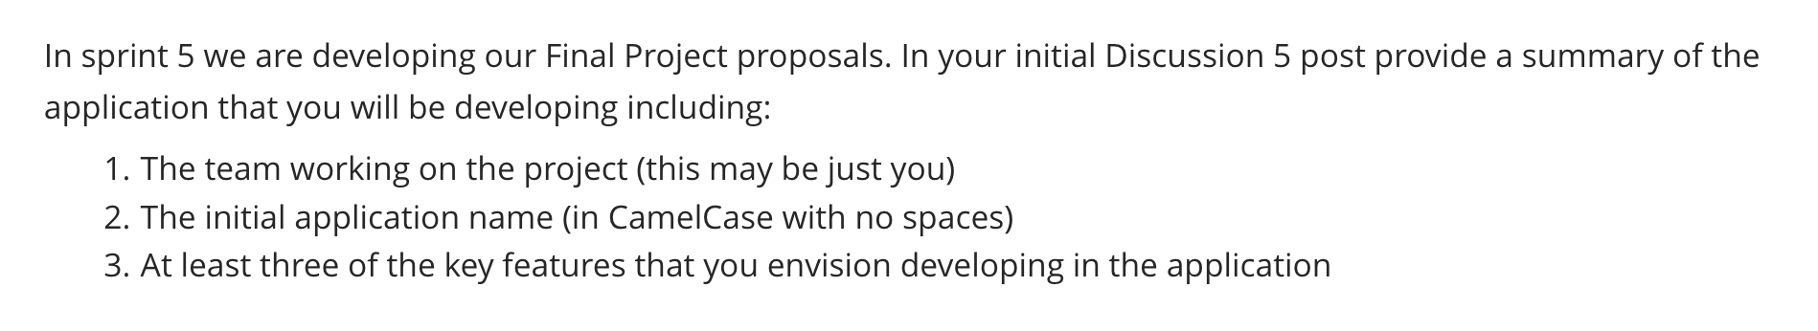
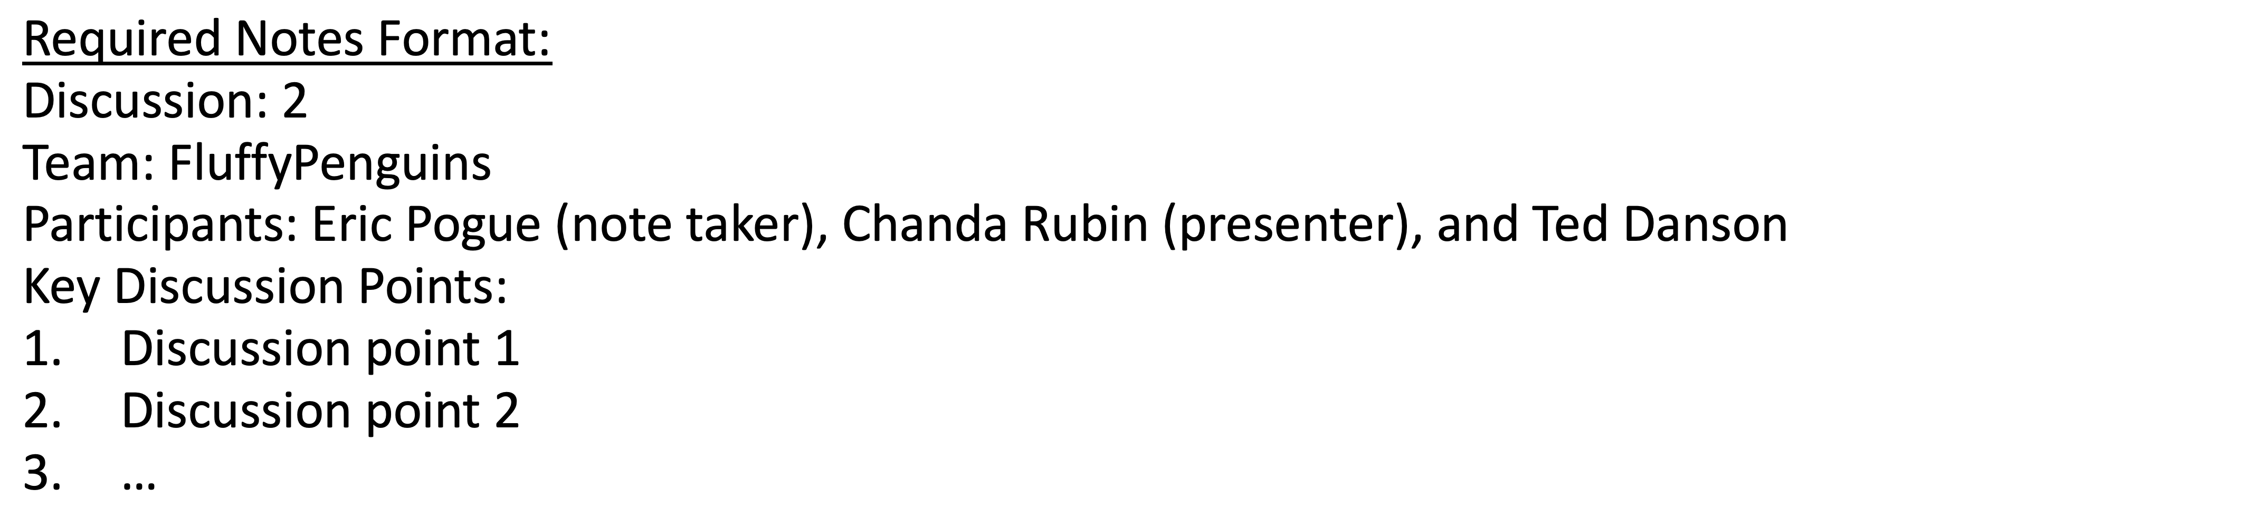
Scrum Team Discussion Board 5
Assign note taker and presenter roles to team members
Review and discuss the discussion topic for this sprint for approximately 10 minutes
Note taker takes notes and presenter prepares a report out summary
Note taker share notes with all participating team members
Each team member pastes and submits exact copy of the notes into their discussion board
Sit back, relax, and tell the note taker and presenter what I wonderful job the did

Slide 8
Report Out
Notes:
Seating chart attendance tracker contact tracer
Data driven syllabus creator
Test/Quiz application
Weather, Sports, Valdiator

Slide 9
Prework
Complete through activity 10+
Be prepared for scrum team discussion of Dale chapter 15 on Networks

Slide 10
End of Session

