Slide 1

Preflight Check List
Everyone:
Sign into our Zoom meeting through our integrated Blackboard/Zoom link
Make sure that you can hear the conversation, see shared desktops, and view group chat topics
You will need a headset with a microphone to be able to effectively listen and speak
You will need to be able to share your computer screen
Thank you if you choose to leave your camera on to help make our class more interactive
In person participants also:
Make sure that your microphone and speakers are muted/off so that we don’t get an echo
Sit in a good spot near the classroom ceiling microphones if possible
Start Recording

Slide 2
Agenda:
Prework and Announcements
Assignment Q&A
Programming Together
Prework for Next Class
Quiz 5 plus final project name review.
Discussion & Questions welcome at any time but please be present with no phones or email during our time together

Slide 3
Prework
Complete through activity 11
Be prepared for Quiz 5

Slide 4
Assignment Q&A
No assignment changes

Slide 5
Programming Together
Review Class Example Code [link]
Azure website creation

Slide 6
Prework
Everything is due Sunday!
Be prepared for Programming Together with SwissArmyKnife

Slide 7
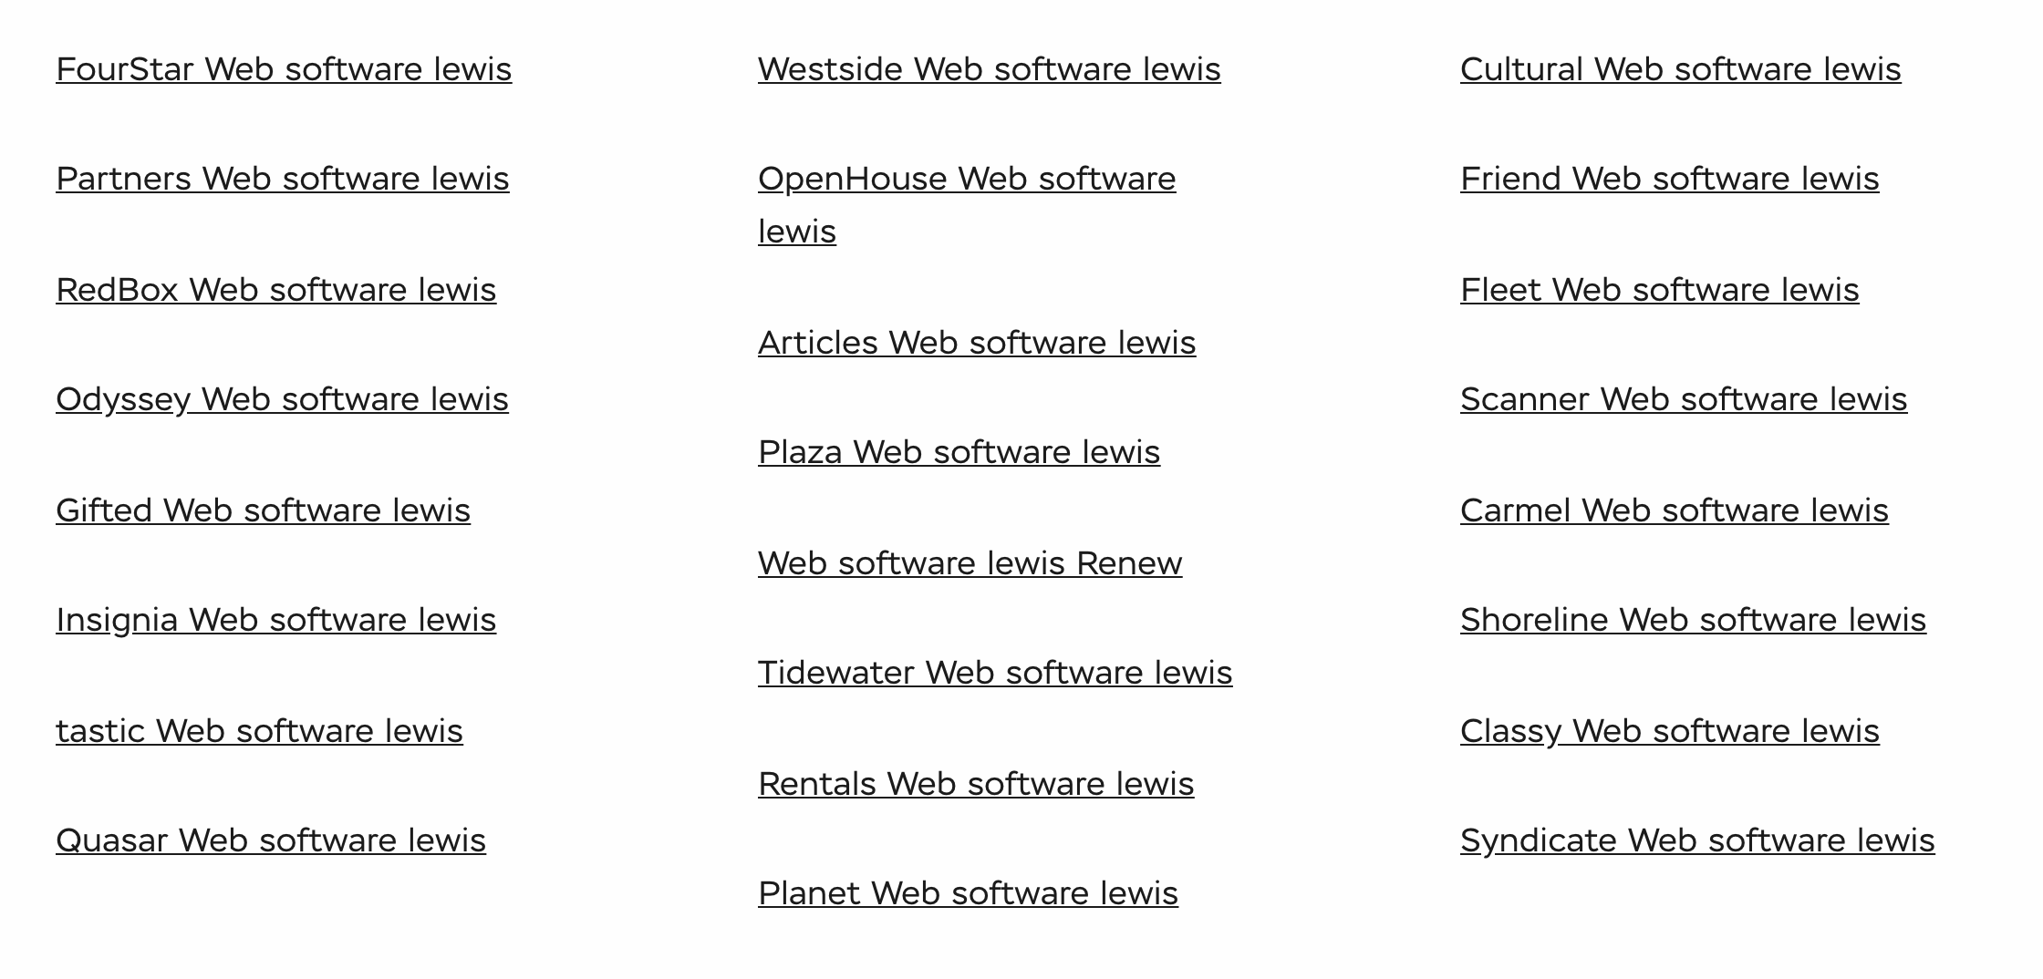
Application Name Examples

Slide 8
Quiz 5
Review your final project name
before you leave today.

Slide 9
End of Session

Slide 10
Programming Together
SwissArmyKnifeLite, Getters, Setters, and toString (Matt)
Azure Deployment (Ryan)

