Slide 1

Preflight Check List
Everyone:
Sign into our Zoom meeting through our integrated Blackboard/Zoom link
Make sure that you can hear the conversation, see shared desktops, and view group chat topics
You will need a headset with a microphone to be able to effectively listen and speak
You will need to be able to share your computer screen
Thank you if you choose to leave your camera on to help make our class more interactive
In person participants also:
Make sure that your microphone and speakers are muted/off so that we don’t get an echo
Sit in a good spot near the classroom ceiling microphones if possible
Start Recording

Slide 2
Agenda:
Prework and Announcements
Review Software Maintenance (continued)
Prework for Next Class
Scrum Team Sprint 1 Planning
Discussion & Questions welcome at any time but please be present with no phones or email during our time together

Slide 3
Prework
Be prepared for scrum team sprint 1 planning

Slide 4
Recall Scrum Team Review of Maintenance
Assign presenter
Team reviews key topics using “team number by percent of content” method
Team sits back, relaxes, and acknowledges the bravery and dedication of the presenter
Sections:
9.1 What Makes Code “Legacy” and How Can Agile Help?
9.2 Exploring a Legacy Codebase
9.3 Establishing Ground Truth With Characterization Tests
9.4 Comments and Commits: Documenting Code
9.5 Metrics, Code Smells, and SOFA
9.6 Method-Level Refactoring
9.7 The Plan-And-Document Perspective on Working With Legacy Code
9.8 Fallacies and Pitfalls
9.9 Concluding Remarks: Continuous Refactoring

Slide 5
Maintenance vs. Support

Slide 6
Software Maintenance vs Software Support
Many processes include both Software Maintenance and Software Support in a single Maintenance category. This is a grave disservice from a process perspective because the two activities are dissimilar in many ways including:
The processes are aligned to different audiences with support focusing on application users and maintenance focusing on application sponsors
Support needs to scale with the user base where maintenance scales with enhancement requests
The optimal process is different with support generally adopting a Kanban and issue ticketing process where maintenance following a software development process like Waterfall or Agile
Support is optimized by supporting all products associated with a user base where maintenance is more single product focused
The cadence of support is minutes and hours where maintenance is days, weeks, and months which can make it challenging to balance the immediate vs the important daily activities
Notes:
Grace period until Monday morning a 6am CT

Slide 7
Metrics

Slide 8
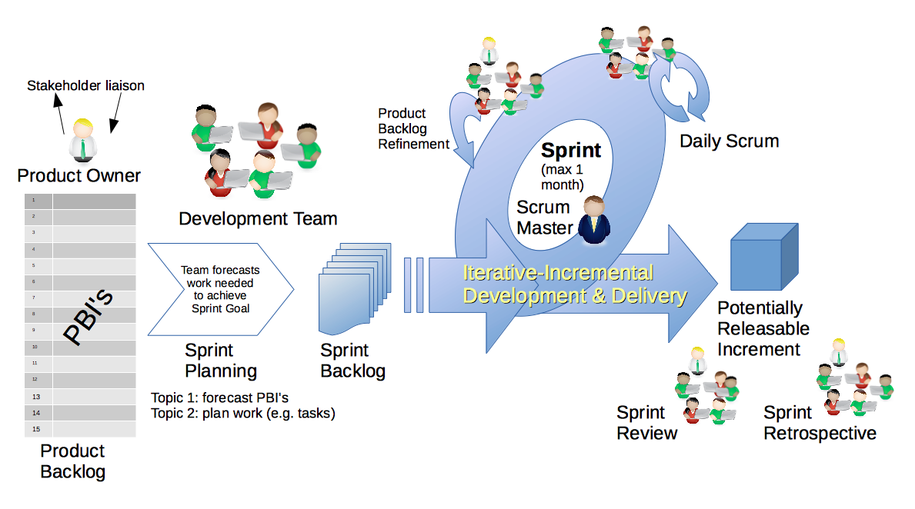
Scrum Process – Sprint Retrospective & Metrics
By Dr ian mitchell - Own work, CC BY-SA 4.0, Link

Slide 9
Characteristics of a Good Metric
What makes a good software quality metric?
Easy to collect and understand
Good approximation of reality and good correlation to quality & goals
Meaningful to the group that can deliver positive change and can drive positive actions
Meaningful over time to encourage positive trends
Discourages “gaming the system,” or at least limits the impact of “gaming”
Does not allow one group to declare success (project management, developers, business analysts, etc.) while the overall product is failing
Comparable across teams, companies, and the industry

Slide 10
Common Metrics for Software Development
Line of code per time-period
On-time
On-budget
… Scope delivered
Defects
Weighted Defects
Weighted Defects per unit delivered
Unit delivered per hour/day/month… per person
Unit delivered per hour/day/month… per dollar

Slide 11
Common Metrics for Agile Software Development
Story Points per Sprint per person
Say/Do ratio
Story Points delivered per Sprint… change in Story Points delivered per Sprint
Team versatility
Percent coverage with automated testing or with Test-Driven Development
Satisfaction surveys with internal or external customers
Eric’s Favorite: Weighted Defect Density per 10,000 hours worked… production

Slide 12
Prework
Everything is due Sunday!
Each team should be prepared to Demo sprint 0 work
Review scheduled Demos
Be prepared for sprint 6 planning
Note that Lab 5 grades will not be posted prior to Tuesday demos because:
Working software is the primary measure of progress
“Done” means demo-able in a production like environment

Slide 13
Your Scrum Process

Slide 14
Scrum Process
By Dr ian mitchell - Own work, CC BY-SA 4.0, Link

Slide 15
Recall Perspectives & Priorities
Perspectives:
Process
Technology
Customer (User)

Slide 16
Recall Perspectives & Priorities
Process:
Waterfall
Iterative
Agile
CMMI and ISO
Technology:
Architecture & Design,
Languages, Tools, and Platforms
Customer (User):
Epics, Features, Stories

Slide 17
Recall Perspectives & Priorities
Agile Priorities:
Customer
Technology
Process

Slide 18
Agile Manifesto
& Principles [link]

Slide 19
Scrum Team Sprint 1 Planning
(6 Step Process)

Slide 20
Priorities & Roles
Agile Priorities (associated scrum role):
Customer (Product Owner)
Technology (Architect)
Process (Scrum Master)
Recall the Agile Glossary [link]
Recall that one person can play multiple roles.
Recall that it is different/difficult for us because we are playing the role of the customer as well as the delivery team.

Slide 21
Step 1: Assign Roles for Sprints 1 through 3
Agile Priorities (associated scrum role):
Customer (Product Owner)
Technology (Architect)
Process (Scrum Master)
Requirements:
Everyone must play the Scrum Master role for at least one sprint during the class
There must be a Product Owner responsible for managing User Stories, Epics and Backlogs
What role (or individual) will be responsible for Demoing each sprint starting next Tuesday
The architect role is not a formal part of Scrum and is therefore optional
Report out who is the Scrum Master and Product Owner for sprint 1 plus who will demo your sprint 0 product next Tuesday.
Notes:
Who before what.

Slide 22
User Stories, Epics and Backlogs
Recall the Agile Glossary [link]… review User Story format

Slide 23
Step 2: Epic Backlog Grooming
Product Owner to lead the review and/or creation of Epics.
Requirements:
There must be one list of Epics managed by the Product Owner
Each Epic must deliver customer functionality and value
Epics should be written in User Story format
Epics must be prioritized and forced ranked
Each product must have at least three Epics
Report out on number of Epics.

Slide 24
Scrum Process – Product Backlog Grooming
By Dr ian mitchell - Own work, CC BY-SA 4.0, Link

Slide 25
Step 2: Product Backlog Grooming
Product Owner to lead the review and/or creation of User Stories.
Requirements & Actions:
There must be one Product Backlog (list of User Stories) managed by the Product Owner
Each User Story must deliver user (customer) functionality and value
User Stories must be written in User Story format and be prioritized (forced ranked)
User Stories must be associated with one or more Epics
User Stories that are completed (i.e. “Done”) should be removed from the Product Backlog and placed a “Completed User Stories” list
User Stories that are committed for the current sprint (sprint 0) should be removed from the Product Backlog and placed in a “Pending User Stories” list
Report out number of user stories in Product Backlog
Notes:
How will you handle dependancies?

Slide 26
Step 2b: Additional Future Considerations
Scrum Master lead the review and/or creation of User Stories.
Actions:
Consider required Spikes and treat them as a User Story that does not deliver user value
Consider User Story or Spike dependencies
Consider missed commitments in current Sprint
Report out anything.
Notes:
How will you handle dependancies?

Slide 27
Scrum Process – Product Backlog Grooming
By Dr ian mitchell - Own work, CC BY-SA 4.0, Link

Slide 28
Step 3: User Story Estimation
Product Owner to lead the estimating of User Stories.
Requirements:
Each User Story must have an estimated effort in Story Points
For our purposes assume 1 Story Point is approximately equal to 1 hour of effort
Each User Story must be deliverable in a single sprint
Activities:
Consider required Spikes and treat them as a User Story that does not deliver user value
Estimate Scrum Team Capacity for sprint 1 by multiplying the number of team members times 6 hours each team member (would be 8 except for holiday next sprint)
Review your Product Backlog and draw your Sprint 1 “cut line” to create your Sprint Backlog
Report out total stories in Product Backlog, total stories / story points in Sprint Backlog, estimated team Capacity, percent of Spike story points, and unutilized capacity.

Slide 29
Step 4: Team Capacity Estimation and Cut Line
Product Owner to lead the estimating of User Stories.
Activities:
Estimate Scrum Team Capacity for sprint 1 by multiplying the number of team members times 6 hours each team member (would be 8 except for holiday next sprint)
Review your Product Backlog and draw your Sprint 1 “cut line” to create your Sprint Backlog
Consider leaving some unutilized capacity to account for missed sprint 0 commitments (carry-over stories)
Report out total stories in Product Backlog, total stories / story points in Sprint Backlog, estimated team Capacity, percent of Spike story points, and unutilized capacity.

Slide 30
Scrum Process – Product Backlog Grooming
By Dr ian mitchell - Own work, CC BY-SA 4.0, Link

Slide 31
Step 5: Commit to your Sprint Backlog
The team commits to completing (i.e. “Done”) the stories in the Sprint 1 backlog.
It is acceptable to miss commitments in Agile/Scrum.
However, it is required that we:
Commit and deliver as a team
Be non-ambiguous in our commitments
Be transparent in our actions
Commit to continuous improvement

Slide 32
Step 6: Celebrate
Recognize your teammates that stepped up. Tell them “Well done!”

Slide 33
End of Session

