Slide 1

Preflight Check List
Everyone:
Sign into our Zoom meeting through our integrated Blackboard/Zoom link
Make sure that you can hear the conversation, see shared desktops, and view group chat topics
You will need a headset with a microphone to be able to effectively listen and speak
You will need to be able to share your computer screen
Thank you if you choose to leave your camera on to help make our class more interactive
In person participants also:
Make sure that your microphone and speakers are muted/off so that we don’t get an echo
Sit in a good spot near the classroom ceiling microphones if possible
Start Recording

Slide 2
Agenda:
Prework and Announcements
Sprint 5 Demos
Sprint 5 Retrospective
Sprint 6 Planning
Prework for Next Class
Scrum Team Sprint 6 Planning Update
Discussion & Questions welcome at any time but please be present with no phones or email during our time together

Slide 3
Prework
Everything is due Sunday!
Each team should be prepared to Demo sprint 0 work
Review scheduled Demos
Be prepared for sprint 6 planning
Note that Lab 5 grades will not be posted prior to Tuesday demos because:
Working software is the primary measure of progress
“Done” means demo-able in a production like environment

Slide 4
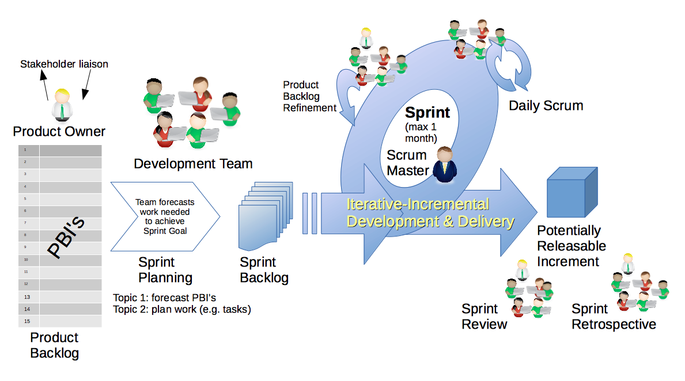
Scrum Process – Sprint Review & Demo
By Dr ian mitchell - Own work, CC BY-SA 4.0, Link

Slide 5
Demo Guidelines – Presenter
Everyone will give at least one demo of their work during the semester.
Your demo should be 2 to 5 minutes and can include any or all of the following:
Show your application running
Comment on your implementation
Show the source code
Explain how you organized the code
Talk about any challenges
You should not prepare slides or a presentation
**You will also need to complete the Demo assignment in Blackboard.

Slide 6
Demo Guidelines – Listener
Everyone will be listening to many demos during the semester.
Your listener responsibilities include:
Actively listening and watching what is being demoed
Come up with a meaningful yet easy to answer question
Ask your question if the presenter does not get sufficient questions from other listeners
Do not ask hard question or attempt to review the presenters code
Clap for the presenter at the end of the demo and thank them for presenting
Optionally follow up with the presenter later if you have what could be more difficult questions or if you have suggestions

Slide 7
Sprint Demos
Plus Product Demos (as needed)

Slide 8
Complete Sprint Demo Assignment

Slide 9
Scrum Process – Sprint Retrospective
By Dr ian mitchell - Own work, CC BY-SA 4.0, Link

Slide 10
Submission Percentage for Sprint 3

Slide 11
Submission Percentage for Sprint 4

Slide 12
Submission Percentage for Sprint 4

Slide 13
Class Retrospective
Feedback from Assignments & Reflections:
Excellent submission numbers
Grades are posted for Discussion, Quiz, and Reflections
Quiz answer should be available now… email me with questions or comments about the quiz
Grades for Labs will be posted after demos
Working in teams can be challenging and tends to be at the extremes
Quiz was challenging
Node.js was sporadically challenging
A couple reflection comments that distinguishing group assignments from personal activities was confusing

Slide 14
Scrum Team Retrospective
Provide your feedback on:
What is one thing your team can commit to improving
Do you have a new scrum master
Ideas for recognizing extra effort… and encouraging engagement?
What stories from sprint 0 did not get completed, and do they need to be added to sprint 1?

Slide 15
Sprint Planning

Slide 16
Sprint Planning
Sprint 5:
Similar to last sprint including Discussion, Quiz, Lab, and Reflection
No class Thursday, Friday, or Monday will be a challenge
Initial Discussion post not due until the end of class Tuesday
All about working on a real project as a team

Slide 17
Scrum Process – Sprint Planning
By Dr ian mitchell - Own work, CC BY-SA 4.0, Link

Slide 18
Review Activities List and Assignments

Slide 19
Prework For Next Class
Complete through activity 7 prior to next class
Be prepared for a scrum team discussion on:
Chapter 10 of Fox on Project Management, Scrum, Pairs, and Version Control Systems
Be prepared for scrum team Discussion 6

Slide 20
Scrum Team Sprint 6 Planning Update
Report out: Do you have what you need to be productive through Tuesday?

Slide 21
End of Session

