Slide 1

Preflight Check List
Everyone:
Sign into our Zoom meeting through our integrated Blackboard/Zoom link
Make sure that you can hear the conversation, see shared desktops, and view group chat topics
You will need a headset with a microphone to be able to effectively listen and speak
You will need to be able to share your computer screen
Thank you if you choose to leave your camera on to help make our class more interactive
In person participants also:
Make sure that your microphone and speakers are muted/off so that we don’t get an echo
Sit in a good spot near the classroom ceiling microphones if possible
Start Recording

Slide 2
Prework
Complete through activity 5 prior to next class
Be prepared for demos & retrospective
Be prepared for Programming Together with hosting of Matchmaker for the Web
Be prepared for scrum team discussion of Dale chapter 16 on The World Wide Web

Slide 3
Agenda:
Sprint 5 Demos
Sprint 5 Retrospective
Prework for Next Class
Programming Together with Matchmaker for the Web (as time allows)
Discussion & Questions welcome at any time but please be present with no phones or email during our time together

Slide 4
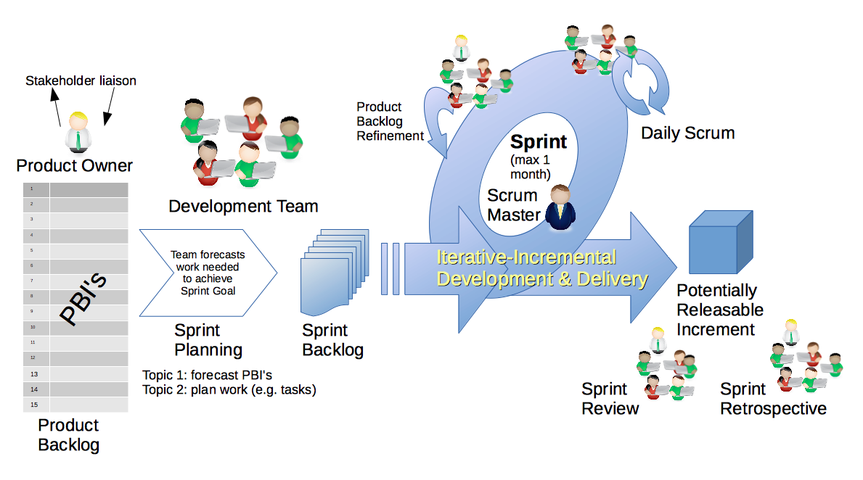
Scrum Process – Sprint Review & Demo
By Dr ian mitchell - Own work, CC BY-SA 4.0, Link

Slide 5
Demo Guidelines – Presenter
Everyone will give at least one demo of their work during the semester.
Your demo should be 2 to 5 minutes and can include any or all of the following:
Show your application running
Comment on your implementation
Show the source code
Explain how you organized the code
Talk about any challenges
You should not prepare slides or a presentation
**You will also need to complete the Demo assignment in Blackboard.

Slide 6
Demo Guidelines – Listener
Everyone will be listening to many demos during the semester.
Your listener responsibilities include:
Actively listening and watching what is being demoed
Be prepared to ask a meaningful yet easy to answer question
Clap for the presenter at the end of the demo and thank them for presenting

Slide 7
Sprint Demos

Slide 8
Complete Sprint Demo Assignment

Slide 9
Scrum Process – Sprint Retrospective
By Dr ian mitchell - Own work, CC BY-SA 4.0, Link

Slide 10
Submission Percentage for Sprint 4

Slide 11
Submission Percentage for Sprint 5

Slide 12
Class Retrospective
Feedback from Assignments & Reflections:
Exception assignment submission numbers!
Grades are posted and up to date through sprint 5
Quiz answer are available

Slide 13
Your Class Retrospective Feedback?

Slide 14
Prework
Enjoy your Easter holiday!
Complete through activity list item 7
Prior to next class complete Programming Together with MatchmakerLite – Part 1 for the Web
Be prepared for scrum team discussion of Dale chapter 16 on The World Wide Web
Be prepared for scrum team Discussion 6… your initial Discussion 6 is due by the end of class
Upcoming:
Friday & Monday: No class
Wednesday: See above prework
Friday: Quiz 6 plus Programming Together with MatchmakerLite – Part 2

Slide 15
Programming Together
Matchmaker for the Web (as time allows):
Discuss Matchmaker vs. MatchmakerLite
Set up your Matchmaker GitHub repository and Azure website

Slide 16
End of Session

