Slide 1

Preflight Check List
Everyone:
Sign into our Zoom meeting through our integrated Blackboard/Zoom link
Make sure that you can hear the conversation, see shared desktops, and view group chat topics
You will need a headset with a microphone to be able to effectively listen and speak
You will need to be able to share your computer screen
Thank you if you choose to leave your camera on to help make our class more interactive
In person participants also:
Make sure that your microphone and speakers are muted/off so that we don’t get an echo
Sit in a good spot near the classroom ceiling microphones if possible
Start Recording

Slide 2
Agenda:
Prework and Announcements
Scrum Team Review of The World Wide Web
The Internet and The Web
Scrum Team Discussion 6
Prework for Next Class
Programming Together with Final Project Proposals Azure Hosting
Discussion & Questions welcome at any time but please be present with no phones or email during our time together

Slide 3
Prework and Announcements

Slide 4
Prework
Enjoy your Easter holiday!
Complete through activity list item 7
Prior to next class complete Programming Together with MatchmakerLite – Part 1 for the Web
Be prepared for scrum team discussion of Dale chapter 16 on The World Wide Web
Be prepared for scrum team Discussion 6… your initial Discussion 6 is due by the end of class
Upcoming:
Friday & Monday: No class
Wednesday: See above prework
Friday: Quiz 6 plus Programming Together with MatchmakerLite – Part 2

Slide 5
Scrum Team Review
Assign presenter
Team reviews key topics using “team number by percent of content” method
Team sits back, relaxes, and acknowledges the bravery and dedication of the presenter
Chapter 16 of Dale on The World Wide Web
16.1 Spinning The World Wide Web
16.2 HTML and CSS
16.3 Interactive Web Pages
16.4 XML
16.5 Summary

Slide 6
The Internet and The Web

Slide 7
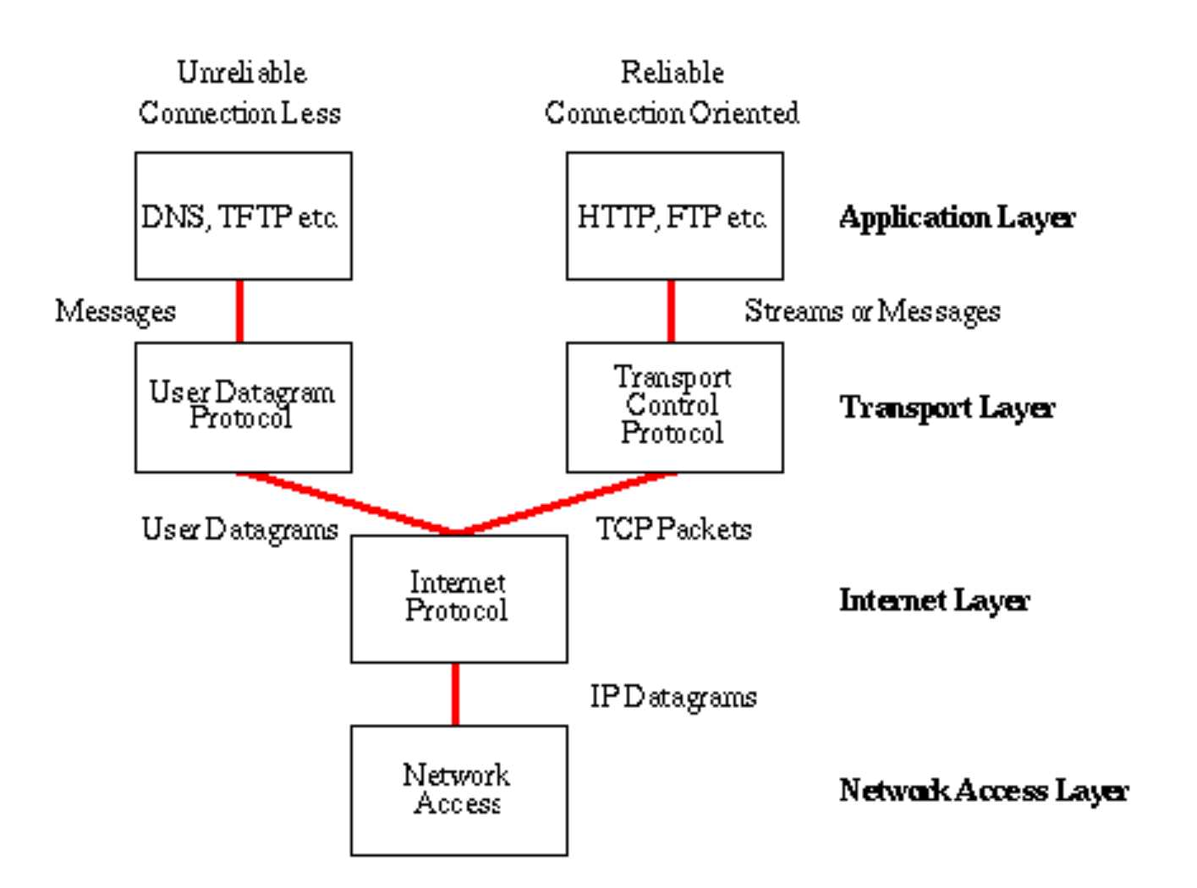
Network Architecture – The Internet
The Internet [link]
IP (Internet Protocol) [link]
TCP (Transmission Control Protocol) [link]
TCP/IP
UDP (User Datagram Protocol) [link]
UDP/IP
TCP/IP or UDP/IP Socket [link]
TCP and UDP Protocols & Port Numbers [link]

Slide 8
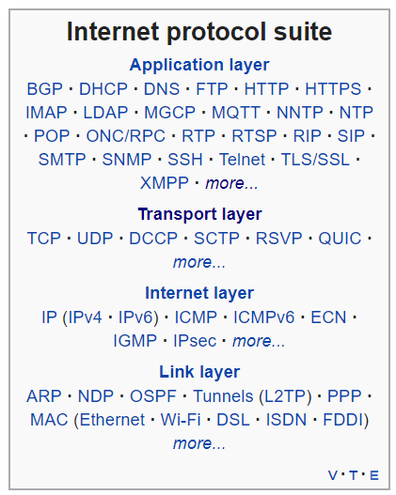
Network Architecture – The Web
The Web [link]
HTTP (Hypertext Transfer Protocol) [link]
DNS (Domain Name System) [link]
HTML (Hypertext Markup Language) [link]
CSS (Cascading Style Sheets) [link]
JavaScript [link]
Internet Protocol Suite [link]

Slide 9
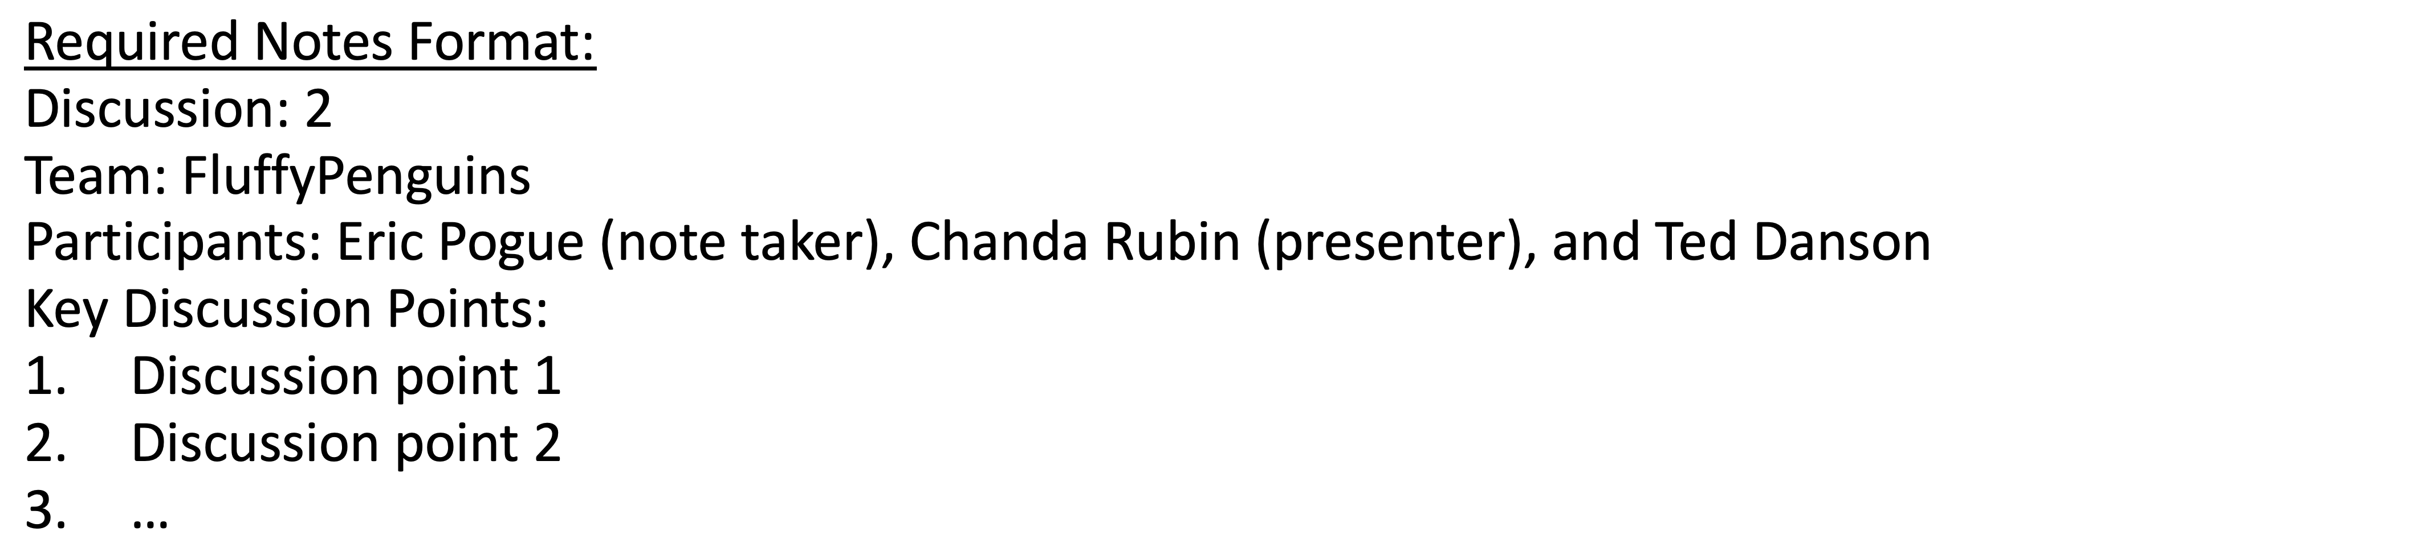
Scrum Team Discussion Board 6
Assign note taker and presenter roles to team members
Review and discuss the discussion topic
Note taker takes notes and presenter prepares a brief report out summary
Note taker share notes with all participating team members
Each team member pasts and submits exact copy of the notes in their discussion board
Presenter reports out

Slide 10
Prework for Next Class

Slide 11
Prework
Complete through activity list item 9
Be prepared for Quiz 6
Be prepared for Programming Together with MatchmakerLite
Upcoming:
Everything is due Sunday

Slide 12
Programming Together
Azure Hosting of Final Project Proposals

Slide 13
End of Session

