Slide 1

Preflight Check List
Everyone:
Sign into our Zoom meeting through our integrated Blackboard/Zoom link
Make sure that you can hear the conversation, see shared desktops, and view group chat topics
You will need a headset with a microphone to be able to effectively listen and speak
You will need to be able to share your computer screen
Thank you if you choose to leave your camera on to help make our class more interactive
In person participants also:
Make sure that your microphone and speakers are muted/off so that we don’t get an echo
Sit in a good spot near the classroom ceiling microphones if possible

Slide 2
Four Minutes of Preparation and Reflection
Please spend the first few minutes of class reviewing your assigned prework:
Complete through activity 6 prior to next class
Be prepared for scrum team review “Application Architectures, Object-Oriented Programming, and Databases - Part 1”
Scrum team discussion 7
Start Recording

Slide 3
Agenda:
Friendly Conversation Topic: Lasallian Traditions, Jeff Bezos, Eric’s small frustration, and the first few minutes of class
Scrum Team Discussion Board 7
Prework for Next Class
Programming Together
Discussion & Questions welcome at any time but please be present with no phones or email during our time together

Slide 4
Friendly Conversation Topic
What do Lasallian Traditions, Jeff Bezos, Eric’s small frustration, and the first few minutes of class have in common?

Slide 5
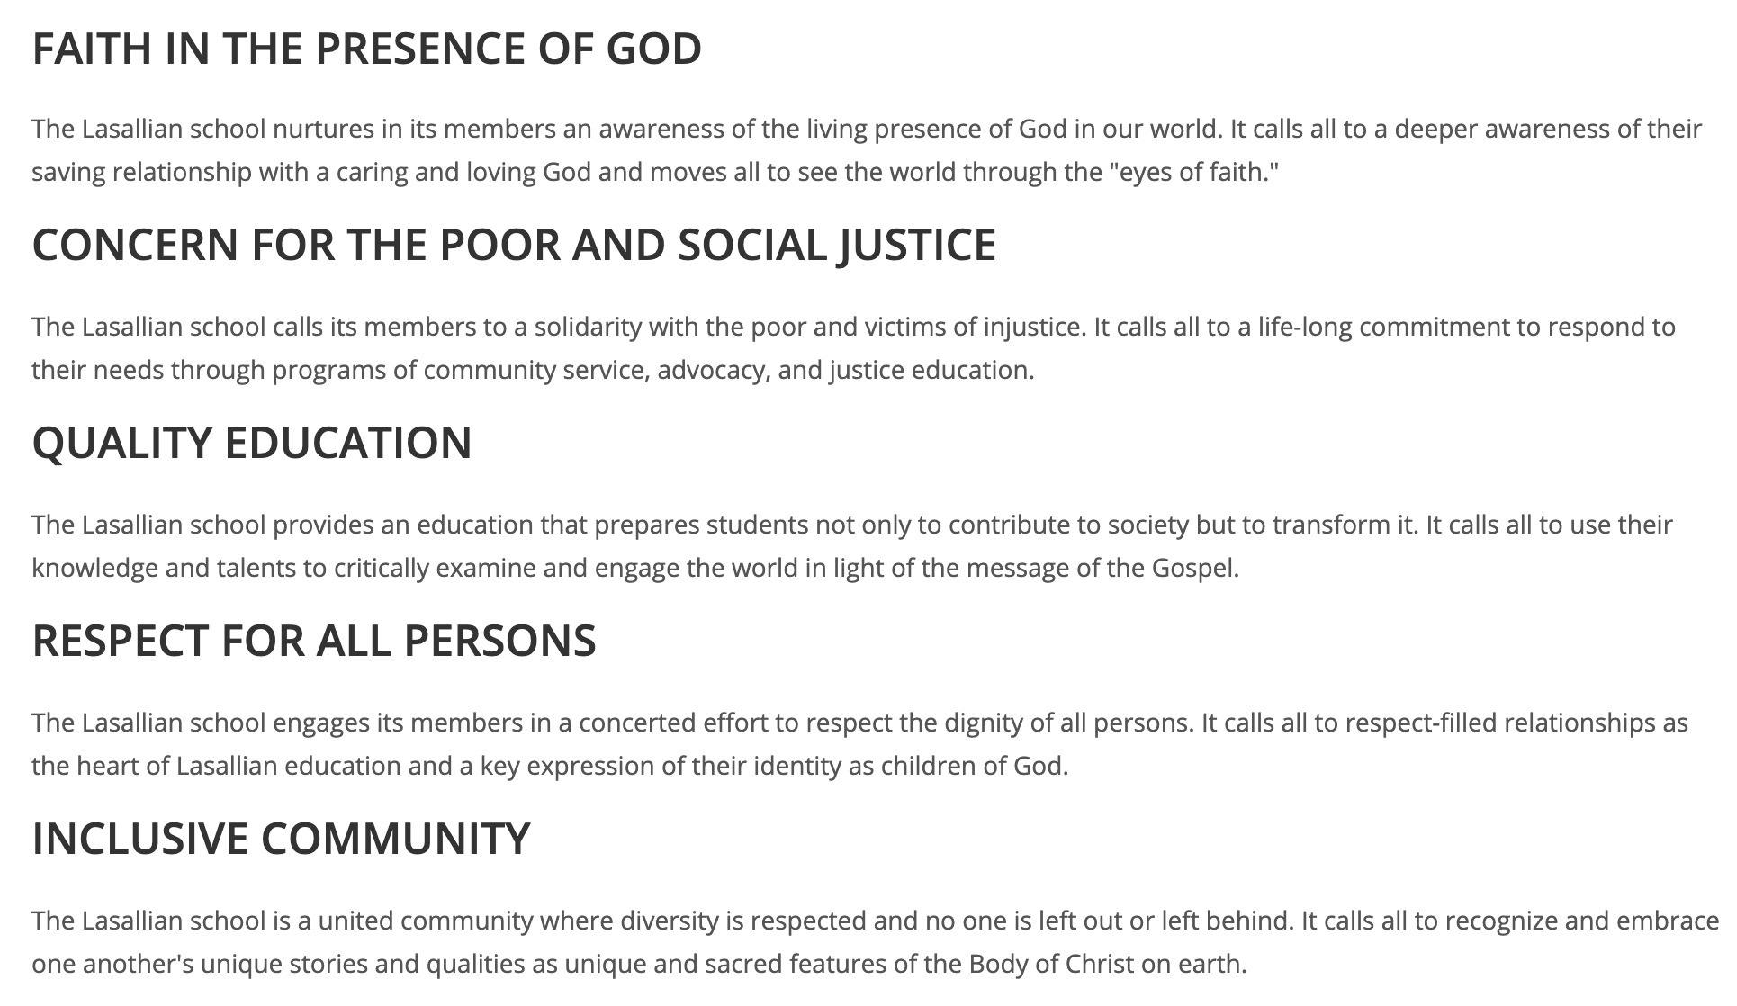
Friendly Conversation Topic – Lasallian Principles
Notes:
We are practical University educators.

Slide 6
Lasallian Tradition
Recall:
I’m challenging you today to demonstrate:
Commitment to a Quality Education by proactively participating to make our time together effective
Community & Togetherness by getting to know your classmates and your instructor
Today:
Part of our Lasallian Tradition is to be okay with some quiet time in class to prepare ourselves to learn and to prepare and reflect.
Notes:
Compassion and Empathy
Commitment and Integrity
Togetherness and Association

Slide 7

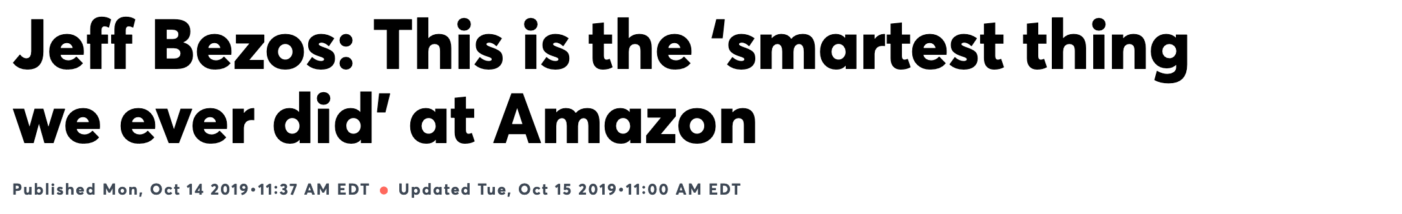
Bezos created a new way to hold meetings: Meetings start with each attendee sitting and silently reading [the memo and preparing for the discussion]
…
″[The memo is] supposed to create the context for what will then be a good discussion,” Bezos said.

Slide 8
Eric’s Small Frustration
(And Continuous Improvement)

Slide 9
Friendly Conversation Topic - Conclusion
For the next several classes, we are going to give ourselves the first four minutes of class to prepare and reflect.
Requests:
Embrace this for the next several classes
Be prepared to vote whether to continue, enhance, or stop this activity in our sprint 7 reflection
Please continue to focus on being on time or slightly early to class
Please come to class even you come late
Help continue to make our class time effective and enjoyable

Slide 10
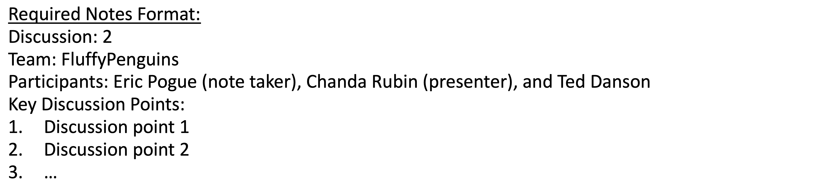
Scrum Team Discussion 7
Assign note taker and presenter roles to team members
Review and discuss the discussion topic for this sprint for approximately 10 minutes
Note taker takes notes and presenter prepares a report out summary
Note taker share notes with all participating team members
Each team member pastes and submits exact copy of the notes into their discussion board
Presenter reports out
Report Out

Slide 11
Prework
Prework for next class:
Complete through activity 7
Scrum team review “Application Architectures, Object-Oriented Programming, and Databases - Part 1”

Slide 12
Programming Together

Slide 13
End of Session

