Slide 1

Preflight Check List
Everyone:
Sign into our Zoom meeting through our integrated Blackboard/Zoom link
Make sure that you can hear the conversation, see shared desktops, and view group chat topics
You will need a headset with a microphone to be able to effectively listen and speak
You will need to be able to share your computer screen
Thank you if you choose to leave your camera on to help make our class more interactive
In person participants also:
Make sure that your microphone and speakers are muted/off so that we don’t get an echo
Sit in a good spot near the classroom ceiling microphones if possible

Slide 2
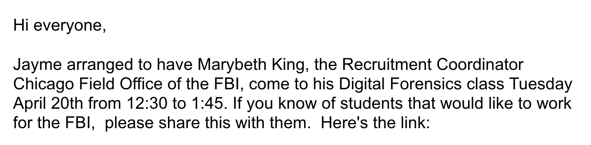
Four Minutes of Preparation and Reflection
Please spend the first few minutes of class reviewing your assigned prework:
Complete through activity 10
Be prepared for Quiz 7
Start Recording

Slide 3
Agenda:
Final Project Presentation Date & Time
Final Project Presentation Questions & Answers
Job, Internship, and Tutoring Opportunities
Prework for Next Class
Quiz 7
Discussion & Questions welcome at any time but please be present with no phones or email during our time together

Slide 4
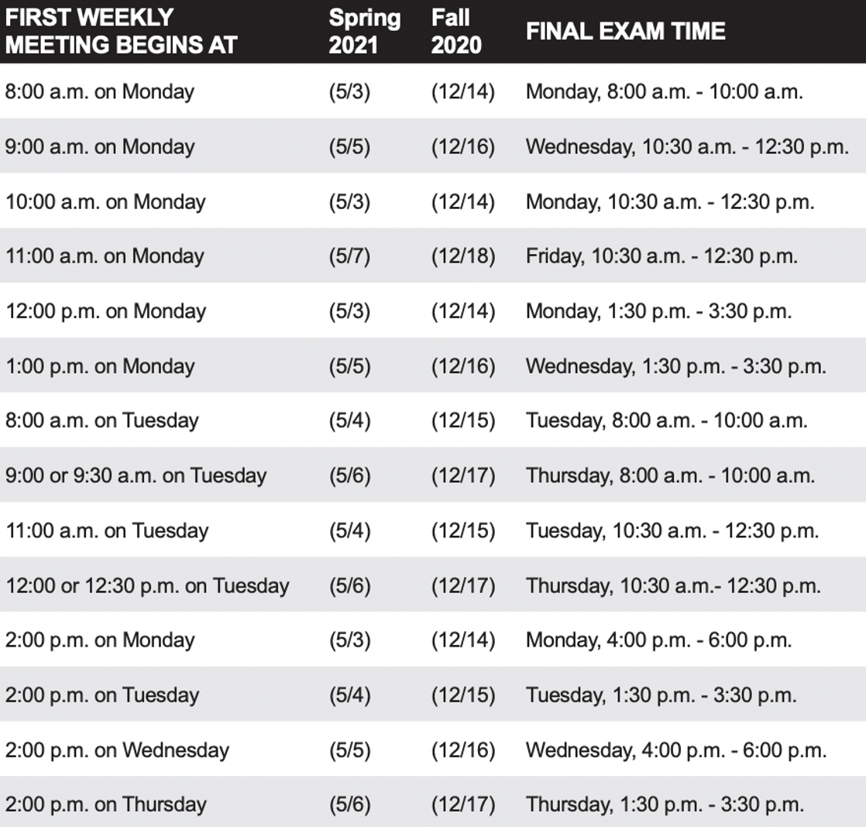
Final Project Presentations
Foreshadowing Sprint 8:
Finals week start Monday, May 3rd
No regular classes during finals week
Final project presentations are scheduled during our final exam time time
Everything is due at least 2 hours before your final project presentation timeslot
You may resubmit assignments up until the end of the day Thursday, May 6th

Slide 5
Final Project Presentation Questions & Answers
Can I present earlier and be done with the class?
Yes.
When do sprint 8 assignments need to be submitted?
Two hours before your scheduled Final Project presentation time.
Can I resubmit sprint 8 assignments later in the week?
Yes. Everything needs to be submitted by the end of the day Thursday, May 6th.
What if I miss my Final Project Presentation time?
Contact me before your scheduled time and make sure that your assignments are submitted

Slide 6
Review Final Project
Presentations & Schedule

Slide 7
Q&A from Thursday Team Discussion
Topic: Application Architectures, Object-Oriented Programming, and Databases - Part 1:
Scrum Master accepts volunteers for (or assigns) Presenter
Team discusses and presenter summarizes the key sections including:
Three-tier Application Architecture / Object-Oriented Programming Concepts, Patterns, Principles
Horizontal vs Vertical Scaling / Files, JSON/XML, Binary, and Shared Files
SQL and NoSQL Databases /
Database Pros & Cons / ORM?
Shared Data Best Practices
Team sits back, relaxes, and acknowledges the bravery and dedication of the presenter
Team returns to class Zoom session where presenter presents summary
Report Out

Slide 8
Job, Internship,
and Tutoring Opportunities

Slide 9
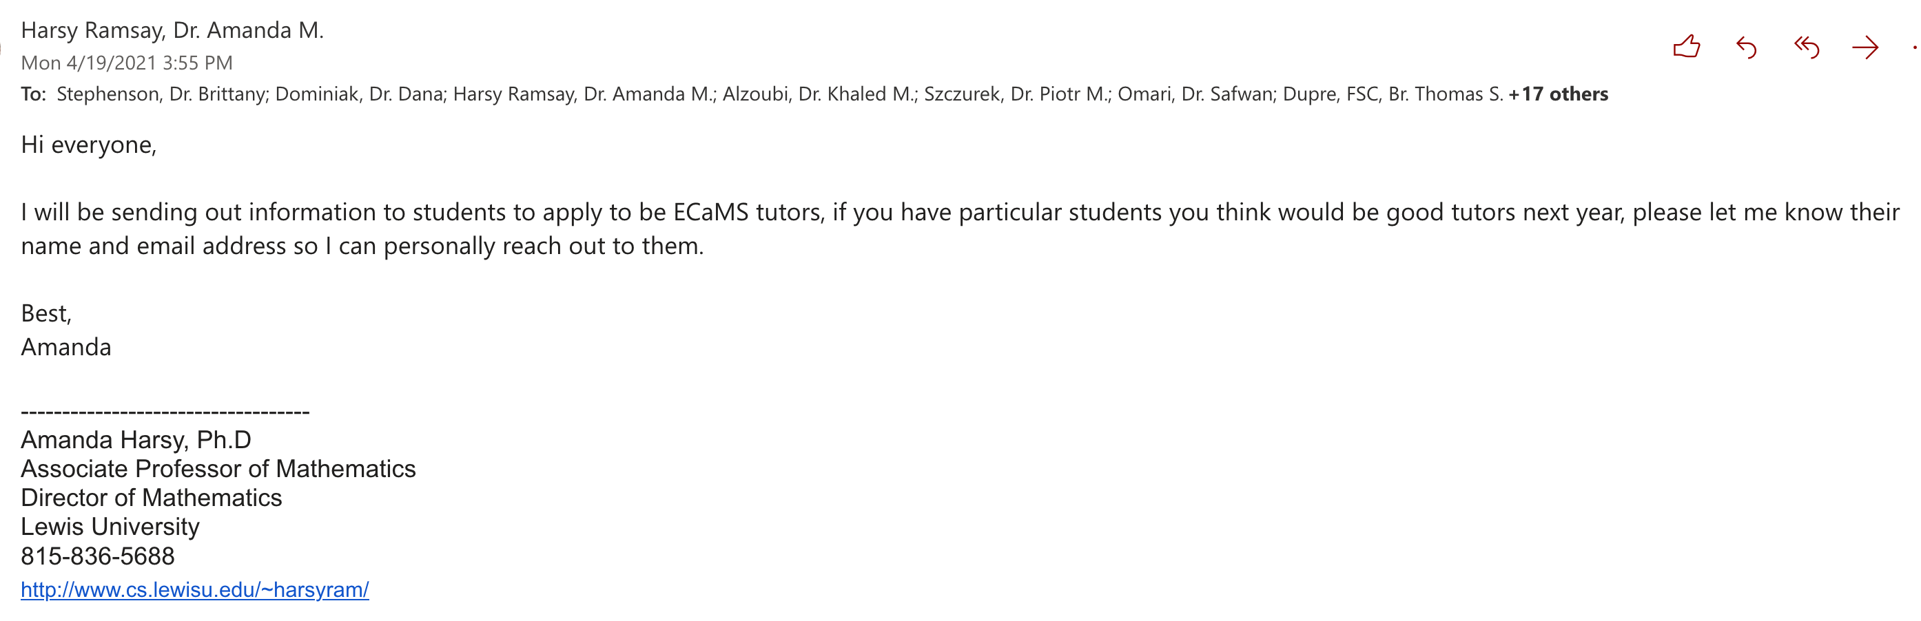
ECaMS Tutors Needed

Slide 10
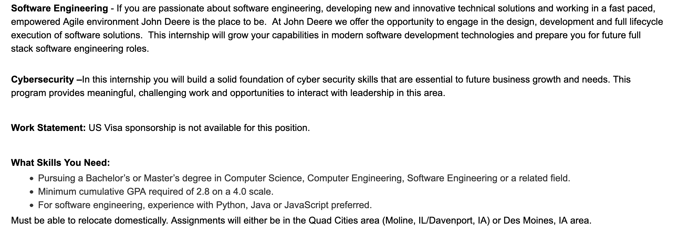
Job Opportunities

Slide 11
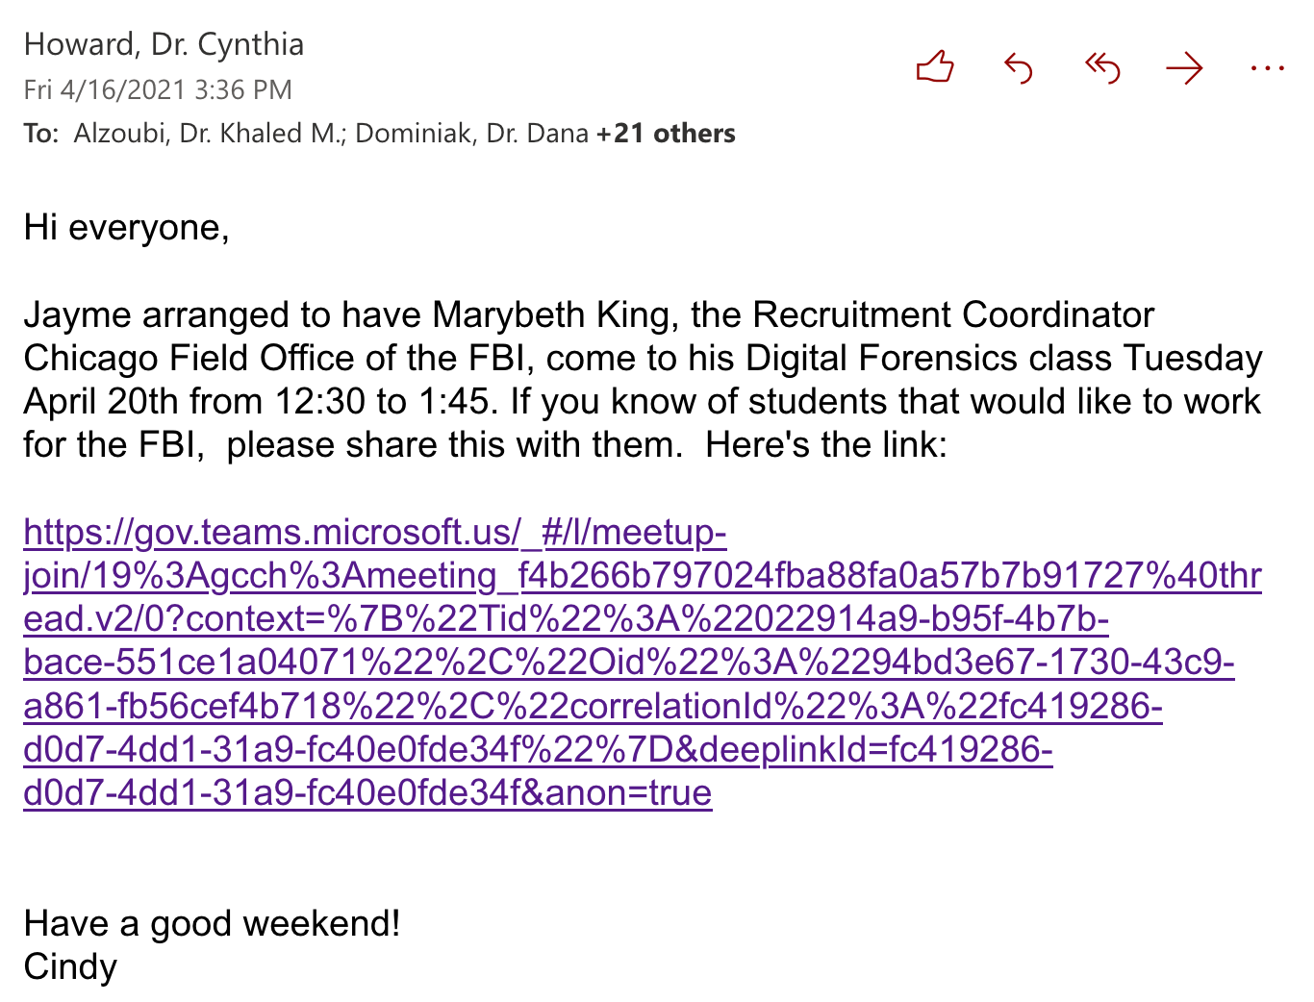
Job Opportunities

Slide 12
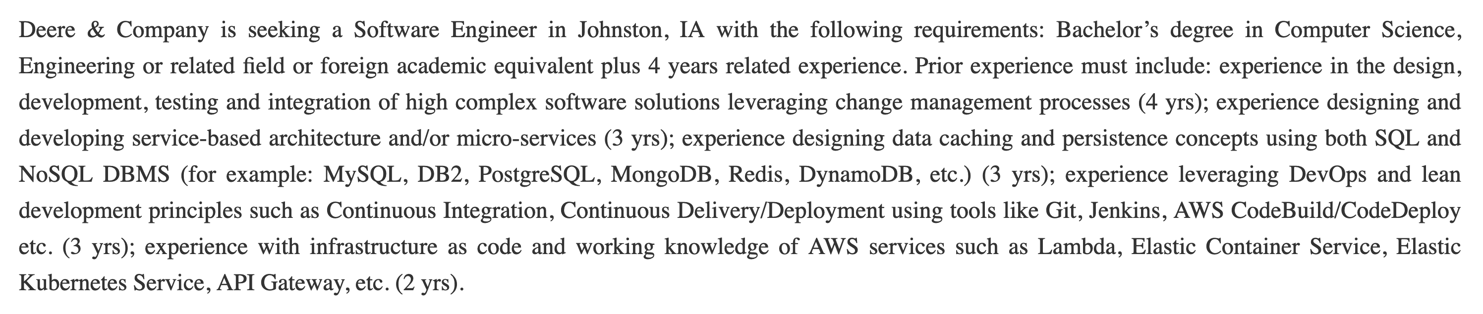
Job Opportunities

Slide 13
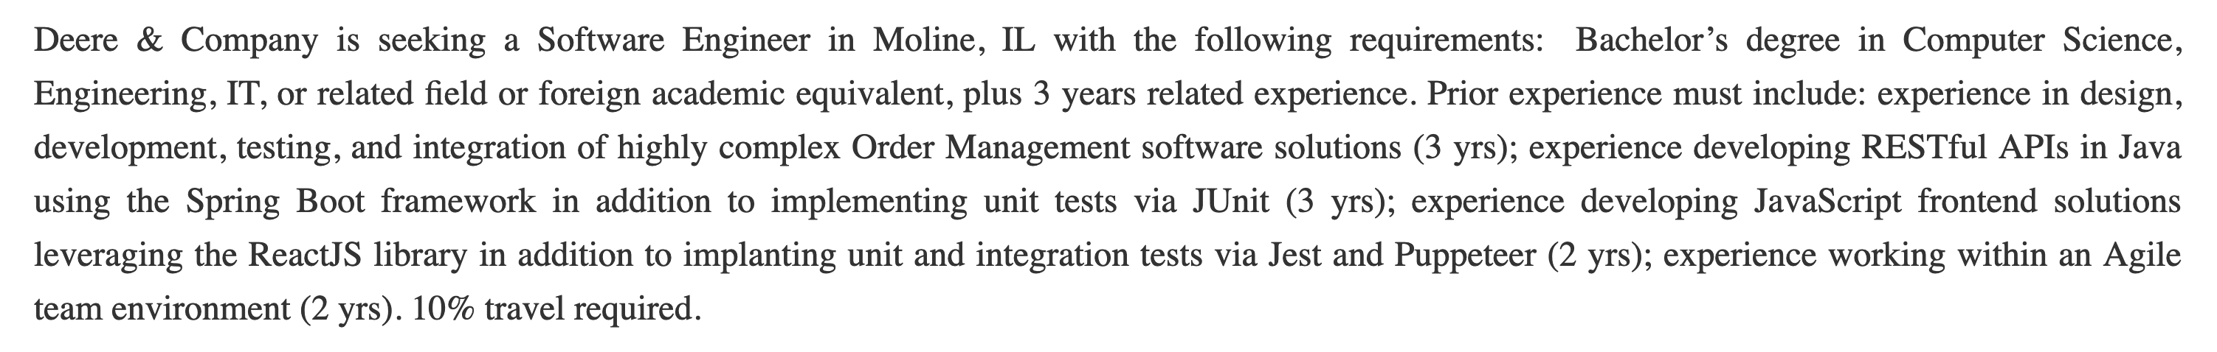
Job Opportunities

Slide 14
Prework For Next Class
Complete through activity 14
Be prepared for sharing your Azure Authentication experiences to date

Slide 15
Quiz 7

Slide 16
End of Session

