Slide 1

Preflight Check List
Everyone:
Sign into our Zoom meeting through our integrated Blackboard/Zoom link
Make sure that you can hear the conversation, see shared desktops, and view group chat topics
You will need a headset with a microphone to be able to effectively listen and speak
You will need to be able to share your computer screen
Thank you if you choose to leave your camera on to help make our class more interactive
In person participants also:
Make sure that your microphone and speakers are muted/off so that we don’t get an echo
Sit in a good spot near the classroom ceiling microphones if possible

Slide 2
A Couple Minutes of Preparation and Reflection
Please spend the first few minutes of class reviewing your assigned prework:
Be diligently working on activity 10 and 11
Be prepared for Programming Together
Start Recording

Slide 3
Agenda:
Sprint 8 Preview
Programming Together
Prework for Next Class
What’s Next (as time allows)
Discussion & Questions welcome at any time but please be present with no phones or email during our time together

Slide 4
Sprint 8 Preview
Normal class schedule next week with:
Sprint 8 planning Monday
Sprint 7 Demos, Retrospective, and Chapter discussion on Wednesday
Quiz 8 and Lab on Friday
Final Exams start the following week with no regular classes
We will be presenting our Final Project during our scheduled Final Exam time

Slide 5
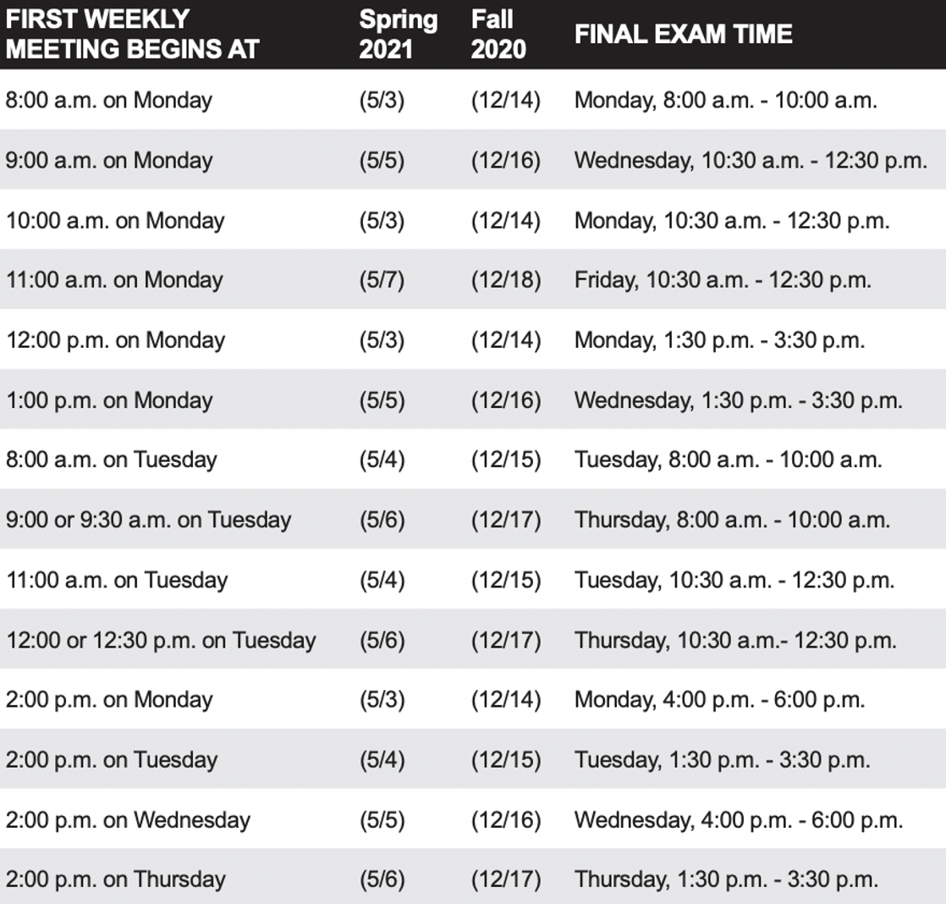
Sprint 8 Preview
Sprint 8 week 2:
Finals week starts Monday, May 3rd
No regular classes during finals week
Final project presentations will be during our final exam time time
All assignments are due 2 hours before our scheduled final exam time
You may resubmit assignments up until the end of the day Thursday, May 6th

Slide 6
Programming Together

Slide 7
Prework
Everything is due Sunday
Be prepared for sprint 8 planning
Be prepared to focus on your final project

Slide 8
What’s Next?
Notes:
Functional Programming
OOP -> Code Reuse
Functional Programming -> Testability & Multithreading

Slide 9
End of Session

