Slide 1

Preflight Check List
Everyone:
Sign into our Zoom meeting through our integrated Blackboard/Zoom link
Make sure that you can hear the conversation, see shared desktops, and view group chat topics
You will need a headset with a microphone to be able to effectively listen and speak
You will need to be able to share your computer screen
Thank you if you choose to leave your camera on to help make our class more interactive
In person participants also:
Make sure that your microphone and speakers are muted/off so that we don’t get an echo
Sit in a good spot near the classroom ceiling microphones if possible

Slide 2
Preparation and Reflection
Please spend the first few minutes of class reviewing our assigned prework:
Everything is due Sunday
Be prepared for to demo your team’s sprint 2 product
Be prepared for sprint 7 reviews, retrospectives, and demos
Be prepared for sprint 8 planning
Start Recording

Slide 3
Agenda:
Sprint 2 Demos (team)
Sprint 2 Retrospectives & Sprint 3 Planning Update Breakout session (team)
Sprint 7 Retrospective (class)
Sprint 7 Start, Stop, Continue Breakout session (class)
Sprint 8 Planning (class)
Prework for Next Class
Discussion & Questions welcome at any time but please be present with no phones or email during our time together

Slide 4
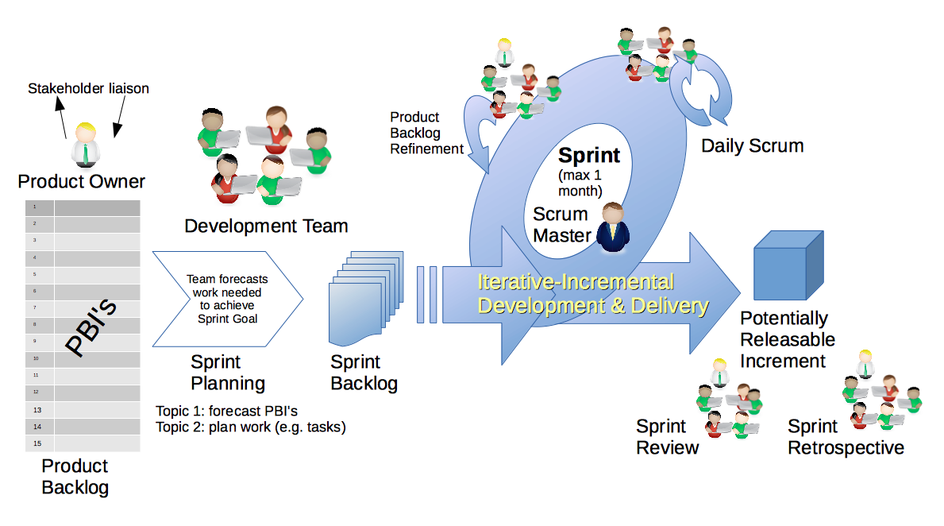
Scrum Process – Sprint Review & Demo
By Dr ian mitchell - Own work, CC BY-SA 4.0, Link

Slide 5
Demo Guidelines – Presenter
Everyone will give at least one demo of their work during the semester.
Your demo should be 2 to 5 minutes and can include any or all of the following:
Show your application running
Comment on your implementation
Show the source code
Explain how you organized the code
Talk about any challenges
You should not prepare slides or a presentation
**You will also need to complete the Demo assignment in Blackboard.

Slide 6
Demo Guidelines – Listener
Everyone will be listening to many demos during the semester.
Your listener responsibilities include:
Actively listening and watching what is being demoed
Come up with a meaningful yet easy to answer question
Ask your question if the presenter does not get sufficient questions from other listeners
Do not ask hard question or attempt to review the presenters code
Clap for the presenter at the end of the demo and thank them for presenting
Optionally follow up with the presenter later if you have what could be more difficult questions or if you have suggestions

Slide 7
Sprint & Product Demos

Slide 8
Complete Sprint Demo Assignment

Slide 9
Scrum Process – Sprint Retrospective
By Dr ian mitchell - Own work, CC BY-SA 4.0, Link

Slide 10
Sprint 2 Retrospectives plus
Sprint 3 Planning Update
Breakout session (team)

Slide 11
Sprint 2 Retrospective & Sprint 3 Planning Update
The team calculates sprint metrics and completes retrospective.
Calculate say/do ratio with no ambiguity.
Report out questions (Scrum Master):
What was your say/do ratio and how was it calculated (story points committed and story points done)?
What was one specific item from your retrospective?
What were the sprint 3 plan?
What is your original and updated story and story point commitment?

Slide 12
Sprint 7 Retrospective (class)

Slide 13
Submission Percentage for Sprint 3

Slide 14
Submission Percentage for Sprint 4

Slide 15
Submission Percentage for Sprint 5

Slide 16
Recall Submission Percentage for Sprint 6

Slide 17
Submission Percentage for Sprint 7

Slide 18
Retrospective (class)
Feedback from Assignments & Reflections:
Very good submission numbers
Grades are posted for Discussion and Quiz answer should be available now… email me with questions or comments about the quiz
Grades for Labs and Reflections will be posted by the end of the day tomorrow
I can see the team effectiveness improving… this is really hard to effectively work in a team to develop software

Slide 19
Class Retrospective Breakout
Start, Stop, Continue for the class:
Continue: What is something specific that is working? Something that we should make sure that we continue to do.
Start: What is something specific that would be nice to do that we are not doing now? Maybe something that you have seen work well for others.
Stop: What is not working or not adding value? Something to stop doing.
Report out questions (Scrum Master):
What are two start, stop, continue items?
Should I continue the preparation and reflection time at the beginning of class? If so, what is the optimal length of time?
How can I better reward scrum team and class participation?
What else could I do to improve the class?

Slide 20
Thank you!

Slide 21
Sprint 8 Planning

Slide 22
Scrum Process – Sprint Planning
By Dr ian mitchell - Own work, CC BY-SA 4.0, Link

Slide 23
Sprint 8 Planning
Sprint 8 Changes:
Focused on Final Projects
No required Discussion 8
Final Project Presentation assignment
No regular classes in week 2
Final Project presentations during final exam time

Slide 24
Sprint 8 Planning
Sprint 8 Week 1:
Normal class schedule
Today: Sprint 7 Demos and Retrospective and Sprint 8 planning
Thursday: Topic Discussion, Quiz 8, and Lab

Slide 25
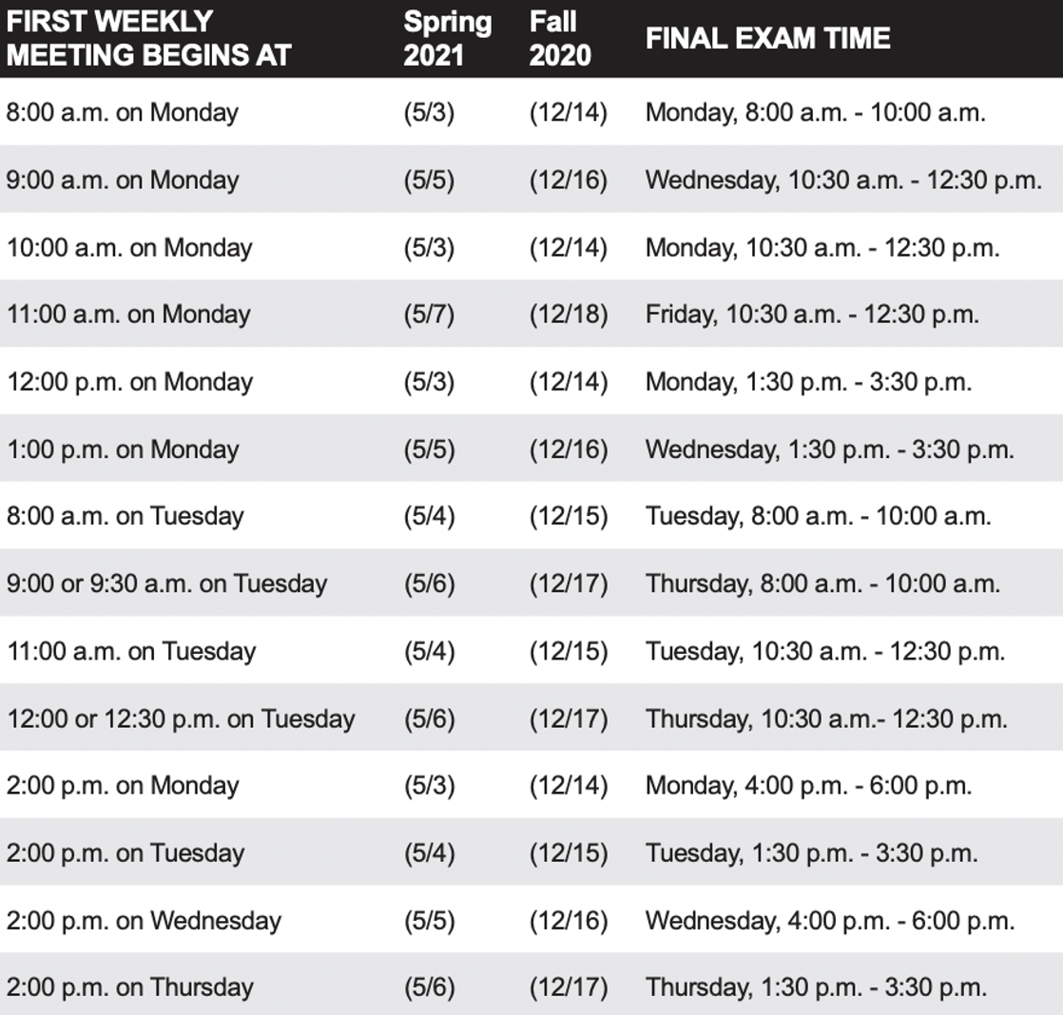
Sprint 8 Planning
Sprint 8 Week 2:
Finals week starts Monday, May 3rd
No regular classes during finals week
Final project presentations will be during our final exam time time
All assignments are due 2 hours before our scheduled final exam time
You may resubmit assignments up until the end of the day Thursday, May 6th
You need to let me know during your final project presentation if you will be resubmitting Lab 8

Slide 26
Review Activities List and Assignments

Slide 27
Prework For Next Class
Complete through activity 7 prior to next class
Be prepared for scrum team discussion of “Application Architectures, Object-Oriented Programming, and Databases - Part 2”
Be prepared for Quiz 8
Upcoming Next Week:
Final Project Presentations during our final exam time

Slide 28
End of Session

