Slide 1

Preflight Check List
Everyone:
Sign into our Zoom meeting through our integrated Blackboard/Zoom link
Make sure that you can hear the conversation, see shared desktops, and view group chat topics
You will need a headset with a microphone to be able to effectively listen and speak
You will need to be able to share your computer screen
Thank you if you choose to leave your camera on to help make our class more interactive
In person participants also:
Make sure that your microphone and speakers are muted/off so that we don’t get an echo
Sit in a good spot near the classroom ceiling microphones if possible

Slide 2
Preparation
Please spend the first few minutes of class reviewing our assigned prework:
Complete through activity 5 prior to next class
Be prepared for demos
Be prepared for scrum team review of “Application Architectures, Object-Oriented Programming, and Databases - Part 2”
Be prepared for retrospectives
Start Recording

Slide 3
Agenda:
Sprint 7 Demos
Sprint 7 Retrospective
Sprint 7 Start, Stop, Continue Breakout session (class)
Prework for Next Class
Programming Together (as time allows)
Discussion & Questions welcome at any time but please be present with no phones or email during our time together

Slide 4
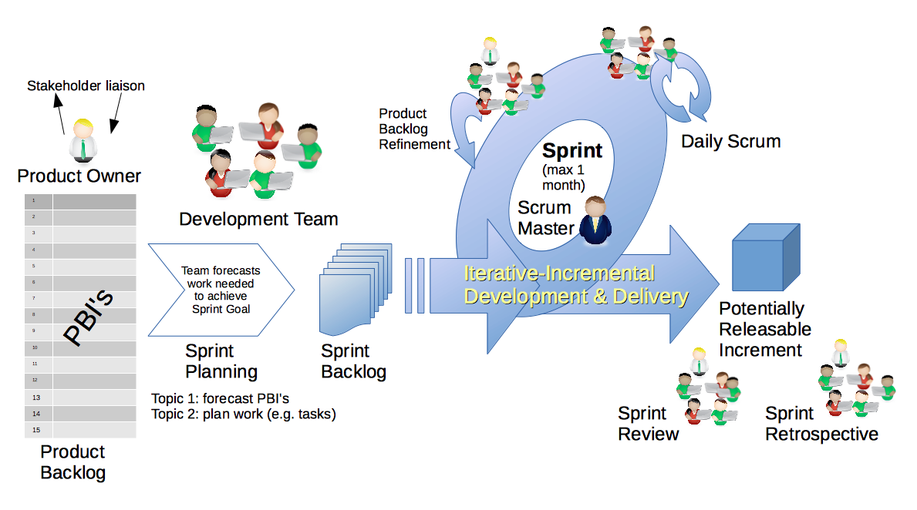
Scrum Process – Sprint Review & Demo
By Dr ian mitchell - Own work, CC BY-SA 4.0, Link

Slide 5
Demo Guidelines – Presenter
Everyone will give at least one demo of their work during the semester.
Your demo should be 2 to 5 minutes and can include any or all of the following:
Show your application running
Comment on your implementation
Show the source code
Explain how you organized the code
Talk about any challenges
You should not prepare slides or a presentation
**You will also need to complete the Demo assignment in Blackboard.

Slide 6
Demo Guidelines – Listener
Everyone will be listening to many demos during the semester.
Your listener responsibilities include:
Actively listening and watching what is being demoed
Be prepared to ask a meaningful yet easy to answer question
Clap for the presenter at the end of the demo and thank them for presenting

Slide 7
Sprint Demos

Slide 8
Complete Sprint Demo Assignment

Slide 9
Scrum Process – Sprint Retrospective
By Dr ian mitchell - Own work, CC BY-SA 4.0, Link

Slide 10
Submission Percentage

Slide 11
Class Retrospective
Feedback from Assignments & Reflections:
Solid assignment submission numbers
Grades are posted and up to date through sprint 7
Quiz answers are available… can someone double check?
Very well done on your programming assignments

Slide 12
Class Retrospective Breakout
Start, Stop, Continue for the class:
Continue: What is something specific that is working? Something that we should make sure that we continue to do.
Start: What is something specific that would be nice to do that we are not doing now? Maybe something that you have seen work well for others.
Stop: What is not working or not adding value? Something to stop doing.
Report out questions (Scrum Master):
What are two start, stop, continue items?
Should I continue the preparation time at the beginning of class? If so, what is the optimal length of time?
How can I better reward scrum team and class participation?
What else could I do to improve the class?

Slide 13
Prework For Next Class
Be prepared for scrum team review of “Application Architectures, Object-Oriented Programming, and Databases - Part 2”
Be prepared for quiz 8

Slide 14
Programming Together
(as time allows)

Slide 15
End of Session

