Slide 1

Preflight Check List
Everyone:
Sign into our Zoom meeting through our integrated Blackboard/Zoom link
Make sure that you can hear the conversation, see shared desktops, and view group chat topics
You will need a headset with a microphone to be able to effectively listen and speak
You will need to be able to share your computer screen
Thank you if you choose to leave your camera on to help make our class more interactive
In person participants also:
Make sure that your microphone and speakers are muted/off so that we don’t get an echo
Sit in a good spot near the classroom ceiling microphones if possible

Slide 2
Preparation
Please spend the first few minutes of class reviewing our assigned prework:
Be prepared for quiz 8
Final project, final project, and more final project
Start Recording

Slide 3
Agenda:
Friendly Conversation Topic
Review Final Project Presentation Schedule
Prework for Next Class
Review Final Project Presentation Exceptions?
Quiz 8 and Final Project Assistance
Discussion & Questions welcome at any time but please be present with no phones or email during our time together

Slide 4
Friendly Conversation Topic
Thank You!

Slide 5
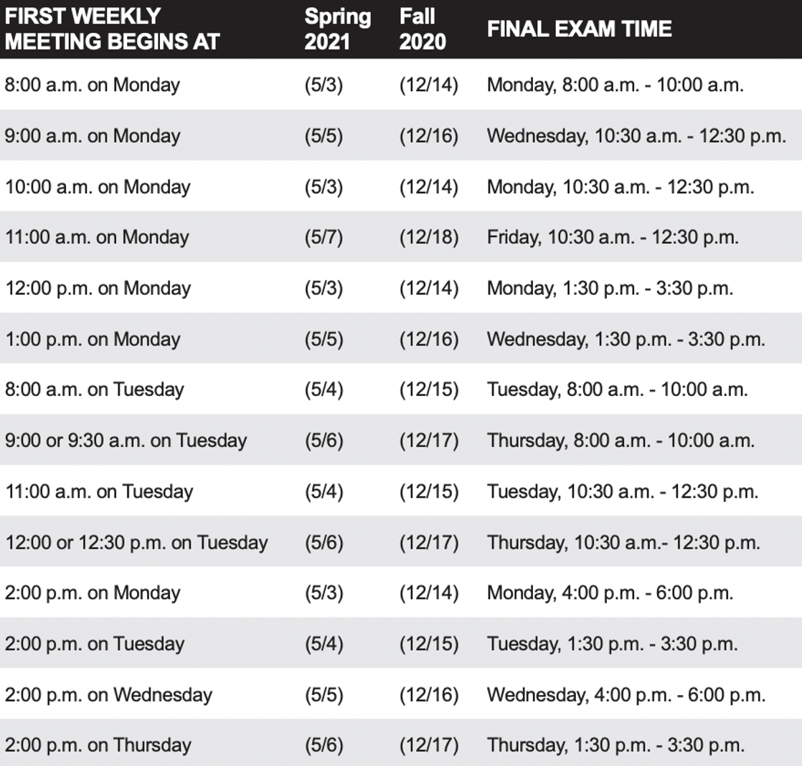
Sprint 8 Planning
Sprint 8 week 2:
Finals week starts Monday, May 3rd
No regular classes during finals week
Final project presentations will be during our final exam time time
All assignments are due 2 hours before our scheduled final exam time
You may resubmit assignments up until the end of the day Thursday, May 6th
You need to let me know during your final project presentation if you will be resubmitting Lab 8

Slide 6
Prework For Next Class
Everything needs to be submitted two hours before you scheduled Final Project presentation time
Be prepared Final Project presentations during our final exam time

Slide 7
Review Final Project
Presentation Exceptions?

Slide 8
Quiz 8 and
Final Project Assistance

Slide 9
End of Session

