Slide 1

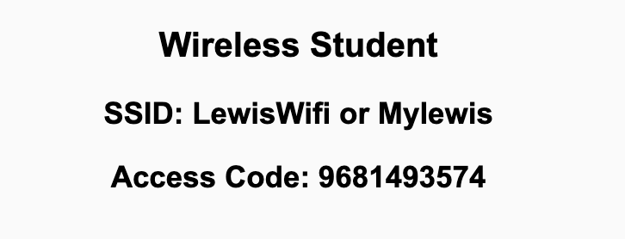
Preflight Check List
Sign into our Zoom meeting through our integrated Blackboard/Zoom link
Make sure that you can hear the conversation, see shared desktops, and view chat topics
Thank you if you choose to leave your camera on to help make our class more interactive
Be prepared to share your computer screen
Be prepared to utilize a headset with a microphone
In person participants also:
Make sure that your microphone and speakers are muted/off so that we don’t get an echo
Sit in a good spot near the classroom ceiling microphones if possible

Slide 2
Recordings
Discuss that recording are:
Opportunistic
Automatically available in Blackboard/Zoom
Sound Check… plus Video, and Desktop Sharing check
Start Recording

Slide 3
Agenda:
Prework and Announcements
What is a Product Owner?
Sprint 5 Planning
Prework for Next Class
Team Planning Review
Discussion & Questions welcome at any time but please be present with no phones or email during our time together

Slide 4
Prework
Everything is due Sunday!
Be prepared for sprint 5 planning on Monday

Slide 5
Announcements
We are at the halfway through the semester. How does it feel?

Slide 6
Sprint Planning

Slide 7
What is a Product Owner?

Slide 8
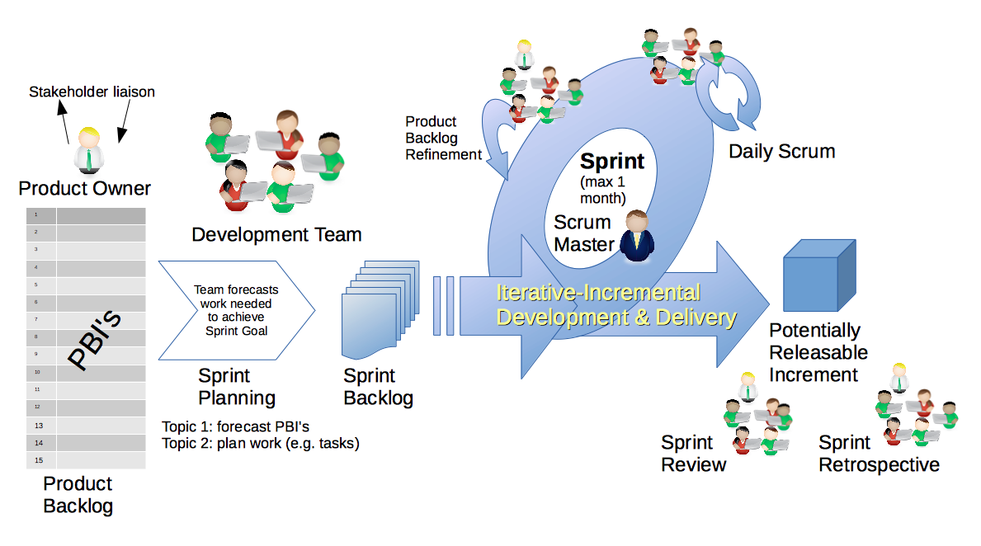
Scrum Process – Sprint Planning
By Dr ian mitchell - Own work, CC BY-SA 4.0, Link

Slide 9
Sprint Planning
Sprint 5 Changes:
New Product Owner (and backup product owner) role being added to teams
Moving from instructor led to scrum team led activities… this is hard!
We are moving from me being the Product Owner managing the Backlogs to your team working with the Product Owner creating and management the Backlogs

Slide 10
Scrum Process – Sprint Planning
By Dr ian mitchell - Own work, CC BY-SA 4.0, Link

Slide 11
Review Activities List
and Assignments

Slide 12
Prework For Next Class
Complete through activity 6
Those scheduled to demo on Wednesday please be a couple of minutes early to class
Be prepared of discussion of Software Maintenance (FOX chapter 9)
Looking Farther Ahead:
Friday (Oct 29): Discuss with a Product Owner plus Backlog Grooming
Monday (Nov 1): Sprint Planning …contact me if you cannot be there Monday or need to be remote
Wednesday (Nov 3): Metrics plus Quiz 5
Friday (Nov 5): Backlog Grooming plus Lab
Monday (Nov 8): Sprint Planning …contact me if you cannot be there Monday or need to be remote

Slide 13
Review Wednesday
Demo Schedule

Slide 14
Scrum Team Planning Review
As a scrum team:
Review if you can keep your current scrum master for sprint 5
Who will be your product owner for sprint 5?
Who will be your scrum master and production owner for sprint 6?
Review sprint activities & assignments in detail
Discuss and document questions/concerns
Report Out:
Who is your sprint 5 scrum master and product owner?
Who is your sprint 6 scrum master and product owner? Can we keep them the same?
Scrum master share your team’s top 2 questions/concerns during report out

Slide 15
End of Session

