Slide 1

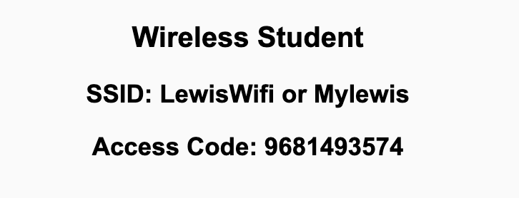
Preflight Check List
Sign into our Zoom meeting through our integrated Blackboard/Zoom link
Make sure that you can hear the conversation, see shared desktops, and view chat topics
Thank you if you choose to leave your camera on to help make our class more interactive
Be prepared to share your computer screen
Be prepared to utilize a headset with a microphone
In person participants also:
Make sure that your microphone and speakers are muted/off so that we don’t get an echo
Sit in a good spot near the classroom ceiling microphones if possible

Slide 2
Recordings
Discuss that recording are:
Opportunistic
Automatically available in Blackboard/Zoom
Sound Check… plus Video, and Desktop Sharing check
Start Recording

Slide 3
Agenda:
Prework & Announcements
Sprint 4 Review & Demos
Sprint 4 Retrospective
Scrum Team Sprint 4 Retrospective
Prework for Next Class
Discussion & Questions welcome at any time but please be present with no phones or email during our time together

Slide 4
Prework
Complete through activity 6
Those scheduled to demo on Wednesday please be a couple of minutes early to class
Be prepared of discussion of Software Maintenance (FOX chapter 9)
Looking Farther Ahead:
Friday (Oct 29): Discuss with a Product Owner plus Backlog Grooming
Monday (Nov 1): Sprint Planning …contact me if you cannot be there Monday or need to be remote
Wednesday (Nov 3): Metrics plus Quiz 5
Friday (Nov 5): Backlog Grooming plus Lab
Monday (Nov 8): Sprint Planning …contact me if you cannot be there Monday or need to be remote

Slide 5
Sprint Review & Demos

Slide 6
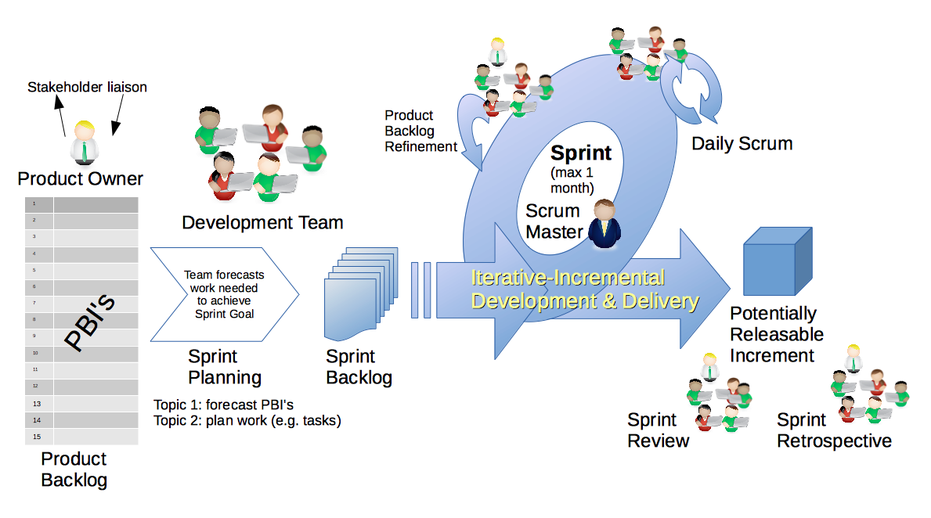
Scrum Process – Sprint Review & Demo
By Dr ian mitchell - Own work, CC BY-SA 4.0, Link

Slide 7

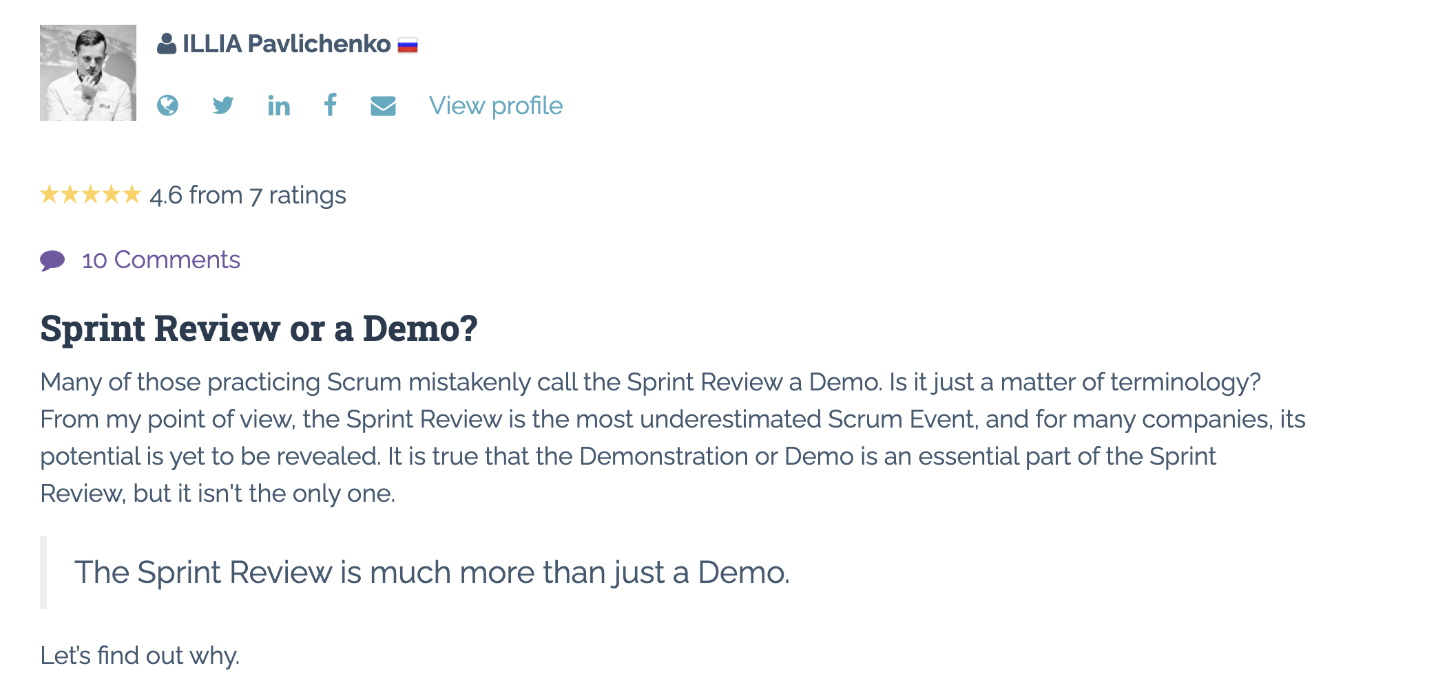
Sprint Review: Much More Than Just A Demo

Slide 8
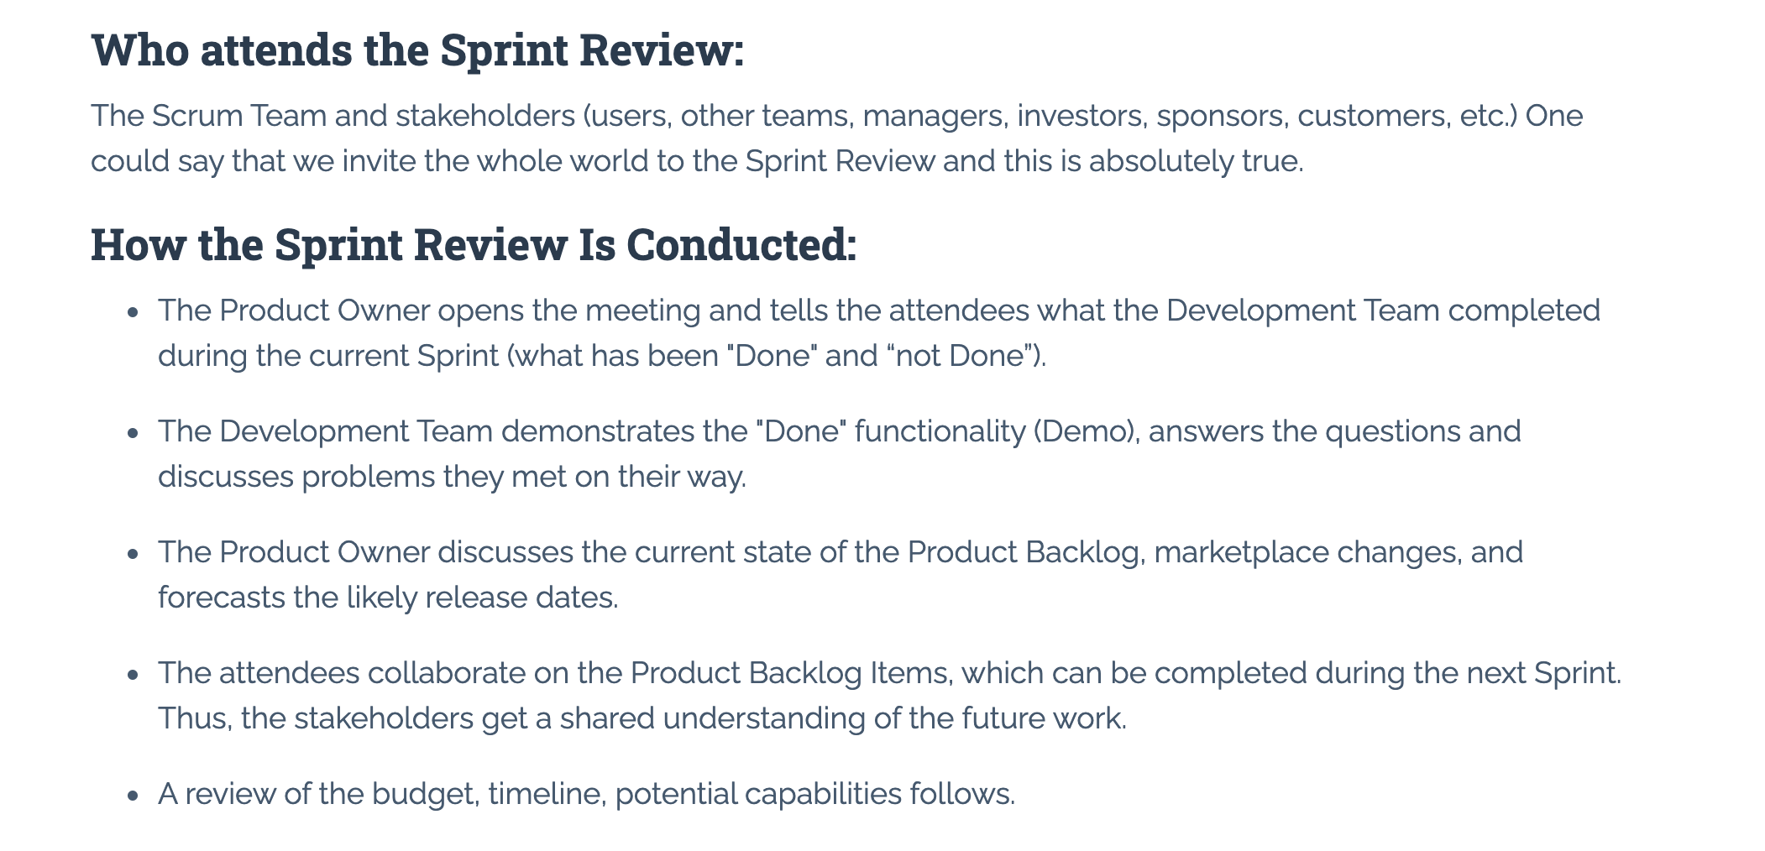
Sprint Review: Much More Than Just A Demo

Slide 9
Demos

Slide 10
Demo Guidelines – Presenter
Everyone will give at least one demo of their work during the semester.
Your demo should be 2 to 5 minutes and can include any or all of the following:
Show your application running
Comment on your implementation
Show the source code
Explain how you organized the code
Talk about any challenges
You should not prepare slides or a presentation
**You will also need to complete the Demo assignment in Blackboard.

Slide 11
Demo Guidelines – Listener
Everyone will be listening to many demos during the semester.
Your listener responsibilities include:
Actively listening and watching what is being demoed
Come up with a meaningful yet easy to answer question
Ask your question if the presenter does not get sufficient questions from other listeners
Do not ask hard question or attempt to review the presenters code
Clap for the presenter at the end of the demo and thank them for presenting
Optionally follow up with the presenter later if you have what could be more difficult questions or if you have suggestions

Slide 12
Sprint Demos

Slide 13
Complete Sprint Demo Assignment
(everyone should have completed this)

Slide 14
Scrum Process – Sprint Retrospective
By Dr ian mitchell - Own work, CC BY-SA 4.0, Link

Slide 15
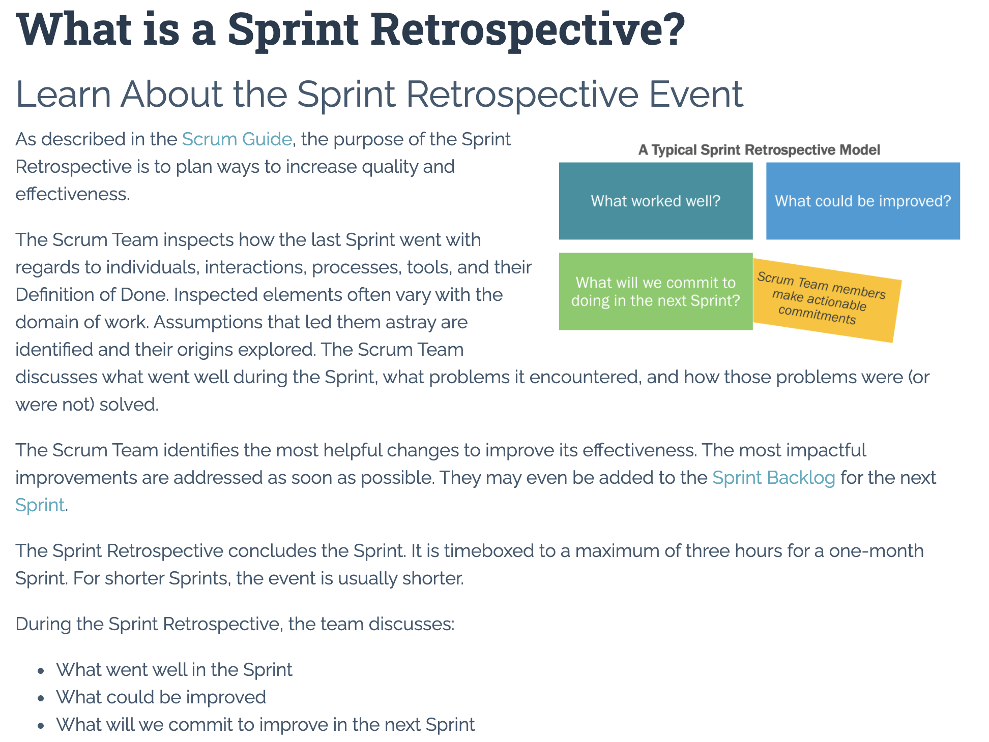

Slide 16
Submission Percentage – Sprint 4

Slide 17
Class Retrospective
Feedback from Assignments & Reflections:
Solid job submitting assignments
Very nice Health Insurance Risk Calculator for the Web with Teams implementations
All assignments are graded and posted
P&D style architectural analysis papers were overall not quite up to expectations

Slide 18
Scrum Team Retrospective
What’s working and what’s not working for your scrum team?
What is one continuous improvement activity for your scrum team? Can you add this to your backlog?
What are two elements of “Done”?
How will you demo sprint 5 User Stories within your team?
Team Report-out

Slide 19
Prework For Next Class
Complete through activity 9
Be prepared for Product Owner discussion with Robert Pogue
Be prepared for Discussion 5
Be prepared for Sprint 5 Backlog Grooming
Be prepared of discussion of Software Maintenance (FOX chapter 9) and Software Maintenance & Support… I may ask that you complete this on your own so that we have more time for other activities
Looking Farther Ahead:
Monday (Nov 1): Sprint Planning …contact me if you cannot be there Monday or need to be remote
Wednesday (Nov 3): Metrics plus Quiz 5
Friday (Nov 5): Backlog Grooming plus Lab
Monday (Nov 8): Sprint Planning …contact me if you cannot be there Monday or need to be remote

Slide 20
End of Session

