Slide 1

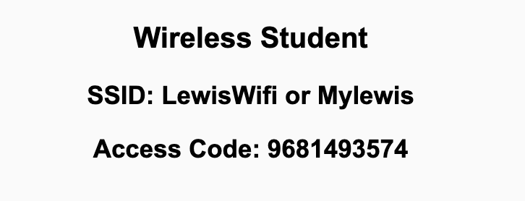
Preflight Check List
Sign into our Zoom meeting through our integrated Blackboard/Zoom link
Make sure that you can hear the conversation, see shared desktops, and view chat topics
Thank you if you choose to leave your camera on to help make our class more interactive
Be prepared to share your computer screen
Be prepared to utilize a headset with a microphone
In person participants also:
Make sure that your microphone and speakers are muted/off so that we don’t get an echo
Sit in a good spot near the classroom ceiling microphones if possible

Slide 2
Recordings
Discuss that recording are:
Opportunistic
Automatically available in Blackboard/Zoom
Sound Check… plus Video, and Desktop Sharing check
Start Recording

Slide 3
Agenda:
Prework & Announcements
Commitments
Maintenance & Support plus Metrics
Quiz 5
Discussion & Questions welcome at any time but please be present with no phones or email during our time together

Slide 4
Prework For Today
Be prepared to discuss Maintenance & Support plus Metrics
Be prepared for Quiz 5

Slide 5
Announcement
Anyone interested in taking?
Software Systems Capstone Project (CPSC-49200.001)
Software Systems Capstone Project
In this course students will participate, as part of a team, in the design, implementation and testing of a medium-to-large software project. Additionally, this course will cover topics in professional ethics, intellectual properties, privacy, and professional communication.
Credits: 3
Prerequisite: CPSC 44000

Slide 6
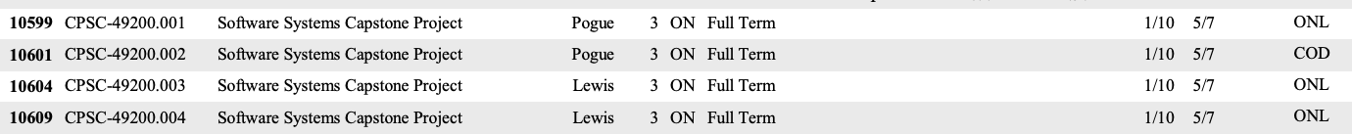
Announcement
Anyone interested in taking:
Software Systems Capstone Project (CPSC-49200.001)

Slide 7
Commitments
Ready to sign off on sprint 5 commitment?
Number of team members?
Total story point commitment?
Does every team member committed to at least 2 stories and 5 story points?

Slide 8
Review of Maintenance & Support plus Metrics
Assign presenter
Team reviews key topics using “team number by percent of content” method
Team sits back, relaxes, and acknowledges the bravery and dedication of the presenter
At a minimum, identify (1) the most interesting topic and (2) the most important topic from each of the following topics:
Maintenance & Support
Metrics

Slide 9
Software Maintenance & Support
Many processes include both Software Maintenance and Software Support in a single Maintenance category. This is a grave disservice from a process perspective because the two activities are dissimilar in many ways including:
The processes are aligned to different audiences with support focusing on application users and maintenance focusing on application sponsors
Support needs to scale with the user base where maintenance scales with enhancement requests
The optimal process is different with support generally adopting a Kanban and issue ticketing process where maintenance following a software development process like Waterfall or Agile
Support is optimized by supporting all products associated with a user base where maintenance is more single product focused
The cadence of support is minutes and hours where maintenance is days, weeks, and months which is very challenging to balance the immediate vs the important daily activities
The appropriate Metrics for Software Maintenance is very different from the appropriate Metrics for Support
Notes:
Grace period until Monday morning a 6am CT

Slide 10
Characteristics of a Good Metric
What makes a good software quality metric?
Easy to collect and understand
Good approximation of reality and good correlation to quality & goals
Meaningful to the group that can deliver positive change and can drive positive actions
Meaningful over time to encourage positive trends
Discourages “gaming the system,” or at least limits the impact of “gaming”
Does not allow one group to declare success (project management, developers, business analysts, etc.) while the overall product is failing
Comparable across teams, companies, and the industry

Slide 11
Common Metrics for Waterfall Software Development
Line of code per time-period
On-time
On-budget
… Scope delivered
Defects
Weighted Defects
Weighted Defects per unit delivered
Unit delivered per hour/day/month… per person
Unit delivered per hour/day/month… per dollar

Slide 12

Common Metrics for Agile Software Development
Story Points per Sprint per person
Say/Do ratio
Story Points delivered per Sprint… change in Story Points delivered per Sprint
Team versatility
Percent coverage with automated testing or with Test-Driven Development
Satisfaction surveys with internal or external customers
Eric’s Favorite: Weighted Defect Density per 10,000 hours worked… production

Slide 13
Prework For Next Class
Be prepared for Backlog Grooming and Lab
Everything is due Sunday!
Monday: In-person Sprint 6 Planning... Contact me if you will not be there or if you will be remote.

Slide 14
Quiz 5
A sincere attempt of the quiz is due
before you leave class today.

Slide 15
End of Session

