Slide 1

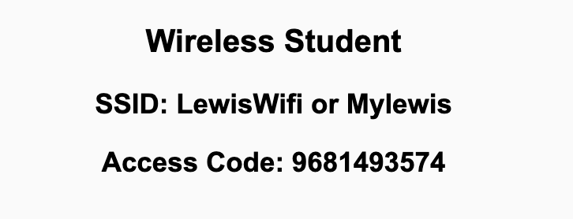
Preflight Check List
Sign into our Zoom meeting through our integrated Blackboard/Zoom link
Make sure that you can hear the conversation, see shared desktops, and view chat topics
Thank you if you choose to leave your camera on to help make our class more interactive
Be prepared to share your computer screen
Be prepared to utilize a headset with a microphone
In person participants also:
Make sure that your microphone and speakers are muted/off so that we don’t get an echo
Sit in a good spot near the classroom ceiling microphones if possible

Slide 2
Recordings
Discuss that recording are:
Opportunistic
Automatically available in Blackboard/Zoom
Sound Check… plus Video, and Desktop Sharing check
Start Recording

Slide 3
Agenda:
Prework and Announcements
Sprint 6 Planning
Prework for Next Class
Scrum Team Planning Review
Discussion & Questions welcome at any time but please be present with no phones or email during our time together

Slide 4
Prework For Next Class
Everything is due Sunday!
Be prepared for sprint 6 planning Monday

Slide 5
Prework
Everything is due Sunday!
Be prepared Sprint 6 Planning on Monday

Slide 6
Sprint Planning

Slide 7
Sprint Planning
Sprint 6 Changes:
Similar to the previous sprints with Discussion, Quiz, Lab, and Reflection
No significant changes

Slide 8
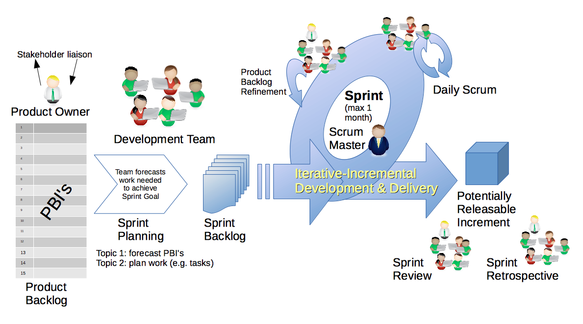
Scrum Process – Sprint Planning
By Dr ian mitchell - Own work, CC BY-SA 4.0, Link

Slide 9
Review Activities List
and Assignments

Slide 10
Prework For Next Class
Complete through activity 5
Those scheduled to demo on Wednesday please be a couple of minutes early to class

Slide 11
Review Wednesday
Demo Schedule

Slide 12
Scrum Team Planning Review
As a scrum team:
Do you want to change scrum masters?
Review sprint activities & assignments in detail
Discuss and document questions/concerns
Report Out:
Who is the sprint 6 scrum master
Scrum master share your team’s top 2 questions/concerns during report out

Slide 13
Agenda:
Prework
Public APIs and Possible Final Project Ideas
Lab
Discussion & Questions welcome at any time but please be present with no phones or email during our time together

Slide 14
Prework For Next Class
Be prepared for Lab
Everything is due Sunday!

Slide 15
Public APIs and Possible Final Project Ideas
Dogs, JavaScript & An API 🐶 Fetch, Promises & Async Await
Public APIs

Slide 16
Lab
Final Project Proposals
Personal Information Files
Mustang Lite
Note: Don’t be afraid to clear your browser cache if you see inconsistencies!

Slide 17
Prework For Next Class
Everything is due Sunday!
Be prepared for sprint 6 planning Monday

Slide 18
End of Session

