Slide 1

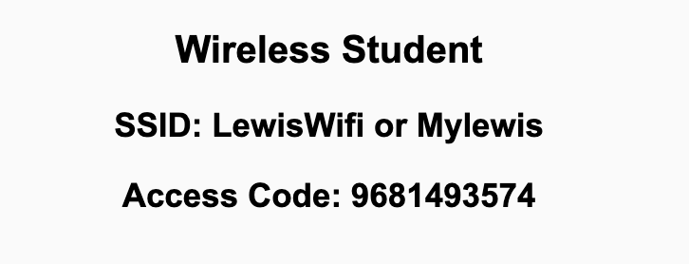
Preflight Check List
Sign into our Zoom meeting through our integrated Blackboard/Zoom link
Make sure that you can hear the conversation, see shared desktops, and view chat topics
Thank you if you choose to leave your camera on to help make our class more interactive
Be prepared to share your computer screen
Be prepared to utilize a headset with a microphone
In person participants also:
Make sure that your microphone and speakers are muted/off so that we don’t get an echo
Sit in a good spot near the classroom ceiling microphones if possible

Slide 2
Recordings
Discuss that recording are:
Opportunistic
Automatically available in Blackboard/Zoom
Sound Check… plus Video, and Desktop Sharing check
Start Recording

Slide 3
Agenda:
Prework & Announcements
Discussion 6
Prework for Next Class
Lab
Discussion & Questions welcome at any time but please be present with no phones or email during our time together

Slide 4
Prework
Complete through activity 8
Be prepared for Discussion 6
What else do we need to focus on Friday?

Slide 5
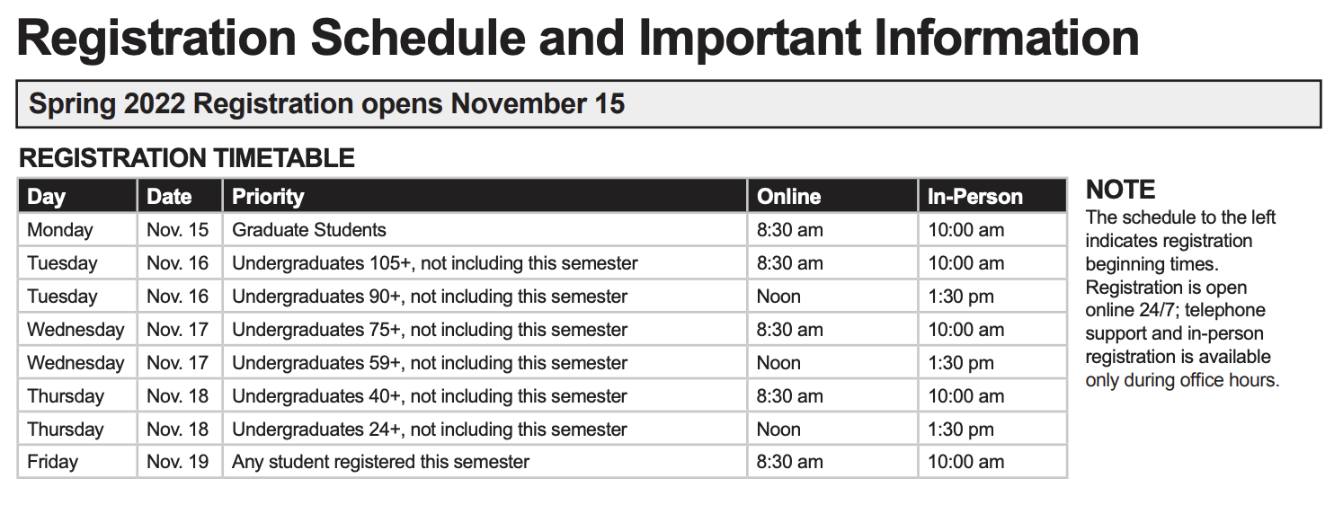
Announcements

Slide 6
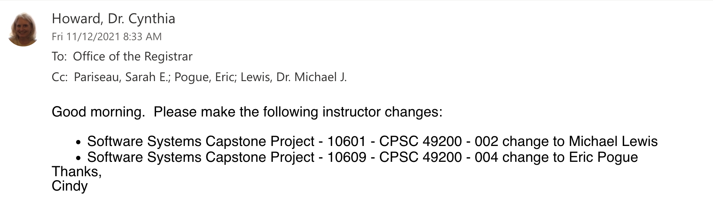
Announcements

Slide 7
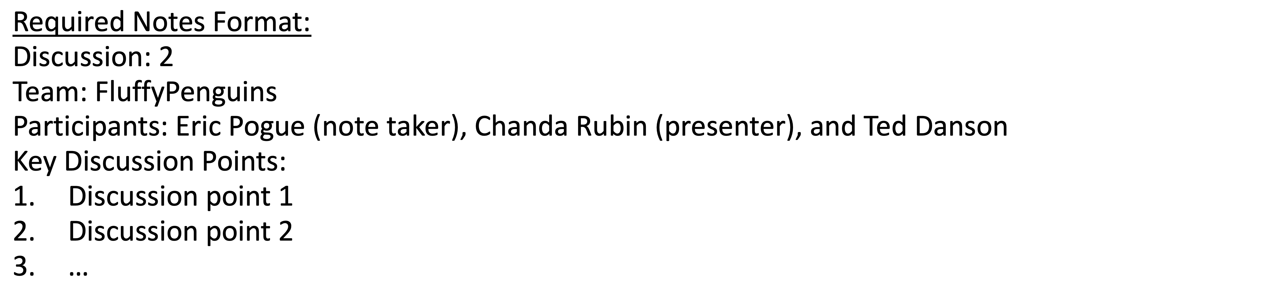
Discussion
Assign note taker and presenter roles
Review and discuss the discussion topic for this sprint for approximately 10 minutes
Note taker takes notes and presenter prepares a summary report out
Note taker share notes with all participating team members and each team member pastes and submits exact copy of the notes into their individual discussion board
Presenter Report Out

Slide 8
Prework For Next Class
Complete through activity 11
Be prepared to Review “Computer Science Illuminated” The World Wide Web and review the associated lecture

Slide 9
Prework For Next Class
Complete through activity 11
Be prepared to discuss Fox chapter 10 on Project Management, Scrum, Pairs, and Version Control Systems

Slide 10
Lab
Sprint 6 Deliverables

Slide 11
End of Session

