Slide 1

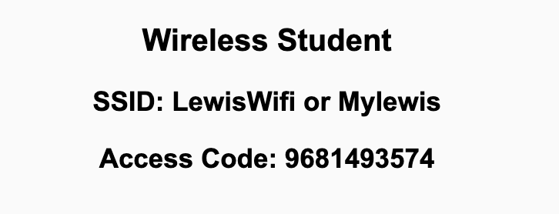
Preflight Check List
Sign into our Zoom meeting through our integrated Blackboard/Zoom link
Make sure that you can hear the conversation, see shared desktops, and view chat topics
Thank you if you choose to leave your camera on to help make our class more interactive
Be prepared to share your computer screen
Be prepared to utilize a headset with a microphone
In person participants also:
Make sure that your microphone and speakers are muted/off so that we don’t get an echo
Sit in a good spot near the classroom ceiling microphones if possible

Slide 2
Recordings
Discuss that recording are:
Opportunistic
Automatically available in Blackboard/Zoom
Sound Check… plus Video, and Desktop Sharing check
Start Recording

Slide 3
Agenda:
Prework & Announcements
Review The World Wide Web
Prework for Next Class
Lab
Discussion & Questions welcome at any time but please be present with no phones or email during our time together

Slide 4
Prework For Next Class
Complete through activity 11
Be prepared to Review “Computer Science Illuminated” The World Wide Web and review the associated lecture

Slide 5
Prework
Complete through activity 9
Be prepared for Scrum Team Discussion 6
Be prepared for (or complete with) programming together with “Matchmaker for the Web - Part 1”

Slide 6
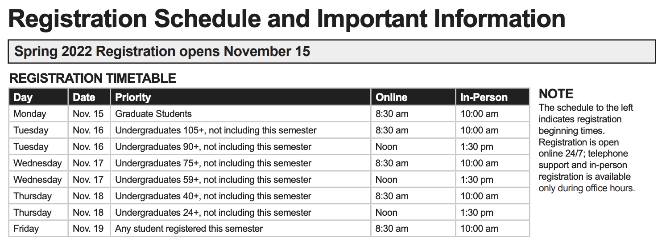
Announcements

Slide 7
Scrum Team Review
Assign presenter
Team reviews key topics using “team number by percent of content” method
Team sits back, relaxes, and acknowledges the bravery and dedication of the presenter
Chapter 16 of Dale on The World Wide Web
16.1 Spinning The World Wide Web
16.2 HTML and CSS
16.3 Interactive Web Pages
16.4 XML
16.5 Summary

Slide 8
Networks, The Internet, and The Web (Protocols, Layers, and Data Representation)

Slide 9
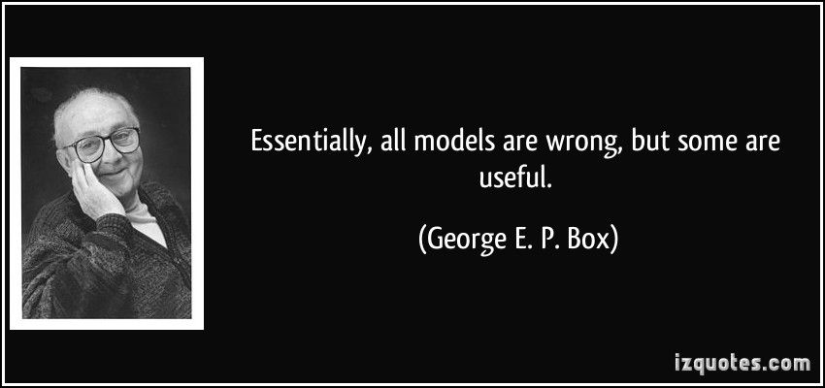
Models

Slide 10

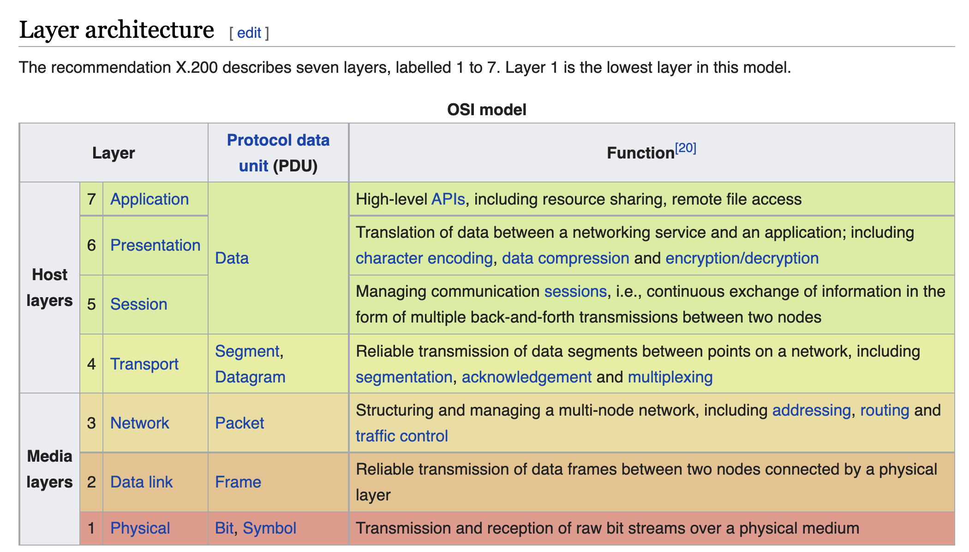
OSI Model

Slide 11
And Some Models Are More Simple Or More Useful

Slide 12
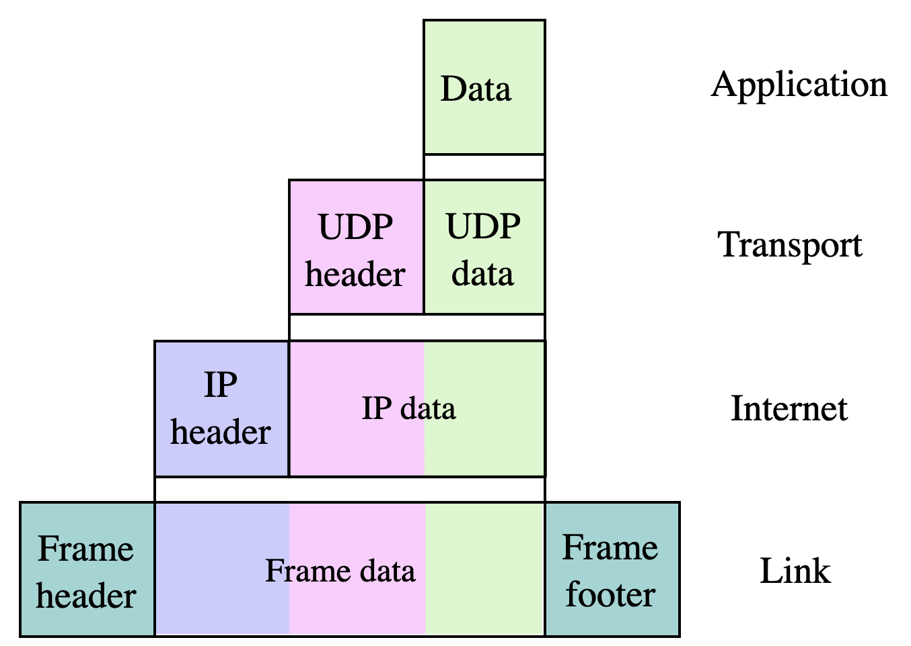
Internet Model

Slide 13
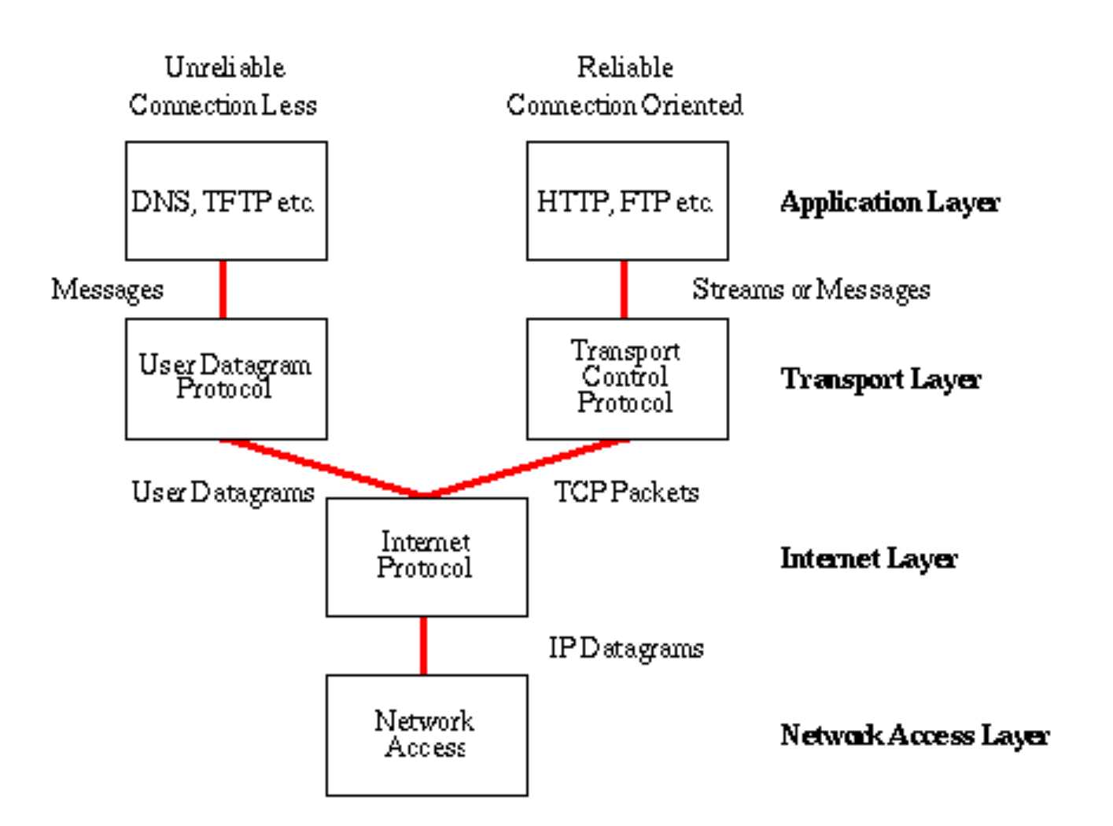
Network Architecture – The Internet
The Internet [link]
IP (Internet Protocol) [link]
TCP (Transmission Control Protocol) [link]
TCP/IP
UDP (User Datagram Protocol) [link]
UDP/IP
TCP/IP or UDP/IP Socket [link]
TCP and UDP Protocols & Port Numbers [link]

Slide 14
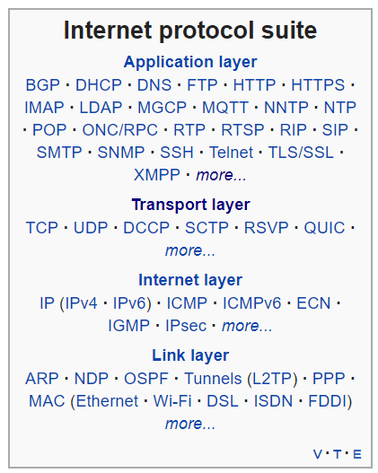
Network Architecture – The Web
The Web [link]
HTTP (Hypertext Transfer Protocol) [link]
DNS (Domain Name System) [link]
HTML (Hypertext Markup Language) [link]
CSS (Cascading Style Sheets) [link]
JavaScript [link]
Internet Protocol Suite [link]

Slide 15
Prework For Next Class
Complete through activity 12
Be prepared for Quiz 6

Slide 16
Lab
Azure websites

Slide 17
End of Session

