Slide 1

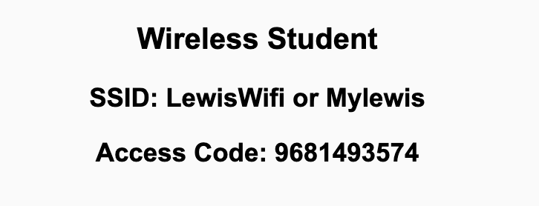
Preflight Check List
Sign into our Zoom meeting through our integrated Blackboard/Zoom link
Make sure that you can hear the conversation, see shared desktops, and view chat topics
Thank you if you choose to leave your camera on to help make our class more interactive
Be prepared to share your computer screen
Be prepared to utilize a headset with a microphone
In person participants also:
Make sure that your microphone and speakers are muted/off so that we don’t get an echo
Sit in a good spot near the classroom ceiling microphones if possible

Slide 2
Recordings
Discuss that recording are:
Opportunistic
Automatically available in Blackboard/Zoom
Sound Check… plus Video, and Desktop Sharing check
Start Recording

Slide 3
Agenda:
Prework & Announcements
Lab
Application Architecture
Discussion & Questions welcome at any time but please be present with no phones or email during our time together

Slide 4
Prework For Next Class
Everything is due Sunday!
Be prepared for Lab

Slide 5
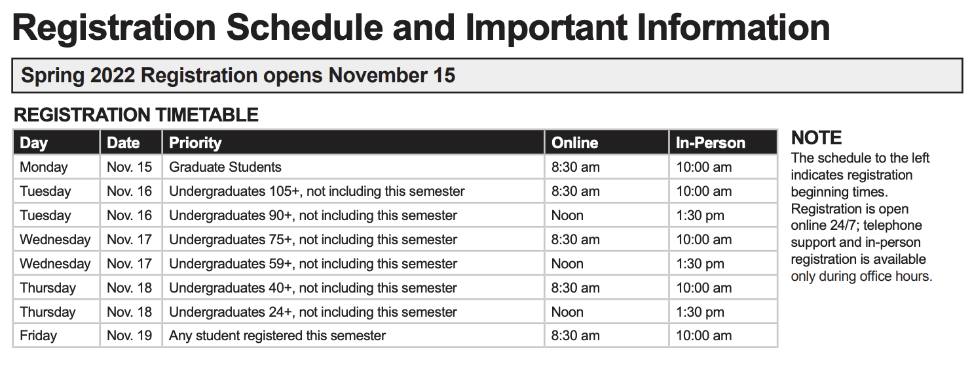
Announcements

Slide 6
Lab
How can I help?
Do we have any more JSON links to add?
MustangLite 2?

Slide 7
Prework For Next Class
Everything is due Sunday!
Be prepared for Print 7 Planning on Monday

Slide 8
Application Architectures, Files, and Databases

Slide 9
Learning Objectives
Review Files including Shared Files
Introduce Relational Databases, Database Servers, the SQL language
Understand how databases support (or don’t support) Object Oriented Programming
Explore Two-Tier (client-server) Implementations and Limits
Introduce Three-Tier (n-tier) Architectures
Discuss Server Side Programming
Discuss NoSQL Database and Azure Tables
Notes:
We are reviewing this so that we can relate it back to databases and client-server development.

Slide 10
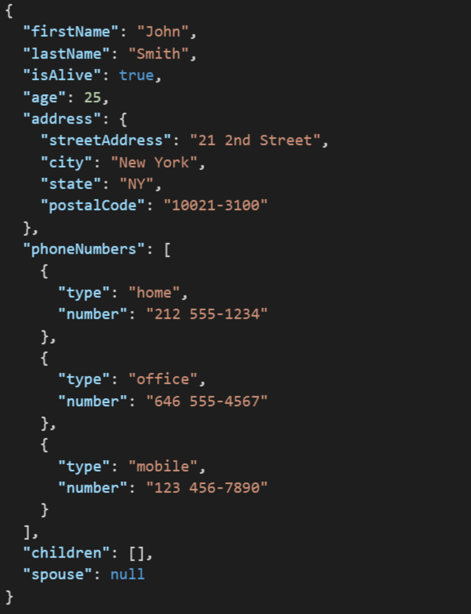
JSON Example
JSON (JavaScript Object Notation) is a lightweight data-interchange format. It is easy for humans to read and write. It is easy for machines to parse and generate. It is an open standard that:
Supports nearly all development languages and platforms
Allows us to cross between many applications
Can result in large files
Notes:
JSON is an open-standard format that uses human-readable text to transmit data objects consisting of attribute–value pairs. It is a very common data format used for asynchronous browser/server communication, including as a replacement for XML in some web service style systems.

Slide 11
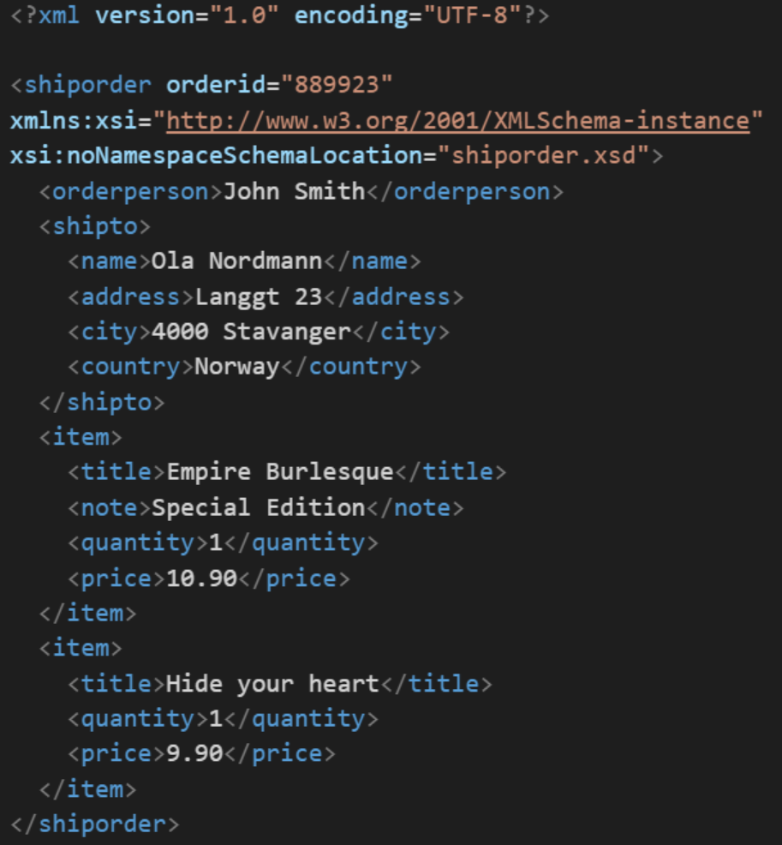
XML Example
In computing, XML (Extensible Markup Language) is a markup language that defines a set of rules for encoding documents in a format that is both human-readable and machine-readable. It is an open standard that:
Supports nearly all development languages and platforms
Allows us to cross between many applications
Can result in large files
Supports schema to validate data

Slide 12
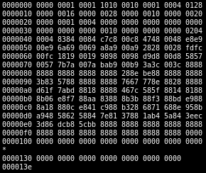
Binary Files
A binary file is a computer file that is not a text file. The term "binary file" is often used as a term meaning "non-text file". The can be open or closed formats that are generally:
Fast, small, and efficient*
Often not very portable across applications and platforms
Difficult to maintain backward compatibility
Notes:
Some people would say that binary files include all files, and that text files are just binary files that are being interpreted in a specific way.

Slide 13
Shared or Network Files
Text or Binary files can be shared by multiple applications running on the same computer or across the network or Internet.
Sharing static files is easy… web pages, images, etc.
Sharing files that can be modified by multiple processes is VERY hard
Enter databases
Notes:
Some people would say that binary files include all files, and that text files are just binary files that are being interpreted in a specific way.

Slide 14
Applications & Files
Application
File
File
File
Notes:
Replication is most often a bad idea.
“Smart Naming” is always bad

Slide 15
Applications & Networked Shared Files
Application
Turns out this is REALLY hard!
Shared File
Notes:
Replication is most often a bad idea.
“Smart Naming” is always bad

Slide 16
Two-tier (client-server)
Application 1
Database 1
Notes:
Replication is most often a bad idea.
“Smart Naming” is always bad

Slide 17
Learning Objectives
Review Files including Shared Files
Introduce Relational Databases, Database Servers, the SQL language
Understand how databases support (or don’t support) Object Oriented Programming
Explore Two-Tier (client-server) Implementations and Limits
Introduce Three-Tier (n-tier) Architectures
Discuss Server Side Programming
Discuss NoSQL Database and Azure Tables
Notes:
We are reviewing this so that we can relate it back to databases and client-server development.

Slide 18
SQL Databases [link]
A database is an organized collection of data. It is the collection of schemas, tables, queries, views, and other objects. The data are typically organized to model aspects of reality in a way that supports business processes requiring information.
A database management system (DBMS) is a application that interacts with the user, other applications, and the itself to capture and manage data. A general-purpose DBMS is designed to allow the definition, creation, querying, update, and administration of databases. Well-known DBMSs include MySQL, PostgreSQL, Microsoft SQL Server, Oracle, Sybase, SAP HANA, and IBM DB2.
Schemas – defines that data constraints and definitions for tables and fields
Tables – collection of related data held in a structured format that consists of columns and rows
Views & Queries – used to create more easily accessible relationships without modifying the underlying physical schema
Notes:
I will often start with definitions from Wikipedia and other sources. If you are struggling with a topic and/or would like more information, it can often be valuable to review the references. You should be able to click on the [link] tag (possibly while holding the shift key down) in order open the reference in a browser. Please let me know if this is not working for you.
Databases and Database Management Systems (DBMS) are a HUGE topic and one of the cornerstones of most IT organizations. We are just going to be touching the surface today.
We often inadvertently refer to database management systems as databases. We should try to be specific in our conversation. In addition, we generally use the term database and DBMS to infer a relational database.
Databases are generally not portable between DBMS systems. However, a level of portability can be obtained by utilizing industry standard tools and languages like SQL.
Spreadsheets are often used… inappropriately in many cases.
A database is not generally portable across different DBMSs, but different DBMS can interoperate by using standards such as SQL and ODBC or JDBC to allow a single application to work with more than one DBMS. Database management systems are often classified according to the database model that they support; the most popular database systems since the 1980s have all supported the relational model as represented by the SQL language.
We generally attempt model our databases so that that they reflect real-world relationships. Optimal database design and optimal object-oriented design often diverge. When they do, you will need to make a judgement call.
Normalization vs De-normalization:
https://en.wikipedia.org/wiki/Database_normalization

Slide 19
Database Normalization [link]
Database Normalization, or simply normalization, is the process of organizing the columns (attributes) and tables (relations) of a relational database to reduce data redundancy and improve data integrity.
Normalization is also the process of simplifying the design of a database so that it achieves the optimum structure. It reduces and eliminates redundant data. In normalization, data integrity is assured. It can also cause a performance tradeoff.
It may be important when you are doing object-modeling in your application to consider the database relationships and normalizing that will be important.

Slide 20
Database Normalization Example:
Consider the non-normalized and normalized table structure for a simple “checkbook” transaction database:

Slide 21
Phone Number Database Example
For example, a PhoneNumber database could be set up with two Tables. One table of Names and the other table of PhoneNumbers. For this simple example we might end up with something like:
Schemas: Two tables one called Names and one called PhoneNumbers, text will be stored in UTF-8, we will allow duplicates, and set an index on Names.FirstName and Names.LastName.
Names Table: Three fields including FirstName and LastName of UTF-8 text, maximum length 40 characters, and can not be NULL. The third field will be an autoincrement unique ID that is an integer and does not allow duplicates. All three fields would be indexed for fast searching.
PhoneNumbers Table: Four fields including CountryCode, AreaCode, and Number which are all UTF-8 strings that can only contain numbers. Maximum lengths for each are 2, 3, and 7 respectively. The fourth field will be the unique ID of the person associated with the phone number. CountryCode can be NULL, other fields cannot. Fields will not be indexed as it will be rare that we have a phone number and want to lookup the person.
Views & Queries – A query that Joins a set of Names to all of their respective phone numbers and shows that in a view would be valuable.

Slide 22
Structured Query Language (SQL) [link]
Structured Query Language or SQL is a domain-specific language used in programming and designed for managing data held in a relational database management systems. SQL was initially developed at IBM by Donald D. Chamberlin and Raymond F. Boyce in the early 1970s.
Data Definition Language (DDL) – manages the table and index structure with common terms including CREATE, ALTER, RENAME, and DROP
Queries – The most common operation in SQL makes use of the SELECT statement and generally includes a WHERE clause
Many others…
Notes:
I will often start with definitions from Wikipedia and other sources. If you are struggling with a topic and/or would like more information, it can often be valuable to review the references. You should be able to click on the [link] tag (possibly while holding the shift key down) in order open the reference in a browser. Please let me know if this is not working for you.
Databases and Database Management Systems (DBMS) are a HUGE topic and one of the cornerstones of most IT organizations. We are just going to be touching the surface today.
We often inadvertently refer to database management systems as databases. We should try to be specific in our conversation. In addition, we generally use the term database and DBMS to infer a relational database.
Databases are generally not portable between DBMS systems. However, a level of portability can be obtained by utilizing industry standard tools and languages like SQL.
Spreadsheets are often used
Student
Course
Semester
Room
Prerequisite Courses
A database is not generally portable across different DBMSs, but different DBMS can interoperate by using standards such as SQL and ODBC or JDBC to allow a single application to work with more than one DBMS. Database management systems are often classified according to the database model that they support; the most popular database systems since the 1980s have all supported the relational model as represented by the SQL language.
Relationships are based on the shaping of columns between col
Table definition
guidelines that help you determine what classes are needed and how they should divide up the work
such as modelling the availability of rooms in hotels in a way that supports finding a hotel with vacancies.
Natural relationship among different parts of the data

Slide 23
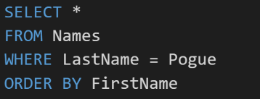
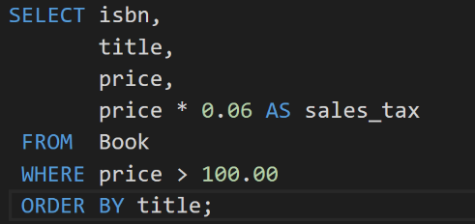
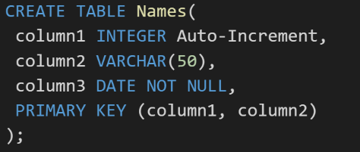
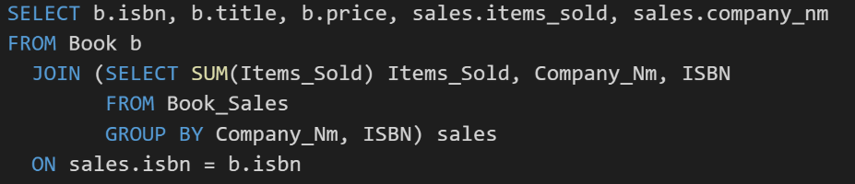
SQL Examples
Notes:
Very powerful language for managing data and is often used as an “embedded” language from within other environments like Java, C#, and Python.

Slide 24
Data Base Management Systems Pro & Cons
Many of the most powerful DBMS strengths can also be their greatest weaknesses… particularly as it come to object-oriented development:
Independent Data… vs Combining Functionality & Data
Ubiquitous access… vs Encapsulation and Data Hiding
Tables & Relationships… vs Inheritance
Joining Tables to Create Relationships… vs Polymorphism
Relationship Modeling… vs Object Modeling
SQL… vs Java or C# or Python

Slide 25
Data Base Management Systems with OOP Editorial
Live in harmony. Embrace the database while keeping a focus on OOP concepts:
Store your data in a database
Enforce all important relationships in the database
Differentiate enterprise or shared data from application specific data… keep the shared data as small as is reasonable and have a separate person/team manage the shared data
Don’t utilize two-tier client-server architectures for anything more than small scale (less than 8 local users) application
… And be very very careful about using tools that automate the connection between you two-teir view elements and their associated database elements
Recombine you data, and functionality by creating three-tier application for more important applications
Don’t try to “automate” your object model to relationship model conversions
Never, never, never uses “smart” or cute naming conventions to represent relationships!

Slide 26
Learning Objectives
Review Files including Shared Files
Introduce Relational Databases, Database Servers, the SQL language
Understand how databases support (or don’t support) Object Oriented Programming
Explore Two-Tier (client-server) Implementations and Limits
Object-Oriented Programming – The Dark Ages (OMG)
Introduce Three-Tier (n-tier) Architectures
Discuss Server Side Programming
Discuss NoSQL Database and Azure Tables
Notes:
We are reviewing this so that we can relate it back to databases and client-server development.

Slide 27
Two-tier (client-server) Implementation Examples
Application 1
Application 2
Application 3
Application 4
“Smart Naming”
Database 1
Database 2
Database 3
Database 4
Replication
Notes:
Replication is most often a bad idea.
“Smart Naming”

Slide 28
Two-tier (client-server) “Limits” Editorial
Application 1
Application 2
Database 1
Database 2
What now?!
Notes:
Replication is most often a bad idea.
“Smart Naming” is always bad

Slide 29
Learning Objectives
Review Files including Shared Files
Introduce Relational Databases, Database Servers, the SQL language
Understand how databases support (or don’t support) Object Oriented Programming
Explore Two-Tier (client-server) Implementations and Limits
Introduce Three-Tier (n-tier) Architectures
Discuss Server Side Programming
Discuss NoSQL Database and Azure Tables
Notes:
We are reviewing this so that we can relate it back to databases and client-server development.

Slide 30
Three-Tier Application Architecture
Benefits Include:
Full leverage of Web technologies
True data protection. Encapsulation plus plus!!
Partial Inheritance & Polymorphism via Interface Inheritance
Performance through multiple computer, multiple processors, and multiple threads
Horizontal scaling
Heterogeneous optimized hardware and operating systems
Enforce data integrity centrally and outside of the database
… allowing for new types of Databases (NoSQL and Azure Tables)
Application
Business Logic
Database

Slide 31
Three-Tier Architecture Protocols & Formats
Three-Tier application architectures can use a variety of network protocols and formats including:
HTTP: Hypertext Transfer Protocol
HTTPs: Hypertext Transfer Protocol Secure
JSON or XML
SQL
Aggregated Protocol Standards:
SOAP: Simple Object Access Protocol (HTTP/HTTPs/Sockets with XML)
REST: Representational State Transfer (HTTP/HTTPs with JSON)
Application
Business Logic
Database

Slide 32
Two-tier and Three-tier Architectures
Application 1
Application 2
Application 3
Application 4
“Smart Naming”
Database 1
Database 2
Database 3
Database 4
Replication
Notes:
Replication is most often a bad idea.
“Smart Naming”

Slide 33
Two-tier and Three-tier Architectures
Application 1
Application 2
Database 1
Database 2
Notes:
Replication is most often a bad idea.
“Smart Naming”

Slide 34
Two-tier and Three-tier Architectures
Application 1
Application 2
Application 3
Application 4
Database 1
Database 2
Database 3
Database 4
Share Data APIs
Shared Database
Shared Database
Shared Database
Notes:
Cross-platform Enforced Encapsulation & Data Hiding!
Security
Sharing of business logic and processes.
Interface Inheritance
Very little benefit in Implementation Inheritance or Polymorphism

Slide 35
Learning Objectives
Review Files including Shared Files
Introduce Relational Databases, Database Servers, the SQL language
Understand how databases support (or don’t support) Object Oriented Programming
Explore Two-Tier (client-server) Implementations and Limits
Introduce Three-Tier (n-tier) Architectures
Discuss Server Side Programming
Discuss NoSQL Database and Azure Tables
Notes:
We are reviewing this so that we can relate it back to databases and client-server development.

Slide 36
Server-Side Programming
Application 1
Application 2
Application 3
Application 4
Database 1
Database 2
Database 3
Database 4
Share Data APIs
Shared Database
Shared Database
Shared Database
Notes:
Cross-platform Enforced Encapsulation & Data Hiding!
Security
Sharing of business logic and processes.
Interface Inheritance
Very little benefit in Implementation Inheritance or Polymorphism

Slide 37
Server-Side Programming
Since the three-tier application architecture evolved from the Web, the middle-tier application environment naturally support all of the standard web development tools including:
Java… and anything that compiles into Java byte codes
C#/.Net… and all of the .Net tools
Python
Node.js
PHP
Etc.

Slide 38
Two-tier and Three-tier Architectures
Application 1
Application 2
Application 3
Application 4
Database 1
Database 2
Database 3
Database 4
Share Data APIs
Shared Database
Shared Database
Shared Database
Notes:
Cross-platform Enforced Encapsulation & Data Hiding!
Security
Sharing of business logic and processes.
Interface Inheritance
Very little benefit in Implementation Inheritance or Polymorphism

Slide 39
Learning Objectives
Review Files including Shared Files
Introduce Relational Databases, Database Servers, the SQL language
Understand how databases support (or don’t support) Object Oriented Programming
Explore Two-Tier (client-server) Implementations and Limits
Introduce Three-Tier (n-tier) Architectures
Discuss Server Side Programming
Discuss NoSQL Database and Azure Tables
Notes:
We are reviewing this so that we can relate it back to databases and client-server development.

Slide 40
NoSQL Databases and Azure Tables [link]
NoSQL databases are databases that do not utilize the table and field relationships mechanisms nor the SQL language that Relational Databased utilize. They have existed since the late 1960 but have become prevalent with modern Web application development
Benefits include:
Better "horizontal" scaling… threading and clusters of machines (which is a problem for relational databases)
Data structures that better support Inheritance and Polymorphism
Encourages Encapsulation and Data Hiding to be enforced in other tiers… usually a middle-tier
Fewer schema-breaking changes

Slide 41
Learning Objectives
Review Files including Shared Files
Introduce Relational Databases, Database Servers, the SQL language
Understand how databases support (or don’t support) Object Oriented Programming
Explore Two-Tier (client-server) Implementations and Limits
Introduce Three-Tier (n-tier) Architectures
Discuss Server Side Programming
Discuss NoSQL Database and Azure Tables
Notes:
We are reviewing this so that we can relate it back to databases and client-server development.

Slide 42
End of Session

