Slide 1

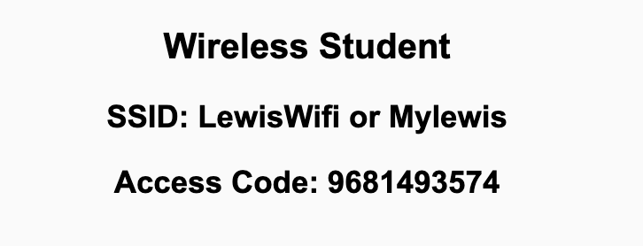
Preflight Check List
Sign into our Zoom meeting through our integrated Blackboard/Zoom link
Make sure that you can hear the conversation, see shared desktops, and view chat topics
Thank you if you choose to leave your camera on to help make our class more interactive
Be prepared to share your computer screen
Be prepared to utilize a headset with a microphone
In person participants also:
Make sure that your microphone and speakers are muted/off so that we don’t get an echo
Sit in a good spot near the classroom ceiling microphones if possible

Slide 2
Recordings
Discuss that recording are:
Opportunistic
Automatically available in Blackboard/Zoom
Sound Check… plus Video, and Desktop Sharing check
Start Recording

Slide 3
Agenda:
Prework & Announcements
Networks – The Internet & The Web
“Computer Science Illuminated” Networks and the associated lecture
Prework for Next Class
Lab
Discussion & Questions welcome at any time but please be present with no phones or email during our time together

Slide 4
Prework For Next Class
Complete through activity 10
Be prepared to Review “Computer Science Illuminated” Networks and review the associated lecture

Slide 5
Networks – The Internet & The Web

Slide 6
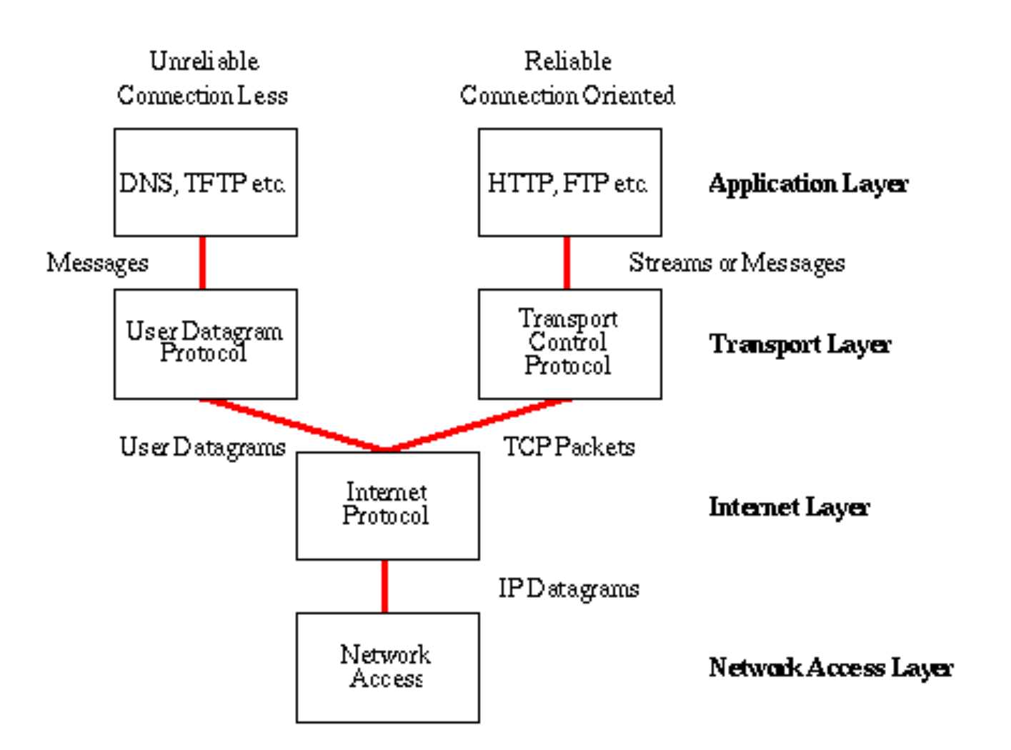
Networks – The Internet
The Internet [link]
IP (Internet Protocol) [link]
TCP (Transmission Control Protocol) [link]
TCP/IP
UDP (User Datagram Protocol) [link]
UDP/IP
TCP/IP or UDP/IP Socket [link]
TCP and UDP Protocols & Port Numbers [link]

Slide 7
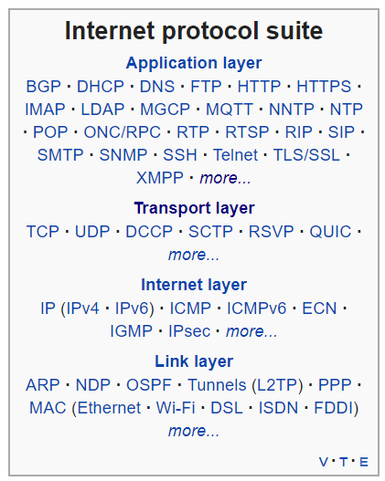
Networks – The Web
The Web [link]
HTTP (Hypertext Transfer Protocol) [link]
DNS (Domain Name System) [link]
HTML (Hypertext Markup Language) [link]
CSS (Cascading Style Sheets) [link]
JavaScript [link]
Internet Protocol Suite [link]

Slide 8
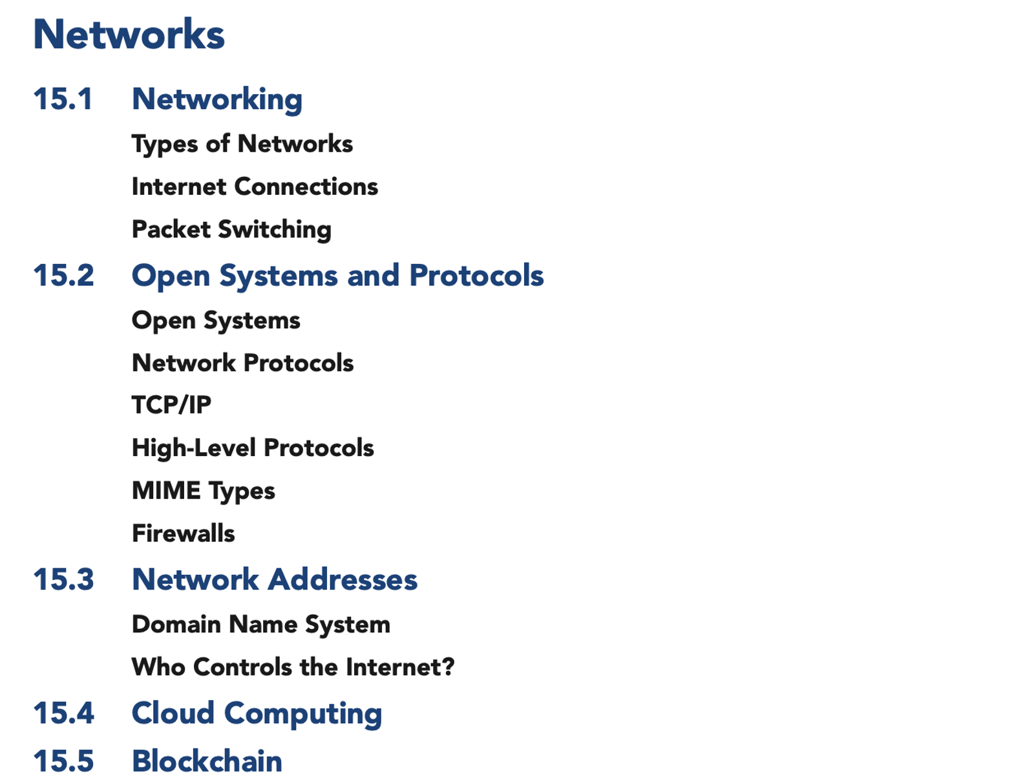
Scrum Team Review of Networks
Assign presenter
Team sits back, relaxes, and acknowledges the bravery and dedication of the presenter

Slide 9
Prework For Next Class
Complete through activity 11
Be prepared for Quiz 5

Slide 10
Lab
Programming together with Python Strings

Slide 11
End of Session

Slide 12
Friendly Conversation Topic
Who made the following statement?
This is my reality. I am not an emotionally empathetic kind of person and that probably doesn't come as a big surprise to anybody. Least of all me. The fact that I then misread people and don't realize (for years) how badly I've judged a situation and contributed to an unprofessional environment is not good. This week people in our community confronted me about my lifetime of not understanding emotions. My flippant attacks in emails have been both unprofessional and uncalled for. Especially at times when I made it personal. In my quest for a better patch, this made sense to me. I know now this was not OK and I am truly sorry. The above is basically a long-winded way to get to the somewhat painful personal admission that hey, I need to change some of my behavior, and I want to apologize to the people that my personal behavior hurt and possibly drove away from kernel development entirely. I am going to take time off and get some assistance on how to understand people’s emotions and respond appropriately.

Slide 13

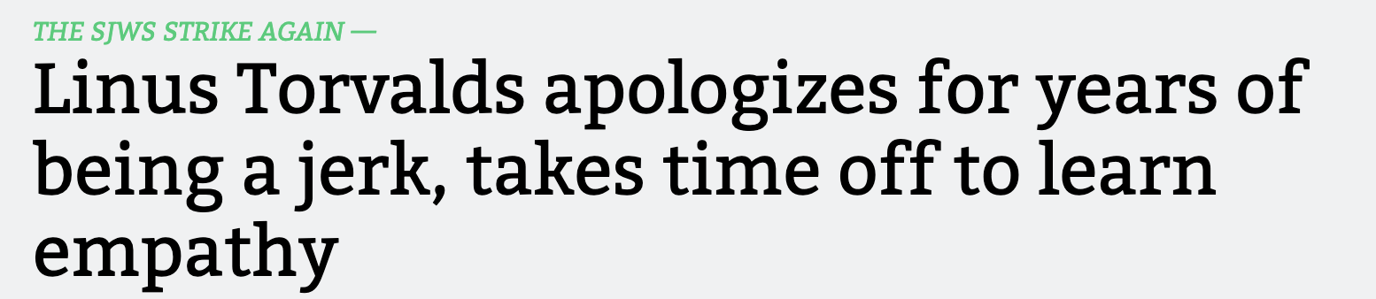
Friendly Conversation Topic

Slide 14

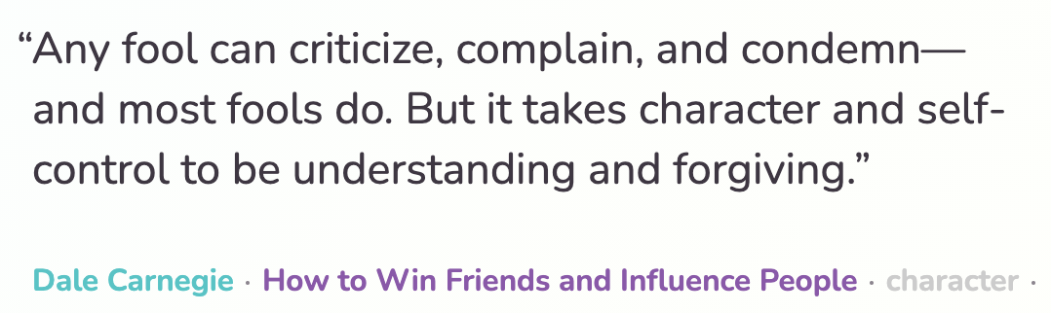


Slide 15
Architectural Analysis Discussions

Slide 16
Recall Architecture Analysis Papers
Serverless Computing Analysis
As a team, write a 2+ paper that compares Azure Functions, Google Cloud Functions, and AWS Lamda. Compare and contrast the environments across at least 4 key platform characteristics. One characteristic should be support for the Go language.
The initial section should list team participants and describe each serverless platform. In the second section of your paper, complete a table with each platform across the top and each characteristic listed in priority order (most important first) along the left side of the table. Complete the table for all serverless platforms. Finally, provide a conclusion section that summarizes your findings.
In the space below comment on your personal contribution to the paper before attaching a copy of the paper in MS Word format to this question.

Slide 17
Architectural Analysis Discussions

Slide 18
Saas Layers
Layers:
Presentation
Logic
Data

Slide 19
Architectural Analysis Discussions
Application Name (2 minutes)
Application Purpose and Key Features (10 minutes)
Technology Components (8 minutes)
Notes:
Seating chart and attendance tracker (virtual and in person)

Slide 20
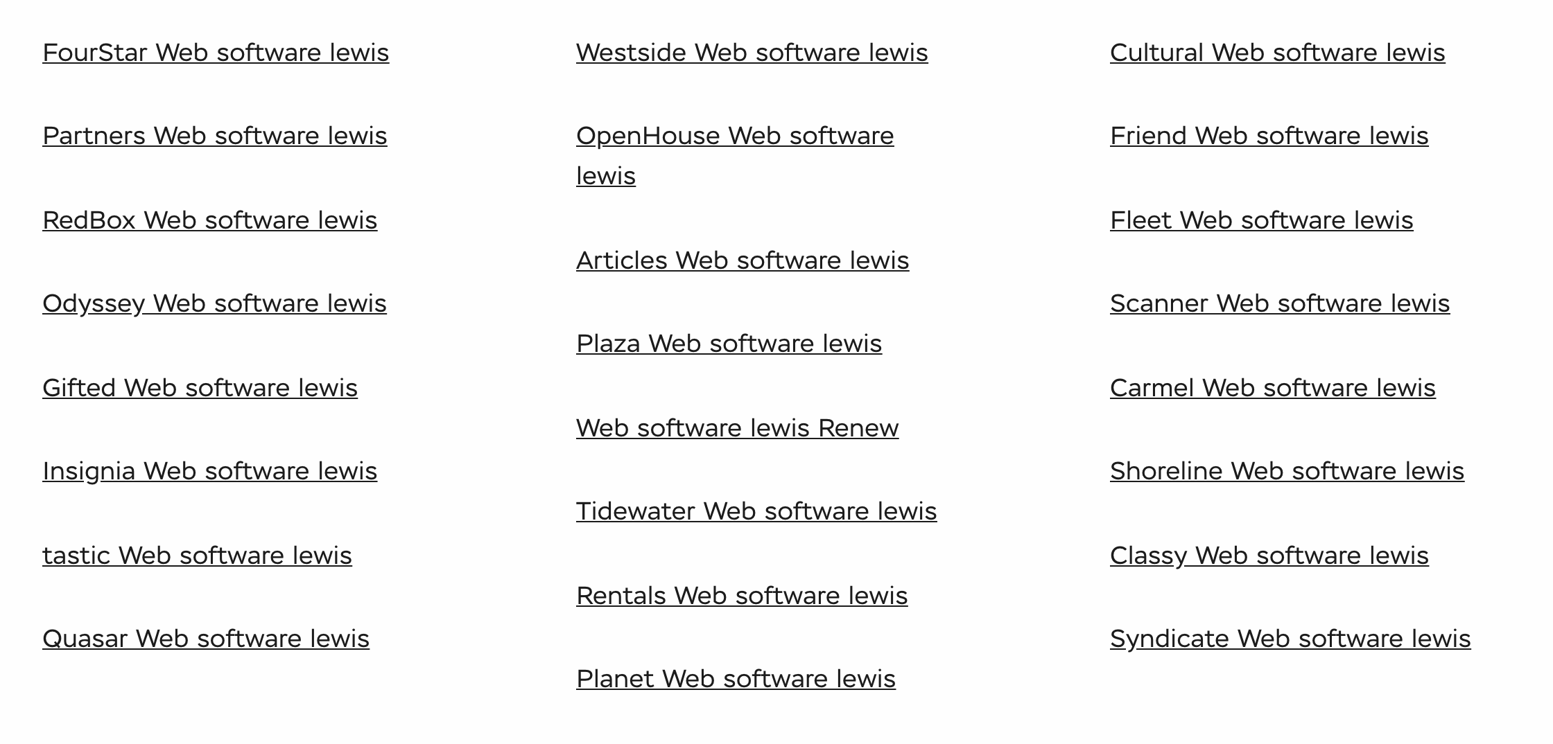
Lab
Final Project Teams and Application Names

Slide 21
Recall Perspectives & Priorities
Agile Priorities:
Customer
**Technology**
Process

Slide 22
Recall Architecture Analysis Papers
As a team select one of the following topics and perform a P&D style architectural analysis. Pick something that is interesting to your team and that you feel would likely be useful in your eventual final project. The analysis should be done in the context of enhancing our current Azure, Node.js, and Express software as a service (Saas) platform by:
Utilizing React
Utilizing React and React Bootstrap
Utilizing Azure-based Authentication/Authorization (preferably that can utilize our Office 365 credentials)
Utilizing Azure Tables
Utilizing Azure Functions
Utilizing and Azure Database

Slide 23
Recall Saas Layers
Layers:
Presentation
Logic
Data

Slide 24
Architectural Analysis Discussions

Slide 25
Programming Together with
Together with TurtleDraw Lite – Part 1/2

Slide 26
Final Project Discussions
Application Name (2 minutes)
Application Purpose and Key Features (10 minutes)
Notes:
Seating chart and attendance tracker (virtual and in person)

Slide 27
Lab
Final Project Teams and Application Names

Slide 28
Scrum Team Review of Maintenance
Assign presenter
Team reviews key topics using “team number by percent of content” method
Team sits back, relaxes, and acknowledges the bravery and dedication of the presenter
Sections:
9.1 What Makes Code “Legacy” and How Can Agile Help?
9.2 Exploring a Legacy Codebase
9.3 Establishing Ground Truth With Characterization Tests
9.4 Comments and Commits: Documenting Code
9.5 Metrics, Code Smells, and SOFA
9.6 Method-Level Refactoring
9.7 The Plan-And-Document Perspective on Working With Legacy Code
9.8 Fallacies and Pitfalls
9.9 Concluding Remarks: Continuous Refactoring

Slide 29
Software Maintenance & Support
Many processes include both Software Maintenance and Software Support in a single Maintenance category. This is a grave disservice from a process perspective because the two activities are dissimilar in many ways including:
The processes are aligned to different audiences with support focusing on application users and maintenance focusing on application sponsors
Support needs to scale with the user base where maintenance scales with enhancement requests
The optimal process is different with support generally adopting a Kanban and issue ticketing process where maintenance following a software development process like Waterfall or Agile
Support is optimized by supporting all products associated with a user base where maintenance is more single product focused
The cadence of support is minutes and hours where maintenance is days, weeks, and months which can make it challenging to balance the immediate vs the important daily activities
Notes:
Grace period until Monday morning a 6am CT

Slide 30
Characteristics of a Good Metric
What makes a good software quality metric?
Easy to collect and understand
Good approximation of reality and good correlation to quality & goals
Meaningful to the group that can deliver positive change and can drive positive actions
Meaningful over time to encourage positive trends
Discourages “gaming the system,” or at least limits the impact of “gaming”
Does not allow one group to declare success (project management, developers, business analysts, etc.) while the overall product is failing
Comparable across teams, companies, and the industry

Slide 31
Common Metrics for Software Development
Line of code per time-period
On-time
On-budget
… Scope delivered
Defects
Weighted Defects
Weighted Defects per unit delivered
Unit delivered per hour/day/month… per person
Unit delivered per hour/day/month… per dollar

Slide 32

Common Metrics for Agile Software Development
Story Points per Sprint per person
Say/Do ratio
Story Points delivered per Sprint… change in Story Points delivered per Sprint
Team versatility
Percent coverage with automated testing or with Test-Driven Development
Satisfaction surveys with internal or external customers
Eric’s Favorite: Weighted Defect Density per 10,000 hours worked… production

Slide 33
Preview: Scrum Team Sprint 0 Delivery

Slide 34
Recall Perspectives & Priorities
Perspectives:
Process
Technology
Customer (User)

Slide 35
Recall Perspectives & Priorities
Process:
Waterfall
Iterative
Agile
CMMI and ISO
Technology:
Architecture & Design,
Languages, Tools, and Platforms
Customer (User):
Epics, Features, Stories

Slide 36
Recall Perspectives & Priorities
Agile Priorities:
Customer
Technology
Process

Slide 37
Agenda:
Prework and Announcements
Review Software Maintenance (continued)
Prework for Next Class
Scrum Team Sprint 1 Planning
Discussion & Questions welcome at any time but please be present with no phones or email during our time together

Slide 38
Prework
Be prepared for scrum team sprint 1 planning

Slide 39
Recall Scrum Team Review of Maintenance
Assign presenter
Team reviews key topics using “team number by percent of content” method
Team sits back, relaxes, and acknowledges the bravery and dedication of the presenter
Sections:
9.1 What Makes Code “Legacy” and How Can Agile Help?
9.2 Exploring a Legacy Codebase
9.3 Establishing Ground Truth With Characterization Tests
9.4 Comments and Commits: Documenting Code
9.5 Metrics, Code Smells, and SOFA
9.6 Method-Level Refactoring
9.7 The Plan-And-Document Perspective on Working With Legacy Code
9.8 Fallacies and Pitfalls
9.9 Concluding Remarks: Continuous Refactoring

Slide 40
Maintenance vs. Support

Slide 41
Software Maintenance vs Software Support
Many processes include both Software Maintenance and Software Support in a single Maintenance category. This is a grave disservice from a process perspective because the two activities are dissimilar in many ways including:
The processes are aligned to different audiences with support focusing on application users and maintenance focusing on application sponsors
Support needs to scale with the user base where maintenance scales with enhancement requests
The optimal process is different with support generally adopting a Kanban and issue ticketing process where maintenance following a software development process like Waterfall or Agile
Support is optimized by supporting all products associated with a user base where maintenance is more single product focused
The cadence of support is minutes and hours where maintenance is days, weeks, and months which can make it challenging to balance the immediate vs the important daily activities
Notes:
Grace period until Monday morning a 6am CT

Slide 42
Metrics

Slide 43
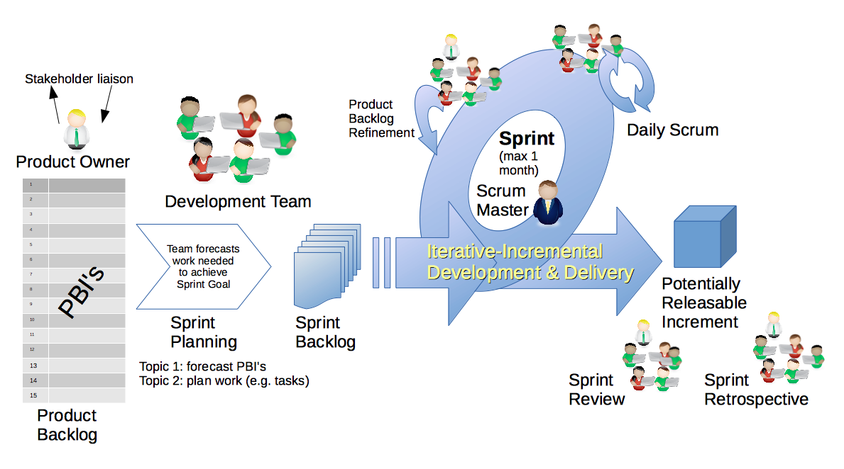
Scrum Process – Sprint Retrospective & Metrics
By Dr ian mitchell - Own work, CC BY-SA 4.0, Link

Slide 44
Characteristics of a Good Metric
What makes a good software quality metric?
Easy to collect and understand
Good approximation of reality and good correlation to quality & goals
Meaningful to the group that can deliver positive change and can drive positive actions
Meaningful over time to encourage positive trends
Discourages “gaming the system,” or at least limits the impact of “gaming”
Does not allow one group to declare success (project management, developers, business analysts, etc.) while the overall product is failing
Comparable across teams, companies, and the industry

Slide 45
Common Metrics for Software Development
Line of code per time-period
On-time
On-budget
… Scope delivered
Defects
Weighted Defects
Weighted Defects per unit delivered
Unit delivered per hour/day/month… per person
Unit delivered per hour/day/month… per dollar

Slide 46
Common Metrics for Agile Software Development
Story Points per Sprint per person
Say/Do ratio
Story Points delivered per Sprint… change in Story Points delivered per Sprint
Team versatility
Percent coverage with automated testing or with Test-Driven Development
Satisfaction surveys with internal or external customers
Eric’s Favorite: Weighted Defect Density per 10,000 hours worked… production

Slide 47
Prework
Everything is due Sunday!
Each team should be prepared to Demo sprint 0 work
Review scheduled Demos
Be prepared for sprint 6 planning
Note that Lab 5 grades will not be posted prior to Tuesday demos because:
Working software is the primary measure of progress
“Done” means demo-able in a production like environment

Slide 48
Your Scrum Process

Slide 49
Scrum Process
By Dr ian mitchell - Own work, CC BY-SA 4.0, Link

Slide 50
Recall Perspectives & Priorities
Perspectives:
Process
Technology
Customer (User)

Slide 51
Recall Perspectives & Priorities
Process:
Waterfall
Iterative
Agile
CMMI and ISO
Technology:
Architecture & Design,
Languages, Tools, and Platforms
Customer (User):
Epics, Features, Stories

Slide 52
Recall Perspectives & Priorities
Agile Priorities:
Customer
Technology
Process

Slide 53
Agile Manifesto
& Principles [link]

Slide 54
Scrum Team Sprint 1 Planning
(6 Step Process)

Slide 55
Priorities & Roles
Agile Priorities (associated scrum role):
Customer (Product Owner)
Technology (Architect)
Process (Scrum Master)
Recall the Agile Glossary [link]
Recall that one person can play multiple roles.
Recall that it is different/difficult for us because we are playing the role of the customer as well as the delivery team.

Slide 56
Step 1: Assign Roles for Sprints 1 through 3
Agile Priorities (associated scrum role):
Customer (Product Owner)
Technology (Architect)
Process (Scrum Master)
Requirements:
Everyone must play the Scrum Master role for at least one sprint during the class
There must be a Product Owner responsible for managing User Stories, Epics and Backlogs
What role (or individual) will be responsible for Demoing each sprint starting next Tuesday
The architect role is not a formal part of Scrum and is therefore optional
Report out who is the Scrum Master and Product Owner for sprint 1 plus who will demo your sprint 0 product next Tuesday.
Notes:
Who before what.

Slide 57
User Stories, Epics and Backlogs
Recall the Agile Glossary [link]… review User Story format

Slide 58
Step 2: Epic Backlog Grooming
Product Owner to lead the review and/or creation of Epics.
Requirements:
There must be one list of Epics managed by the Product Owner
Each Epic must deliver customer functionality and value
Epics should be written in User Story format
Epics must be prioritized and forced ranked
Each product must have at least three Epics
Report out on number of Epics.

Slide 59
Scrum Process – Product Backlog Grooming
By Dr ian mitchell - Own work, CC BY-SA 4.0, Link

Slide 60
Step 2: Product Backlog Grooming
Product Owner to lead the review and/or creation of User Stories.
Requirements & Actions:
There must be one Product Backlog (list of User Stories) managed by the Product Owner
Each User Story must deliver user (customer) functionality and value
User Stories must be written in User Story format and be prioritized (forced ranked)
User Stories must be associated with one or more Epics
User Stories that are completed (i.e. “Done”) should be removed from the Product Backlog and placed a “Completed User Stories” list
User Stories that are committed for the current sprint (sprint 0) should be removed from the Product Backlog and placed in a “Pending User Stories” list
Report out number of user stories in Product Backlog
Notes:
How will you handle dependancies?

Slide 61
Step 2b: Additional Future Considerations
Scrum Master lead the review and/or creation of User Stories.
Actions:
Consider required Spikes and treat them as a User Story that does not deliver user value
Consider User Story or Spike dependencies
Consider missed commitments in current Sprint
Report out anything.
Notes:
How will you handle dependancies?

Slide 62
Scrum Process – Product Backlog Grooming
By Dr ian mitchell - Own work, CC BY-SA 4.0, Link

Slide 63
Step 3: User Story Estimation
Product Owner to lead the estimating of User Stories.
Requirements:
Each User Story must have an estimated effort in Story Points
For our purposes assume 1 Story Point is approximately equal to 1 hour of effort
Each User Story must be deliverable in a single sprint
Activities:
Consider required Spikes and treat them as a User Story that does not deliver user value
Estimate Scrum Team Capacity for sprint 1 by multiplying the number of team members times 6 hours each team member (would be 8 except for holiday next sprint)
Review your Product Backlog and draw your Sprint 1 “cut line” to create your Sprint Backlog
Report out total stories in Product Backlog, total stories / story points in Sprint Backlog, estimated team Capacity, percent of Spike story points, and unutilized capacity.

Slide 64
Step 4: Team Capacity Estimation and Cut Line
Product Owner to lead the estimating of User Stories.
Activities:
Estimate Scrum Team Capacity for sprint 1 by multiplying the number of team members times 6 hours each team member (would be 8 except for holiday next sprint)
Review your Product Backlog and draw your Sprint 1 “cut line” to create your Sprint Backlog
Consider leaving some unutilized capacity to account for missed sprint 0 commitments (carry-over stories)
Report out total stories in Product Backlog, total stories / story points in Sprint Backlog, estimated team Capacity, percent of Spike story points, and unutilized capacity.

Slide 65
Scrum Process – Product Backlog Grooming
By Dr ian mitchell - Own work, CC BY-SA 4.0, Link

Slide 66
Step 5: Commit to your Sprint Backlog
The team commits to completing (i.e. “Done”) the stories in the Sprint 1 backlog.
It is acceptable to miss commitments in Agile/Scrum.
However, it is required that we:
Commit and deliver as a team
Be non-ambiguous in our commitments
Be transparent in our actions
Commit to continuous improvement

Slide 67
Step 6: Celebrate
Recognize your teammates that stepped up. Tell them “Well done!”

Slide 68
Scrum Team Review
Assign presenter
Team reviews key topics using “team number by percent of content” method
Team sits back, relaxes, and acknowledges the bravery and dedication of the presenter
Chapter 10 of Fox on Project Management, Scrum, Pairs, and Version Control Systems
Team Sizes, SDLCs, and key Scrum Roles
Key rituals including daily stand-up meetings… what are the three questions?
The priority of specialization vs generalization in Agile vs Waterfall/Iterative
Project Managers including the relative importance of PMs in Agile vs Waterfall/Iterative
Configuration Management
The importance of Branching is VCS systems (which VCS focused on branching)
Where should pared programming fit into the development process
The two most important book on managing people and conflict (according to the author)

Slide 69
Network Protocols & Serverless Functions (as time allows)

Slide 70
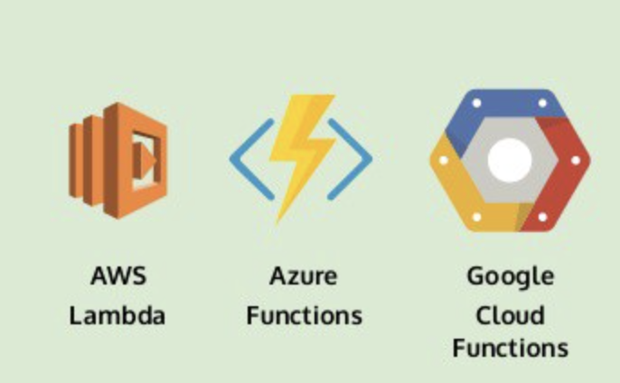
Preview Serverless Functions
Notes:
Review activity list item.

Slide 71
Network Architecture & Protocols

Slide 72

Foreshadowing Web Services
In a web service, the Web technology such as HTTP and HTTPS — originally designed for human-to-machine communication—is utilized for machine-to-machine RPC communication, more specifically for transferring machine-readable file formats such as XML and JSON.

Slide 73
Network Architecture – The Internet
The Internet [link]
IP (Internet Protocol) [link]
TCP (Transmission Control Protocol) [link]
TCP/IP
UDP (User Datagram Protocol) [link]
UDP/IP
TCP/IP or UDP/IP Socket [link]
TCP and UDP Protocols & Port Numbers [link]

Slide 74
Network Architecture – The Web
The Web [link]
HTTP (Hypertext Transfer Protocol) [link]
DNS (Domain Name System) [link]
HTML (Hypertext Markup Language) [link]
CSS (Cascading Style Sheets) [link]
JavaScript [link]
Internet Protocol Suite [link]

Slide 75
Network Architecture – Distributed Computing
RPC (Remote procedure call) [link]
… SOA (service-oriented architecture) version 1
Java RMI (Java remote method invocation) [link]
DCOM (Distributed Component Object Model) [link]
CORBA (Common Object Request Broker Architecture) [link]
… [The Web takes over the world]
XML (Extensible Markup Language) [link]
XML-RPC (XML & HTTP) [link]
Internet Protocol Suite [link]

Slide 76
Network Architecture – Web Services
Web Services [link]
…SOA (service-oriented architecture) version 2
XML (Extensible Markup Language) [link]
XML-RPC (XML & HTTP) [link]
SOAP (Simple Object Access Protocol) [link]
JSON (JavaScript Object Notation) [link]
REST (Representational State Transfer) [link]
Internet Protocol Suite [link]

Slide 77
Network Architecture – Back to the Future
Web Services [link]
…SOA (service-oriented architecture) version 2 [link]
JSON (JavaScript Object Notation) [link]
REST (Representational State Transfer) [link]
gRPC [link] Or https://grpc.io/faq/
REST vs gRPC
REST vs. gRPC: Battle of the APIs [link]
Evaluating Performance of REST vs. gRPC [link]
Internet Protocol Suite [link]

Slide 78
Web Services, REST, SOAP, and CORs

Slide 79
Web Services
In a web service, the Web technology such as HTTP—originally designed for human-to-machine communication—is utilized for machine-to-machine communication, more specifically for transferring machine-readable file formats such as XML and JSON.
In practice, a web service commonly provides an object-oriented web-based interface to a database server, utilized for example by another web server, or by a mobile app, that provides a user interface to the end user.
Many organizations that provide data in formatted HTML pages will also provide that data on their server as XML or JSON, often through a web service to allow syndication

Slide 80
REST vs. SOAP

Slide 81
REST
Representational State Transfer (REST) is an architectural style that defines a set of constraints and properties based on HTTP. Other kinds of web services, such as SOAP web services, expose their own arbitrary sets of operations.
"Web resources" were first defined on the World Wide Web as documents or files identified by their URLs. However, today they have a much more generic and abstract definition that encompasses every thing or entity that can be identified, named, addressed, or handled, in any way whatsoever, on the web. In a RESTful web service, requests made to a resource's URI will elicit a response that may be in HTML, XML, JSON, or some other format. The response may confirm that some alteration has been made to the stored resource, and the response may provide hypertext links to other related resources or collections of resources. When HTTP is used, as is most common, the operations available are GET, POST, PUT, DELETE, and other predefined CRUD HTTP methods.
By using a stateless protocol and standard operations, REST systems aim for fast performance, reliability, and the ability to grow, by re-using components that can be managed and updated without affecting the system as a whole, even while it is running.

Slide 82


CORS
Cross-Origin Resource Sharing (CORS): CORS is a mechanism that uses additional HTTP headers to tell a browser to let a web application running at one origin (domain) have permission to access selected resources from a server at a different origin. A web application makes a cross-origin HTTP request when it requests a resource that has a different origin (domain, protocol, and port) than its own origin.
An example of a cross-origin request: The frontend JavaScript code for a web application served from http://domain-a.com uses XMLHttpRequest to make a request for http://api.domain-b.com/data.json.
For security reasons, browsers restrict cross-origin HTTP requests initiated from within scripts. For example, XMLHttpRequest and the Fetch API follow the same-origin policy. This means that a web application using those APIs can only request HTTP resources from the same origin the application was loaded from, unless the response from the other origin includes the right CORS headers.
Notes:
https://developer.mozilla.org/en-US/docs/Web/HTTP/CORS
https://www.youtube.com/watch?v=o8puzjzpjqo

Slide 83
Serverless Functions

