Slide 1

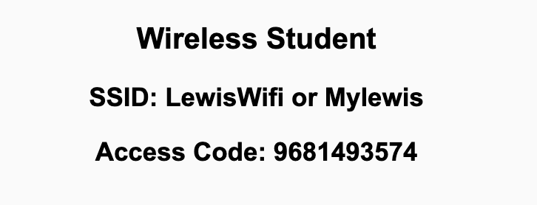
Preflight Check List
Sign into our Zoom meeting through our integrated Blackboard/Zoom link
Make sure that you can hear the conversation, see shared desktops, and view chat topics
Thank you if you choose to leave your camera on to help make our class more interactive
Be prepared to share your computer screen
Be prepared to utilize a headset with a microphone
In person participants also:
Make sure that your microphone and speakers are muted/off so that we don’t get an echo
Sit in a good spot near the classroom ceiling microphones if possible

Slide 2
Recordings
Discuss that recording are:
Opportunistic
Automatically available in Blackboard/Zoom
Sound Check… plus Video, and Desktop Sharing check
Start Recording

Slide 3
Agenda:
Prework & Announcements
Review Maintenance & Support plus Metrics
Backlog Grooming for Monday’s Sprint 6 Planning
Lab
Discussion & Questions welcome at any time but please be present with no phones or email during our time together

Slide 4
Prework For Next Class
Be prepared for Backlog Grooming and Lab
Everything is due Sunday!
Monday: In-person Sprint 6 Planning... Contact me if you will not be there or if you will be remote.

Slide 5
Software Maintenance & Support
Many processes include both Software Maintenance and Software Support in a single Maintenance category. This is a grave disservice from a process perspective because the two activities are dissimilar in many ways including:
Support needs to scale with the user base where maintenance scales with enhancement requests
The optimal process is different with support generally adopting a Kanban and issue ticketing process where maintenance following a software development process like Waterfall or Agile
Support is optimized by supporting all products associated with a user base where maintenance is more single product focused
The cadence of support is minutes and hours where maintenance is days, weeks, and months which is very challenging to balance the immediate vs the important daily activities
The appropriate Metrics for Software Maintenance is very different from the appropriate Metrics for Support
Notes:
Grace period until Monday morning a 6am CT

Slide 6
Characteristics of a Good Metric
What makes a good software quality metric?
Easy to collect and understand
Good approximation of reality and good correlation to quality & goals
Meaningful to the group that can deliver positive change and can drive positive actions
Meaningful over time to encourage positive trends
Discourages “gaming the system,” or at least limits the impact of “gaming”
Does not allow one group to declare success (project management, developers, business analysts, etc.) while the overall product is failing
Comparable across teams, companies, and the industry

Slide 7
Common Metrics for Waterfall Software Development
Line of code per time-period
On-time
On-budget
… Scope delivered
Defects
Weighted Defects
Weighted Defects per unit delivered
Unit delivered per hour/day/month… per person
Unit delivered per hour/day/month… per dollar

Slide 8

Common Metrics for Agile Software Development
Story Points per Sprint per person
Say/Do ratio
Story Points delivered per Sprint… change in Story Points delivered per Sprint
Team versatility
Percent coverage with automated testing or with Test-Driven Development
Satisfaction surveys with internal or external customers
Eric’s Favorite: Weighted Defect Density per 10,000 hours worked… production

Slide 9
Backlog Grooming
for Monday’s Sprint 6 Planning

Slide 10
INVEST to Write Good User Stories
Independent: Self contained, not dependent on other user stories
Negotiable: Leave space for discussion, discovery and invention
Valuable: Has immediate value to stakeholder.
Estimable: Constrained in size and scope, just enough information
Small: Ideally 1-2 days work with larger efforts being decomposed
Testable: Acceptance criteria makes clear when work is done

Slide 11
Sprint Planning Goal
By the end the class Monday every team member will have committed to multiple meaningful User Stories that are estimated at a total effort 8 or more Story Points per person
Steps:
Update “Done” definition prior to Monday’s session
Come into Sprint Planning with a fully Groomed Story Backlog of at least 8 story points per team member
Team members REQUEST stories, stories are assigned, and team members COMMIT to delivering stories by end of sprint
The TEAM is responsible for defining Done and having a fully Groomed Backlog.
The Product Owner maintains and updates the Backlogs.
Each team member is responsible for requesting and committing to stories. Stories must be deliverable within the sprint. Make it a priority to assign a story to a single team member.

Slide 12
This is Your Scrum Process

Slide 13
Backlog Grooming
for Sprint 6 Planning

Slide 14
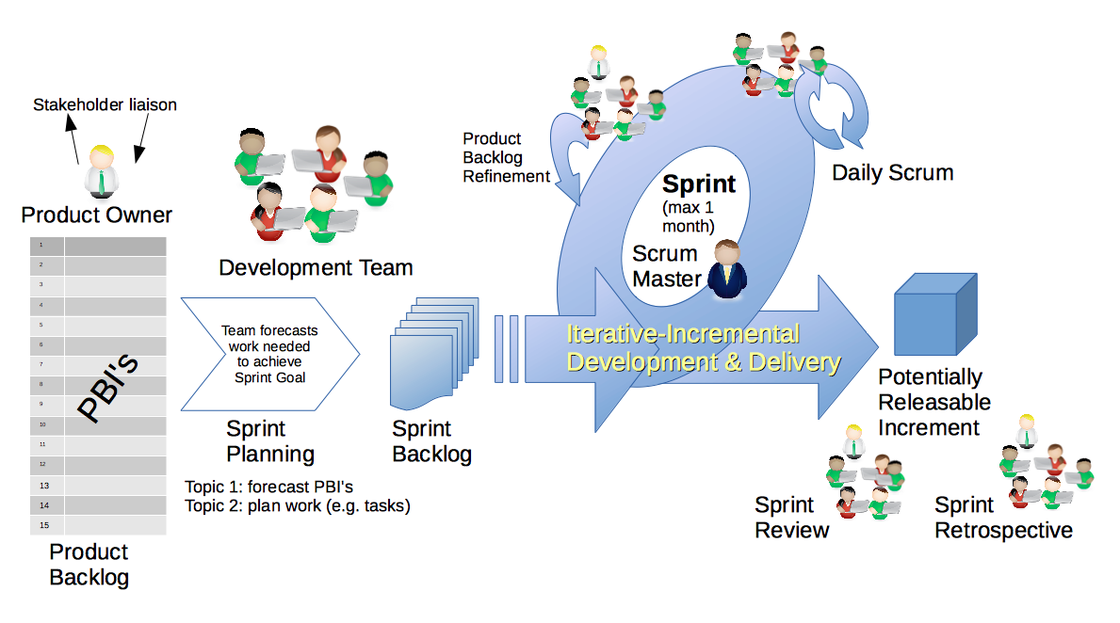
Scrum Process
By Dr ian mitchell - Own work, CC BY-SA 4.0, Link

Slide 15
Backlog Grooming and Sprint Planning
Steps:
Priorities & Roles Assignment (review)
Epic Backlog Grooming
Story Backlog Grooming
Sprint Planning (Monday)
Commitment to Sprint Backlog (Monday)
Celebrate! (Monday)

Slide 16
Step 1: Priorities & Roles
Recall Agile Priorities (associated scrum role):
Customer (Product Owner)
Technology (Architect)
Process (Scrum Master)
Recall the Agile Glossary [link]
Recall that one person can play multiple roles.
Recall that it is different/difficult for us because we are playing the role of the customer as well as the delivery team.

Slide 17
Step 2: Epic Backlog Grooming
Recall User Stories, Epics and Backlogs
Recall the Agile Glossary [link]… review User Story format

Slide 18
Scrum Process – Where is Epic Backlog Grooming?
By Dr ian mitchell - Own work, CC BY-SA 4.0, Link
Notes:
Epics are not part of Scrum.

Slide 19
Recall Scaled Agile

Slide 20
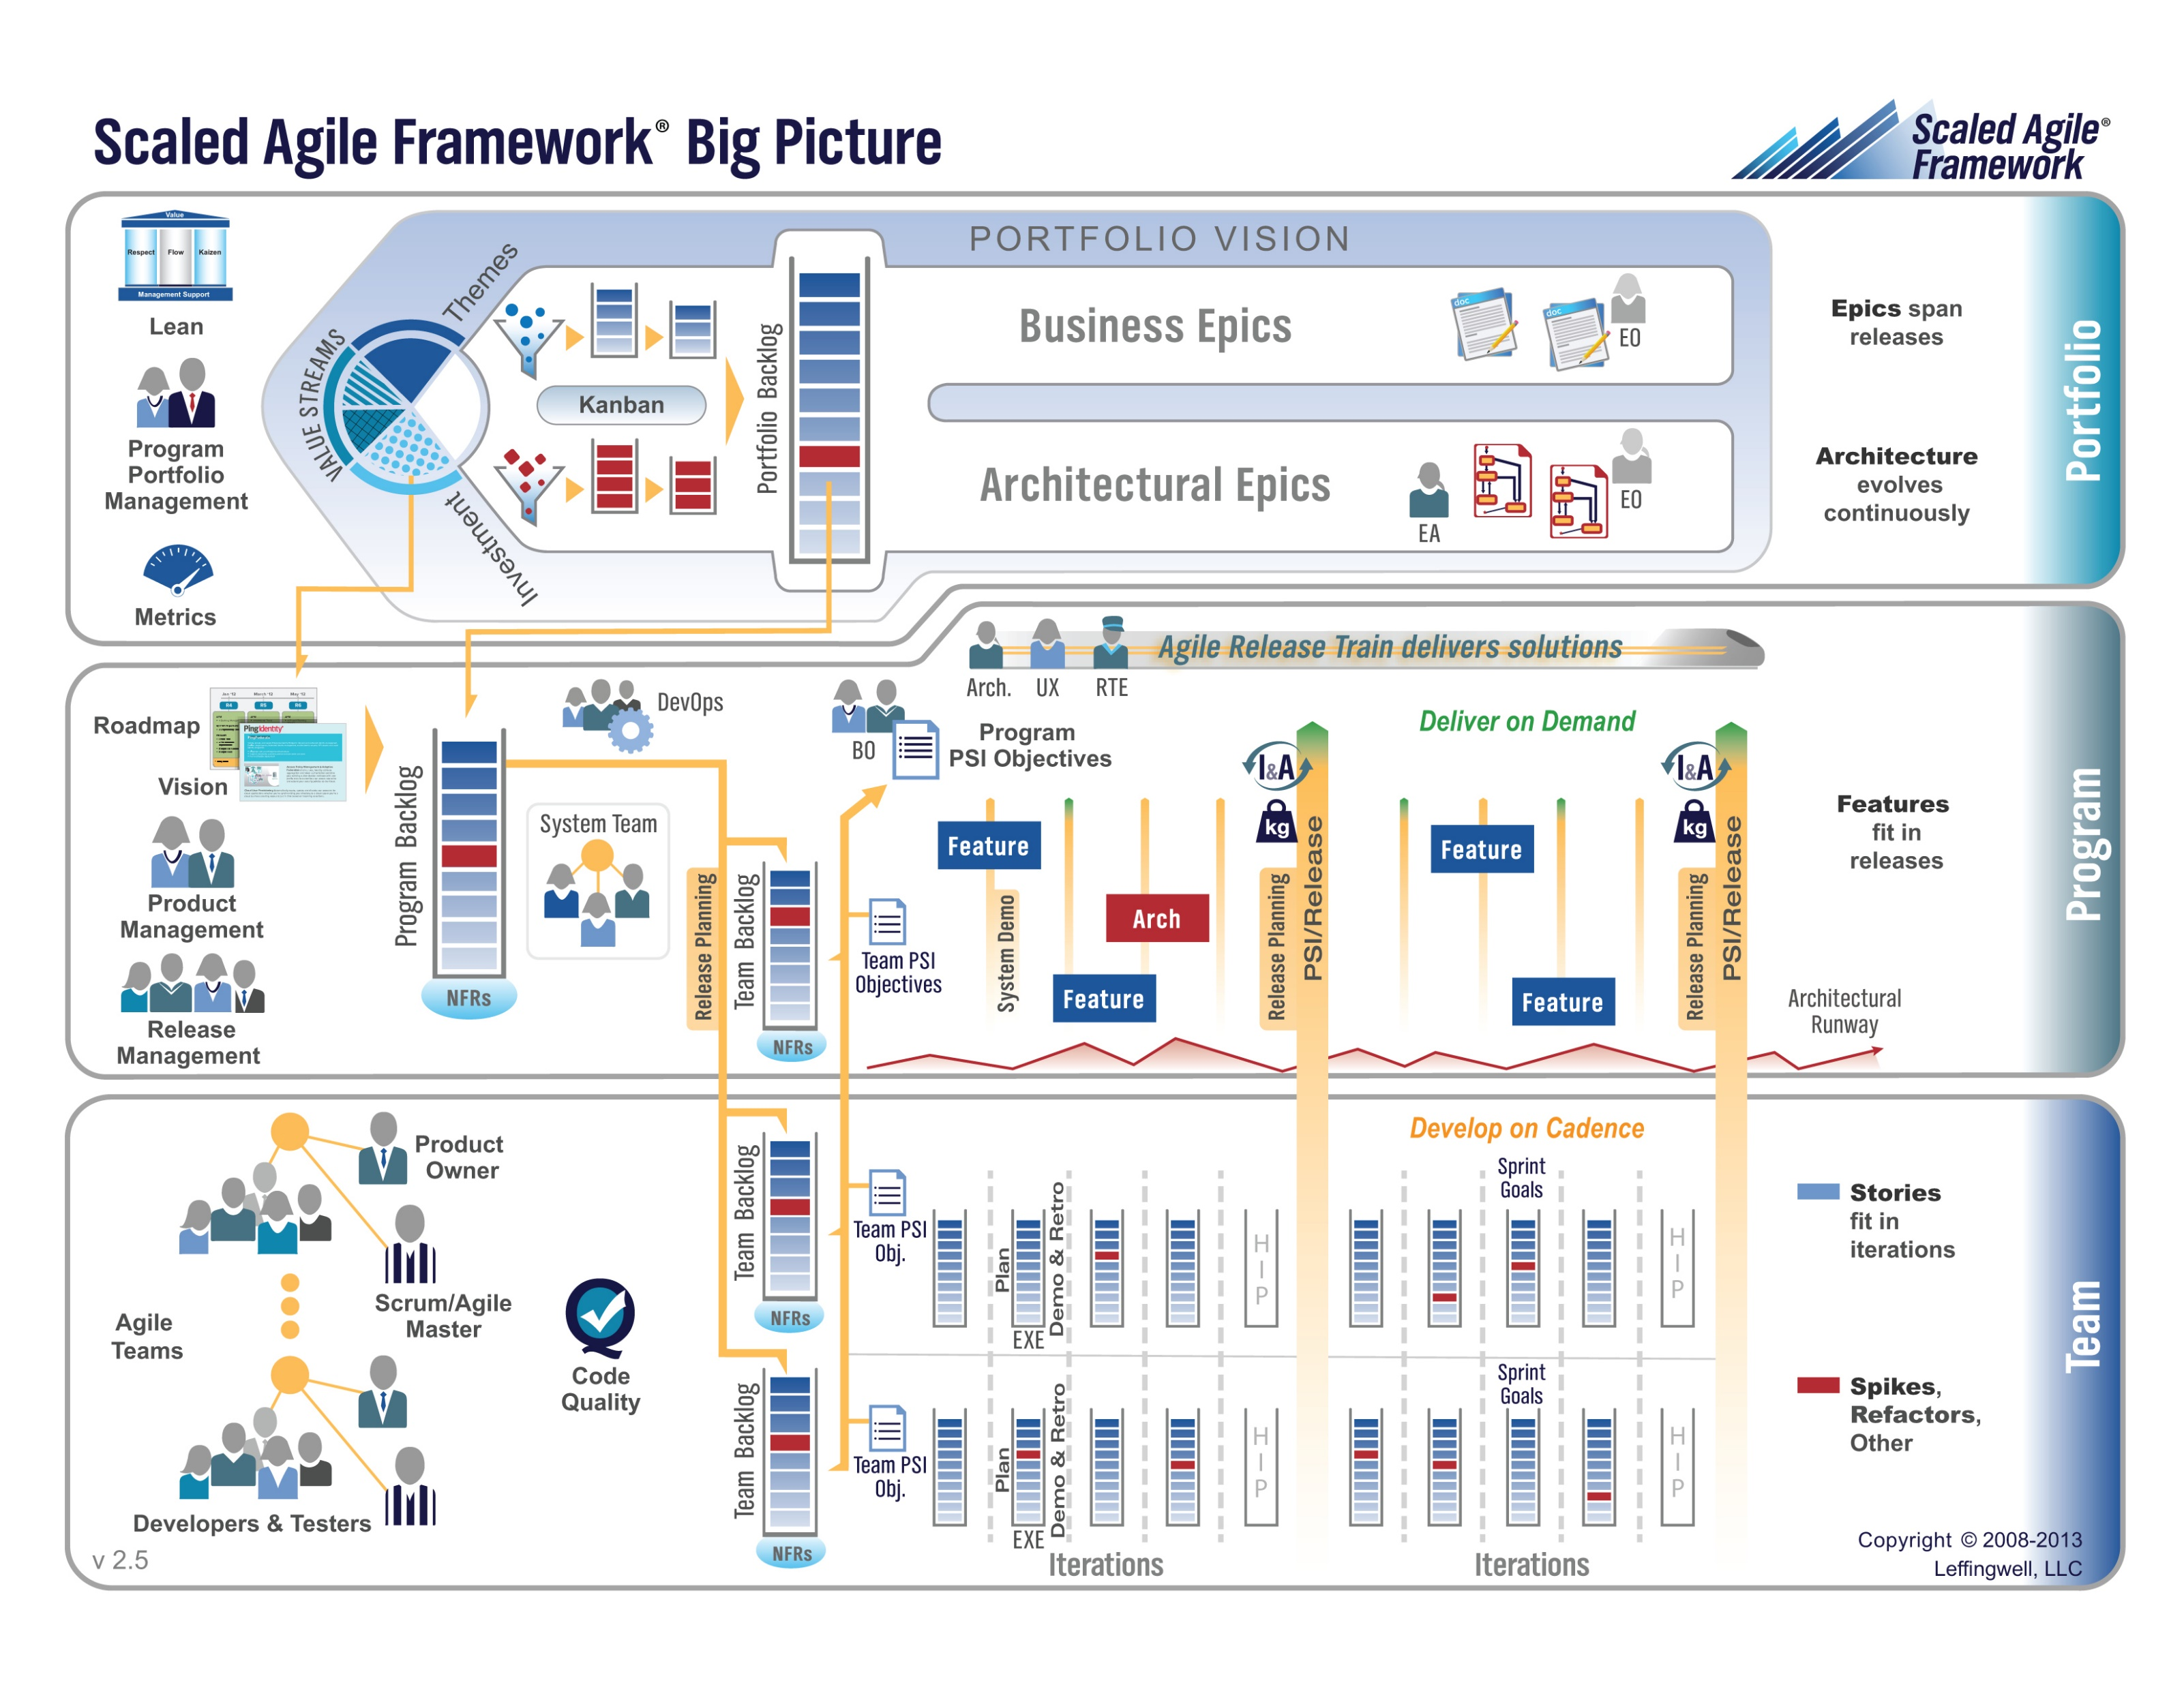

Slide 21
Step 2: Epic Backlog Grooming
Actions & Requirements:
Product Owner to lead the review and/or creation of Epics
There must be one list of Epics managed by the Product Owner
Each Epic must deliver customer functionality and value
Epics should be written in User Story format
Epics must be prioritized and forced ranked
Each product must have at least three Epics
Epic Backlog Grooming report questions (Scrum Master):
What is the number of Epics?
How many are force ranked?

Slide 22
Step 3: Story Backlog Grooming
By Dr ian mitchell - Own work, CC BY-SA 4.0, Link

Slide 23
Step 3: Story Backlog Grooming
Review Done, User Stories, and Story Backlog:
“Done” must be well defined and for us includes at a minimum:
Successfully deployed and integration tested in the production environment
Demoed to the Product Owner
Available to be demoed to the class
User Stories must:
Be written in User Story format from a customer / user perspective
Deliver user (customer) value
Be associated with Epic
Product Product Backlog is:
Managed by to Product Owner
The team’s master list of prioritized (force ranked) User Stories
The team’s master list of all important project work (spikes, continuous improvement, etc.)
Notes:
How will you handle dependancies?

Slide 24
Step 3: Story Backlog Grooming
Requirements:
Product Owner to lead the creation, force ranking, and estimating of User Stories.
Each User Story must have an estimated effort in Story Points
For our purposes assume 1 Story Point is approximately equal to 1 hour of effort
Each User Story must be deliverable in a single sprint

Slide 25
Step 3: Story Backlog Grooming
Requirements & Actions:
Update Product Backlog by:
Relocating “Done” User Stories “Done” list (skip)
Relocating “Pending” User Stories to the “Pending” list
Reviewing remaining User Stories
Creating new User Stories
Prioritize and force rank important stories (anything that might make it to the Sprint Backlog)
Provide Story Point estimates for important stories
Product Backlog report out questions (Product Owner):
How is “Done” defined for your team?
What is the total number of user stories?
What is the total number of story points?
How many stories and story points are force ranked?
Notes:
How will you handle dependancies?

Slide 26
Lab

Slide 27
Prework For Next Class
Complete Backlog Grooming including at least 8 story points worth of stories per team member
Be prepared for in-person Sprint 6 Planning
... Contact me if you will not be there Monday for Sprint 6 Planning (or if you will be remote).

Slide 28
End of Session

